Slide 1
enigma chess “Chess for all”
Team Members:
Sam Bateman, Kylee Bennett,
Tanay Choudhary, Sheena Hann

Slide 2
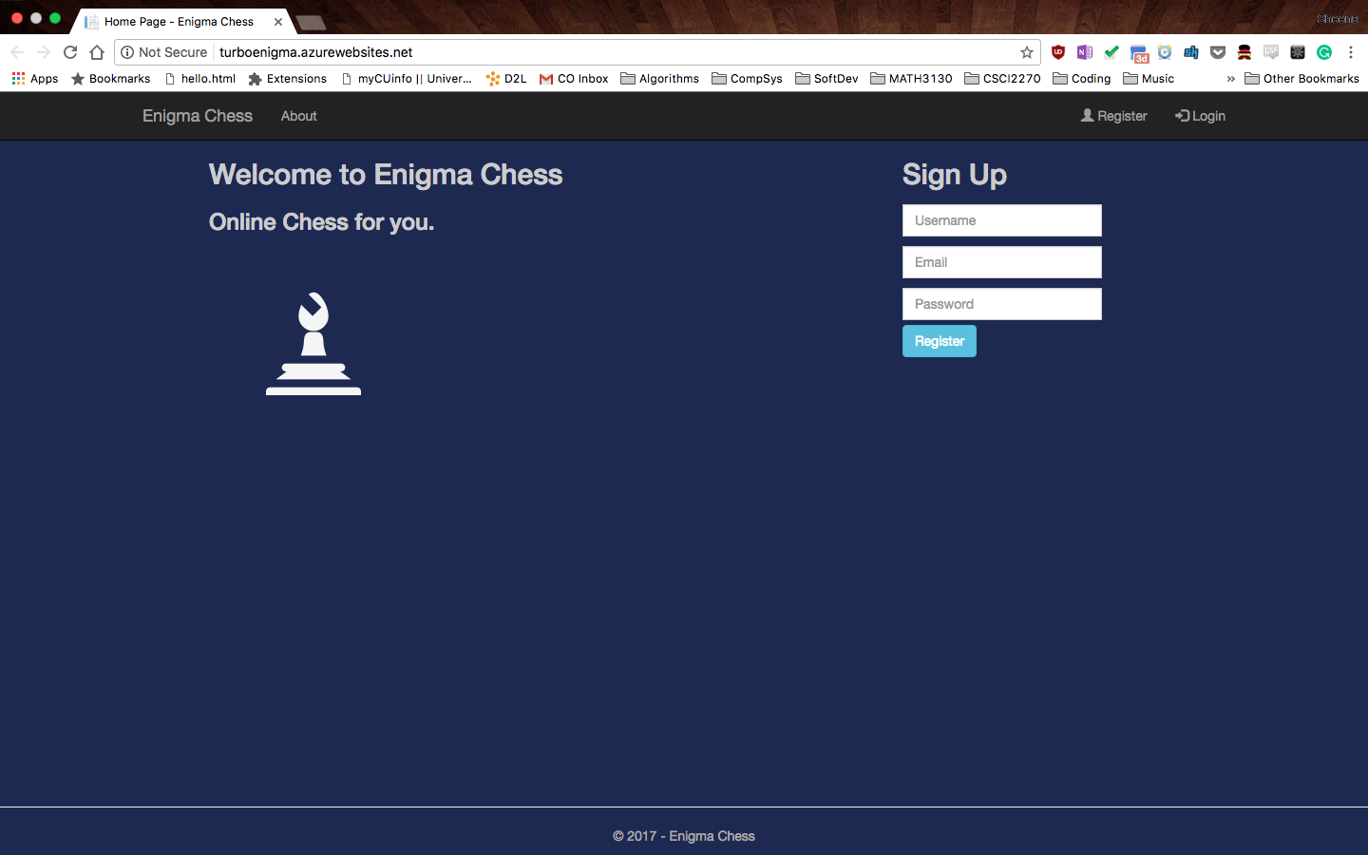
landing page

Slide 3
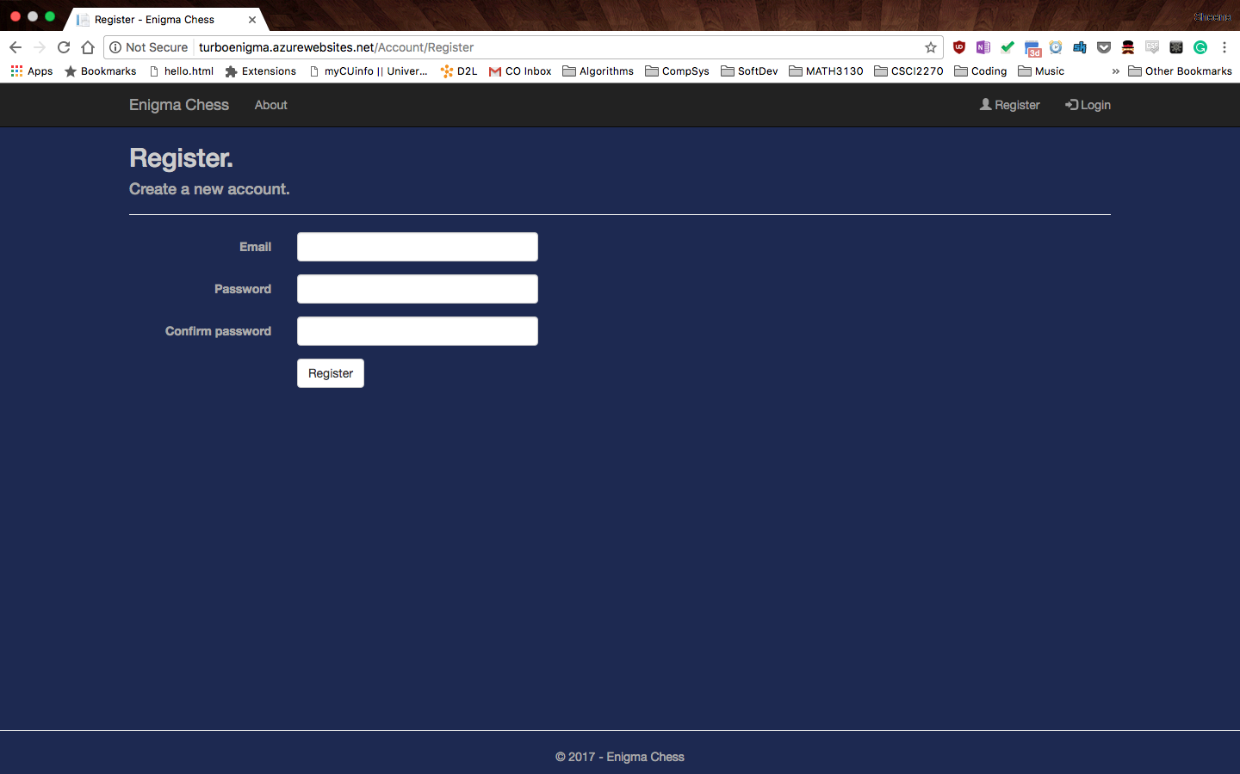
registration page

Slide 4

User accounts

Slide 5
Goals of sprint 1
Create landing page
Set up user accounts
Deploy to web
Get all systems synched
Research languages

