Slide 1
kendra initiative
AN INTRODUCTION

Slide 2


Slide 3
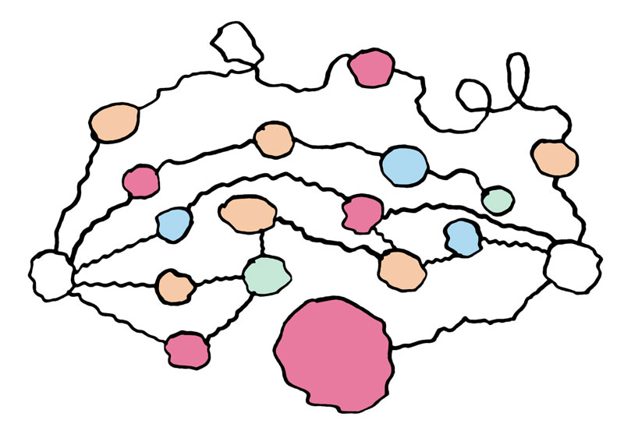

Slide 4


Slide 5
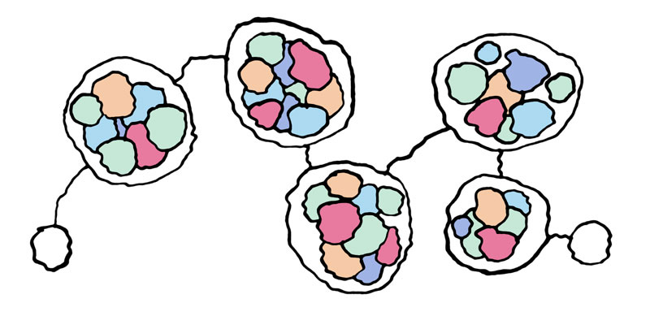

Slide 6


Slide 8
We want to drive understanding…
  Between different technology vendors and service providers

Slide 9
Build demonstrations (trials)…
  Anyone can get involved (don’t have to be technical)

Slide 10
Evangelise (talk)…
  Market the vision

Slide 11
Join or create a Kendra Working Group…
  Use the website, lists and wiki (document centric)
  Arrange small meetings

Slide 12
Any qvestions?
www.kendra.org.uk

