Slide 1

The Kendra Music Catalogue Trial
Romek Szczesniak
Spiky Black Cat Records
romek@spikyblackcat.co.uk

Slide 2
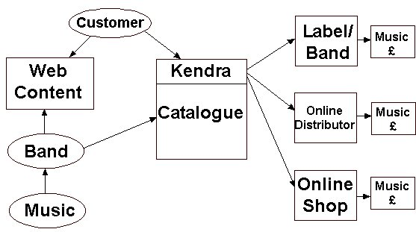
How I See Kendra Working

Slide 3
The Plan I See for the Kendra Music Catalogue
Start small – a handful of small labels
Work together with other projects
Work with Registered Bodies e.g. BPI, AIM, Arts Council
Make it voluntary – bands & labels don’t have to join up
Demonstrate it as a benefit to the industry
Keep it self-funded and independent
Others will join later as it gains in popularity

Slide 4
Why are We Using Kendra for Music Content?
Network all of the disparate online music resources
Lets people easily get to hard-to-find content
Allows the online music industry to be equal to all
There is no public global catalogue of music
Enables musicians and labels to find each other
Enables talented unsigned bands to be discovered

Slide 5
Compiling the Global Music Catalogue
Creating a Patchwork Quilt of Already Created Music Catalogues
Run parallel with Kendra Film and Image Catalogue Trials
Learn lessons from each other
Catalogues will overlap and contain duplicate information
To Trial –
  We need varied database schema to test the Kendra Music system at work
  Test different data format catalogue databases
  Some Duplicate data

Slide 6
A Future Database of Bands & Musicians
Band Name
URLs
Band Members
Session Musicians
Discography
Brief History

Slide 7

The CDDB Database

Slide 8
Unsigned Bands
Thousands of unsigned bands
Difficult to obtain or catalogue material
Music of variable quality
Hard to get musicians interested in an Internet Portal
Need people to locate these bands
CDDB does not cater for unsigned and unknown artists

Slide 9

KarmaDownload

Slide 10
The KarmaDownload Project www.karmadownload.com
Online Independent Music Download Site
Compiling its own catalogue of independent music
No DRM
Treats Unsigned and Signed Bands Equally
Starting With a UK Project, Broadening to a Global Project
Moving to Audio and Video Content
Voluntary membership under legal contracts
Launch April 1, 2004

Slide 11
Forthcoming Problems
Territories – The offline music industry is territory-based
Unsigned Bands – Can we guarantee good content?
Covering all of the various music genres
Obtaining data in the correct format for use
May help alter the present viewpoint of online music

Slide 12
How do We Proceed?
Work with Spiky Black Cat and Karma Records, MusicBank and MusicBrainz
Obtain catalogue from that being compiled for Karma
Demonstrate with how this works in practice using a small collection of content.
Set up a standard format for catalogue entries
Avoid major labels and distributors as they do not need Kendra

Slide 13
Questions?
Romek Szczesniak
romek@spikyblackcat.co.uk

