Slide 1
kendra initiative
AN INTRODUCTION

Slide 2


Slide 3
Frustrated Consumer…
  Many different content providing portals/applications all hosting a subset of the full global catalogue.
  All portals/applications have different/incompatible payment systems.
  Google does not always find all data hidden within portals/applications.
  It is not easy to easily buy content on the Internet.

Slide 4
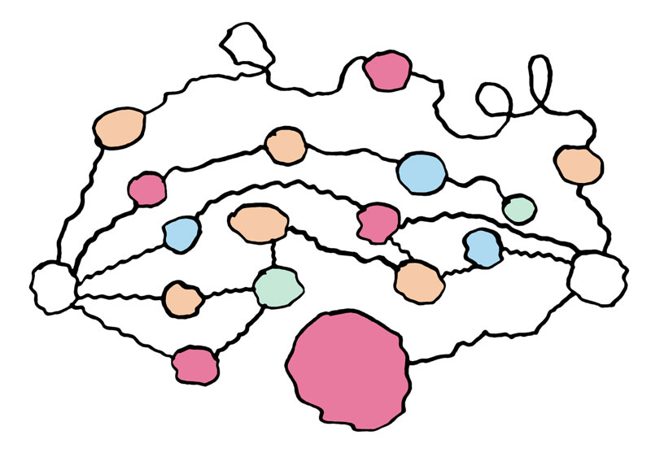

Slide 5
Confused Business Network…
  Business relationship between consumer and content publisher.
    Big red blob could be Kazaa – no revenue to publisher.
  Content encoded to formats not compatible with certain software players / hardware devices.
  Same problems with digital rights management.
  What a mess!

Slide 6


Slide 7
Happy Business Network…
  Using one portal/application can browse, search and purchase from the entire global catalogue.

Slide 8
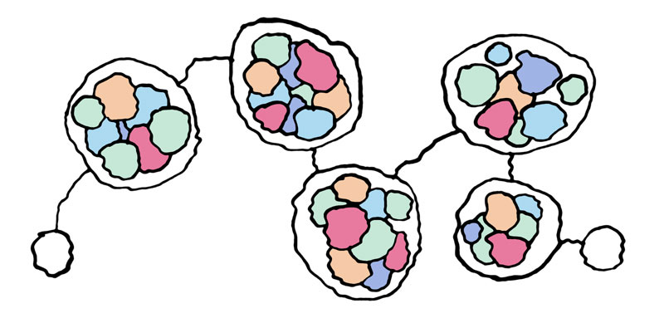

Slide 9
Happy Business Network…
  Now all functions have been decoupled.
  Standardised languages/interfaces.
  All content now compatible with all software players / hardware devices.
  It all just works!

Slide 10
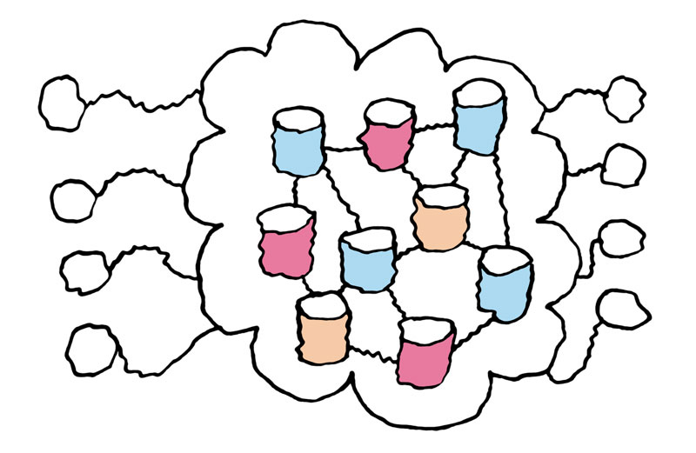

Slide 11
Happy Technical Network…
  Technical relationship between consumer and content publisher.
  Any portal/application now works with any content.
  Just like any browser can see any webpage (almost).

Slide 13
We want to drive understanding…
  Between different technology vendors and service providers.
  In the interests of content owners and consumers to make this happen.
  But how?...

Slide 14
Build demonstrations (trials)…
  Anyone can get involved (don’t have to be technical)
  Rules (digital rights management)
  Commerce
  Catalogue
  Network

Slide 15
Evangelise (talk)…
  Market the vision
  Speak at events
  Describe requirements for technical solutions

Slide 16
Join or create a Kendra Working Group…
  Use the website, lists and wiki (document centric)
  Arrange small meetings
  Suggest ideas and see if they float

Slide 17
Kendra Needs…
  Funding
  Serious partners for funding applications
  Catalogue database sample for trial

Slide 18
Any questions?
www.kendra.org.uk

