Slide 1


Slide 2

frustrated consumer

Slide 3
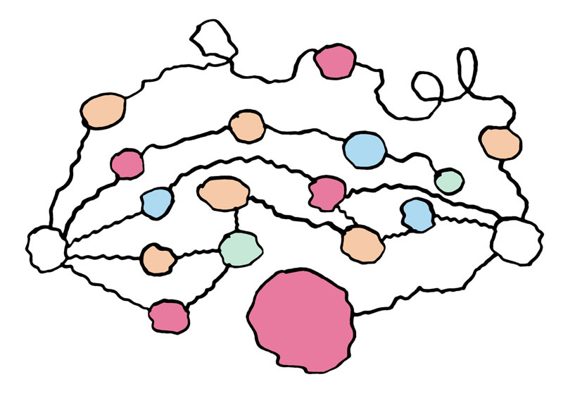
confused content owner

Slide 5
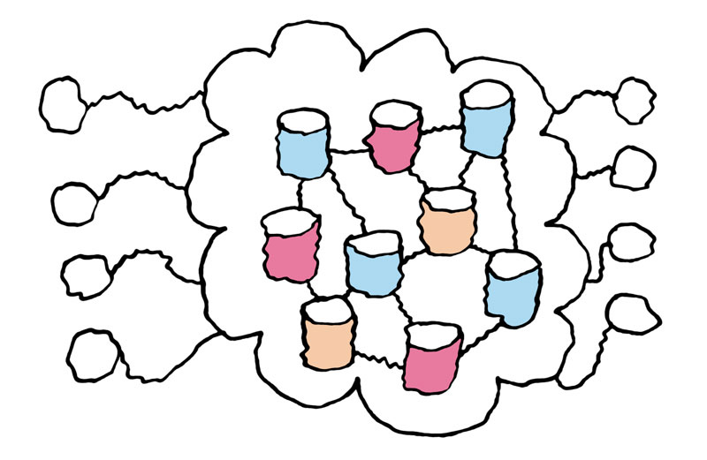
world wide web

Slide 6

happy consumer

Slide 7
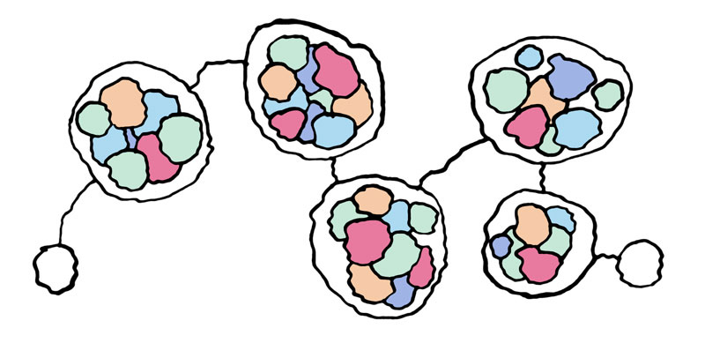
interoperable services

Slide 8
open marketplace for digital media

Slide 10
Kendra What?
Simplify and streamline buying and selling digital content by driving industry adoption of open protocols.
Enable interoperability between service providers, media applications and devices - every link in the content value chain.
Build a system where consumers can use any device or application to browse, search and purchase from the globally distributed collection of content catalogues.
Create a more pleasurable buying experience for consumers and increase reach and revenue for content owners.

Slide 11
Kendra How?
The more we talk about it...
The more we describe it...
The more detail we give the description of it...
The more we build of it...
... the more likely it is to come about.

Slide 12
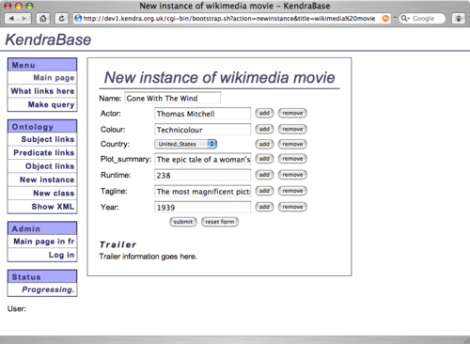
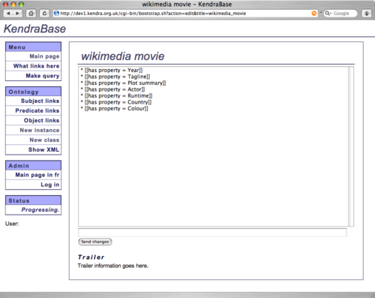
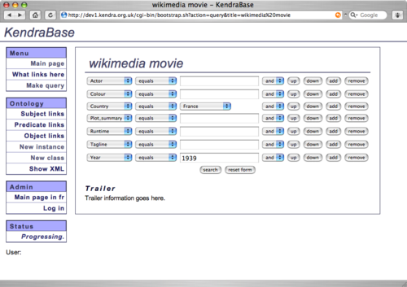
Kendra Base?
A distributed semantic search and publish system prototype
Friday – Developers track

Slide 14
Last word to Tim...
Tim Berners-Lee at WWW2005 talked about the “Independence of the communication from the provider of software”

Slide 15
www.kendra.org.uk
daniel@kendra.org.uk

