Slide 1
‘The Universal Catalogue’ a cultural sector viewpoint
David Dawson
Senior Policy Adviser (Digital Futures)
Museums, Libraries and archives Council

Slide 2
Museums, Libraries and Archives Council
the lead strategic body for the sector in England
objectives
  increase participation and investment in the sector
  modernising services
  putting museums, libraries and archives at the heart of national, regional and local life.
works in close partnership with the nine regional agencies through the MLA Partnership to ensure there are strong and effective links between national and regional activities.

Slide 3
Do we need a ‘universal catalogue’?
Collections are held by institutions
You have to know which institution has collections of interest to you
Then you can find what you are looking for
How do you know which institution has collections of interest to you?
Doesn’t Google do it all?

Slide 4
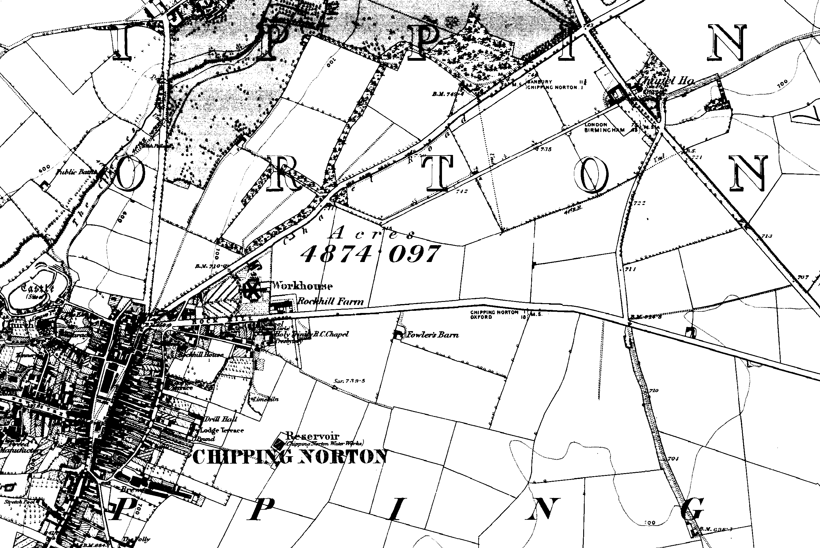
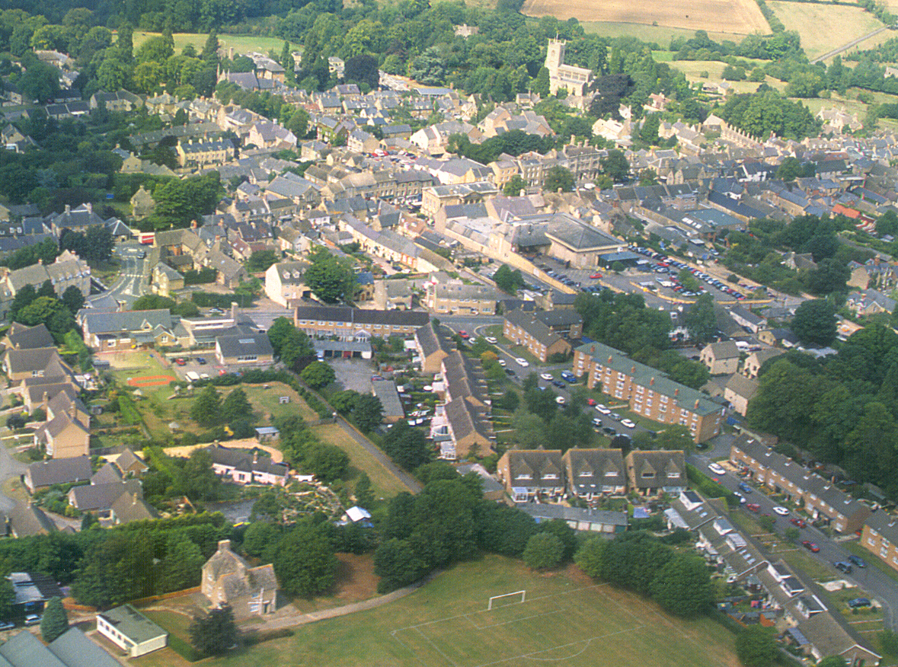
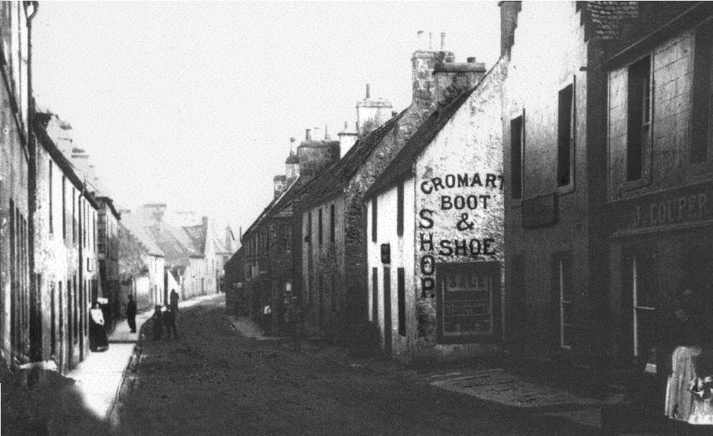
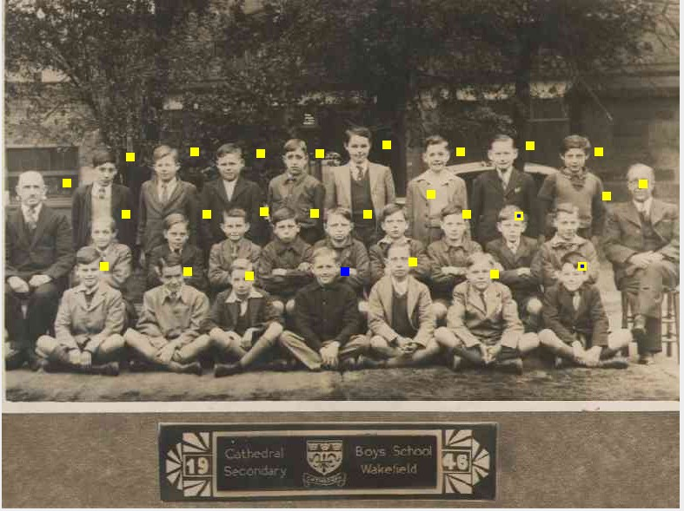
Local history in school
2 university museums
3 local authority museums
2 independent museums
Library service
Archives service
AND
The parish is on the border with another County so …
English Heritage
British Museum
Natural History Museum
British Library
Pathe Newsreel Archive
Regional Film Archive
British FiIm Institute
The National Archives
….
Background piece on Cameron’s consituency?

Slide 5
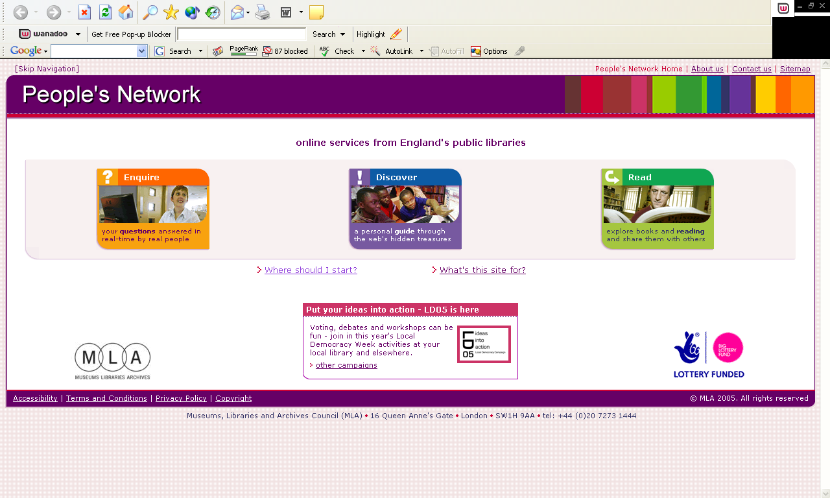
People’s Network Discover Service
harvests other databases
(OAI, web services)
  500k item-level records
  link to images etc held institution websites (option to harvest thumbnails)
  more to come
    a condition of our funding
    10 national museums

Slide 6
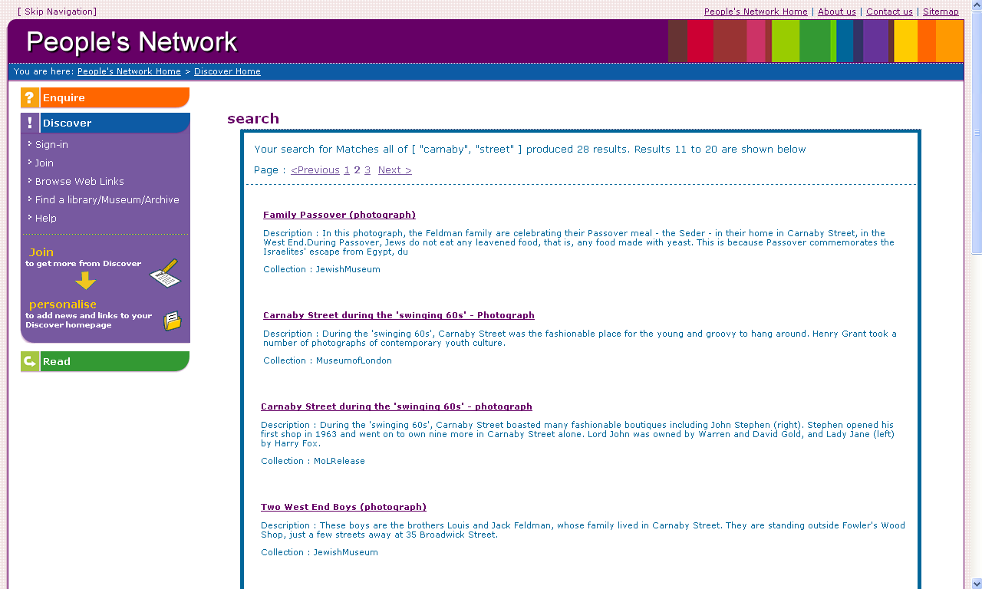
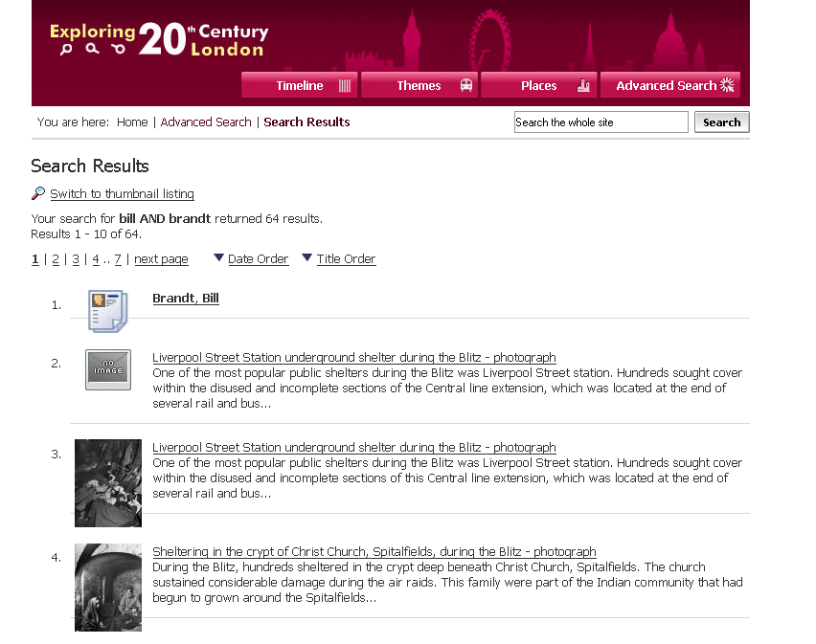
development version for July launch
http://it4me.k-int.com/discover/

Slide 7
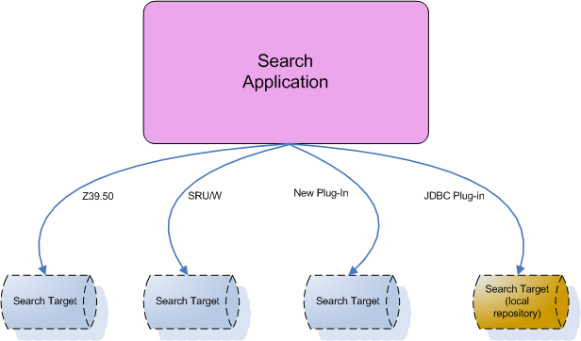
Search Protocols

Slide 8
Metadata
Extended Dublin Core to support Search
  Keyword (in title/description/subject)
  Subject
  Title
  Creator
  "Who" (creator, contributor, publisher, agent-as-subject)
  "What" (concept/thing-as-subject)
  "Where" (spatial coverage)
  "When" (temporal coverage)
  plus display items

Slide 9
So far, so good but …
People trust information from museums, libraries and archives
How do we demonstrate Trust on the internet?
How can this body of knowledge be used by the commercial sector?

Slide 10
European Digital Library

Slide 11
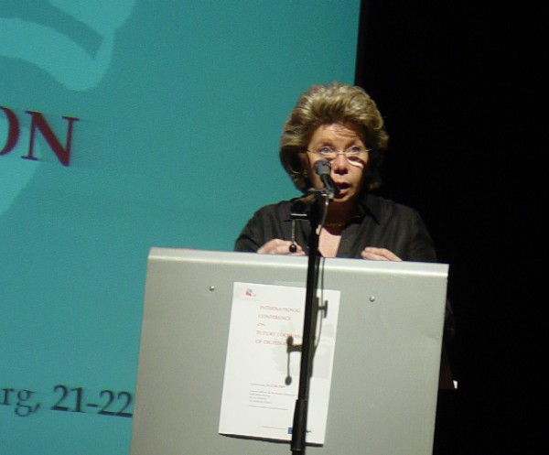
European Digital Library
initiated by France
i2010 Strategy for the
Information Society
about to be built …
information from the cultural sector – museums, archives, libraries, audio-visual
  Books, images, films, audio etc
  27 countries, 30+ languages

Slide 12
The European Digital Library
Semantic interoperability
2010 functionality
2008 Search functionality
Support for semantic interoperability (eg RDF)
MARC
TEL AP
EAD
Archives AP
SPECTRUM
/ CIDOC
Museum AP
Scholarly
Publications
ePrints AP
Other …
specific APs
Existing portals
(UK PNDS, FR Guichet, DE BAM etc)
Libraries search
Archives search
Museumssearch
ePrints
search
Search
‘Who, what, where, when’
Controlled vocabularies
Controlled vocabularies
Controlled vocabularies
Controlled vocabularies
Controlled vocabularies
XML Harvesting
ONE institution may have both library (MARC) and archives (EAD) databases

Slide 13
The problem
establishing in the metadata the USE that can be made of digital objects
  Creative Commons / Creative Archive
  Commercial content
how is this encoded?
how are uses defined?
  what is education?
  what is non-commercial?
  commercial re-use?
work in this area with print publishing industry
  XML encoding of product licencing
to work effectively, needs to be adopted by commercial sector
Is there a similar requirement???

Slide 14
Terminologies
Vitally important – as long as I don’t have to do it!
Need to map between terminologies and folksonomies
BECTA Terminology Bank
  English National Curriculum
  Mapping to other terminologies
    Web-based thesaurus management tool
    (more or less) open source
How do we map across commercial / public sector terminologies?

Slide 15
Questions?
david.dawson@mla.gov.uk

