Slide 1
Joining content production to the DVR
David White, NDS
(Chairman of Joined-up PVR group)
Notes:
25 minutes
Introduction – PVRs, TV-Anytime and micro-navigation
Introduce talk – broadcasting today, changes to the industry, adoption of new technology, the place of Micro-navigation.

Slide 2
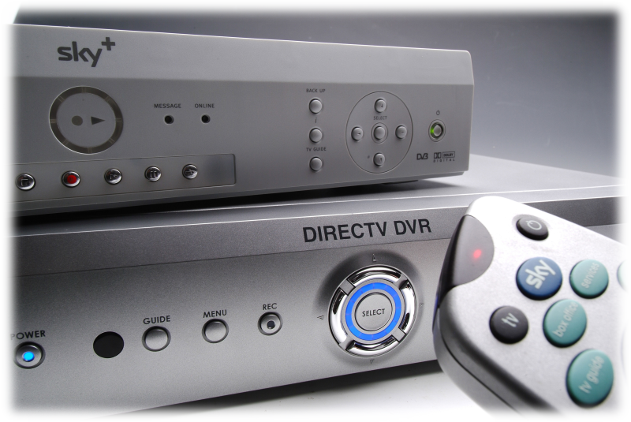
Traditional broadcast
Standard definition
High definition
PVRs/ DVRs

Slide 3
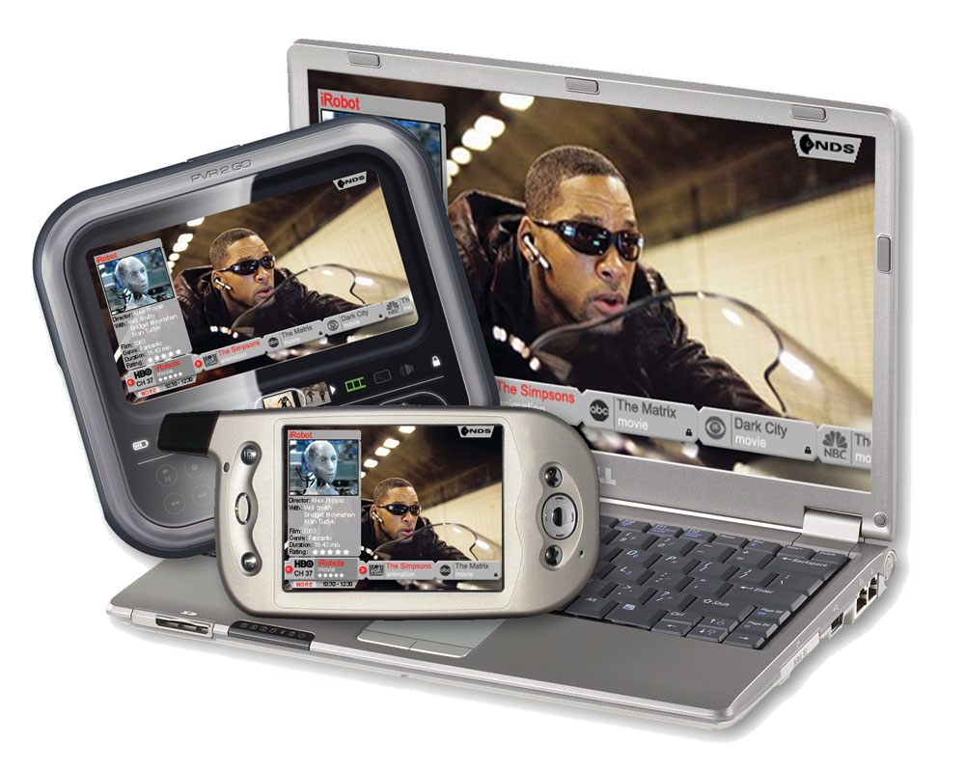
Media players and PVRs
PC / console media players
Mobile media players
Mobile broadcast

Slide 4
Platform features
 | Resolution | Usage | Media storage
SD PVR | 720x576 | Home | Yes
HD PVR | 720x1280 1080x1920 | Home | Yes
PC Webcast / download | Various | Desk | Yes
Portable media player | Various | Personal | Yes
Mobile broadcast | CIF or QCIF @ 15Hz or 30Hz | Personal | Yes
Notes:
New platforms enabled by v. cheap memory

Slide 5
Changes in broadcasting
Broadcasting response to new media
  Re-purpose content in a limited way
    Pioneering programmes. Not scalable
  Automate re-purposing
    Delivery system re-purposing. Quality problems.
  Limited content re-production to suite new media
    Pioneering programmes. Not financially scalable
  Automate multi-platform production
    Scalable.
Conclusion
  Content production & playout will develop!
Notes:
Link – What are the features and characteristics of these platforms?

Slide 6
Key feature: micro-navigation
Can already navigate to content: Macro-navigation
  Digital television EPG
  Web page content selection
  Media player content purchasing
Will navigate within content: Micro-navigation
  Already on some platforms
    DVD navigation, some media players, etc
  Enabled by random-access media storage
    Common feature of distribution platforms
Notes:
How will micro-navigation develop? Competition for the new-media audience will seek to use feature on one platform. This will ripple from one platform to another.

Slide 7
Use cases for micro-navigation
User interaction
  Simple navigation with skip left/ right
  Fast-forward by only playing key sections
  Menu of scenes / points of interest, similar to DVD
Offline content production
  Navigating drama and film
  Temporal scaling – viewing shortened versions / fast forwarding
  Viewing different perspectives in a recorded series
Live content production
  Navigate within news broadcast
  View points of interest in sports match
Commercial advantage
  Micro-navigation can show key adverts / sponsorships
  Fast forward with advertising messages included

Slide 8
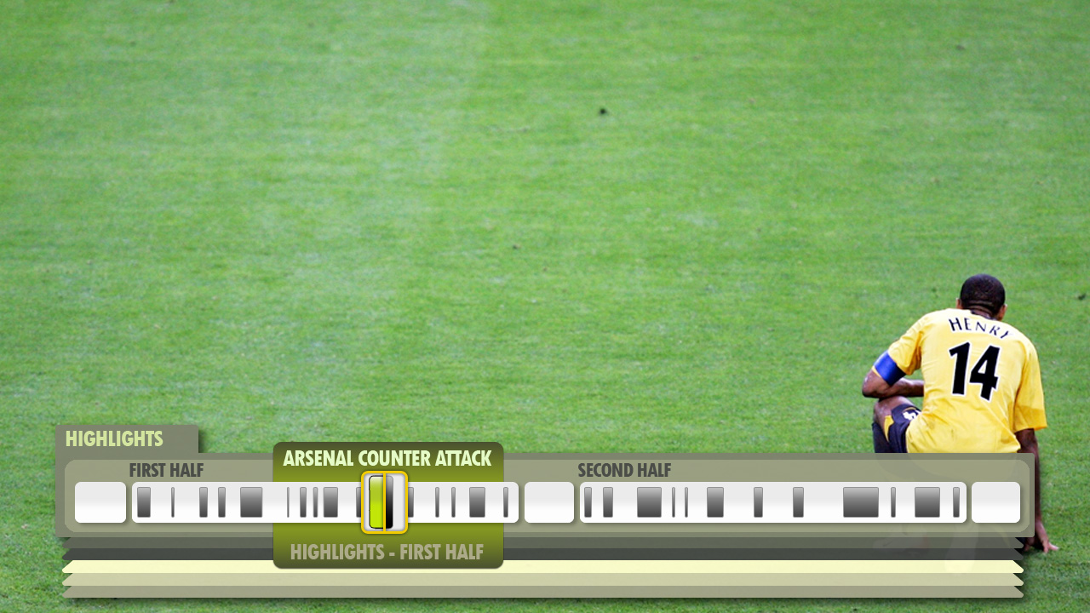
What can it do?
Live sports game

Slide 9
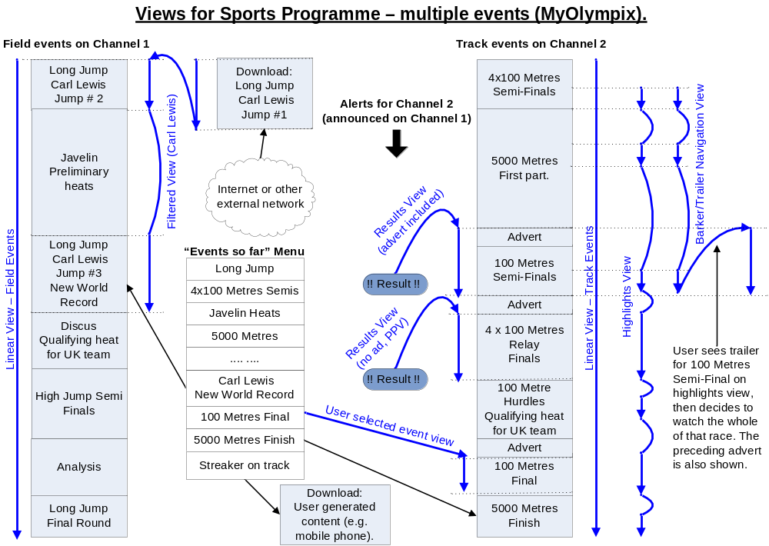
Multi-event sports

Slide 10
Producing micro-navigation
The data is there already!
Sports
  Highlight production provides point-of-interest timing
  Statistics generation provides point-of-interest classification
News
  Automation systems know when story starts
  MOS information contains rich source of information
Drama / Film
  DVD production inserts point-of-interest metadata
Supplementary metadata adds further value

Slide 11
JuP- linking it all together
Joined-up PVR is joining this all together
  Involvement from whole production chain
  UK based but with international participation
  Currently processing use cases
How can I be involved?
  Content producer – sponsor a use case you are interested in!
  Vendors – provide technical expertise
  Contact enquiries@jup.org.uk
  Check out www.jup.org.uk

Slide 12
Thank you

