Slide 1
You manage, we deliver
Gavin Robertson: VP Strategy and Biz Dev

Slide 2

About: Broad Street Digital
Broad Street Digital provides solutions to simplify the exchange of digital media.
Broad Street Digital was founded by a team with vast experience in label management, music distribution, licensing, digital production and technology development, backed by a public company.
Broad Street Digital is a division of Arbinet (NASDAQ: ARBX).
Arbinet is one of the most interconnected companies on the planet, with 900+ voice and data Members, including many of the world’s most recognized fixed-line, mobile telecommunications and cable companies.

Slide 3

About: rightsrouter®
rightsrouter - You manage, we deliver
rightsrouter is a patented platform that offers tools for the music and entertainment industries to manage, license and deliver content to more than a hundred web and mobile services.
    Create and manage a master content archive
    Review contractual agreements with more than a hundred distribution services and have rightsrouter format and deliver your content automatically
    Receive consolidated royalty reporting, billing and settlement

Slide 4
Content Discovery
Two main types of ‘Searcher’
I know what I want
  Artists name
  Product name
  Entity name
I know what it relates to
  Sounds like
  Looks like
  Contains

Slide 5
Search Process
Content User
What do I want - Search
Who owns it - Owner
Can I use it - Licence
Where is it - Source
Deliver it to me - Supply
Content Owner
How do I store it – Archive
How do people find it - Search
How do they know I own it - Owner
How do they licence it - Licence
How do I get it to them - Supply

Slide 6
Process Summary
Archive - BSD
Search - Kendra
Owner - BSD
Licence - BSD
Source - Kendra
Supply – BSD/Kendra

Slide 7
Standards
ISO
  ISRC
  ISBN
  ISWC
DOI/ Handle
DDEX
  Data dictionary
  Message standards

Slide 8
Benefits
Global Market – Local Control

Slide 9
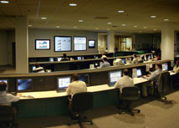
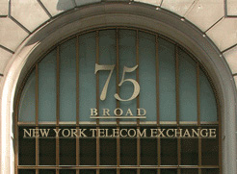
Broad Street Digital (Head Office)
75 Broad Street, 20th floor
New York, NY 10004
Tel.: +1 917 320 2066
Broad Street Digital (European Headquarters)
12/18 Paul Street
London EC2A 4JH
Tel.: +44 (0) 20 7338 0583
Broad Street Digital (Network Operations Center)
467 Herndon Parkway
Herndon, VA
Broad Street Digital (Digital Operations)
Argyle House
1103 Argyle Street
Glasgow G3 8ND
www.broadstreetdigital.com

Slide 10
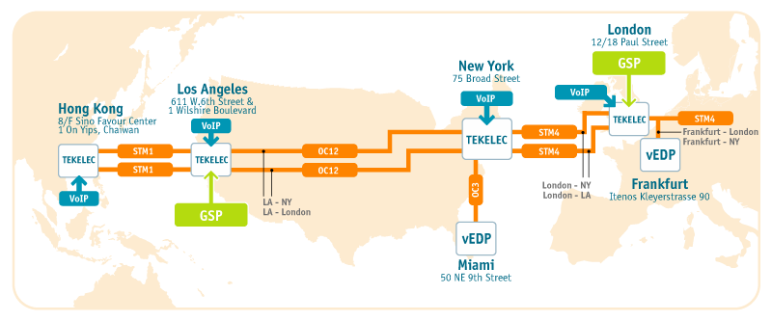
Our Connections

