Slide 1

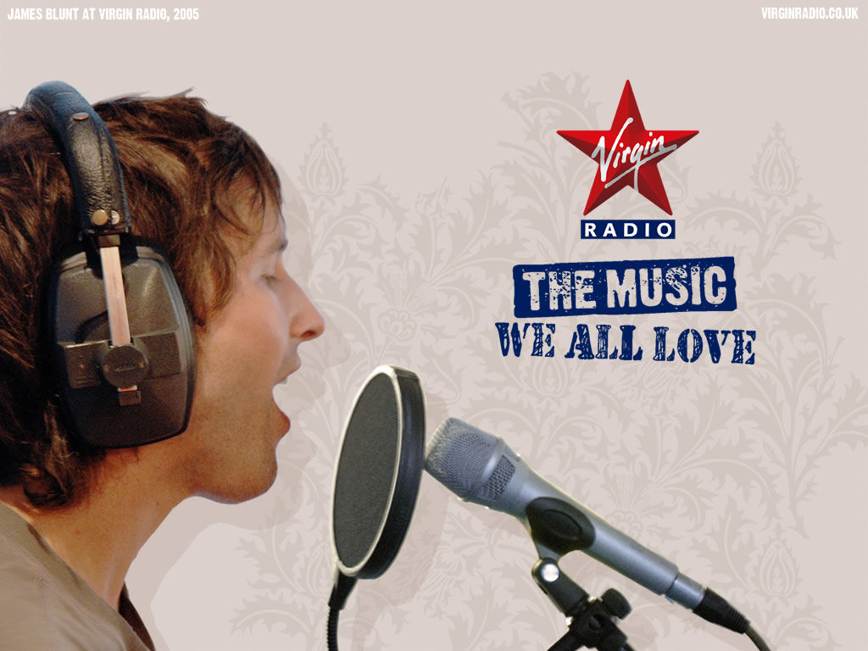
Notes:
So, you’ve heard from the public-funded BBC – now I’d like to talk about commercial radio (while I still can).
There’s a perception that normal broadcast music radio is dying and becoming more irrelevant in an age of Last.FM, Pandora, and on-demand listening.

