Slide 1


ISAN: the Global ID for AV Content
Unique and Permanent Identification
of Audiovisual Works
KENDRA INITIATIVE - LONDON 27th of June 2007
© ISAN International Agency
ISAN International Agency
30 rue de Saint Jean
CH-1203 Geneva
Tel.: + 41 22 545 10 00 Fax: + 41 22 545 10 40
Email: info@isan.org www.isan.org

Slide 2




Reminder: What is ISAN?
The International Standard Audiovisual Number (ISAN) is an ISO Standard (ISO 15706) reflecting the industry-wide consensus behind it.
ISAN permanently identifies audiovisual content at every point in its lifecycle from conception, to production, to distribution and to consumption.
ISAN relates to specific descriptive metadata, (i.e. original and alternative titles, language, type, duration, director, producer, characters, actors, speakers, etc…)
ISAN applies to all types/genres and different versions of works (i.e. films, serials, documentaries, live broadcasts such as football events, video games, video clips, etc…)
ISAN is the SKU (stock keeping unit – for retailers) for the digital realm.
What ISBN is for books…
ISO 15706-1 ISAN
& ISO 15706-2 V-ISAN
…ISAN is for audiovisual works, and more!

Slide 3











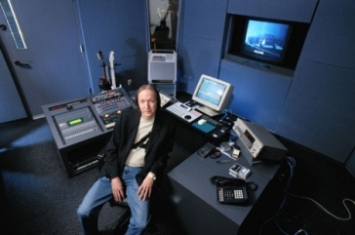




How ISAN is used as the work id in the AV supply chain
Each ISAN version has its own metadata set
Material 1
ISAN 0000-0001-A175-0002-8-0000-0000-D
Material 2
Linguistic Versions
Material 3
FR
IT
DE
ISAN 0000-0001-A175-0002-8-0000-0001-G
Optical Discs Versions
ISAN 0000-0001-A175-0002-8-0000-0002-3
ISAN 0000-0001-A175-0002-8-0000-0003-F
ISAN 0000-0001-A175-0002-8-0000-00A3-X
ISAN 0000-0001-A175-0002-8-0000-00D2-C
INTERNET
Broadcasters Versions
ISAN 0000-0001-A175-0002-8-0000-0010-9
ISAN 0000-0001-A175-0002-8-0000-0008-1
ISAN 0000-0001-A175-0002-8-0000-00E1-A
ISAN 0000-0001-A175-0002-8-0000-0009-1

Slide 4

ISAN is an identification system with related metadata in a central repository
WORK
descriptive metadata
Title of audiovisual work/content
Original language(s) of work
Alternate title(s) in the original language
Original title translated to English (when applicable)
Metadata language
Country (or countries) of reference
Title(s) of other language version(s)
Other language versions
Year of reference
Year of first publication or Year of Release
Full name of main producer
Main production company / Publisher
Full name of principal director(s)
Full name of participants
Full name of script writer(s)
Duration (in minutes and/or seconds)
Work Genre Form & Genre Type
Live action, animation or both
Is this a co-production?
Is this a composite audiovisual work?
Any other additional info
VERSION
descriptive metadata
Version Intention
Version Descriptive Name
Title & Title Language
Spoken & Written Language
Version specific Rating Info
Registrant Information
Running Time
Other Identifiers such as
(ISWC, ISRC, AdID, etc…)
Media Type, Streaming Format, Channel Information, Platform
Image and Sound format information
Editing info
Plus published:
XML ISAN reference schema
Metadata dictionary
EPISODE
descriptive metadata
Title of the Serial Header
Title of Episode
Number of the Episode
Season of the Episode
Year of reference of the Episode
Any additional info
MULTILINGUAL…!

Slide 5
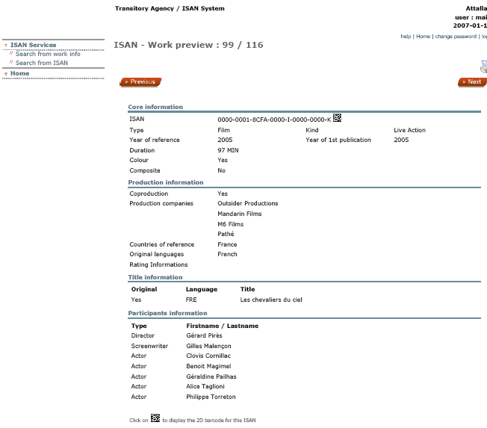



0000-0001-8CFA-0000-I-0000-0000-K

Slide 6
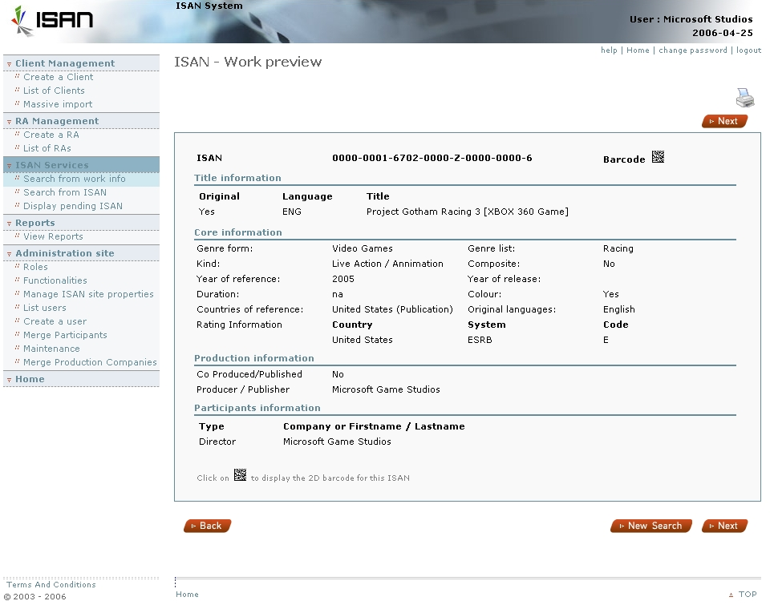




Slide 7











































Few adopters/supporters/users of ISAN …
Less than 500’000 works have been registered so far…!
TF 179
Open EPG
And many others to come….

Slide 8

Main ISAN Benefits…
  ISAN helps in reducing errors and in optimizing efficiency between systems (server to server, machine to machine, etc…)
  therefore facilitates data exchange without translation between proprietary numbering schemes or extensive manual title matching
  ISAN increases broadcasters’ workflow efficiency by linking content creation and management with distribution - in delivering digital content across multiple networks and multiple services, getting it right to the right subscriber at the right time on the right device.
  ISAN increases efficiency in metadata usage like in EPGs or with video files available to VoD service providers, and to consumers via web search.
  ISAN services are available online via web template & web services
  ISAN is integrated in many existing AV standards, in many AV encoders, and AV watermark and fingerprint software solutions
  ISAN is supported by the authors and producers, as well as major industry and trade associations
  ISAN has been designed to last more than 150 years!
ISAN allows as well to preserve the analogue legacy in the digital age.

Slide 9
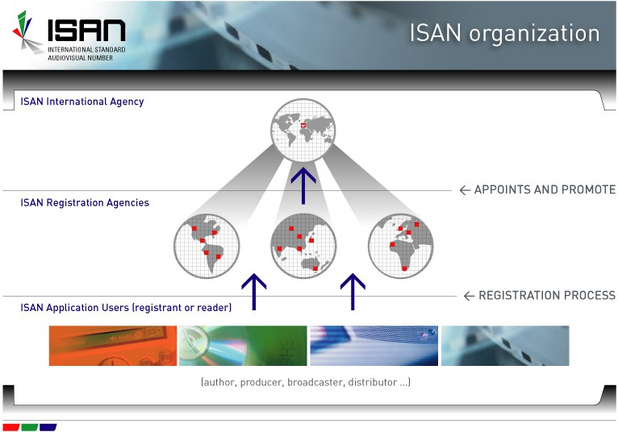
ISAN (International + Registration) Agencies: Organization and functions
The ISAN International Agency (ISAN-IA) based in Geneva was co-founded in 2003 by AGICOA, CISAC and FIAPF. As a service organization its mission is to implement ISAN throughout the world by providing and maintaining the ISAN system, by creating and supporting the network of Registration Agencies and by promoting their activities to the audiovisual industry.
The ISAN Registration Agency (RA), appointed by ISAN-IA, assumes an important role in delivering the ISAN service to the audiovisual users. The RA is established to serve a specific country, region and/or market. The RA receives and processes applications for ISAN. As of today, 14 Registration Agencies have been appointed in Europe (France, Switzerland, Germany, Spain, Netherlands, Sweden, UK, Poland), in Canada, in the USA (Secure Path, IFTA, and Microsoft Studios), in Australia and in Brazil. Others will soon be appointed in HK, India, Iran, Italy, Japan, Korea and Mexico. Less than 500’000 ISANs have been so far allocated.

Slide 10
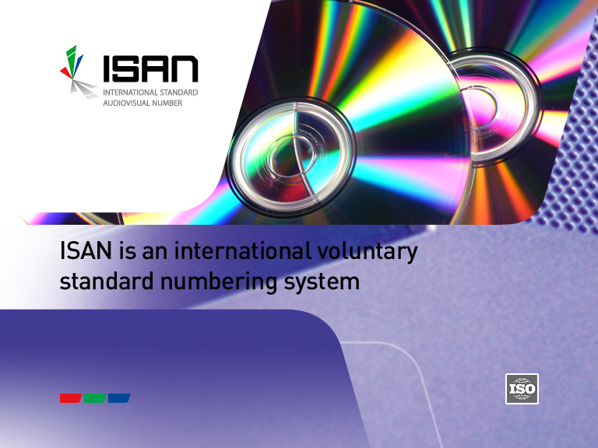

© ISAN International Agency
ISAN helps promote, provide and protect.
Visit ISAN at www.isan.org
THANK YOU
regis.flad@isan.org
patrick.attallah@isan.org

