Slide 1
Do You Have Something Like…?

Slide 2
Market Leader
Largest Digital Distributor of Music
Over 1 million tracks in the catalogue
Source content locally
Supply all digital outlets – DMS and Mobile
Market, promote and sell locally and globally

Slide 3
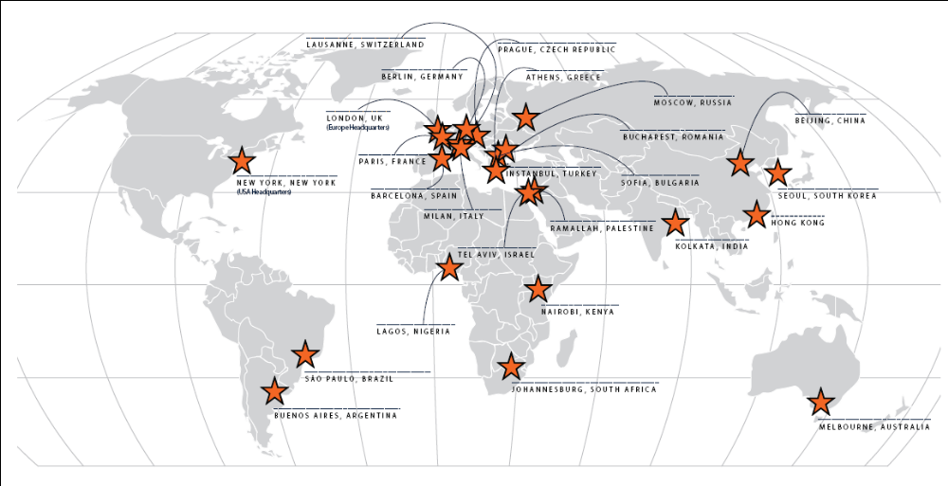
27 Global Offices

Slide 4
Orchard Artists
Afrika Bambaataa
Alexander Shulgin
Anthony Braxton
Archie Shepp
Art Brut
Asha Bhosle
Astor Piazzolla
B.B. King
Bad Brains
Bay City Rollers
Beck
Ben Jelen
Benny Goodman
Big Country
Bill Laswell
Billie Holiday
Billy Bob Thornton
Bing Crosby
Black Flag
Black Uhuru
Blazin' Squad
Blink-182
Bo Diddley
Bob Marley
The Brand New Heavies
Bright Eyes
C&C Music Factory
Cab Calloway
Carl Perkins
Cecil Taylor
Charles Mingus
Charlie Parker
Chris de Burgh
Chuck Berry
Chuck Loeb
Coldplay
Count Basie
Curtis Mayfield
Daniel Johnston
Daniela Mercury
Dave Brubeck
Dead Kennedys
Death Cab for Cutie

Slide 5
Orchard Artists
Deep Purple
Dinah Washington
Dion
Don McLean
The Donnas
Donna Summer
Dr. John
Duke Ellington
Ella Fitzgerald
Ennio Morricone
Eric Dolphy
Evan & Jaron
The Fall
Fats Domino
Fito Paez
Frank Sinatra
George Carlin
Glenn Miller
Green Day
Gregory Isaacs
Hank Williams
Harry Belafonte
Helmet
Herbie Hancock
The Hives
The Hold Steady
Howlin' Wolf
Ike & Tina Turner
Immortal Technique
The Jerky Boys
Jerry Lee Lewis
Jerry Seinfeld
Jimmy Page
Jody Watley
John Cage
John Coltrane
John Denver
John Fahey
John Lee Hooker
John Legend
Johnny Cash
Katatonia
KC & the Sunshine Band

Slide 6
Orchard Artists
Keane
Kim Waters
King Sunny Ade
The Kingsmen
KRS-One
The Last Poets
Lata Mangeshkar
Laura Cantrell
Leadbelly
Lee “Scratch” Perry
Lightnin’ Hopkins
Little Richard
Los Lobos
Louis Armstrong
Mad Professor
Mahalia Jackson
Masta Killa
Medeski Martin & Wood
Melvins
Me'shell N'degeocello
Mikis Theodorakis
Ministry
The Minutemen
Mojo Nixon
Motley Crue
Motorhead
Muddy Waters
Nancy Sinatra
Nat King Cole
Nina Simone
Norman Cook
Nusrat Fateh Ali Khan
Ofra Haza
Ohio Players
Ojos de Brujo
Ol Dirty Bastard
Paul Oakenfold
Perry Como
The Pharcyde
Pigface

Slide 7
Orchard Artists
Public Enemy
Ralph Stanley
Ravi Shankar
Ray Charles
Roger McGuinn
RZA
Sam & Dave
Screamin’ Jay Hawkins
Seu Jorge
The Silos
Simply Red
Sir Mix-A-Lot
The Skatalites
Sly & Robbie
Solomon Burke
Son House
Soulive
Soundgarden
Sublime
Sufjan Stevens
Sun Ra
Swing Out Sister
Taj Mahal
Ted Leo / Pharmacists
The Three Stooges
Tim Buckley
Tom Waits
Tone-Loc
Triumph
The Turtles
The Vandermark 5
Walter Beasley
The Wedding Present
Ween
Wilson Pickett
Yellowman
Young MC
Zakir Hussain
...and thousands more

Slide 8
How Do You Discover Music?
4 million songs in iTunes
100,000,000+ songs on p2p networks
MySpace - Your Network:186,644,936

Slide 9
Paradox of Choice
Consumers demand an abundance of choice
When confronted with unlimited choice consumers FREEZE

Slide 10
Records Don’t Sell Themselves
Need to lead consumers to music
Personal recommendations
Filters (radio, press, blogs, etc.)
Community recommendations
Sophisticated recommendation engines
    Collaborative filtering
    Audio characteristic analysis

Slide 11
Identify Music
Acoustic traits
Acoustic characteristics
Match with library
No tagging or meta data requirements
Language is irrelevant

Slide 12
Content Based Recommendation vs.
Manual Annotation and Collaborative Filtering
Scalable
Consistent
Automated and immediate
Complete

Slide 13
Summary
Discovery is a massive problem
Need a blend of solutions
Solutions need to be integrated into other services

Slide 14
Contact Info:
Scott Cohen
Founder and VP International
scott@theorchard.com
The Orchard
25 Floral Street
Covent Garden, London
WC2E 9DS
UK

