Slide 1


Slide 2

frustrated consumer

Slide 3
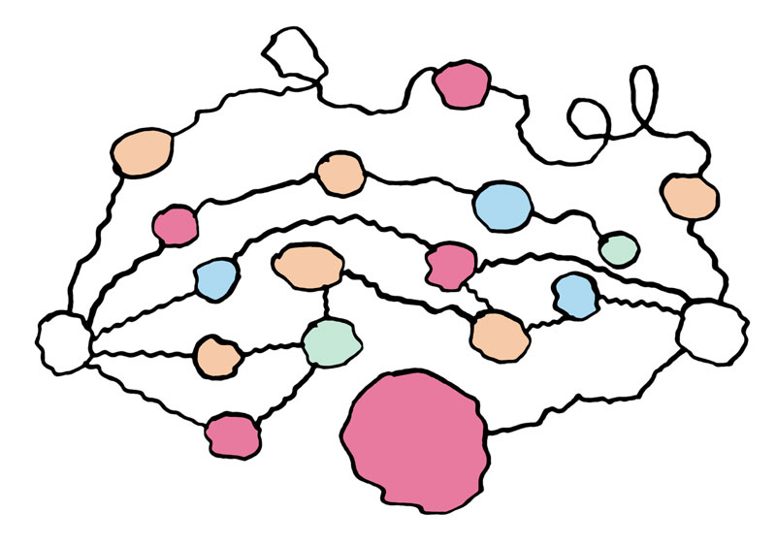
confused content owner

Slide 5
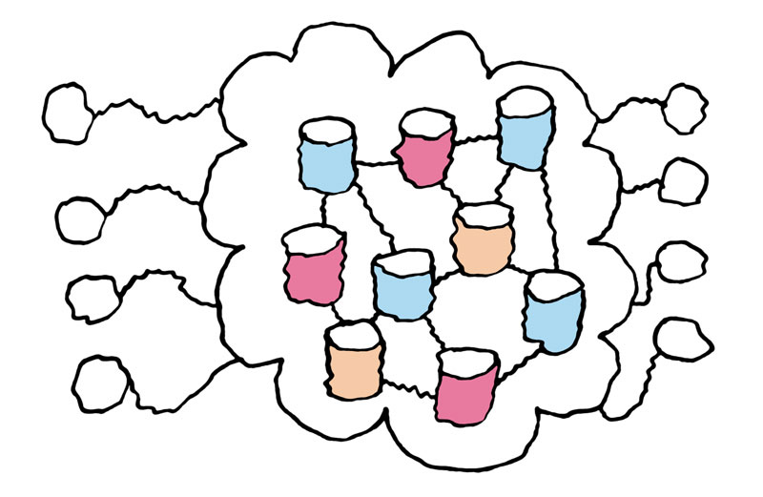
world wide web
All Web Sites
All Web Browsers

Slide 6

happy consumer

Slide 7
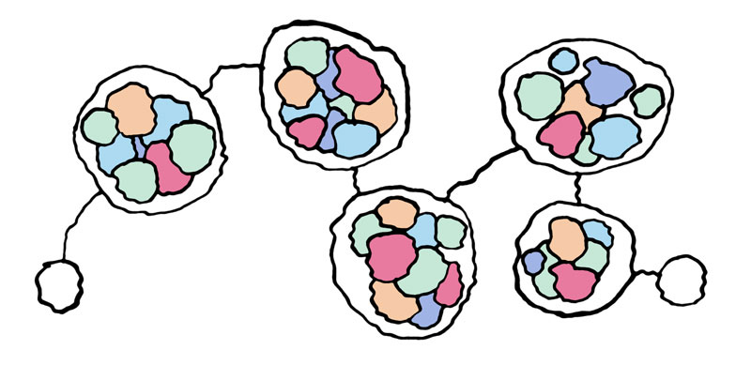
interoperable services
Delivery
Digital Rights Management
Payment
Content Owner
Content Consumer
Content Discovery… Metadata Interoperability
Desktop and Device APIs

Slide 8
open marketplace for digital media
iTunes Store
iPod
Zune
Napster
Mobile
Artist
Generic Browser
Content Aggregator

Slide 10
kendra what
Simplify and streamline buying and selling digital content by driving industry adoption of open protocols.
Enable interoperability between service providers, media applications and devices - every link in the content value chain.
Build a system where consumers can use any device or application to browse, search and purchase from the globally distributed collection of content catalogues.
Create a more pleasurable buying experience for consumers and increase reach and revenue for content owners.

Slide 11













kendra who

Slide 12
kendra how
The more we talk about it...
The more we describe it...
The more detail we give the description of it...
The more we build of it...
... the more likely it is to come about.

Slide 13
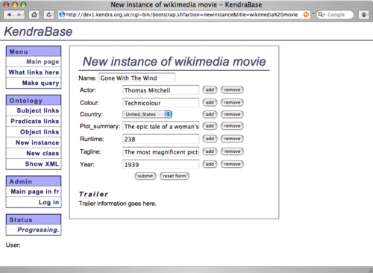
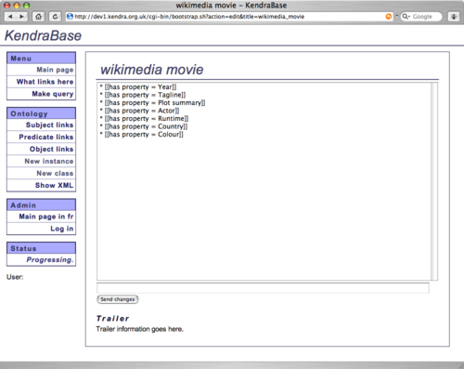
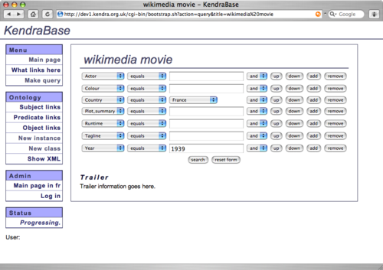
kendra base
A distributed semantic search and publish system prototype

Slide 14
p2p-next
Kendra partner in 14M EUR EU funded FP7 project
Partners include BBC, EBU, Markenfilm, Pioneer, ST Microelectronics, Technische Universiteit Delft, University of Rome and many others
4 years - 2008 to 2011
Metadata Signposts for Content Discovery
P2P content delivery platform

Slide 16
what Tim says...
Tim Berners-Lee at WWW2005 talked about the “Independence of the communication from the provider of software”
Technology Agnostic
De-coupled World

Slide 17
www.kendra.org.uk
daniel@kendra.org.uk

