Slide 1

The Kendra Music Catalogue
Romek Szczesniak
Spiky Black Cat Records
romek@spikyblackcat.co.uk

Slide 2
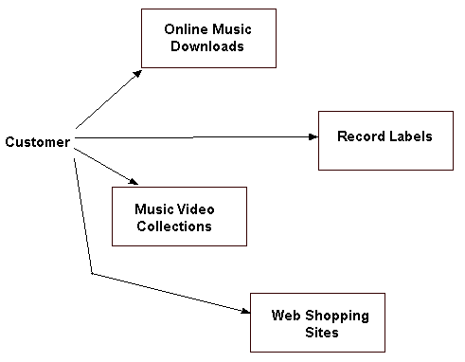
Present State – No Kendra

Slide 3
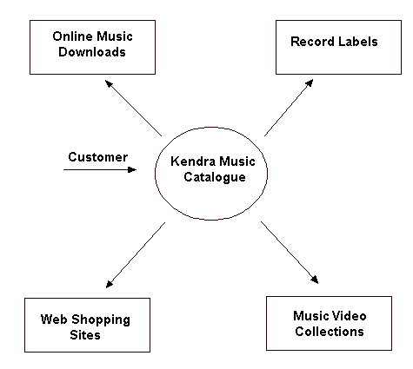
Future With Kendra Music Catalogue in Place

Slide 4
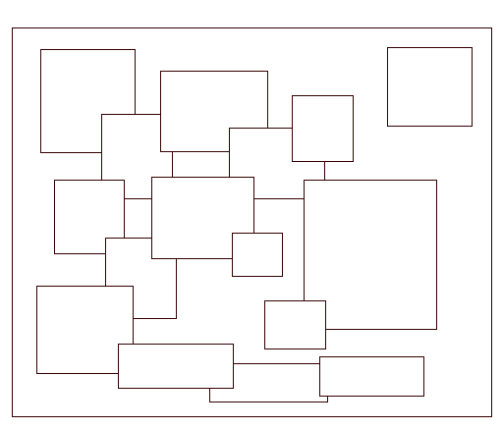
Kendra Music Catalogue
Catalogue of Catalogues

Slide 5
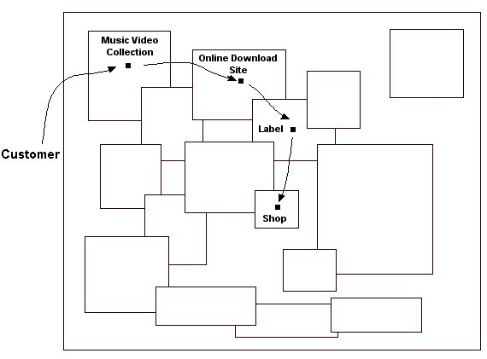
Kendra Music Catalogue

Slide 6
Submitting a Catalogue
Place Catalogue on Your Website
Add Link to Kendra Catalogue Site
That’s It!
Do You Have a Catalogue of Content?
If YES,
Why aren’t you submitting it to the Kendra Trial?

