Slide 1

Progress report
Kendra M. Wu
14 April 2021

Slide 2

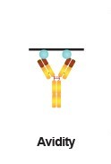
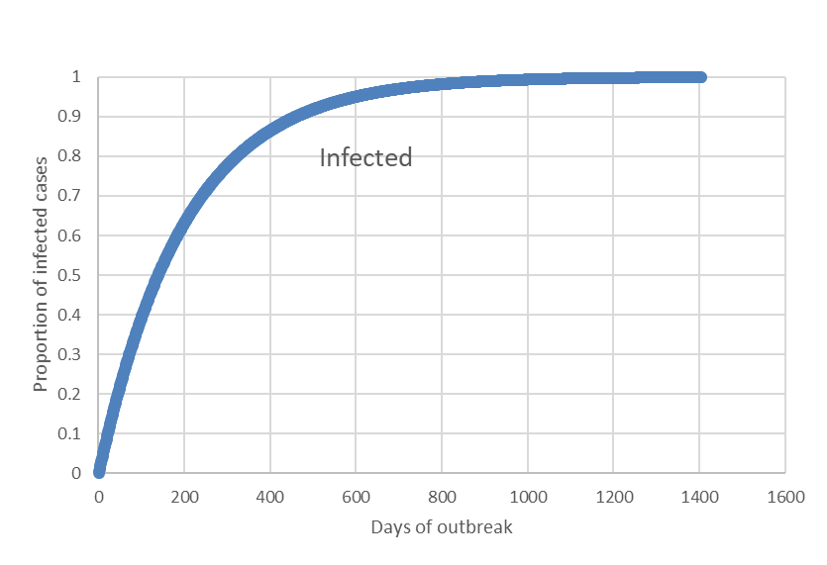
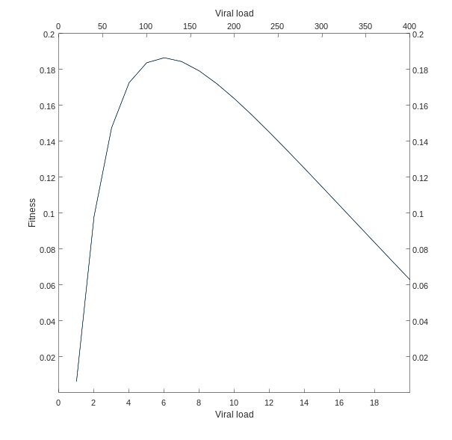
Objectives
      To model mean cellular receptor binding avidity (V), fitness (R), and cumulative fatality risk (CFR) from SEIRH model
Picture credit: https://www.novusbio.com/support/general-support/antibody-basics.html

Slide 3
Definitions
Receptor binding avidity
  Describes the binding strength between an antibody (a protective protein produced by the immune system in response to the presence of a foreign substance - antigen) and antigen
Fitness
  How good a particular gene is at becoming the next generation in natural selection relative to how good other genotypes are at it

Slide 4


Block diagram
Here is the block diagram of a the susceptible-infected-recovery-hospitalization-(re)susceptible (SIRHS) model:
R
S
I
S
H
where β is the transmission rate, 𝛾 is the recovery rate, 𝜎 is the hospitalization rate, and 𝜔 is the rate of waning immunity.

Slide 5
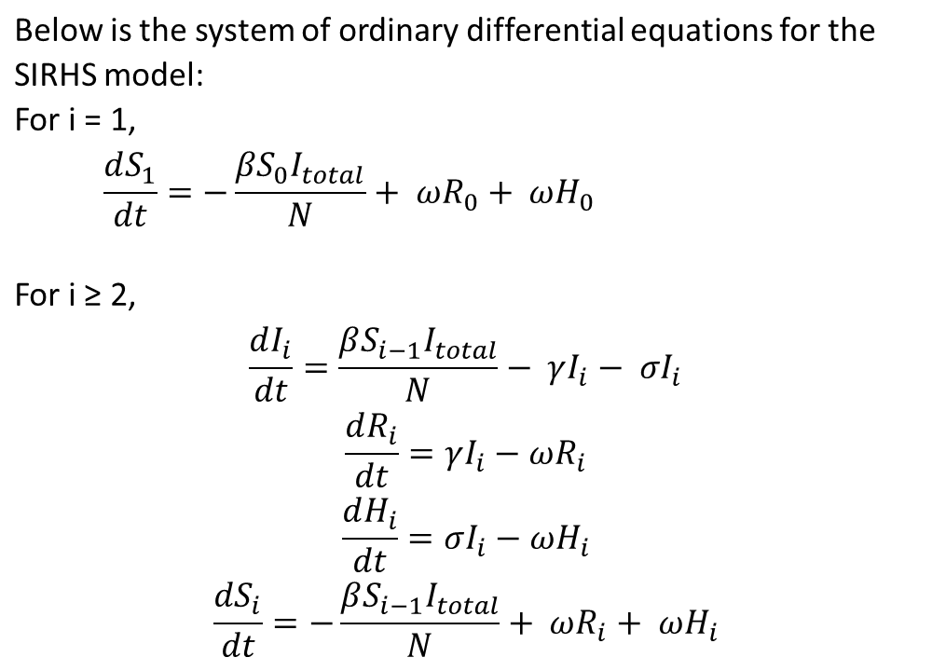
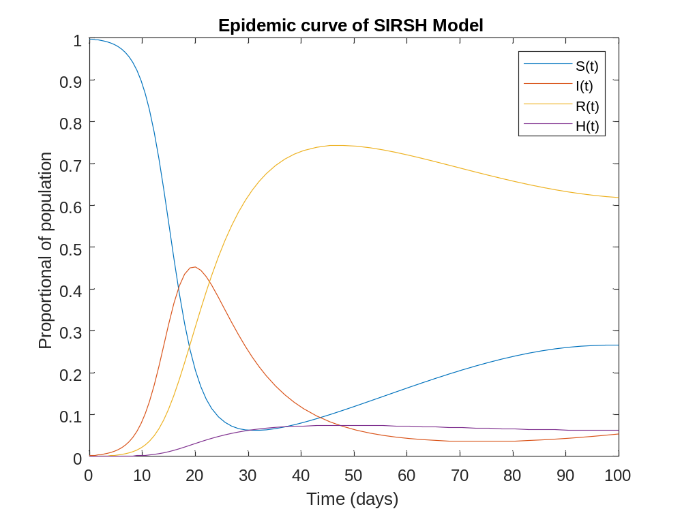
SIRHS model
Figure 1 shows the epidemic curves of SIRHS model when β=5, 𝛾=0.1, 𝜔=0.03, and 𝜎=0.02.

Slide 6
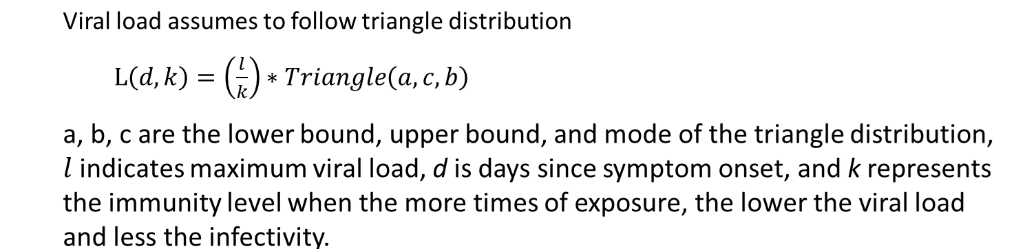
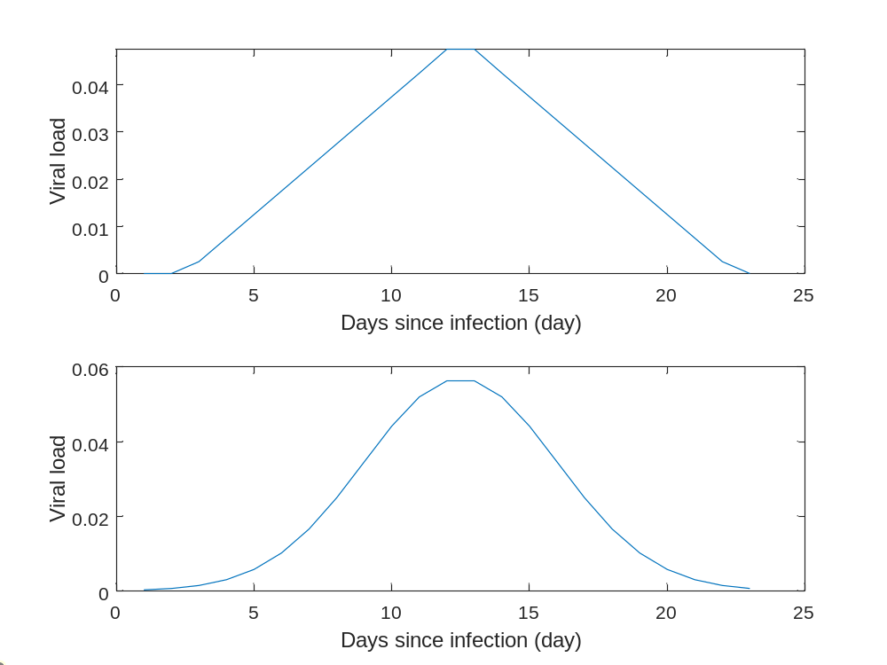
Viral load

Slide 7
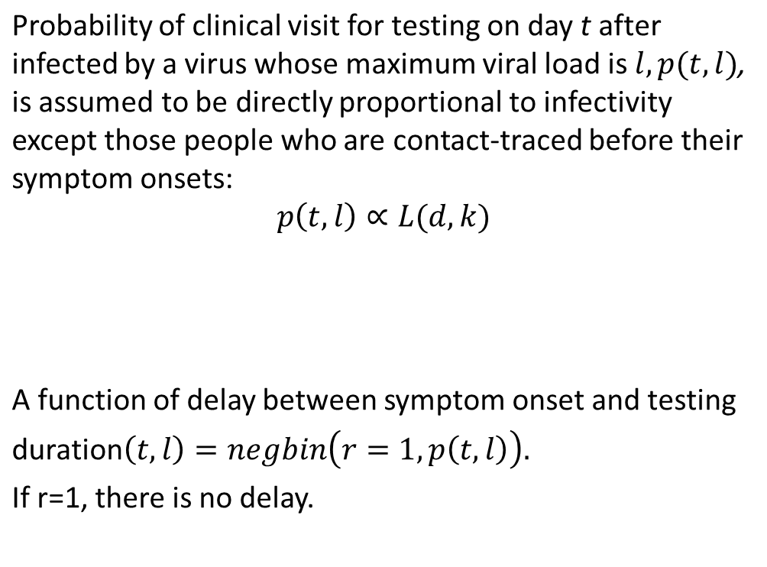
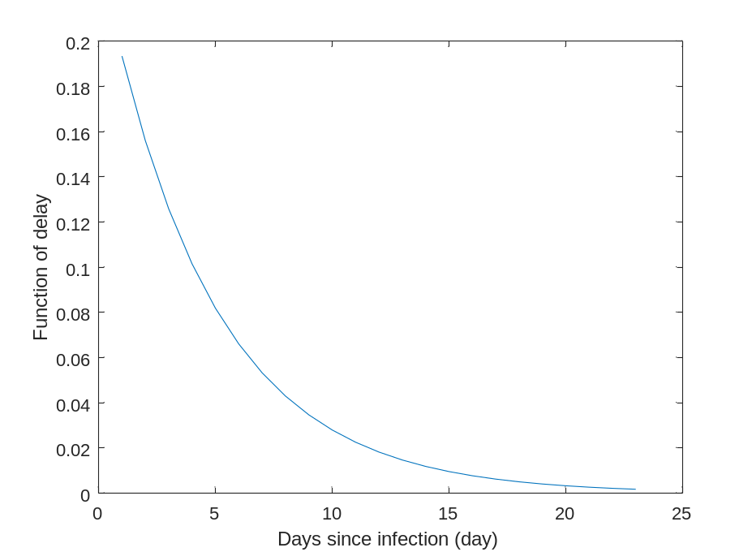
Probability of clinical visit
A function of delay

Slide 8
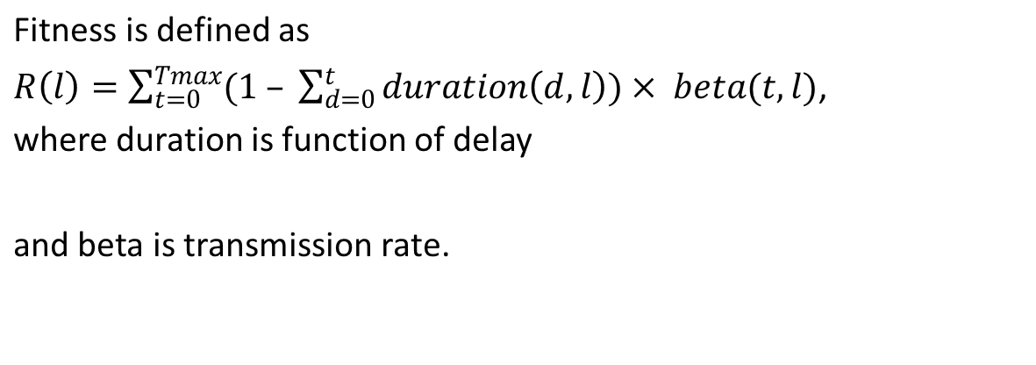
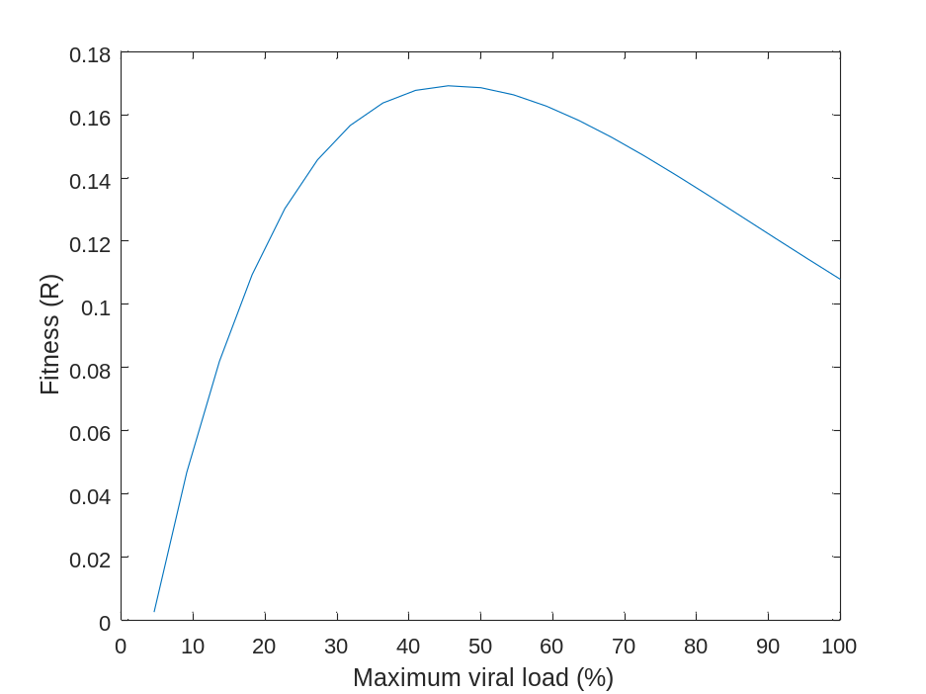
Fitness
duration(d,l)=negbin(r=1 ,p(t,l)),

