Slide 1

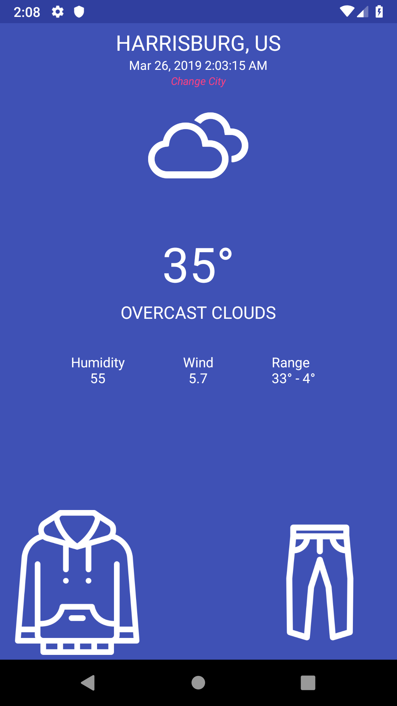
What to Weather?
Aditya Kendre

Slide 2
Objective
Over the past couple of months, I have struggled to efficiently choose what clothing to wear the following day to school. In this project, I have 2 main goals: making it easier in deciding on what to wear the following day and obtaining experience in implementing APIs in programs for my future career. This program/app should be able to accurately predict the following day's temperature and address what clothing to wear.

Slide 3


Software
Android Studios – a platform used to devolve android apps
Adobe Illustrator – a vector graphics editor

Slide 4
Idea
My idea was formed when one day I had worn both a sweatshirt and pants at 80°C. I had the idea of solving this problem by checking the forecast for the next day; however, it soon became clear that it was too tedious to check the weather every day.

Slide 5
Research
I started conducting research on making an app that could both display the temperature, and make an accurate prediction to decide what attire to wear. Most apps that access data from servers use an API (Application Program Interface), which allows applications to communicate with each other. In this case would connect a device to a remote server, allowing the server to send data about the weather conditions to the device. Upon doing some further research, I came across the Open Weather API, which is a free API that provides current weather conditions. After learning about the process of creating an app, I jumped in head first and started exploring API implementation.

Slide 6
Production/Design
After countless attempts on compiling, running and debugging. The app could display the weather conditions for any city in the world and predict what to wear for those weather conditions. In a design process, it is important to gather feedback to help create a better app. I received feedback both from my friends, and my parents. They suggest that I make my GUI more friendly and make splash screen to make the app flow as the data was taking time to come from the server.

