Slide 1
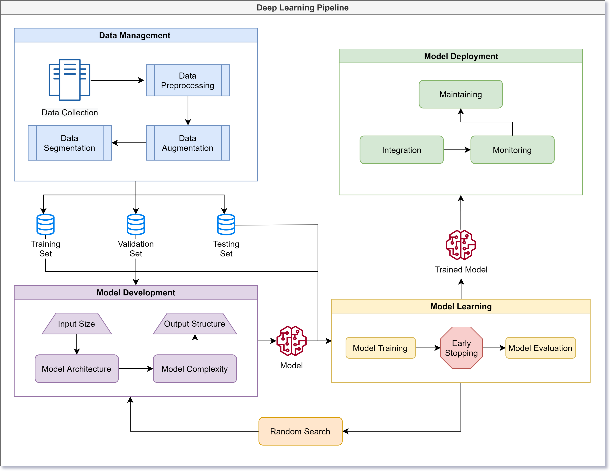
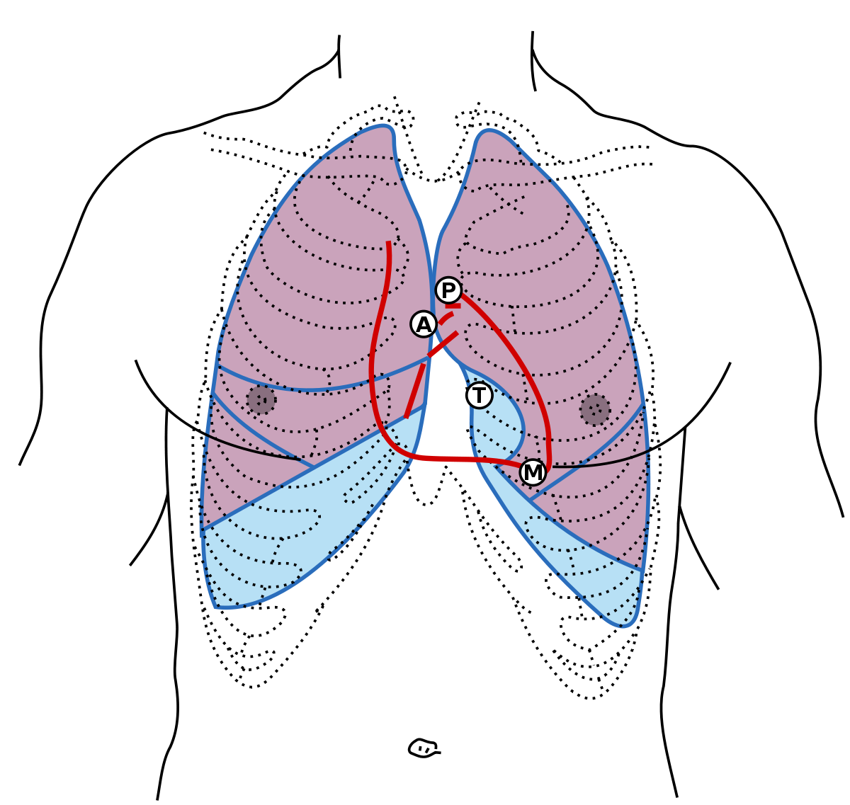
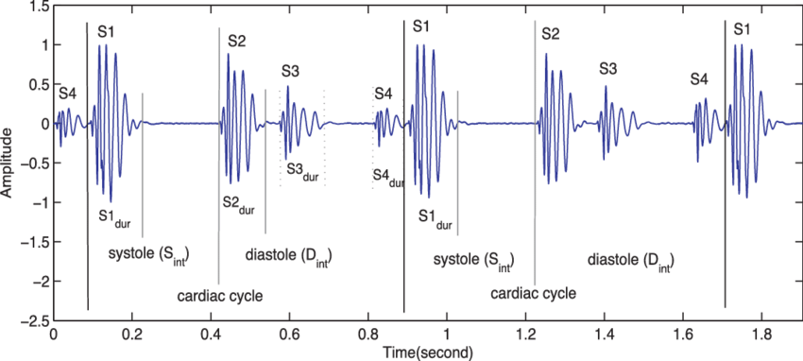
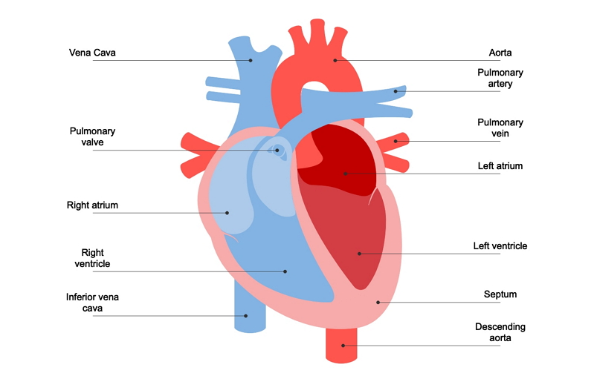
Abstract
PCG-Net:
Generative Adversarial Networks for PCG Arrhythmia Detection
With the rapid growth of computational power and complex algorithms, we propose a novel approach to detect arrhythmias in Phonocardiograms (PCGs). Typically, Electrocardiograms are used to diagnose arrhythmias, requiring medical-grade equipment to recognize cardiac illnesses accurately. However, PCGs provide ease of access to everyone who has a device capable of recording audio, allowing medical professionals to treat arrhythmias in the developmental stages. The new design comprises two subsystems; one is based on the relationship between Electrocardiograms (ECGs) and PCGs, and the other between PCGs and arrhythmias. The association between ECGs and PCGs is amended to translate from one space to another, where ECGs become dimensionally reduced, then reconstructed into a PCG signal. The second subsystem uses a Generative Adversarial Networks (GAN), in which both arbitrary PCG signals are generated, and preexisting ECG datasets are recreated into PCG signals (using subsystem one). These signals are fed into a classifier that detects if an arrhythmia is present. This proposed system's advantage is that PCG data is more readily collected than ECG data; hence, more heart diagnostics can be made.
Part 1:
Background
Motivation
Recommendations
Add your information, graphs and images to this section.
Add your information, graphs and images to this section.
Add your information, graphs and images to this section.
TRIFOLD AREA – THIS GUIDE WILL BE REMOVED BEFORE PRINTING – TRIFOLD AREA – THIS GUIDE WILL BE REMOVED BEFORE PRINTING – TRIFOLD AREA – THIS GUIDE WILL BE REMOVED BEFORE PRINTING – TRIFOLD AREA – THIS GUIDE WILL BE REMOVED BEFORE PRINTING – TRIFOLD
TRIFOLD AREA – THIS GUIDE WILL BE REMOVED BEFORE PRINTING – TRIFOLD AREA – THIS GUIDE WILL BE REMOVED BEFORE PRINTING – TRIFOLD AREA – THIS GUIDE WILL BE REMOVED BEFORE PRINTING – TRIFOLD AREA – THIS GUIDE WILL BE REMOVED BEFORE PRINTING – TRIFOLD
Methodology
Data Collection
Although PCG signals are analyzed less often than ECG signals, these signals are rather analyzed in real-time by physicians and healthcare workers. Preliminary studies done on PCG segmentation and classification primarily used private datasets. Hence, there existed no publicly available datasets until recently. Since then, many public datasets have been developed aiding researchers in their studies and creating open benchmarks for researchers to use in comparing similar findings. However, these datasets are still limited by the number of classes that are collected, when compared to ECG datasets.
Currently, only three major supervised PCG datasets exist: PhysioNet Classification of Heart Sound Recording Challenge dataset, PASCAL Heart Sound Challenge dataset, and the Heart Sound and Murmur Library. These datasets are all anonymized and de-identified for the safety of their subjects, and thus includes no personal information such as name, income, age, etc.
Data Preprocessing
PCG recordings often are recording in non-ideal environments that are filled with unwanted background noise and interference. Data preprocessing is the process of altering the data in the signal, often by denoising, normalizing, standardizing, and transforming the signal. These steps are crucial for automatic localization and classification tasks. Preprocessing the data allows a model to extract meaning features efficiently and reveals the physiological structure of the heart sounds. Furthermore, preprocessing helps ensure that the data that is fed into the model is always in the same domain. This allows the model to generalize more easily.
We first resample the data to 500 Hz, to decrease the spatial resolution of the heart sound recordings for easier processing, but still dense enough to retain important features. Thus, helping the model to converge faster. The resampled data is standardized using the standard score equation.
Data augmentation
Data augmentation is a strategy that enables a significant increase in the diversity of data available while training a model, without actually collecting new data. Data augmentation techniques aim to slightly alter existing data to a point where the model cannot recognize the augmented data as one it has trained on before, but still retains the characteristics of the data's category. This helps in reinforcing important features within the data and is only done during the training portion of the workflow.
We resample the heart sound recordings to different frequencies to simulate slower and faster beats per minute (bpm). The normal bpm for a human is between 60-100 bpm. Thus, measuring the sample distance between the first S1 (the start of systole) and the second marker, S2, we calculate the bps and resample accordingly.
Data Segmentation
Data segmentation refers to the process of creating cross-validation datasets. This process assists in validating if the model is overfitting to the dataset. These datasets include the training set, validation set, and testing set. Typically, the training set is 70%-80% of the dataset, the reset of the dataset is split among the validation set and testing set. Here, we split the data 80% training, 10% validation, and 10% testing.
Model Architecture
Here we propose using Generative Adversarial Networks (GANs) for increased success in PCG heart sound detection. GANs poses a unique advantage over traditional machine learning and deep learning methods, in that a model learns to mimic a dataset by creating its own data and tries to fool a discriminator into thinking the generated data is real.
In a supervised approach, a GAN consists of two parts, a generator and a discriminator. The generator is responsible for creating fake heart sound data, while the discriminator tries to predict whether the incoming data is fake or real. In a semi-supervised approach, however, the discriminator is fed data from a real dataset with multiple classes and the generated data from the generator. Here, the discriminator tries to classify the generator's fake data, as well as predict the classes from the real dataset.
Model Complexity
Traditionally, generators are dense layers that slowly increase the dimensionality of the generated data to match that of the real dataset. Discriminators, on the other hand, are commonly CNNs because majority of GANs work with images. However, it is possible to use a wide variety of architectures; such as LSTMs, RNNs, SVMs, DNNs, ANNs, Transformers.
As mentioned above, there are many types of model architecture, some are used for classification, and others for feature extraction. Optimizing the combination of feature extraction layers and classification layers is extremely time consuming and computationally taxing. This is because there exist many combinations of hyperparameters, thus making it difficult to optimize each parameter. To optimize hyperparameters, we used hyperparameter sweeps to make the optimization process more efficient. This method involves using one of three methods: grid search, random search, and Bayesian search. Grid search computes each possible combination of all hyperparameters and tests them all. Although this is very effective, it can be computationally costly. Random search selects a new combination at random, provided a distribution of values. This method is surprisingly effective and scales very well. Bayesian search creates a probabilistic model of metrics and suggests parameters that have a high probability of improving metrics. This works well for small scale projects, but scales poorly as the complexity of parameter relationships increase. Here, we used random search to optimize our hyperparameters.
Model Training
During the training phase, the model is trained using backpropagation in conjunction with a cost function. Backpropagation attempts to calculate the gradient of the cost function with respect to the weight and biases of the model. This process involves an optimizer, which optimizes the model's parameters and a cost function that measure the correctness or incorrectness of the model. The goal of the optimizer is to minimize the cost function's error by adjusting the parameters to the given label. In this study, we used the Adam optimizer in union with Cross-Entropy Loss. The Adam optimizer uses a hyperparameter that dictates the change in the model's parameters on each backpropagation step, this is called the learning rate. Here we choose a learning rate of 0.0001.
The model is only trained on the training set; thus, backpropagation only occurs on the training set. Additionally, for each step in the training set, the optimizer backpropagates and optimizes the parameters and calculate metrics to further evaluate the model. The number of steps in the training set is dictated by the batch size, the number of signals the model is trained on, in a single forward pass. Here we use a batch size of 32, meaning that the model is fed 32 signals per input. This significantly speeds up the process of training as more signals are passed through the model every time the model is optimized. A full pass of the training set is called an Epoch, here we train the model on 100 Epochs.
Early Stopping
To ensure the model is not overfitting, but generalizing to the training set, we use a validation set to track the metrics of the model. In theory, the metrics on the training set equal to that of the validation set. In practicality,
after many epochs of training the metrics of the validation set become static, but the metrics of the training set still increase. This suggests that the model is overfitting. Thus, we stop training the model on the training set and test it on the testing set.
Model Evaluation
Testing sets or hold-out sets are used to validate the metrics of a model, this is because both the validation set and the testing set have been tested by the model; thus, the model has developed a latent bias to both sets. Therefore, a third set is needed to assess the model's ability to generalize on an independent dataset.
Conclusion
Add your information, graphs and images to this section.
Acknowledgements
Add your information, graphs and images to this section.

Slide 2
TRIFOLD AREA – THIS GUIDE WILL BE REMOVED BEFORE PRINTING – TRIFOLD AREA – THIS GUIDE WILL BE REMOVED BEFORE PRINTING – TRIFOLD AREA – THIS GUIDE WILL BE REMOVED BEFORE PRINTING – TRIFOLD AREA – THIS GUIDE WILL BE REMOVED BEFORE PRINTING – TRIFOLD
TRIFOLD AREA – THIS GUIDE WILL BE REMOVED BEFORE PRINTING – TRIFOLD AREA – THIS GUIDE WILL BE REMOVED BEFORE PRINTING – TRIFOLD AREA – THIS GUIDE WILL BE REMOVED BEFORE PRINTING – TRIFOLD AREA – THIS GUIDE WILL BE REMOVED BEFORE PRINTING – TRIFOLD

