Slide 1

Generative Adversarial Networks for PCG Arrhythmia Detection

Slide 2
Traditionally, arrhythmias are diagnosed by cardiologists by analyzing ECG recordings (Jordaens, 2018). Some clinics have adopted a new technique in which ECG and PCG signals are simultaneously recorded and then computationally analyzed. This, however, still requires an instrument capable of recording ECG data. Such instruments are only available during scheduled appointments, often which are recommended by physicians.
If a physician fails to detect symptoms of arrhythmia, a patient may never receive a diagnosis. One study found 44% of cardiologists were not able to detect common cardiac events with stethoscopes (Mangione et al., 1993); in another study, delays in cardiac-related illness diagnosis and treatment impacted procedural success rates by as much as 24% (Bunch et al., 2013). We propose a method where it is now possible to accurately detect arrhythmias with only PCG recordings. This provides an opportunity for physicians to check for potential developments of cardiac arrhythmias at every physical exam accurately.
Current PCG arrhythmia diagnosis methods only recognize between Normal and Abnormal (binary classification), providing minimal information about what is present within the PCG signal (Aziz et al., 2020). This is because no PCG datasets exist that includes more than 3 classes of arrhythmia. Therefore, it is necessary to transform preexisting ECG datasets with multiple classes to PCG signals. This enables models to detect a larger range of arrhythmia without explicitly collecting new PCG recordings. Currently, no technology attempts to construct PCG signals from existing ECG data.
Background

Slide 3
With the rapid growth of computational power and complex algorithms, we propose a novel approach to detect arrhythmias in Phonocardiograms (PCGs). The new design comprises two subsystems; one is based on the relationship between Electrocardiograms (ECGs) and PCGs, and the other between PCGs and arrhythmias. The association between ECGs and PCGs is amended to translate from one space to another, where ECGs become dimensionally reduced, then reconstructed into a PCG signal. The second subsystem uses a Generative Adversarial Networks (GAN), in which both arbitrary PCG signals are generated, and preexisting ECG datasets are recreated into PCG signals (using subsystem one). These signals are fed into a classifier that detects if an arrhythmia is present. This proposed system's advantage is that PCG data is more readily available than ECG data; hence, more heart diagnostics can be made.
Novel
Approach

Slide 4
Constants
Question:
Is it possible to create a model capable of surpassing the accuracy of
Cardiologists in identifying heart arrhythmias in Phonocardiograms?
Hypothesis:
It is possible to exceed the accuracy of Cardiologists when compared to that of a Generative Adversarial Network‘s, to identify heart arrhythmias in Phonocardiograms.
Objective&
Variables
Raw training data
Hyper Parameters in each layer
Layers in the model
Level of data augmentation
Manipulated Variables
Responding Variables
Loss of the model
Accuracy of the model

Slide 5
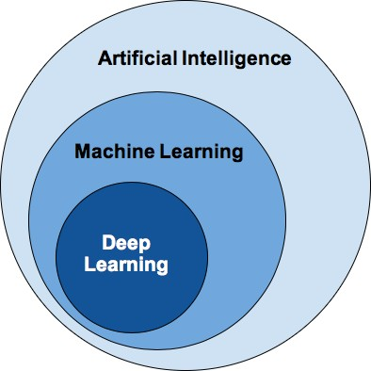
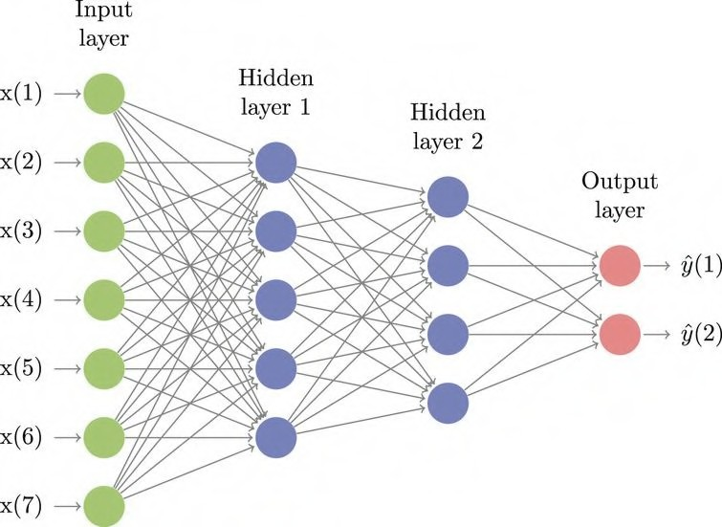
What is Deep Learning?
Deep Learning is a subclass of Machine Learning, which is inspired by a neuron’s structure, and function in the brain, groups of neurons are called Neural Networks.
The first layer of a Neural Network is called the input layer and is composed of neurons that represent the input data.
A neuron holds a number (often between 0-1), the number corresponds to the activation of each neuron.
The layers in the middle are hidden layers. These layers contain neurons that are responsible for identifying features within the dataset.
The activations in neurons of each layer change to correctly predict the right class.
The last layer of a Neural Network is called the output layer, which contains a neuron for each class in the dataset. Each neuron’s activation signifies the model’s certainty for that class. Hence, the largest activation in the output layer resembles the model’s most confident output.
Figure 1.1: Diagram of classes in Artificial Intelligence
Figure 1.2: Example Neural Network

Slide 6
Methodology
Figure 2.1: Flowchart of methods

Slide 7
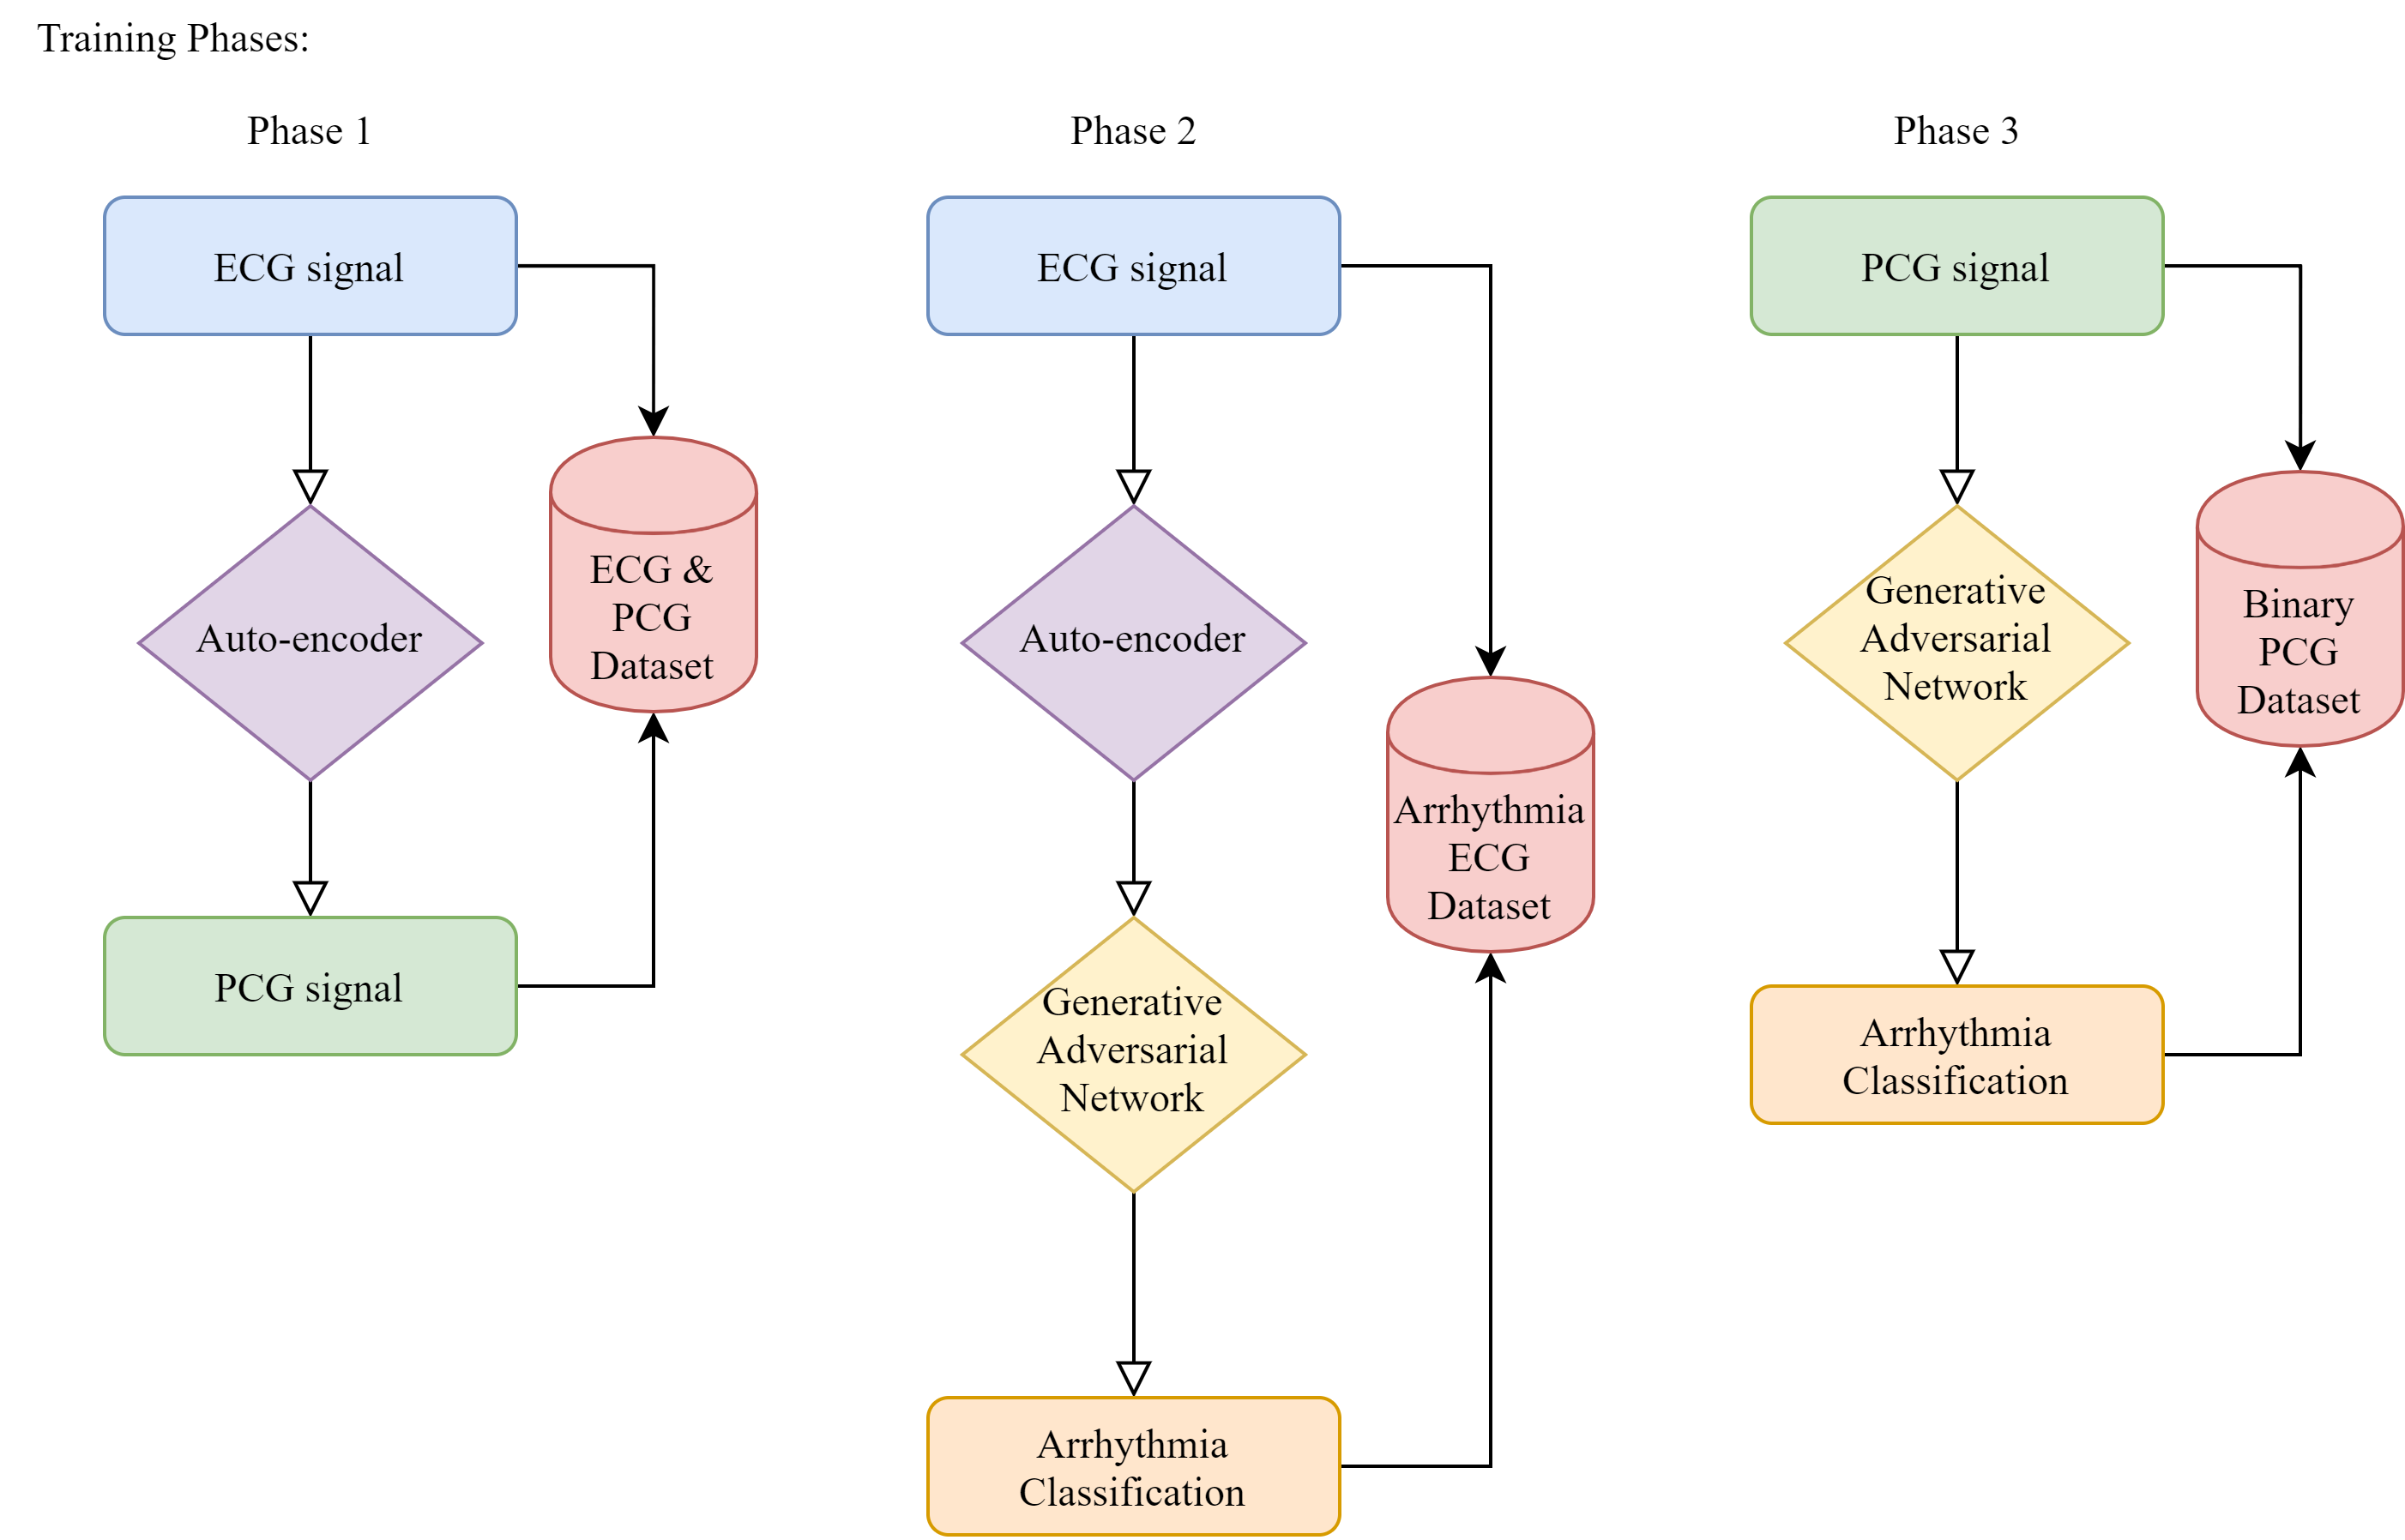
Training Phases
Figure 2.1: Flowchart of methods

Slide 8
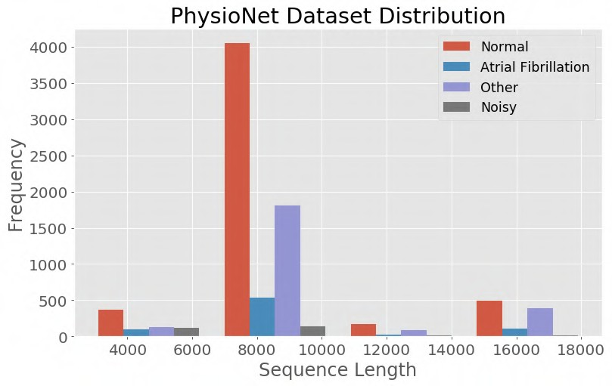
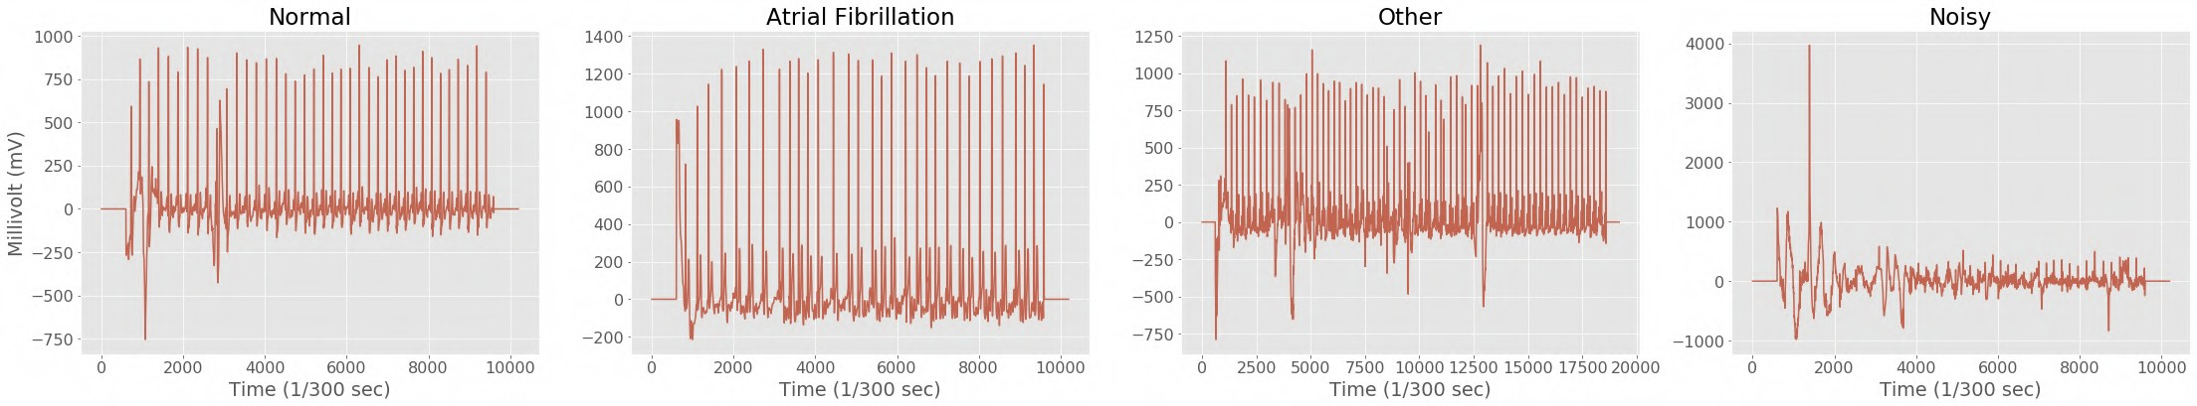
Database
The PhysioNet database contains 8,522 ECG recordings, divided into 4 classes: Normal, Atrial Fibrillation, Other, and Noisy. The raw data is provided in EFDB-compliant MATLAB V4 files, which including a .mat file containing the PCG recording and a .hea file containing the metadata for the recording (Clifford, et al, 2017).
Figure 3.1: Histogram graph of frequency and sequence length of the PhysioNet dataset
Figure 3.2: Example data from dataset for each class

Slide 9
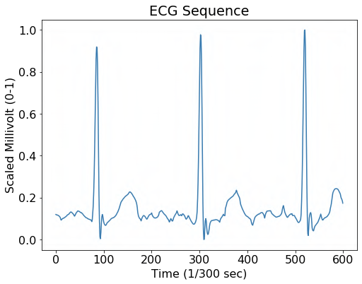
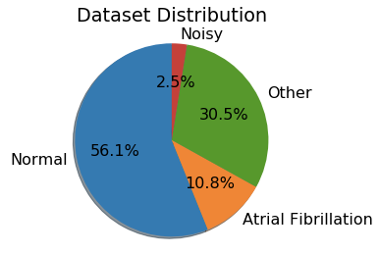
Pre-processing Data
Python Implementation:
Neural Networks require a constant input vector length. Hence, the raw ECG data was split into sequences, each with a length of 600 indices
These slices were based on each peak in an ECG. The peak is considered the middle of the sequence, and a margin of 300 indices on each side of the peak creates a full sequence
Each ECG sequence was normalized to values between 0 and 1 to
create uniformity in the dataset
To create an unbiased model, all classes (e.g. Noisy) in the training data should contain an equal amount of sequences. Thus, the dataset was dramatically reduced to create a fully balanced distribution
def pre_processing_data(self, AUGMEN_NUN): for records in self.LABELS:
with open(records) as record: for ecg_file in tqdm(record):
path = self.DATA+ecg_file[:-1]
metadata = open(path+".hea", "r").read().split(" ") ECGs = list(loadmat(path)['val'][0])
for i in range(int(self.ECG_LENGTH+1)): ECGs.insert(i, 0)
ECGs.append(0)
peaks = detect_beats(ECGs, float(metadata[2]))
for peak in range(0, len(peaks), self.ECG_PER_SAMPLE):
try:
ECG = ECGs[peaks[peak]-int(self.ECG_LENGTH/2):
peaks[peak+self.ECG_PER_SAMPLE]+int(self.ECG_LENGTH/2)] ECG = self.zero_padding(self.rnd_zero(ECG)) ECG = (ECG + abs(np.amin(ECG)))
ECG = ECG / np.amax(ECG) self.data.append([np.array(ECG),
np.eye(len(self.LABELS))[self.LABELS[records]]])
for _ in range(AUGMEN_NUN): aug_ECG = self.zero_padding(
self.rnd_zero(self.resampling(ECG))) aug_ECG = (aug_ECG + abs(np.amin(aug_ECG))) aug_ECG = aug_ECG / np.amax(aug_ECG) self.data.append([np.array(aug_ECG),
np.eye(len(self.LABELS))[self.LABELS[records]]])
Figure 3.3: Graph of ECG sequence with length of 600
Figure 3.4: Pie chart illustrating the dataset distribution
except Exception as e: pass

Slide 10
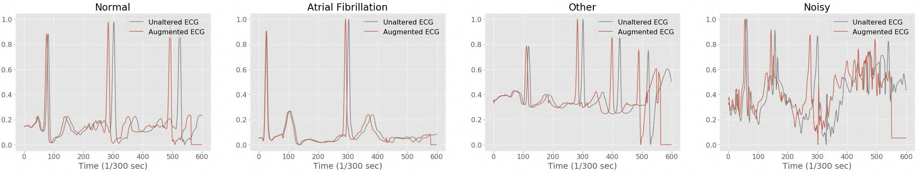
Data Augmentation
A strategy that enables a significant increase in the diversity of data available for training models, without actually collecting new data.
Zero Padding: Appends zeros to the end of an ECG sequence that is not 600 indices in length.
Random Zero Bursts: Implements random zeros in ECG sequences to replicate and constitute noisy data that occurs while collecting a sample
Random Resampling: Changes the sampling rate of an ECG sequence, which stretches or compresses the sequence
Python Implementation:
def zero_padding(self, ECG):
if len(ECG) > self.ECG_LENGTH: return ECG[:self.ECG_LENGTH]
for _ in range(self.ECG_LENGTH-len(ECG)): ECG.append(0)
return ECG
def rnd_bursts(self, ECG):
for _ in range(np.random.randint(7)):
pos = abs(np.random.randint(abs(len(ECG)-11)))
dist = abs(np.random.randint(7))
ECG[pos:pos+dist]=[0]*dist return ECG
def resampling(self, ECG):
MARGIN = 60
return signal.resample(ecg, abs(np.random.randint(MARGIN)+(self.ECG_LENGTH-MARGIN)))
Figure 3.5: Example of augmented ECG for each class

Slide 11
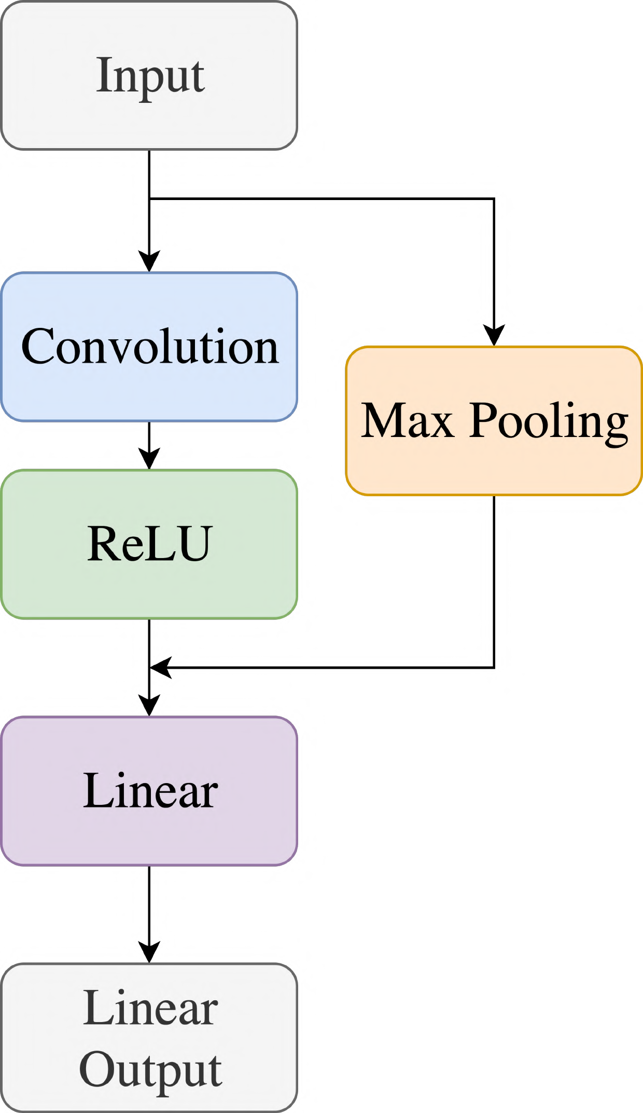
Convolutional Neural Network Model
The input consists of a 1-dimensional tensor (1x1x600) with a length of 600. The elements are normalized to values between 0 and 1.
Python Implementation:
class Net(nn.Module): def __init__(self):
super().__init__()
self.conv1 = nn.Conv1d(1,180, 5, padding=2) self.conv2 = nn.Conv1d(180, 150, 5, padding=2)
self.conv3 = nn.Conv1d(150, 120, 5, padding=2)
self.conv4 = nn.Conv1d(120, 90, 5, padding=2)
self.conv5 = nn.Conv1d(90, 45, 5, padding=2)
Convoluting also decreases the size of the input vector. A vector (with a size of 1x5) filters across the data by producing all values in the vector by a filter vector. This method also assists the model in finding features.
Max Pooling reduces the size of the input, in the case of a 1D tensor. A kernel block (with a size of 1x3) filters over the 1D tensor.
Taking the maximum value in the kernel block. This
operation aids the model in finding features in the data.
x5
x5
x = torch.randn(1,1,600).view(-1,1,600) self._to_linear = None
self.convs(x)
The Rectified Linear activation function alters the range of the incoming data by setting all numbers below 0 to 0 and leaving all positive numbers intact.
x5
self.fc1 = nn.Linear(self._to_linear, 64) self.fc2 = nn.Linear(64, 4)
def convs(self, x):
x = F.max_pool1d(F.relu(self.conv1(x)), 3)
x = F.max_pool1d(F.relu(self.conv2(x)), 3) x = F.max_pool1d(F.relu(self.conv3(x)), 3) x = F.max_pool1d(F.relu(self.conv4(x)), 3) x = F.max_pool1d(F.relu(self.conv5(x)), 3)
The liner function flattens the incoming result (1x135) into a 1D tensor (1x64).
The Linear Output layer transforms the Linear layer output into a 1x4. Each column in the tensor represents a class's likelihood of being the correct class in the dataset.
Thus, the column with the largest values is the model prediction for the input.
if self._to_linear is None:
self._to_linear = x[0].shape[0]*x[0].shape[1] return x
def forward(self, x): x = self.convs(x)
x = x.view(-1, self._to_linear)
x = F.relu(self.fc1(x)) x = self.fc2(x)
return x
Figure 3.6: Flowchart mapping out the Convolutional Neural Network

Slide 12
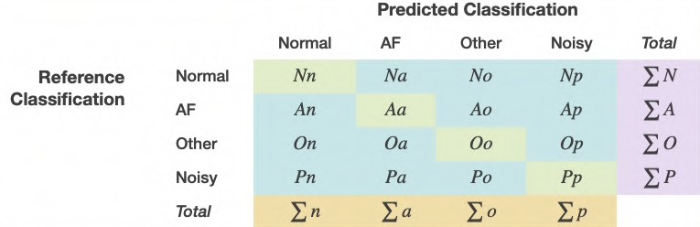
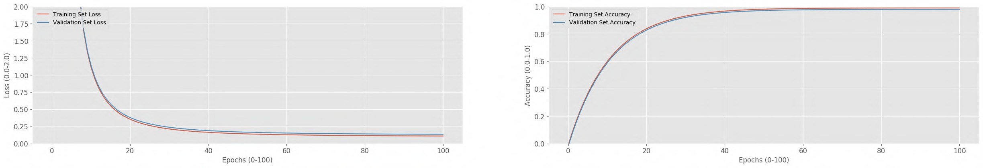
Evaluation Metrics
Cross-Entropy Loss:
Measures how good a prediction from the CNN does in terms of being able to predict the expected outcome.
Aids the CNN in adjusting the weights and bias of a model
Equation:
_{𝑒}*[,]
ℒ 𝑥, 𝑐 = −ln _{∑2}
/01
where…
N = Number of classes
c = Index of the correct class
𝑥 = Vector of predicted probability of classes
Accuracy:
Measures the correctness of the CNN’s prediction with the ground truth (provided annotation)
Equation:
2𝑋*
∑₂ + ∑_{K}
𝐴 =
_{𝑒}*[/]
where…
Ideal Loss Graph
Ideal Accuracy Graph
Figure 3.7: Ideal graph for loss as a model trains

Slide 13
Loss and Accuracy
Table 4.1: Raw data table of the CNN metrics without data augmentation
Table 1 shows both the training and validation set accuracy and loss of the trained Convolution Neural Network without data augmentation.
Epochs Training Set Accuracy (%) ^{Validation Set} Training Set Loss Validation Set Loss Accuracy (%)
1 | 0.25 |  | 0.23 | 1.3876 |  | 1.3773
5 | 0.5 |  | 0.44 | 1.1488 |  | 1.1835
10 | 0.54 |  | 0.51 | 1.0705 |  | 1.086
15 | 0.58 |  | 0.57 | 1.0162 |  | 1.0405
20 | 0.6 |  | 0.57 | 0.9802 |  | 1.0227
25 | 0.61 |  | 0.54 | 0.9513 |  | 1.0055
30 | 0.62 |  | 0.53 | 0.9309 |  | 1.0013
35 | 0.63 |  | 0.5 | 0.9047 |  | 1.0159
40 | 0.63 |  | 0.49 | 0.8849 |  | 1.0114
45 | 0.65 |  | 0.5 | 0.8546 |  | 1.0546
50 | 0.67 |  | 0.52 | 0.8288 |  | 1.0533
55 | 0.67 |  | 0.52 | 0.8121 |  | 1.0662
60 | 0.66 |  | 0.53 | 0.8307 |  | 1.0484
65 | 0.69 |  | 0.5 | 0.7906 |  | 1.0668
70 | 0.68 |  | 0.49 | 0.784 |  | 1.0693
75 | 0.69 |  | 0.5 | 0.778 |  | 1.0442
80 | 0.7 |  | 0.52 | 0.7595 |  | 1.0377
85 | 0.7 |  | 0.52 | 0.752 |  | 1.0387
90 | 0.7 |  | 0.56 | 0.7471 |  | 1.0332
95 | 0.69 |  | 0.52 | 0.7615 |  | 1.0433
100 | 0.71 |  | 0.46 | 0.7288 |  | 1.0854
ΔTraining & Validation Set |  | 0.13099 |  |  | 0.19536
Standard Deviation | 0.07001 |  | 0.03646 | 0.13428 |  | 0.0498
Max Value | 0.8 |  | 0.59 | 0.7138 |  | 1.0414
Layer |  | Hyperparameter
 | Layer 1 | 45
 | Layer 2 | 90
 | Layer 3 | 180
 | Layer 4 | 4
Hype | Total rparameters | 319
Table 4.2: Data table conveying the amount of layers and hyperparameters in the CNN

Slide 14
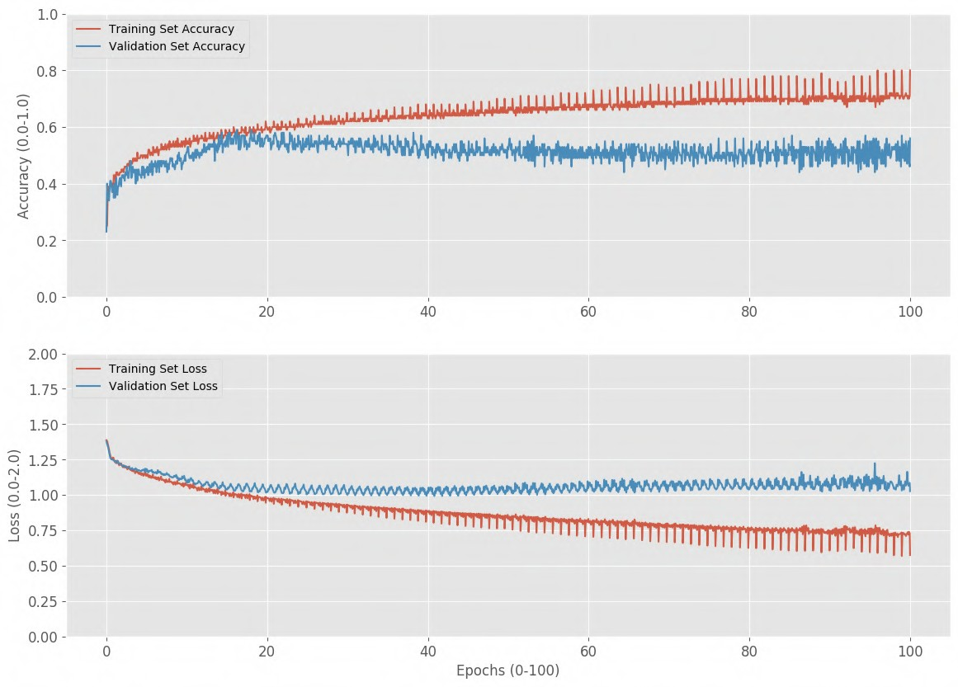
Loss and Accuracy
Figure 4.3: Graph of the CNN metrics without data augmentation
Figure 3.1 shows that the CNN’s accuracy resembles a logarithmic curve. As the validation set’s accuracy approaches a horizontal asymptote at 60% and a point of inflection, the accuracy decreases.
Likewise, the loss curve mimics an exponential curve, approaching a minimum loss of 1.0.

Slide 15
Loss and Accuracy
Table 4.4: Raw data table of the CNN metrics with data augmentation
Table 3 shows both the training and validation set accuracy and loss of the trained Convolution Neural Network with data augmentation.
Epochs Training Set Accuracy (%) ^{Validation Set} Training Set Loss Validation Set Loss Accuracy (%)
1 | 0.26 |  | 0.35 | 1.3898 |  | 1.3703
5 | 0.72 |  | 0.75 | 0.7206 |  | 0.709
10 | 0.78 |  | 0.83 | 0.5783 |  | 0.5382
15 | 0.83 |  | 0.85 | 0.4604 |  | 0.4303
20 | 0.89 |  | 0.88 | 0.3313 |  | 0.3619
25 | 0.88 |  | 0.9 | 0.3084 |  | 0.2827
30 | 0.89 |  | 0.9 | 0.2741 |  | 0.2673
35 | 0.89 |  | 0.87 | 0.2632 |  | 0.3667
40 | 0.93 |  | 0.9 | 0.1946 |  | 0.2877
45 | 0.94 |  | 0.91 | 0.1614 |  | 0.2158
50 | 0.95 |  | 0.93 | 0.1202 |  | 0.2112
55 | 0.96 |  | 0.93 | 0.0966 |  | 0.2344
60 | 0.97 |  | 0.91 | 0.0877 |  | 0.312
65 | 0.95 |  | 0.85 | 0.1289 |  | 0.4028
70 | 0.97 |  | 0.96 | 0.0781 |  | 0.2223
75 | 0.97 |  | 0.91 | 0.0879 |  | 0.2079
80 | 0.97 |  | 0.95 | 0.0788 |  | 0.1301
85 | 0.97 |  | 0.91 | 0.0793 |  | 0.2103
90 | 0.97 |  | 0.89 | 0.0895 |  | 0.2366
95 | 0.98 |  | 0.97 | 0.0554 |  | 0.0833
100 | 0.97 |  | 0.94 | 0.085 |  | 0.1738
ΔTraining & Validation Set |  | 0.03051 |  |  | 0.08152
Standard Deviation | 0.09851 |  | 0.08767 | 0.22844 |  | 0.2023
Best Value | 1 |  | 0.99 | 0.0554 |  | 0.0833
Layer |  | Hyperparameter
 | Layer 1 | 180
 | Layer 2 | 150
 | Layer 3 | 120
 | Layer 4 | 90
 | Layer 5 | 45
 | Layer 6 | 64
 | Layer 7 | 4
Hype | Total rparameters | 653
Table 4.5: Data table conveying the amount of layers and hyperparameters in the CNN

Slide 16
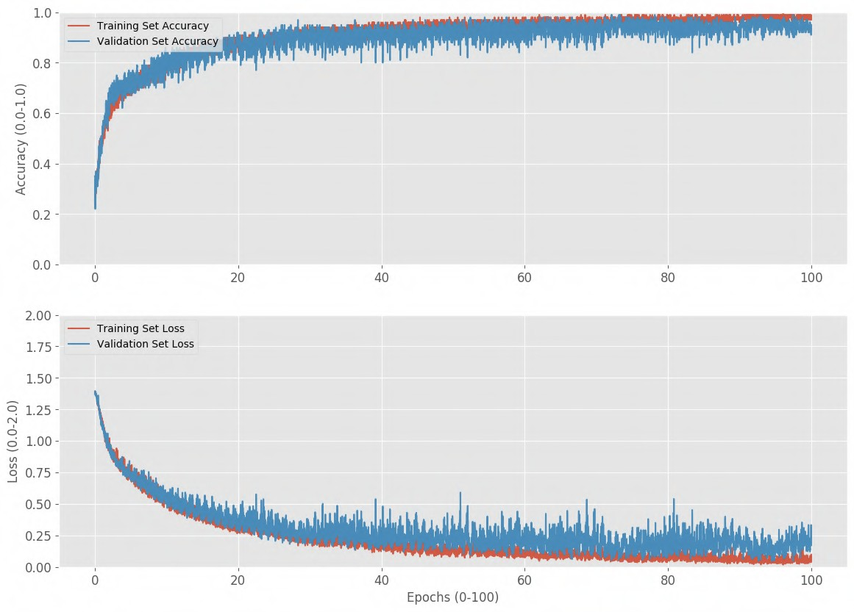
Loss and Accuracy
Figure 4.6: Graph of the CNN metrics with data augmentation
Figure 3.2 illustrates that the CNN’s training and validation set accuracies correlation to each other, implying the CNN is learning, rather than memorizing the training data.
Furthermore, both curves converge
at 100%. Although, the validation loss curve is more sporadic, both loss curves tread similarly, and approach a loss of 0.1.

Slide 17
Discussion
Heart arrhythmias are irregular rhythms in heartbeats that affect 3 million people worldwide every year. Due to the increasing rate of ECGs recording for diagnosis, it is now possible to devolve a Convolutional Neural Network to identify arrhythmias in ECGs. A CNN was developed and trained, to achieve high accuracy in identifying arrhythmias in ECGs. The 1D Convolution Neural Network not only surpassed the accuracy of cardiologists in identifying Atrial Fibrillation, but also achieved an overall top accuracy of 99%, and a constant accuracy of 96%. Furthermore, the CNN was cross- validated against a new dataset that the model had never seen before to ensure no overfitting occurred during the training process. On this test, the CNN model achieved an accuracy of 96%. The key to achieving such success is due to the large annotated dataset (PhysioNet), and data augmentation techniques. Originally, training a shallow CNN with few parameters were thought to create less complexly in learning, and make the CNN faster in training. Doing that merely did the opposite, the model did not learn fast, as the CNN started to overfit to the training data. Adding data augmentation not only fixed the issue of overfitting, but also increased the dataset size; conversely, this increased the time the CNN took to train.

Slide 18
Further Exploration and Application
Implementing larger datasets with multiple nodes that record the heart’s electrical activity simultaneous
Apnea-ECG Database
CTU-UHB Intrapartum Cardiotocography Database
Fantasia Database
MIT-BIH Polysomnographic Database
OB-1 Database
Optimizing the time taken to identify an arrhythmia ECG
Allows for faster training and response times
Apply the CNN to an Electroencephalogram (EEG), which measures neural electrical activity to predict body movement, and thought.
Creating a portable handheld device that can read and identify if arrhythmias are present in an ECG
Aid experts in diagnosing cardiovascular diseases which can be seen from ECG signals.
Discovering new methods in identifying arrhythmias in ECGs
Implement model in ECG reader to autonomously identify arrhythmias in emergency situations
Decrease the number of misdiagnosis in
arrhythmias

Slide 19
Figures
Figure 1.1
Figure 1.2
Figure 2.1
Figure 3.1
Figure 3.2
Figure 3.3
Figure 3.4
Figure 3.5
Figure 3.6
Figure 3.7
Table 4.1
Figure 4.2
Figure 4.3
Table 4.4
Table 4.5
Figure 4.6
Diagram of classes in Artificial Intelligence Example Neural Network
Flowchart of methods
Histogram graph of frequency and sequence length of the PhysioNet dataset
Example data from dataset for each class Graph of ECG sequence with length of 600 Pie chart illustrating the dataset distribution Example of augmented ECG for each class
Flowchart mapping out the Convolutional Neural Network Ideal graph for loss as a model trains
Raw data table of the CNN metrics without data augmentation
Data table conveying the amount of layers and hyperparameters in the CNN
Graph of the CNN metrics without data augmentation Raw data table of the CNN metrics with data augmentation
Data table conveying the amount of layers and hyperparameters in the CNN
Graph of the CNN metrics with data augmentation

Slide 20
References
Awerdich. (2020, January 5). awerdich/physionet. Retrieved from https://github.com/awerdich/physionet
Awni. (2019, January 15). awni/ecg. Retrieved from https://github.com/awni/ecg
Brownlee, J. (2019, December 19). What is Deep Learning? Retrieved from https://machinelearningmastery.com/what-is-deep-learning/
Brownlee, J. (2019, August 6). A Gentle Introduction to the Rectified Linear Unit (ReLU). Retrieved from https://machinelearningmastery.com/rectified-linear-activation- function-for-deep-learning-neural-networks/
Bushaev, V. (2018, October 24). Adam - latest trends in deep learning optimization. Retrieved from https://towardsdatascience.com/adam-latest-trends-in-deep-learning- optimization-6be9a291375c
C-Labpl. (2018, April 30). c-labpl/qrs_detector. Retrieved from https://github.com/c-labpl/qrs_detector
Cao, P., Li, X., Mao, K., Lu, F., Ning, G., Fang, L., & Pan, Q. (2020). A novel data augmentation method to enhance deep neural networks for detection of atrial fibrillation. Biomedical Signal Processing and Control, 56, 101675. doi: 10.1016/j.bspc.2019.101675
Convolutional Neural Networks (LeNet). (n.d.). Retrieved from http://deeplearning.net/tutorial/lenet.html
CVxTz. (2019, May 17). CVxTz/ECG_Heartbeat_Classification. Retrieved from https://github.com/CVxTz/ECG_Heartbeat_Classification
Gao, X. (2019, April 3). Diagnosing Abnormal Electrocardiogram (ECG) via Deep Learning. Retrieved from https://www.intechopen.com/online-first/diagnosing- abnormal-electrocardiogram-ecg-via-deep-learning

Slide 21
References
Gao, X. (2019). Diagnosing Abnormal Electrocardiogram (ECG) via Deep Learning. Electrocardiography [Working Title]. doi: 10.5772/intechopen.85509
Huang, L., Pan, W., Zhang, Y., Qian, L., Gao, N., & Wu, Y. (2020). Data Augmentation for Deep Learning-Based Radio Modulation Classification. IEEE Access, 8, 1498– 1506. doi: 1912.03026
Krylatov-Pavel. (2019, August 19). krylatov-pavel/aibolit-ECG. Retrieved from https://github.com/krylatov-pavel/aibolit-ECG
Pyakillya, B., Kazachenko, N., & Mikhailovsky, N. (2017). Deep Learning for ECG Classification. Journal of Physics: Conference Series, 913, 012004. doi: 10.1088/1742-6596/913/1/012004
Sakai, A., Minoda, Y., & Morikawa, K. (2017). Data augmentation methods for machine-learning-based classification of bio-signals. 2017 10th Biomedical Engineering International Conference (BMEiCON). doi: 10.1109/bmeicon.2017.8229109
Skalski, P. (2019, January 4). Preventing Deep Neural Network from Overfitting. Retrieved from https://towardsdatascience.com/preventing-deep-neural-network-from- overfitting-953458db800a
Wathen, J. E., Rewers, A. B., Yetman, A. T., & Schaffer, M. S. (2005). Accuracy of ECG Interpretation in the Pediatric Emergency Department. Annals of Emergency Medicine, 46(6), 507–511. doi: 10.1016/j.annemergmed.2005.03.013

Slide 22
References
Zhang, X.-R., Lei, M.-Y., & Li, Y. (2018). An Amplitudes-Perturbation Data Augmentation Method in Convolutional Neural Networks for EEG Decoding. 2018 5th
International Conference on Information, Cybernetics, and Computational Social Systems (ICCSS). doi: 10.1109/iccss.2018.8572304
Zhang, Z., Duan, F., Sole-Casals, J., Dinares-Ferran, J., Cichocki, A., Yang, Z., & Sun, Z. (2019). A Novel Deep Learning Approach With Data Augmentation to Classify Motor Imagery Signals. IEEE Access, 7, 15945–15954. doi: 10.1109/access.2019.2895133
Zihlmann, M., Perekrestenko, D., & Tschannen, M. (2017). Convolutional Recurrent Neural Networks for Electrocardiogram Classification. 2017 Computing in Cardiology Conference (CinC). doi: 10.22489/cinc.2017.070-060
Alfaras, Miquel, Soriano, & Silvia. (2019, July 3). A Fast Machine Learning Model for ECG-Based Heartbeat Classification and Arrhythmia Detection., from https://www.frontiersin.org/articles/10.3389/fphy.2019.00103/full.
Mayo Clinic. (2019, April 2). Heart arrhythmia. Retrieved October 30, 2019, from https://www.mayoclinic.org/diseases-conditions/heart-arrhythmia/symptoms-causes/syc- 20350668?utm_source=Google&utm_medium=abstract&utm_content=Cardiac- arrhythmia&utm_campaign=Knowledge-panel.
Srinivasan, N. T., & Schilling, R. J. (2018, June). Sudden Cardiac Death and Arrhythmias. Retrieved October 30, 2019, from
https://www.ncbi.nlm.nih.gov/pmc/articles/PMC6020177/.

Slide 23
Thank You!
Any Questions?

