Slide 1
Epigenetic Age in Macular Degeneration Cohort
16 September 2020

Slide 2
Mike’s AMD Project
GSE102952
44 RPE samples.
27 Males; 17 Females.
25 AMD; 19 Controls.
Age range: 50 – 89 years old.
idats available.
Noob-normalised.
18 retina samples.
6 Males; 12 Females.
9 AMD; 9 Controls.
Age range: 75 – 95 years old.
idats not available.
Not normalised (except for Horvath’s normalisation).

Slide 3
Age-Related Macular Degeneration

Slide 4
Heterogenous group of eye diseases with progressive neurodegeneration of photoreceptors and underlying RPE* .
Leading cause of irreversible blindness in people 50 years or older in developed countries*.
Multifactorial disease with age, environment and genetic susceptibility being the major risk factors* **.
A GWAS study of 17,100 patients with advanced AMD and 60,000 control reveal 19 genes/loci that are associated with AMD, but only accounted for approximately 40 – 70% of total genetic contribution (leading to an interest in non-genetic factors such as epigenetics in late-onset disease)* ** .
Oliver et al. observed decreased methylation at the ARMS2/HTRA1 locus and increased methylation at the PRSS50 locus in AMD patients compared to control – the former which is established previously as the top loci associated with AMD**.
*Chen (2013) Age-Related Macular Degeneration: From Genetics to Epigenetics; **Oliver et al. (2015) Differential DNA methylation identified in the blood and retina of AMD patients;

Slide 5
Retinal Pigment Epithelium (RPE)

Slide 6
The retina is the upper cellular layer, with the retinal pigment epithelium (RPE) and choroid below (posterior to) the retina***.
The choroid comprises blood vessels that support the retina, with the RPE serving as the inner blood–retinal barrier through which nutrients and waste must pass to transfer between the retina and the choroidal blood supply***.
The RPE is a pigmented epithelial monolayer that is derived from optic neuroepithelium**** *****.
Functionally, the RPE serves as a transepithelial transporter, light absorber and protector against photooxidation, and a photo-cycle regulator*****
Integrated ChIP-seq and chromHMM analysis of 11-month-old C57BL/6 mouse retina shows that the retinal epigenome is stable******.
***Pennington & DeAngelis (2015) Epigenetic Mechanisms of Aging Human Retina; ****Bharti et al. (2006) The other pigmented cell: specification and development of pigmented epithelium of the vertebrate eye; *****Simo et al. (2010) The Retinal Pigment Epithelium: Something More than a Constituent of the Blood-Retinal Barrier – Implications for the Pathogenesis of Diabetic Retinopathy; ******Bhutto & Lutty (2013) Understanding age-related macular degeneration (AMD): Relationships between the photoreceptor/retinal pigment epithelium/Bruch’s membrane/choriocapillaris complex
Notes:
Epigenomic Changes Are Conserved across Species
Epigenetic changes were strongly conserved across mouse and human retinal development, with DNA-methylation changes being the least conserved (7%–8%), chromHMM more highly conserved (45%–56%), and the developmental-stage-specific super-enhancers the most highly conserved (62%). This may be an underrepresentation because we had access to fewer developmental stages for human retinal development. There- fore, some genes may have changes in DNA methylation that accompany their dynamic changes in gene expression but were missed because the changes occurred later in development than we analyzed in our study. Also, species-specific difference may occur in the epigenomic regulation of retinogenesis based on the organization of the genome. Changes in histone modifications were more predictive of changes in gene expression across species. For example, nearly 90% of the genes with changes in H3K27me3 during development also had corresponding changes in their expression.

Slide 7
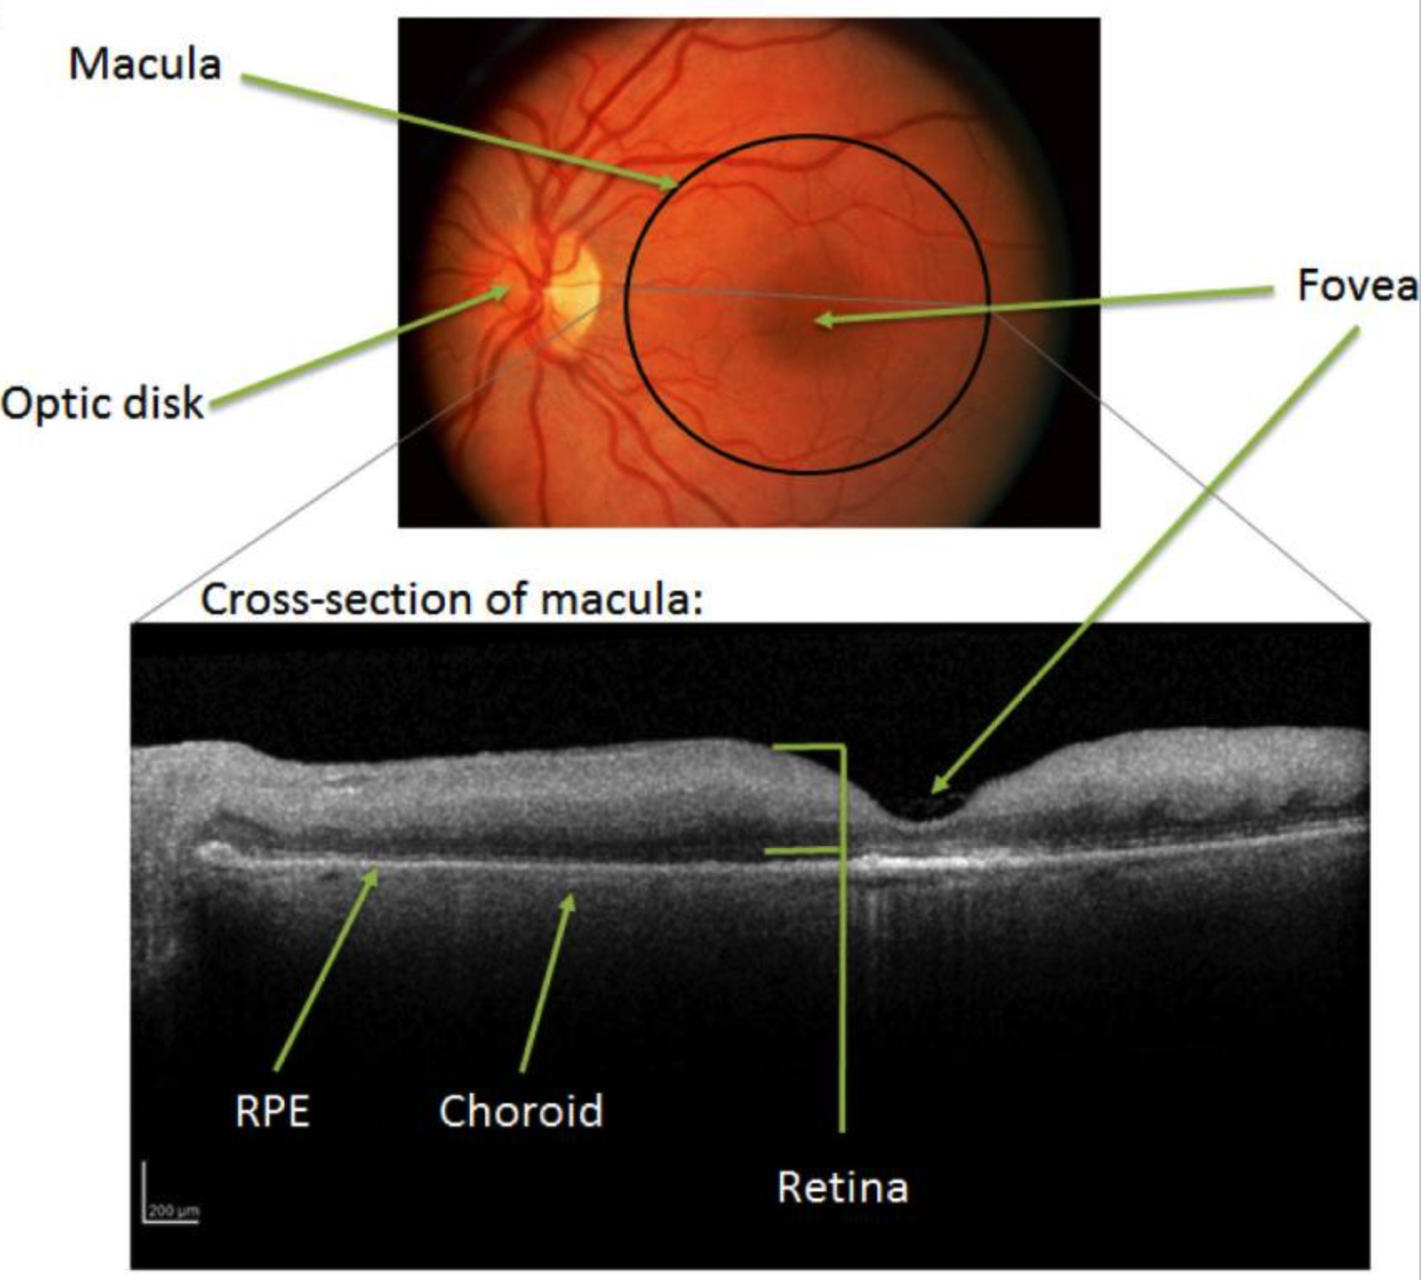
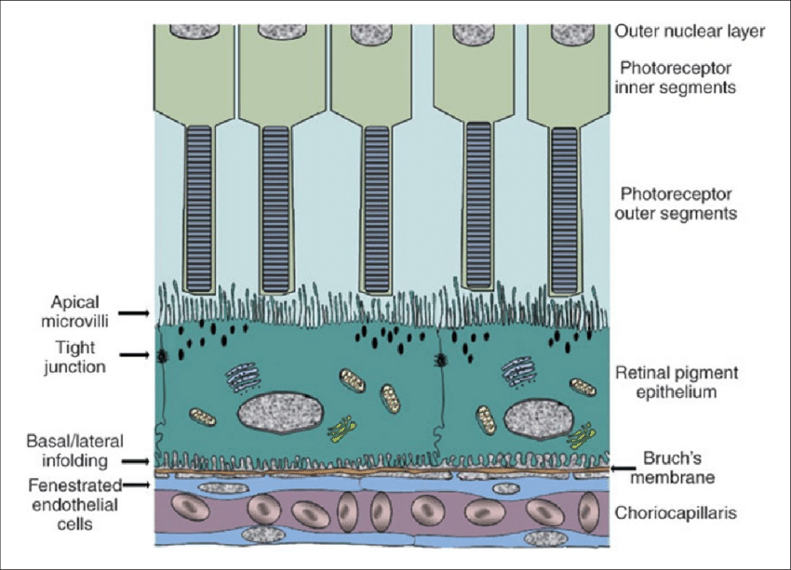
***Pennington & DeAngelis (2015) Epigenetic Mechanisms of Aging Human Retina
***Fronk & Vargis (2016) Methods for culturing retinal pigment epithelial cells: a review of current protocols and future recommendations

Slide 8
Sanity checks

Slide 9
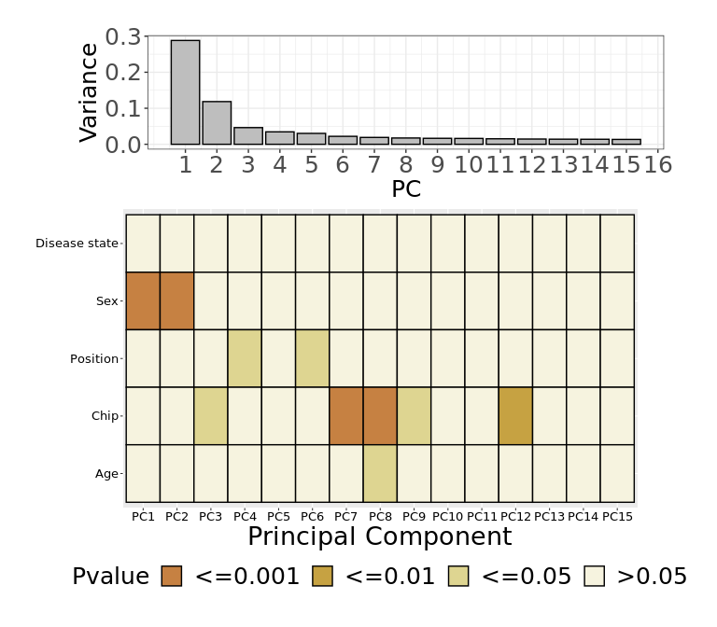
Raw data PCA
44 samples
485512 probes

Slide 10
Post-Sample QC PCA
44 samples
485512 probes

Slide 11
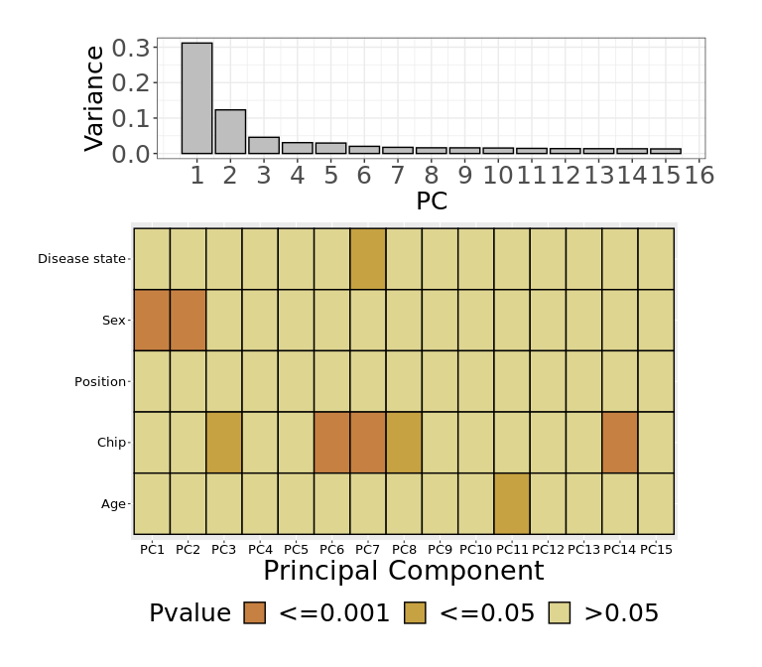
Swan NormalisationPCA
44 samples
485512 probes

Slide 12
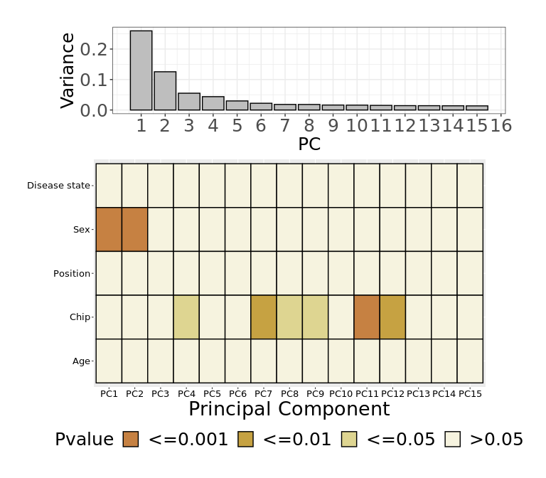
BMIQ NormalisationPCA
44 samples
485512 probes

Slide 13
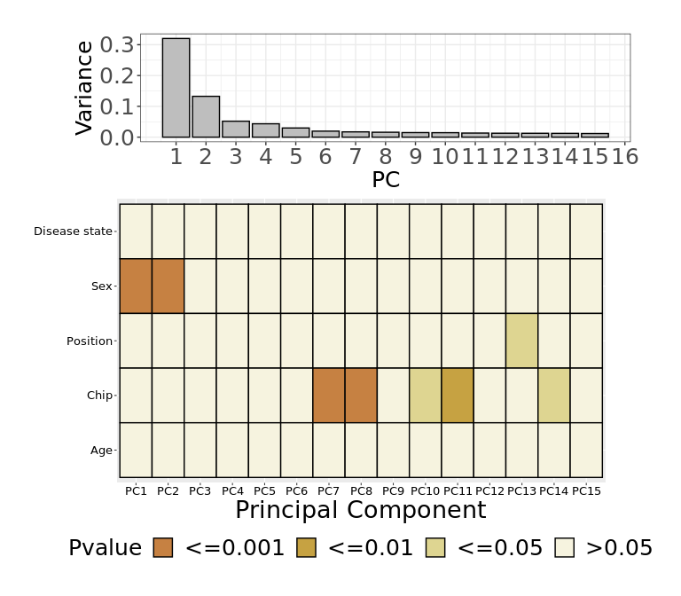
Funnorm NormalisationPCA
44 samples
485512 probes

Slide 14
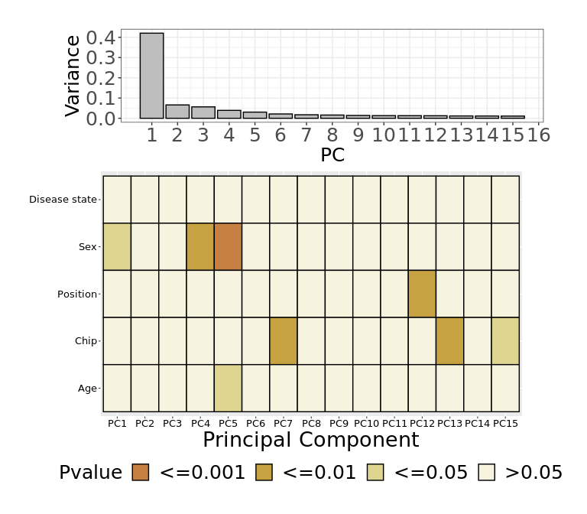
Post-Probe Filtering PCA
44 samples
425456 probes

Slide 15
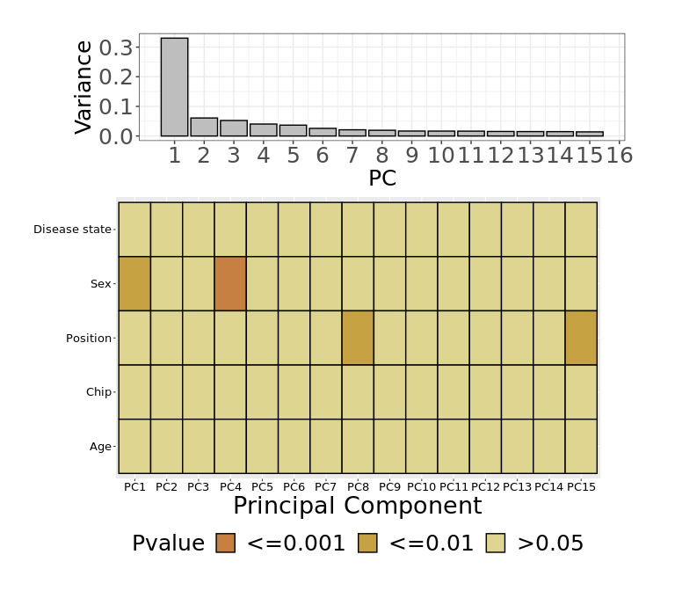
ComBat – Chip PCA
44 samples
425456 probes

Slide 16
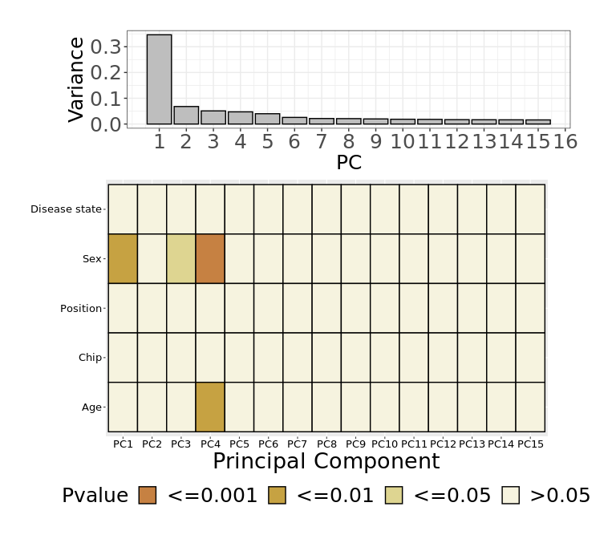
ComBat – Position PCA
44 samples
425456 probes

Slide 17
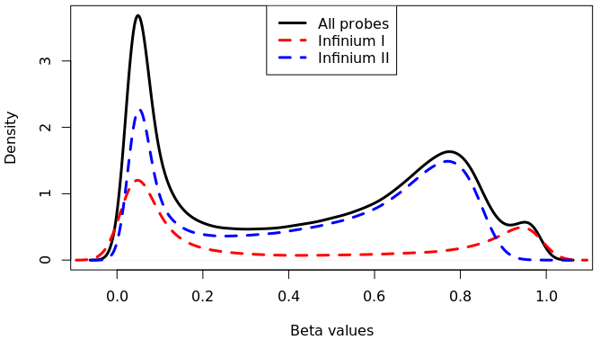
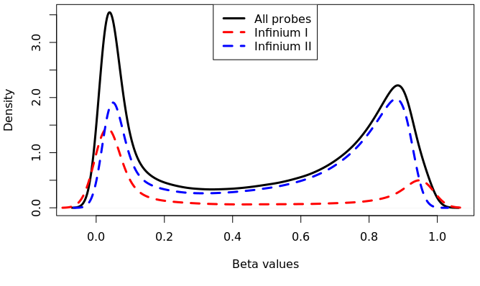
After normalisation
Raw distribution
Funnorm-normalised distribution

Slide 18
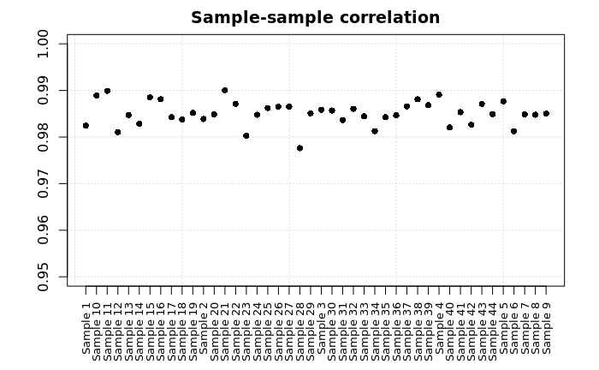
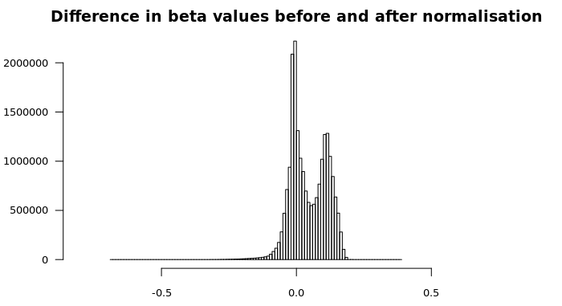
After normalisation

Slide 19
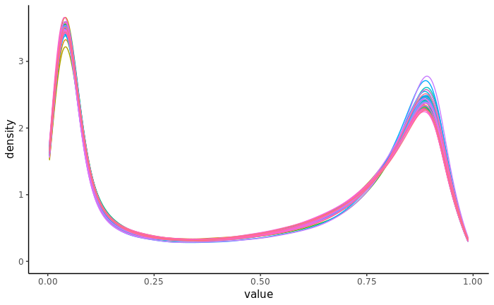
After ComBat correction
Funnorm-normalised distribution
ComBat corrected distribution

Slide 20
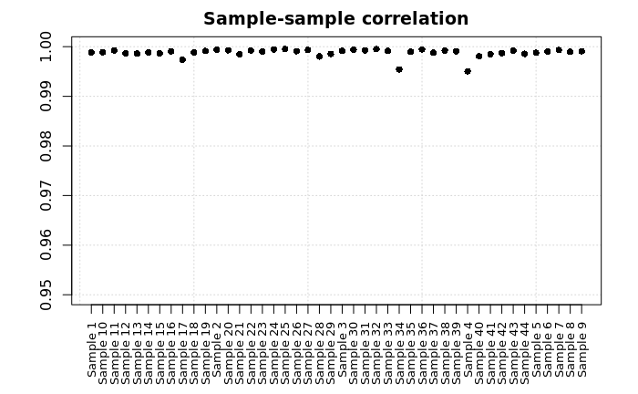
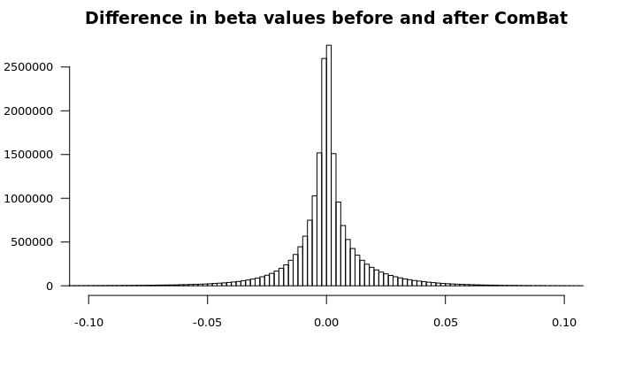
After ComBat correction

Slide 21
Horvath’s clock

Slide 22
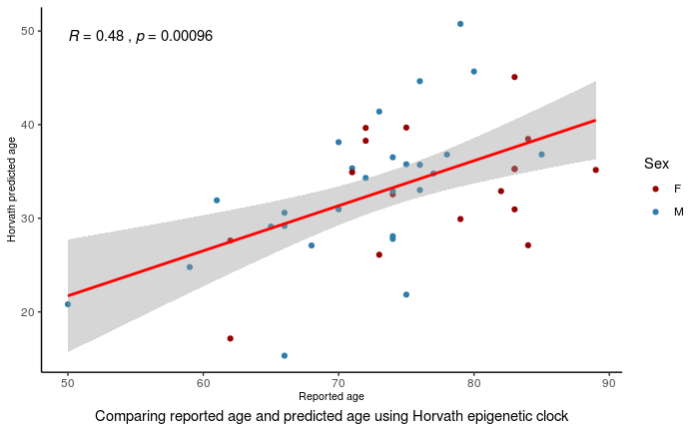
Horvath’s clock – 353 CpG sites
Samples below 70 years old:
R = 0.44, p = 0.1542
Samples above 70 years old:
R = 0.088, p = 0.6292
Method: Spearman Correlation test

Slide 23
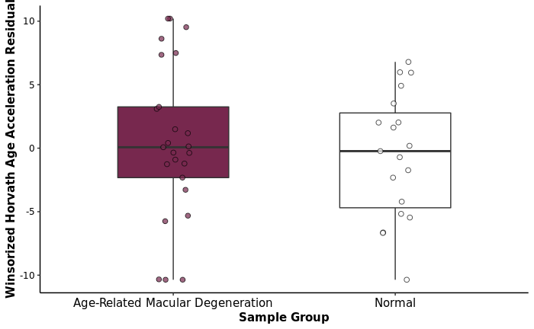
Horvath’s clock
AMD Project (Winsorised)

Slide 24
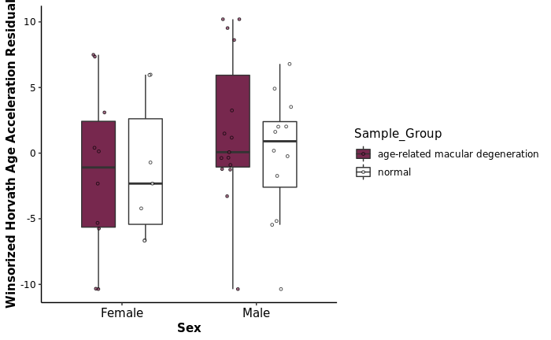
Horvath’s clock
AMD Project (Winsorised)

Slide 25
Hannum’s clock

Slide 26
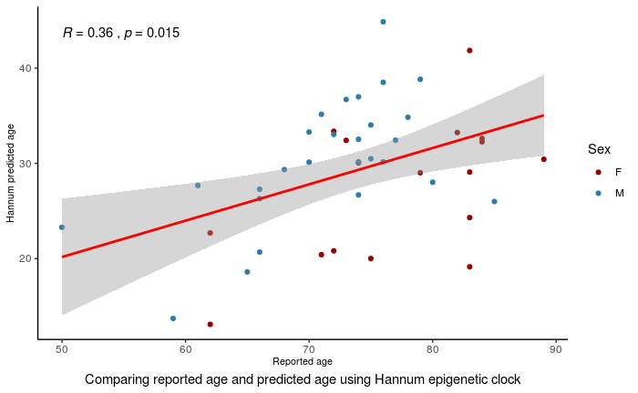
Hannum’s clock – 71 CpG sites

Slide 27

Hannum’s clock
AMD Project (Winsorised)

Slide 28
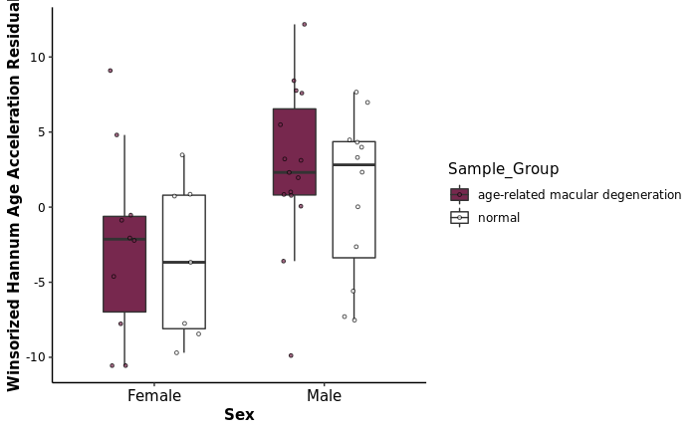
Hannum’s clock
AMD Project (Winsorised)

Slide 29
PhenoAge clock

Slide 30
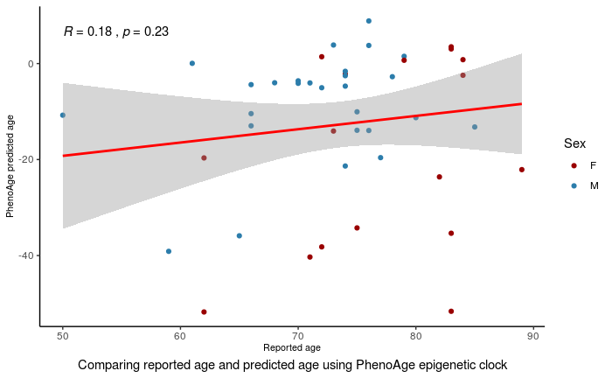
PhenoAge clock – 513 CpG sites

Slide 31
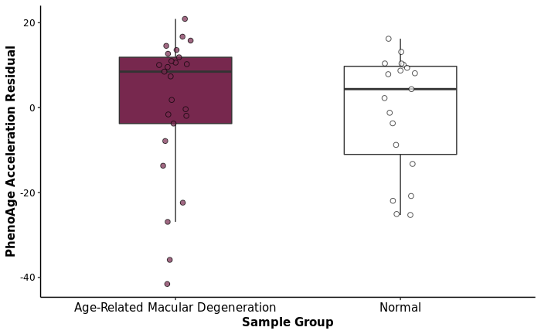
PhenoAge clock

Slide 32
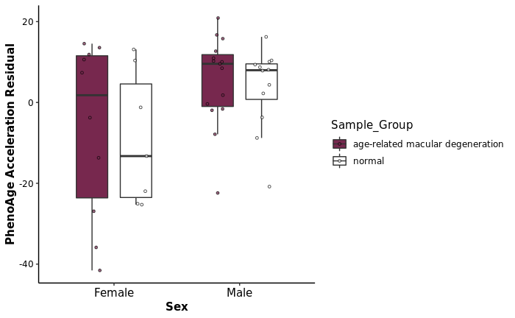
PhenoAge clock

Slide 33
DNAmSkin&Blood clock

Slide 34
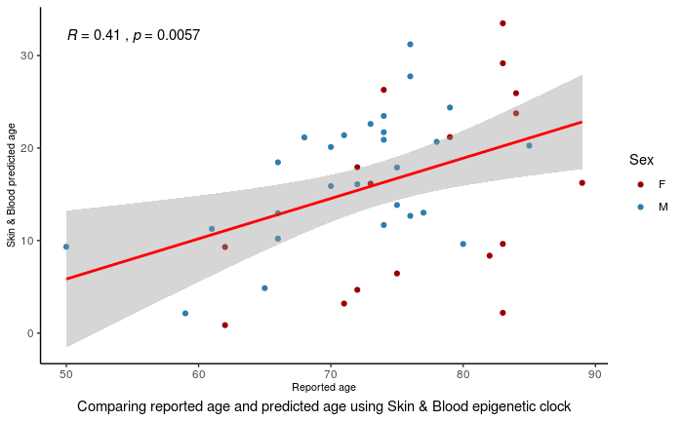
DNAmSkin&Blood clock – 391 CpG sites

Slide 35
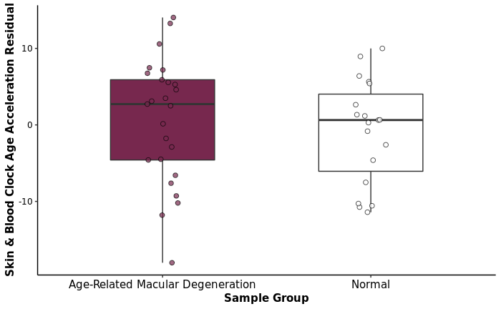
DNAmSkin&Blood clock

Slide 36
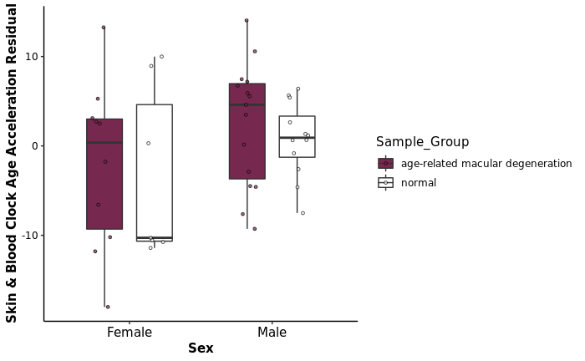
DNAmSkin&Blood clock

Slide 37
Zhang clock

Slide 38
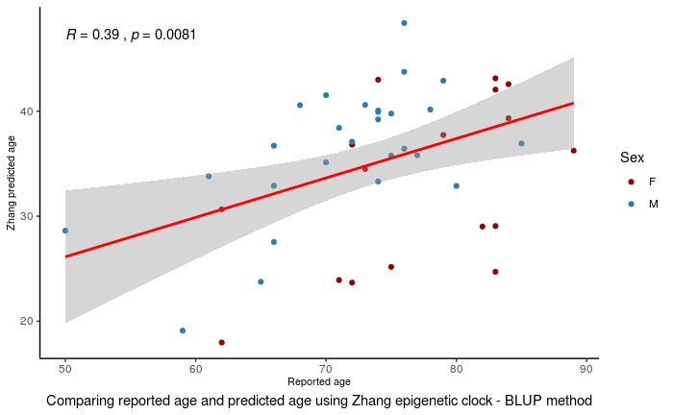
Zhang clock – 514 CpG sites

Slide 39
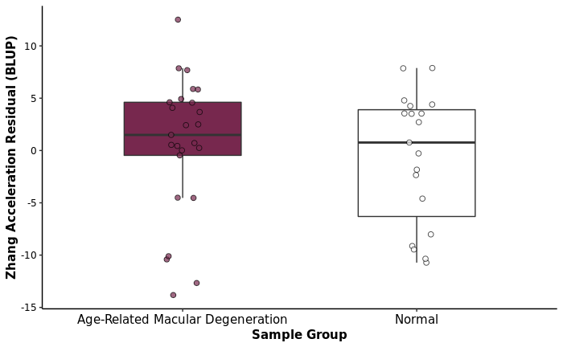
Zhang clock

Slide 40
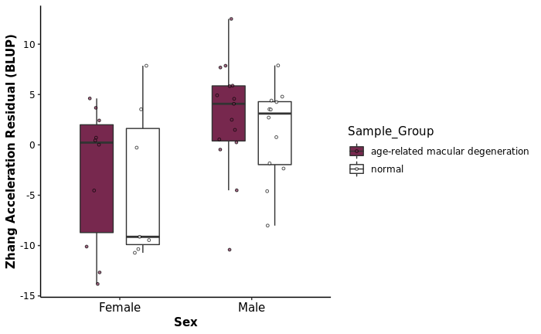
Zhang clock

Slide 41
DNAmCortical clock

Slide 42
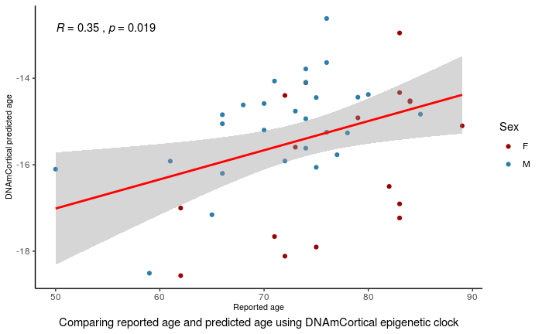
DNAmCortical clock

Slide 43
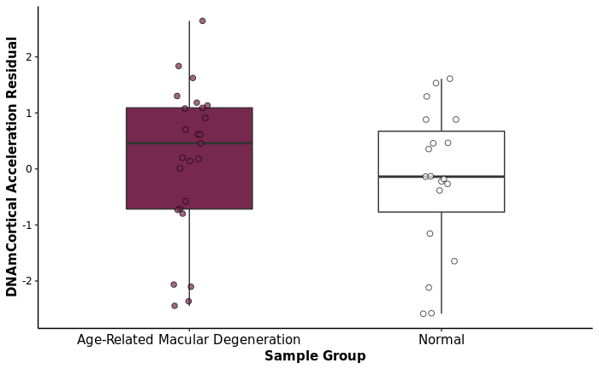
DNAmCortical clock

Slide 44
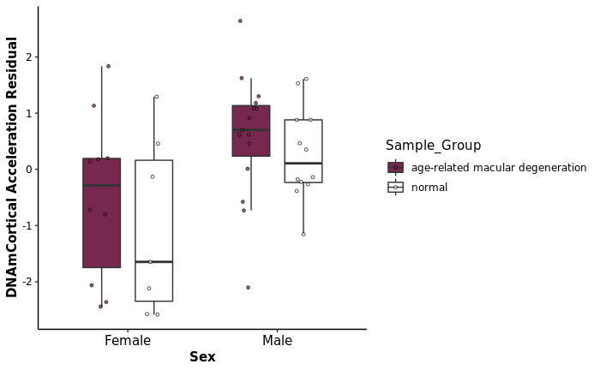
DNAmCortical clock

Slide 45
PedBE clock

Slide 46
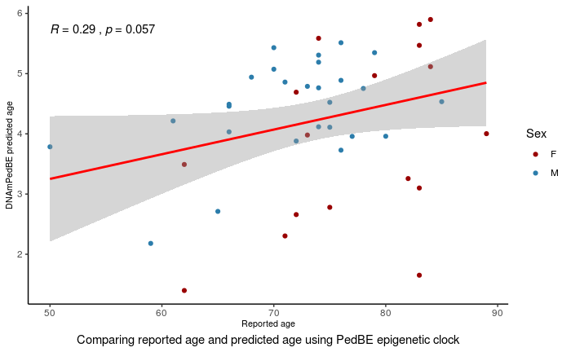
PedBE Clock – 94 CpG sites

Slide 47
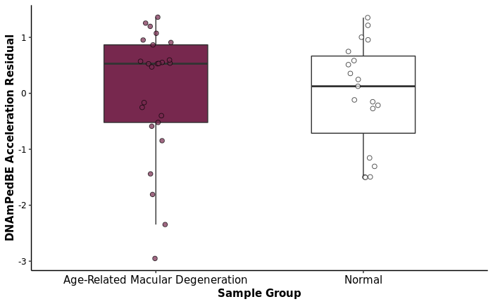
PedBE Clock

Slide 48
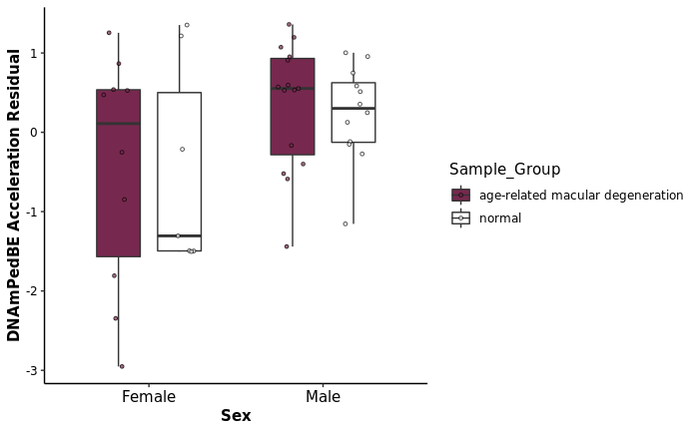
PedBE Clock

Slide 49
Similar underestimation of epigenetic age in other cohort/tissues

Slide 50
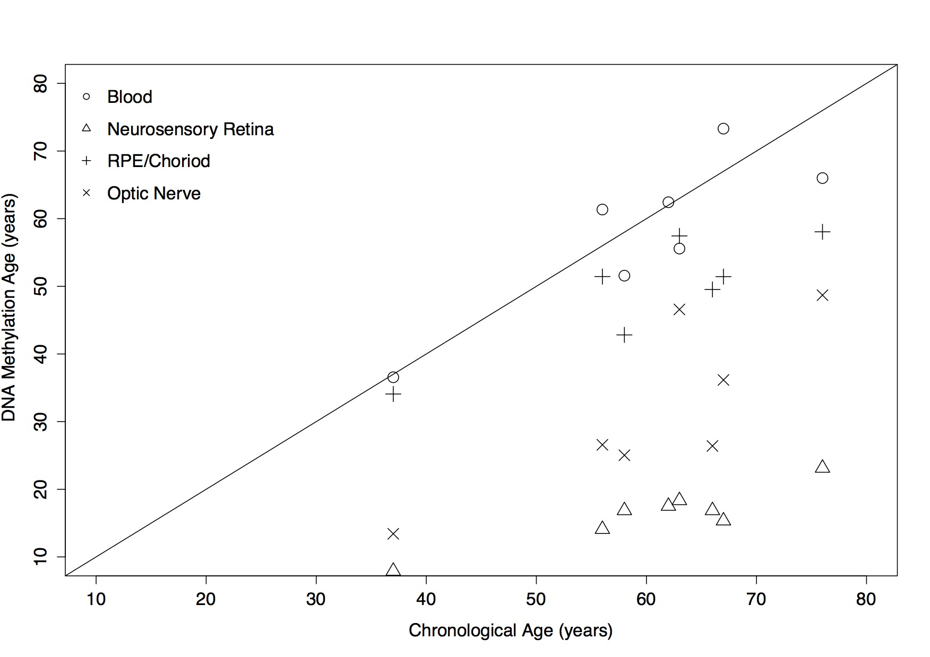
1. Differences in epigenetic age of ocular tissues and the implications for eye disease – Hewitt et al. (2017)
8 male samples with no known ophthalmic disease
r² = 0.37, p = 0.048

Slide 51
2. Systematic underestimation of the epigenetic clock and age acceleration in older subjects – El Khoury et al. (2019)
Horvath’s testing data did not have a large representation of tissues from elderly individuals (or those with age-related diseases).
Suggests that reduction in clock rate in later life is due to saturation, i.e. CpG sites used by the clock reach either full methylation or complete demethylation.
Elevated levels of 5-hmC in the brain could be offsetting age predictions since 5hmC is not distinguished from 5mC following bisulfite conversion.
31/353 Horvath clock sites – amongst the 65,663 elevated 5hmC probes found in the cerebellum by Lunnon et al.
Epigenetic age does not move at a steady pace throughout life – slows as we age (> 60 years old).
Example: Apparent age acceleration in Alzheimer’s disease, but this proves to be a statistical illusion produced by the slowing clock and the fact that Alzheimer’s disease is progressive.

Slide 52
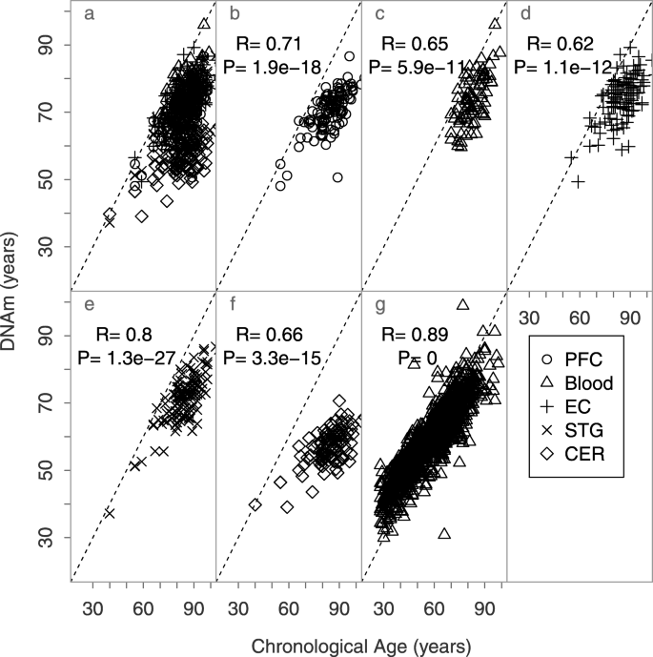
Figure 1: Scatterplots of chronological vs DNAm ages of brain and blood samples using Horvath’s clock
PFC: Prefrontal cortex
EC: Entorhinal cortex
STG: Superior temporal gyrus
CER: Cerebellum

Slide 53
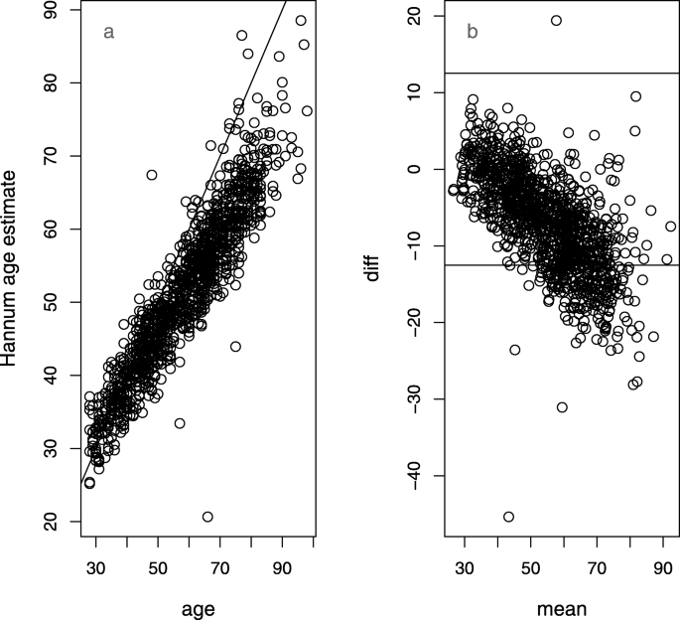
Figure 2: Scatterplots of chronological vs DNAm ages of brain and blood samples using Hannum’s clock

Slide 54
3. DNA methylation-based age prediction and telomere length in white blood cells and cumulus cells of infertile women with normal or poor response to ovarian stimulation – Morin et al. (2018)
Attributes the consistent underestimation of epigenetic age in cumulus cells – regardless of the reported age of the subject – to telomere length measurements, where the cumulus cells have notably longer average telomere lengths than WBCs.
Notes that attrition (shortening) of telomeres has been extensively established to be correlated with cell aging.
Cites breast and endometrial cells which both exhibit older than expected predicted age predictions according to the epigenetic clock. Since these are all cells that respond to the cyclic hormonal changes of menstrual cycle, they speculate that there may be sites that are altered in predictable manner in these hormone responsive tissues.

Slide 55
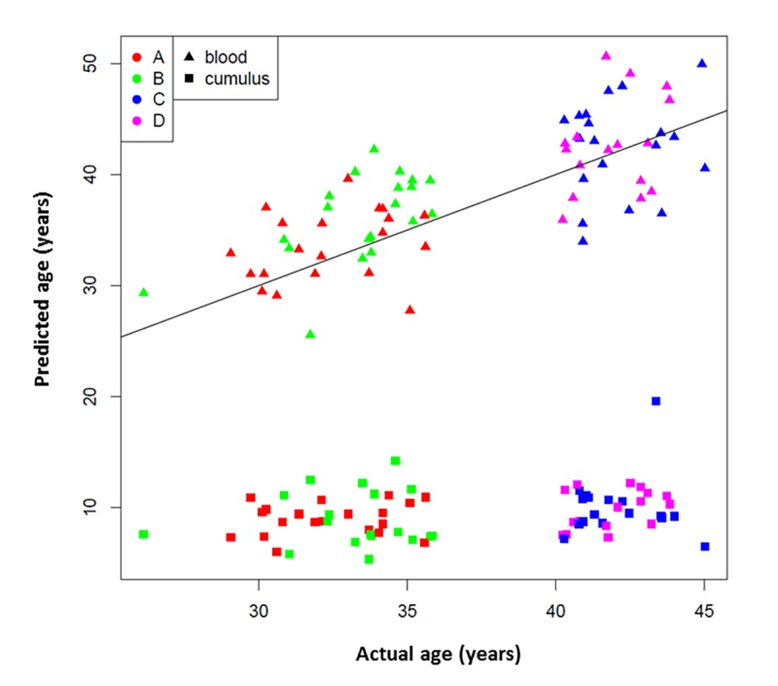
Figure 1: 53 CpG epigenetic age prediction in white blood cells and cumulus cells, which shows consistent underestimation of epigenetic age in cumulus cells across study groups.
Study groups are indicated with colors:
Red A= <35 years old and good responder (≥15 mature follicles).
Green B= <35 years old and poor responder (≤5 mature follicles).
Blue C= >40 years old and poor responder (≤4 mature follicles).
Magenta D= >40 years old and good responder (≥12 mature follicles).
Tissue types are indicated by symbols.

Slide 56
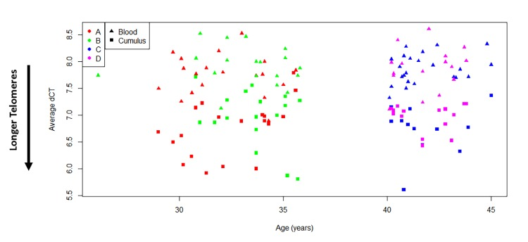
Figure 2: Comparison of average relative telomere length of all study subjects indicates that ovarian cells present longer telomeres than white blood cells (t(138) = -14.46, p<0.0001).
Average relative TL is reported as Average dCT values, which are inversely proportional to actual TL. Therefore, higher average dCTs indicate shorter telomeres.

Slide 57
4. Recalibrating the Epigenetic Clock: Implications for Assessing Biological Age in the Human Cortex – Shireby et al. (Preprint, 2020)
Systematic underestimation may be a consequence of the distribution of ages in the training data used to build existing clocks (these clocks were derived using a relatively small proportion of samples from older people and/or the tissue type of interest is not represented in the dataset).
As there is evidence for cell-type and tissue specific patterns of DNAm age, the observed imprecision may reflect a consequence of underfitting the model across tissues.
The relationship between DNA methylation and age may not be linear across the lifespan, and a non-linear model is needed to capture attenuated effects in older samples (analogous to the transformation required to accurately predict DNAm age for younger samples (0 – 20 years) where association between age and DNA methylation is of larger magnitude).

Slide 58
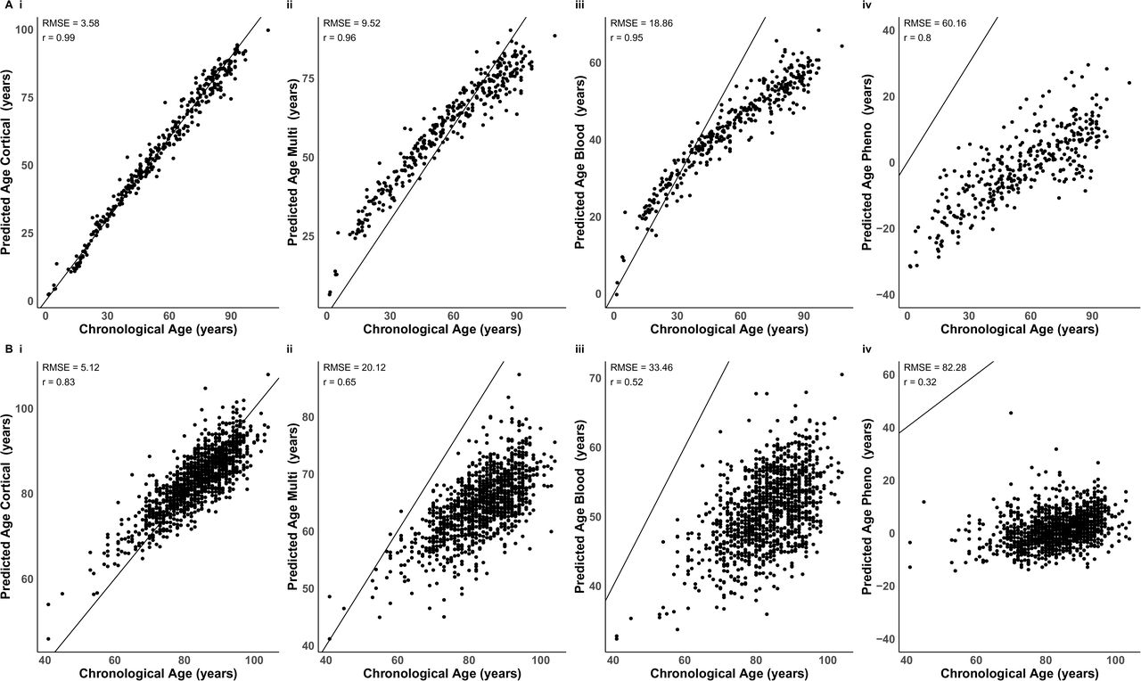
Figure 1: Comparison of chronological age with epigenetic age using four epigenetic clocks.
A: Training dataset (N = 350 cortical samples; age range = 1 – 108 years old)
B: Validation dataset (N = 1221 cortical samples; age range = 41 – 104 years old)
i: DNAmCortical clock
ii: Horvath’s DNAm clock
iii: Zhang’s DNAm clock
iv: DNAmPheno clock

Slide 59
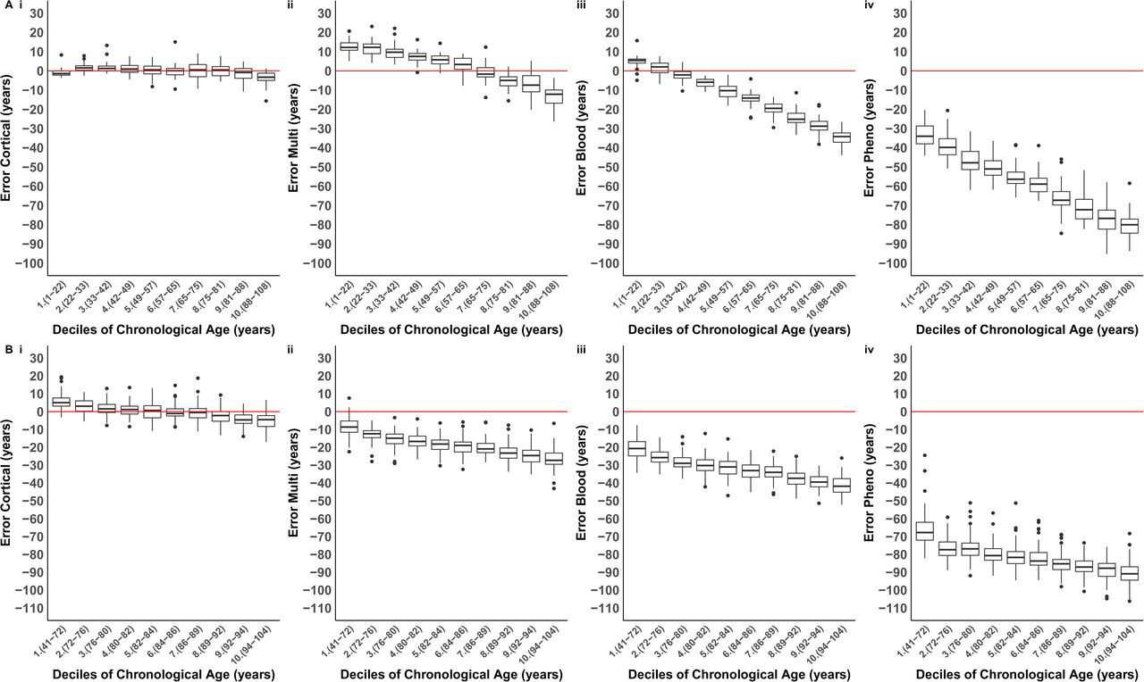
Figure 2: Distribution of error (epigenetic age – chronological age) for each age decile group.
A: Training dataset (N = 350 cortical samples; age range = 1 – 108 years old)
B: Validation dataset (N = 1221 cortical samples; age range = 41 – 104 years old)
i: DNAmCortical clock
ii: Horvath’s DNAm clock
iii: Zhang’s DNAm clock
iv: DNAmPheno clock

