Slide 1
WIP: ANTXR1 in IPF Lung
17-Nov-2025

Slide 2
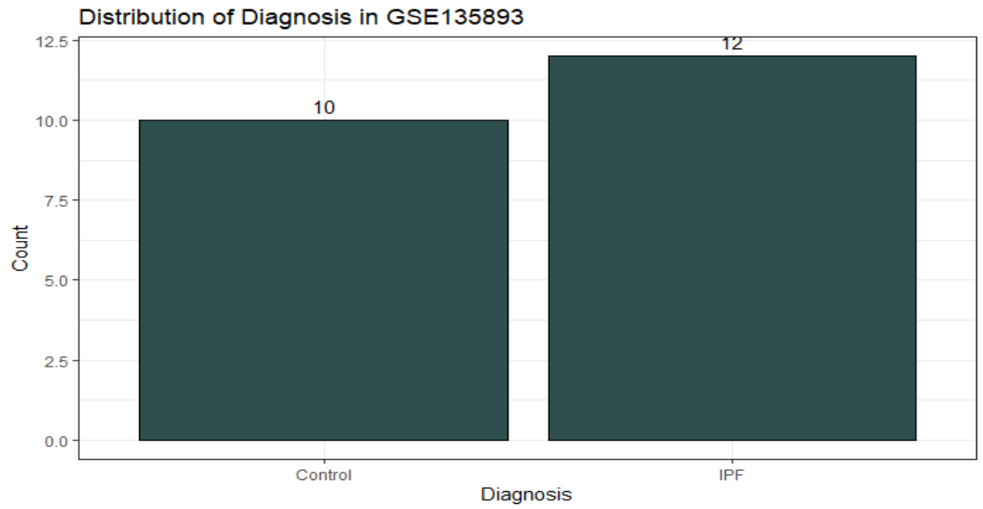
Demographics – Sample Level

Slide 3
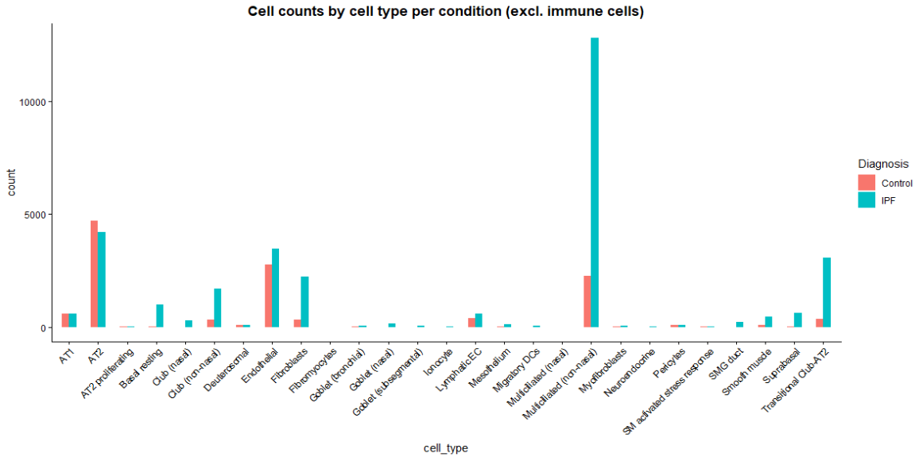
Cell Count by Cell Type

Slide 4
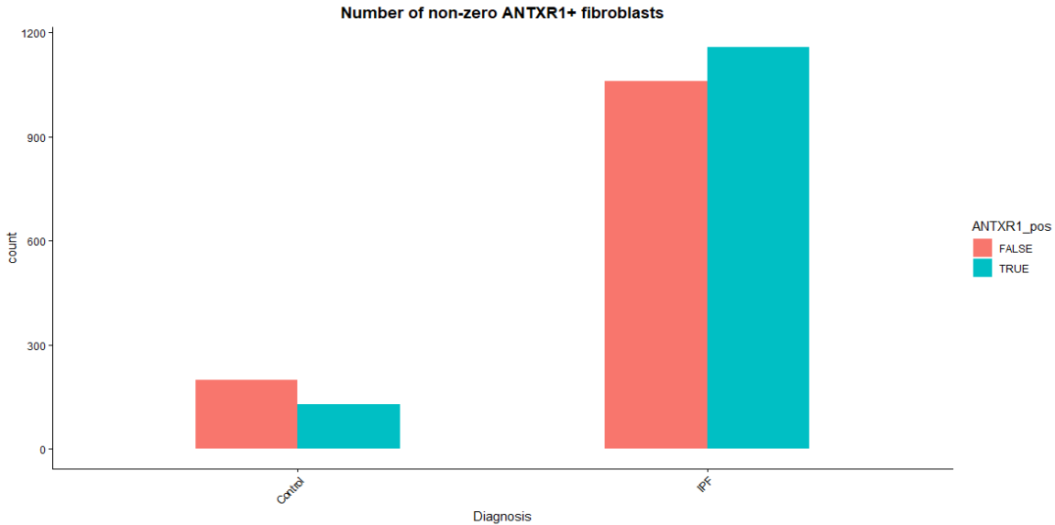
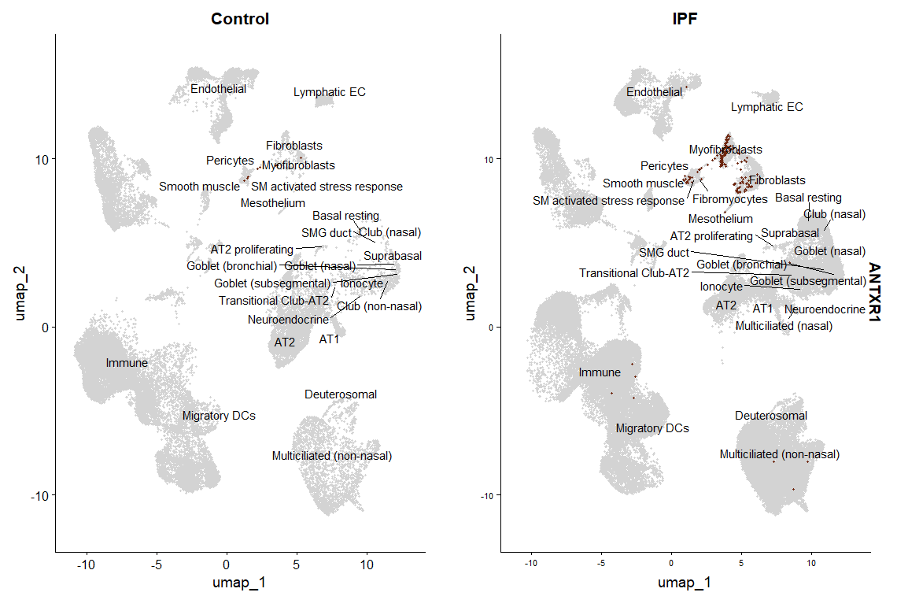
ANTXR1 Expression

Slide 5
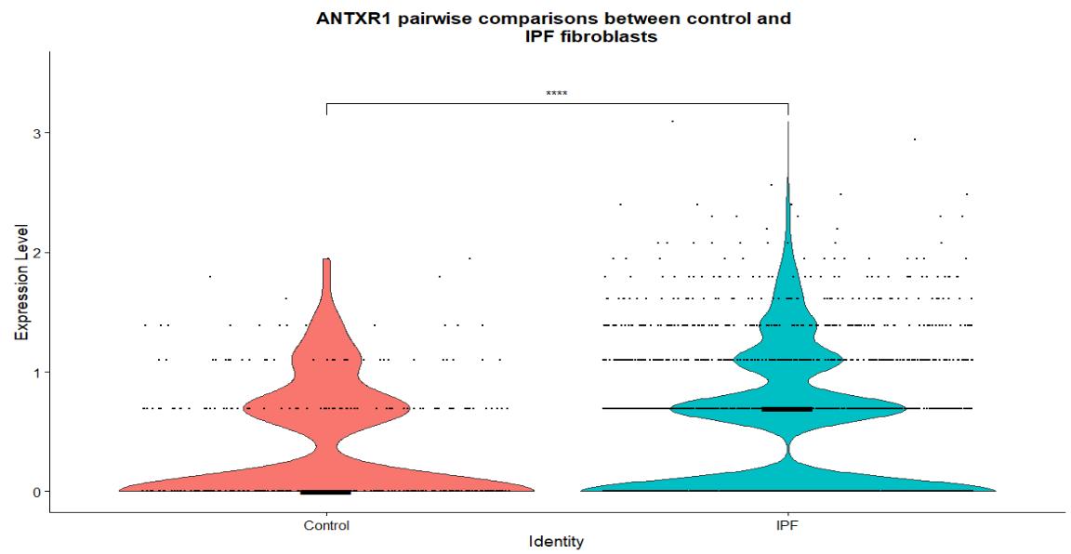
ANTXR1 Expression
Gene | Median Expression (Control) | Median Expression (IPF) | Mean Expression (Control) | Mean Expression (IPF)
ANTXR1 | 0 | 0.693 | 0.356 | 0.526
Notes:
Square plot

Slide 6
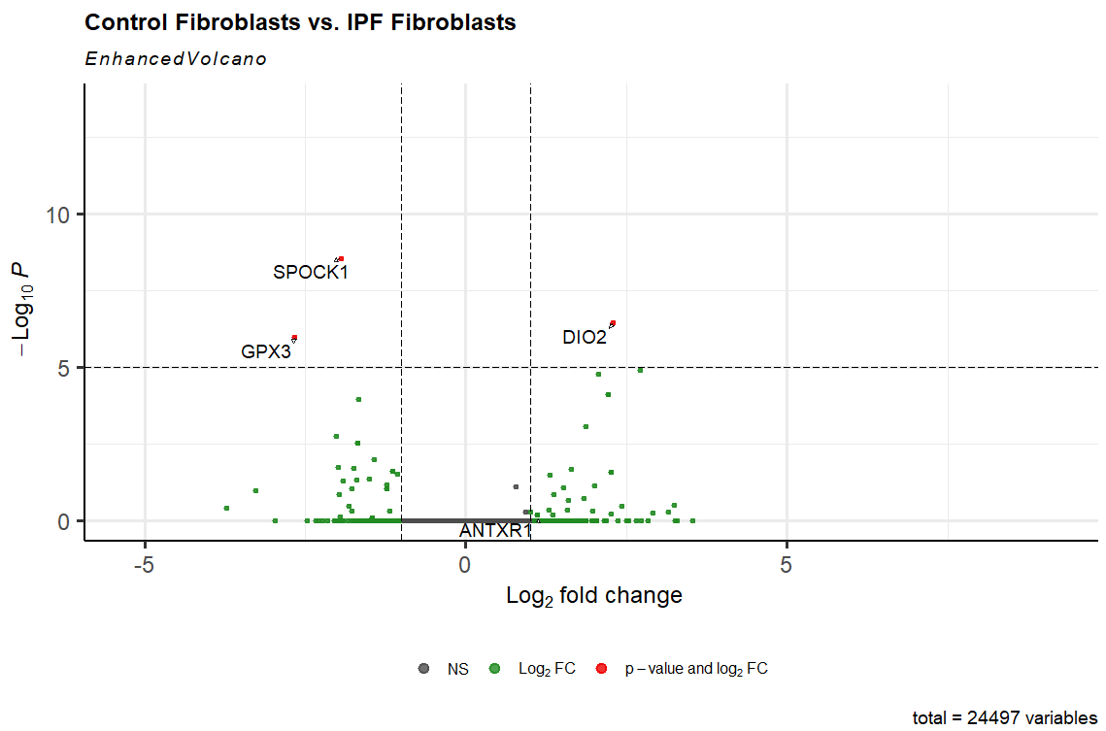
Differential Expression – Fibroblast Control vs. IPF
Gene | Ident 1 | Ident 2 | avg_log2FC | p-val_adj
ANTXR1 | IPF Fibroblasts | Control Fibroblasts | 1.155 | 1.00

