Slide 1
Final_Project
File created on: 05/12/2024 14:05:22

Slide 2
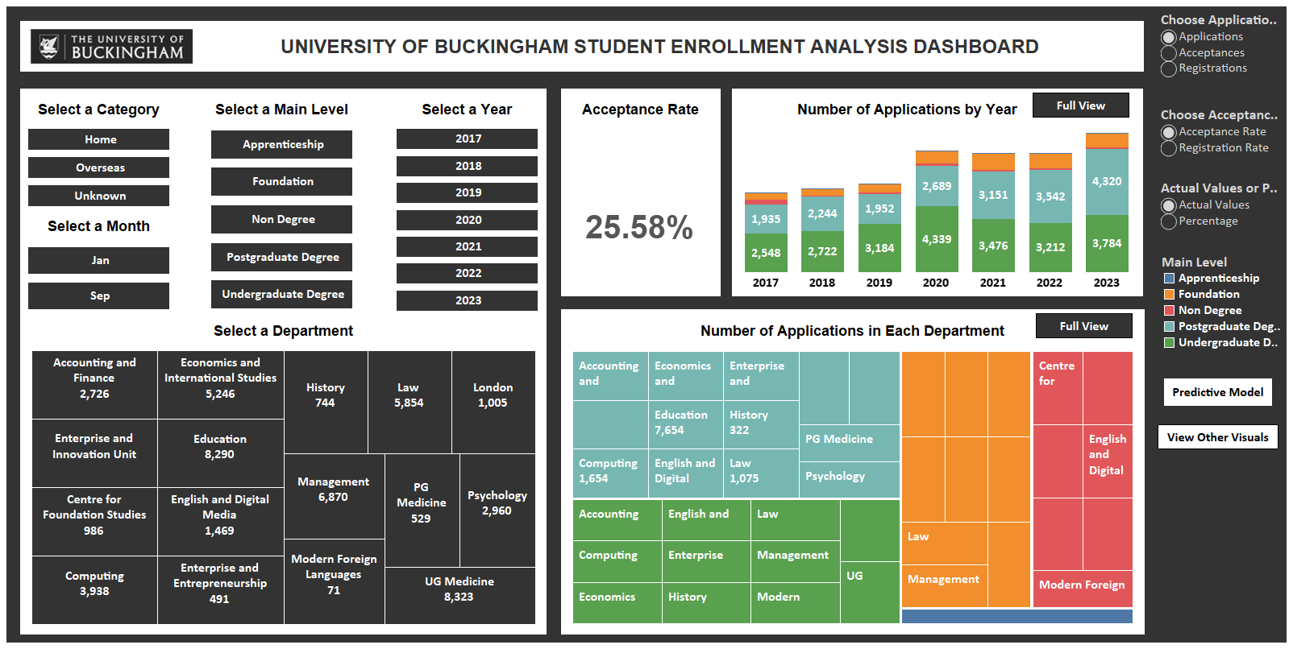

Slide 3
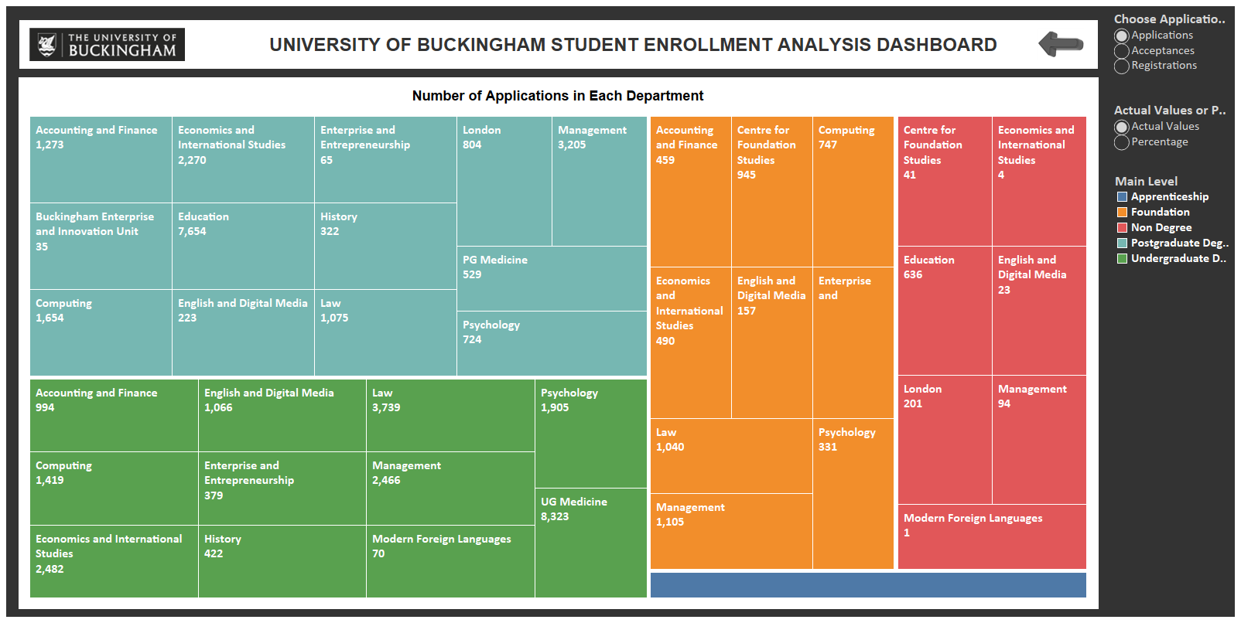

Slide 4
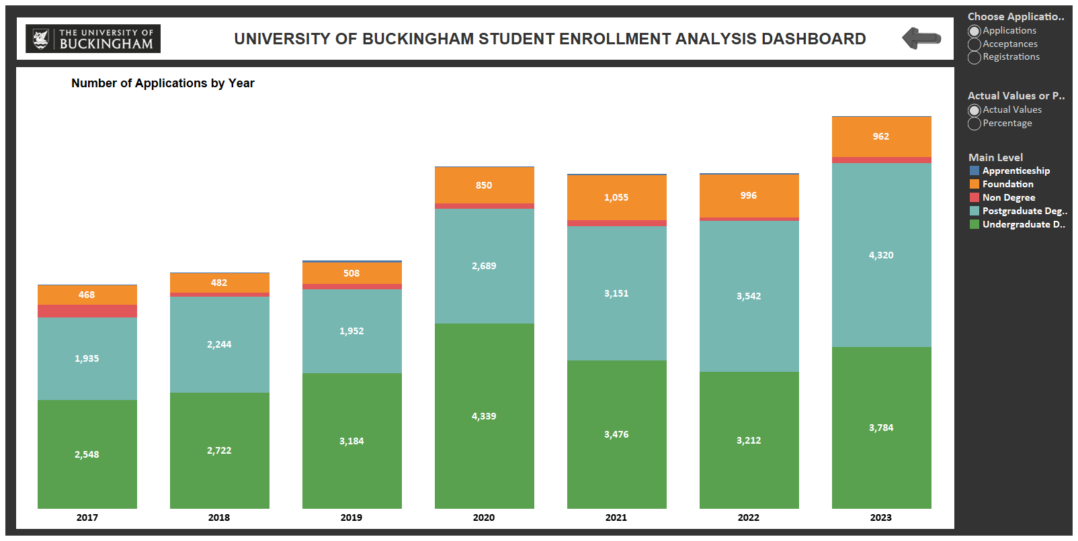

Slide 5
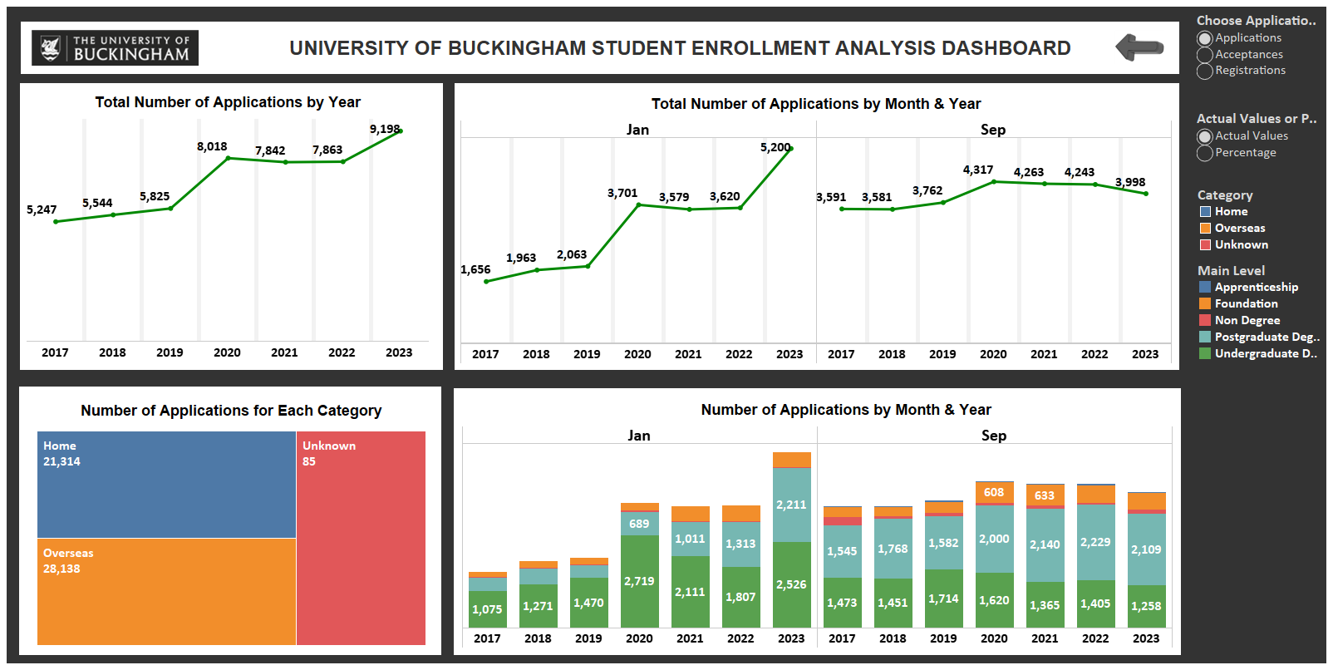

Slide 6
