Slide 1
YSDA
grid simulator

Slide 2
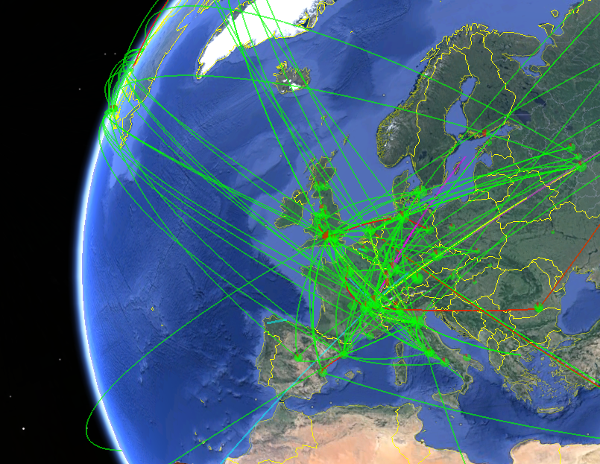
Goals and Problems
Grid is a big distributed system
Failures occurs in it
Can develop smarter algorithms
Data placing
Predict anomalies
Need a simulator to test such algorithms

Slide 3

Strategy
Develop simulator
Collect metrics from existing algorithms
Try to improve collected metrics

Slide 4
Simulation Process
Generate
input data
Simulate
execution of task
Collect
output data
Graphics

Slide 5

Input data flow
Input data.csv contains
following characterics of task
Task name
Execution size
Data size
Type of task
Location1
Location2(opt)
Location3(opt)
Distribution of :
Execution size
Data size
Location
Task type

Slide 6
Scheduling (matching) algorithms
Algorithm
Smart
Smarter?
Round-Robin
Smart Fault Tolerance

Slide 7
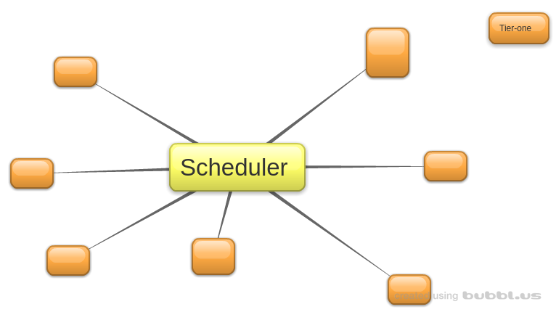
Platfrom
Configuraton of simulation system
Scheduler (Tier0)
Worker (Tier1_id)
Links

Slide 8








Anomaly
Failures of:
Host
Link

Slide 9
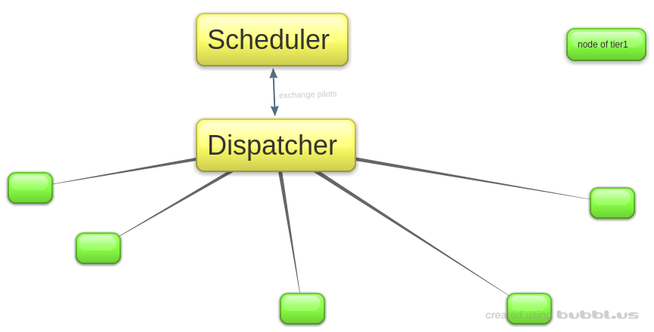
Platform of Tier-one
-Configuration of TierOne
1 dispatcher
N nodes
Links

Slide 10
Future plans and open questions
Where to collect metrics for better simulation?
Failure distribution
What else?
This is early stage of work
Feedback is very welcome
If you see any problems we can potentially solve, please write us!

