Slide 1





PolicyLens
See the policy.
Understand the response.
Verify the claims.
Evidence-grounded intelligence connecting policy text, public response, news and media coverage.
Challenge: Policy and Public Sentiment Analyst
Microsoft × CCI Innovation Challenge 2026 · Virginia Tech team

Slide 2
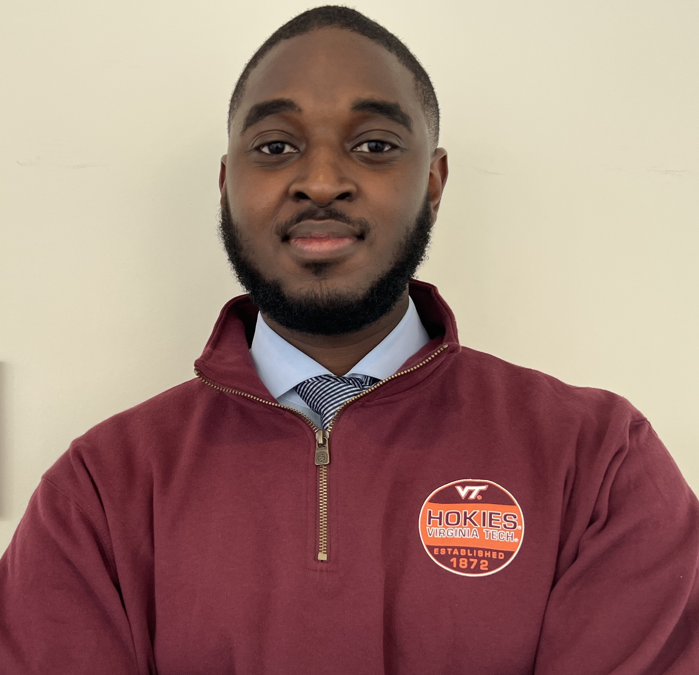

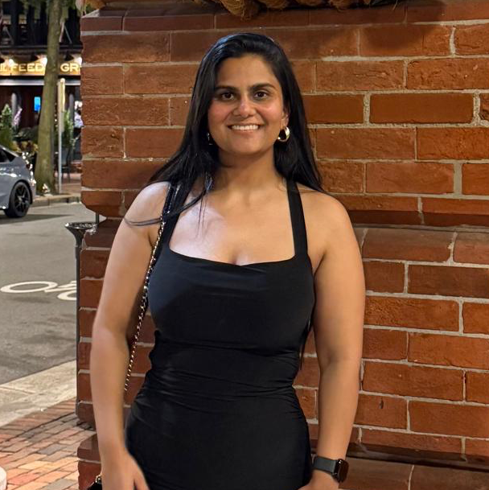


Team Members
Kene Nwodo
Pragya Sharma
Tanvi Garg
Sydney Johns
Kayrene Woods
PhD Student, Computer Engineering, Virginia Tech
PhD Student, Computer Engineering, Virginia Tech
PhD Student, Computer Engineering, Virginia Tech
PhD Student, Computer Science, Virginia Tech
M.Eng. Student, Computer Science, Virginia Tech

Slide 3





Challenge: Policy and Public Sentiment Analyst
What the challenge asks for
THE PROBLEM TODAY
Analysts must assess a new regulation while understanding how citizens, businesses and the media will respond.
Summarize policies and compare revisions
Detect recurring concerns and keep minority viewpoints
Long rule text, split across drafts
Connect news and opinion to the authoritative text
Thousands of public comments
Produce evidence-grounded analyst briefings with citations
News coverage and online video
Weeks of manual review
Separate policy text, reporting, opinion and AI interpretation
Protect personal data and keep humans responsible for conclusions

Slide 4
Policy Document: Ending 'Duration of Status'
A DHS rule replacing D/S stay for international students (F), exchange visitors (J) and foreign media (I) with fixed admission periods of up to four years.
Aug 28, 2025
2025 comment period
Jul 17, 2026
Sep 14, 2026
Proposed rule (V1)
21,923 public comments
Final rule (V2)
Federal court postpones the rule
Federal Register 2025-16554
Regulations.gov docket ICEB-2025-0001
Federal Register 2026-14439
One day before its Sept 15 effective date
Why it matters in Virginia
23,000+
$893.5M
7,801
international students studied in Virginia in 2024–25
contributed to the Commonwealth’s economy
Virginia jobs supported by international students
Sources: Federal Register; Regulations.gov; NAFSA International Student Economic Value Tool (2024–25), via Higher Ed Immigration Portal and Cardinal News.
https://www.nafsa.org/isev/reports/state?year=2024&state=VA

Slide 5

PolicyLens: Policy Insights at a Glance
A new federal rule for international students lands on a policy analyst’s desk. PolicyLens assists the analysts to:
1
Obtain document summaries, compare proposed and final versions
23 policy provisions compared: 13 unchanged, 6 modified, 4 added.
2
Analyze the public comments and sentiments
9,999 comments grouped by concern, sentiment and emotion.
3
Digest claims and stakeholder perspectives from news articles and media
Claims and stakeholder perspectives extracted; claims corroborated against official policy text with evidence-grounding scores.
4
View a combined briefing document
The analyst makes final conclusions by checking each AI verdict against citations, then downloads the one-page briefing.

Slide 6
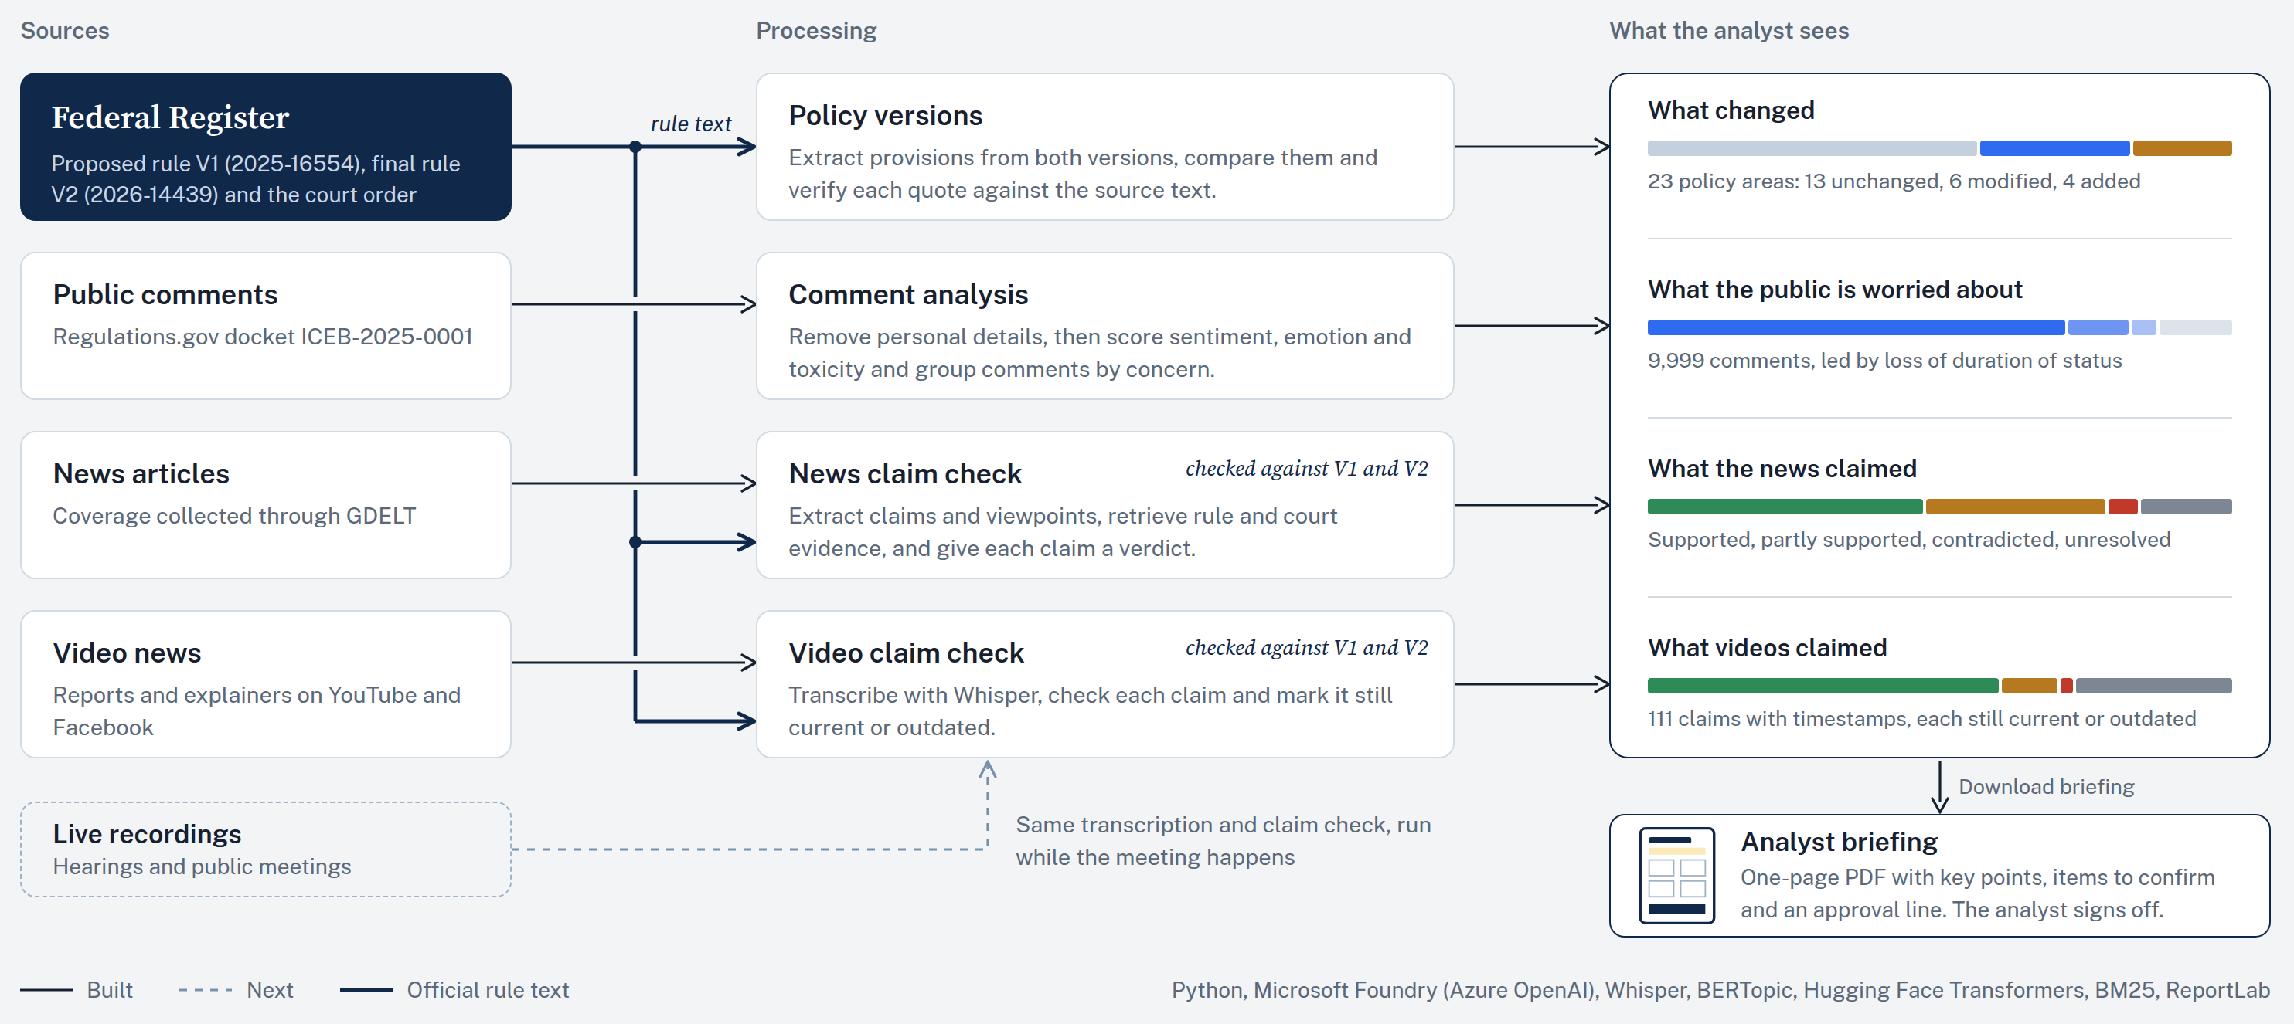
System Design

Slide 7
Results for ICEB-2025-0001
One real example from each component, taken from the outputs committed to our repository.
POLICY PROVISIONS
23 provisions compared · 6 modified · 4 added
PUBLIC COMMENTS
~10k PII-removed comments · 71.5% on loss of D/S
Graduate F-1 students changing programs
A specific concern surfaced from ~10k comments
PROPOSED RULE (V1) · FR 2025-16554
FINAL RULE (V2) · FR 2026-14439
COMMENT TOPIC: Physician Training
CONCERN CLUSTERS (BERTOPIC)
“Prohibiting F-1 students at the graduate education level from changing programs at any point during a program of study.”
“… from changing educational objectives … [or] transferring at any point during their program of study, unless an exception is authorized by SEVP for extenuating circumstances.”
“The proposed rule would be incredibly disruptive to the training of physicians. With current physician shortages, particularly in rural areas, this would endanger medical care …”
Loss of D/S
7,152
Same-level degrees
1,085
Economic impact
472
Global talent
192
Physician training
135
MODIFIED
VALIDATED
SENTIMENT: NEGATIVE
EMOTION: ANGER
Supports the rule
91
AI summary: the final rule extends the ban to transfers but adds SEVP exceptions.
NEWS CLAIM CHECK
88 articles · 1,188 claims · 196 viewpoints · 3,489 citations
VIDEO CLAIM CHECK
10 videos · 111 timestamped claims
News18: US Plans To End “Visa Abuse” By Limiting How Long Foreign Students…
YouTube, law firm explainer, 165,536 views: New F-1 Visa Rules
ARTICLE CLAIM:
EVIDENCE · 8 CFR 214.2(f)(5)(i), V1
▸ 0:01
SPEAKER CLAIM:
EVIDENCE · 91 FR 44976 + COURT ORDER
The new proposal would grant admission for the length of a student’s program, up to a maximum of four years.
“An F-1 student is admitted for a fixed period of time, which is the period necessary to complete the course of study … not to exceed a period of 4 years …”
“The Trump administration has announced new rules for people in the United States on student visas that begin September 15.”
“The effective date is September 15, 2026.”
On Sept 14, 2026, a federal court postponed the rule, so the start date no longer holds.
Claim Verdict:
SUPPORTED
Claim Verdict:
AT PUBLISH: SUPPORTED
Stakeholder Viewpoint: Fanta Aw, NAFSA (OPPOSES): "an additional deterrent to international students choosing to study in the United States"
NOW: OUTDATED

Slide 8







Responsible AI in PolicyLens
Sources kept separate
Policy text, news reporting, public opinion and AI output are never mixed
Personally identifiable information (PII) removed
Before any model analyzes the comments
Evidence cited
Each verdict shows the official text it was based on
Uncertainty flagged
Unclear results go to the analyst
Minority viewpoints included
Shown next to the majority concern
Source limitations stated
For our example docket, results reflect only the sources we collected
Analyst makes final decisions
Confirms or corrects each AI verdict before signing off on the briefing

Slide 9
Economic Value and Societal Impact
Manual review of ICEB-2025-0001
Impact
~760
~$50,000
~19
Savings on every rule
Agencies save about 760 analyst hours on each high-volume rule, since PolicyLens runs from a docket ID.
analyst hours
in agency staff cost
weeks for one analyst
Task | Hours | Salary cost
Read and tag ~10k public comments | 499 | $33,000
Compare proposed and final rule | 39 | $2,600
Verify 1,188 claims from 112 news articles | 203 | $13,400
Verify 111 claims from 10 videos | 19 | $1,300
Briefings based on evidence
Analysts give leadership the rule text, public concerns and press coverage in one place, with citations.
Public input actually heard
Thousands of comments become clear concerns, so what people said shapes decisions.
Assumptions: GS-13 step 5, DC area, about $66/hour (OPM 2026); reading at 238 words/minute (Brysbaert 2019); 2 min per comment, 10 min per claim, 1 hour per policy area.

Slide 10
UP NEXT
Live demo
A walkthrough of PolicyLens

Slide 11
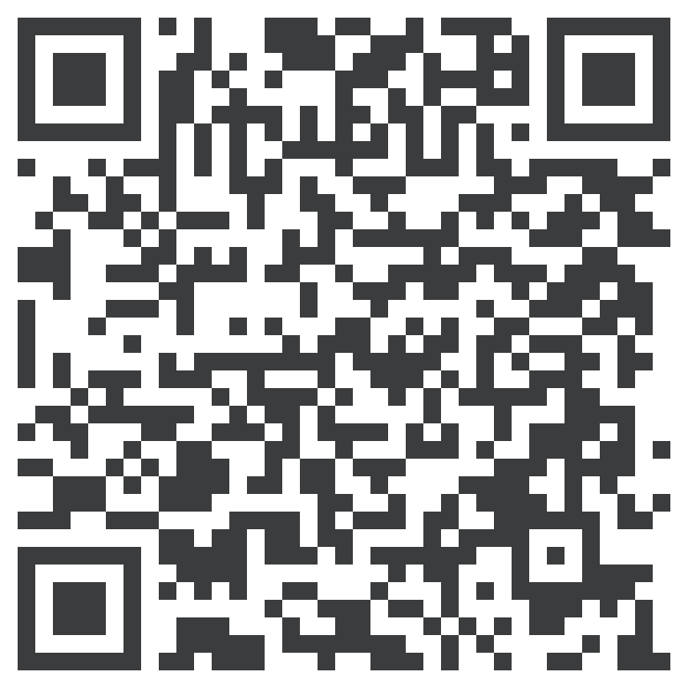

Thank You
Scan for the code
Code repository
github.com/kenenwodo/innovation-challenge-msftxcci-2026

