Slide 1

Unlimited Powerful Learning
Creating new GitLab Pages projects
Here is an overview of the steps we'll take, assuming you already have your GitLab.com account:
Create a new project
Add the configuration file (.gitlab-ci.yml)
Upload your website content
Add your custom domain (optional)
Done

Slide 2
Unlimited Powerful Learning
Step 1: Create a new project
On your dashboard you will see a big green button called + New Project. Click on it.
Set the first things up:
Project path - your project's name, accessed via https://gitlab.com/namespace/projectname
Privacy -choose if you want your project to be visible and accessible just for you (private), just for GitLab.com users (internal) or free to anyone to view, clone, fork and download it (public)

Slide 3
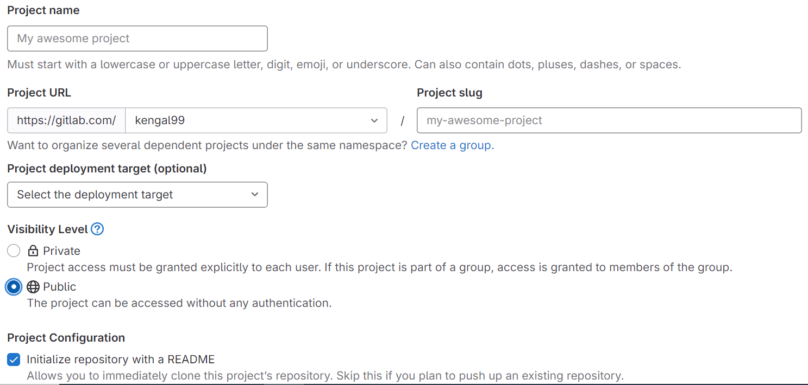
Unlimited Powerful Learning

Slide 4
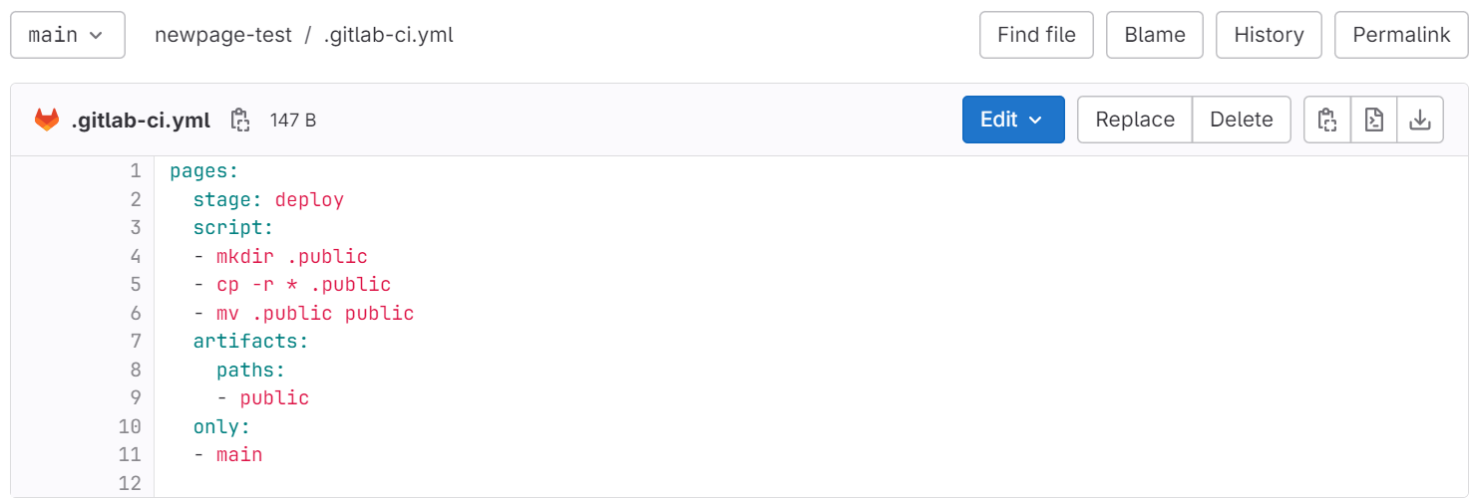
Unlimited Powerful Learning
Step 2: Add the configuration file: .gitlab-ci.yml
GitLab CI for plain HTML websites
In order to build your plain HTML site with GitLab Pages, your .gitlab-ci.yml file doesn't need much:
What this code is doing is creating a job called pages telling the Runner to deploy the website artifacts to a public path, whenever a commit is pushed only to the main branch.
All pages are created after the build completes successfully and the artifacts for the pages job are uploaded to GitLab.

Slide 5
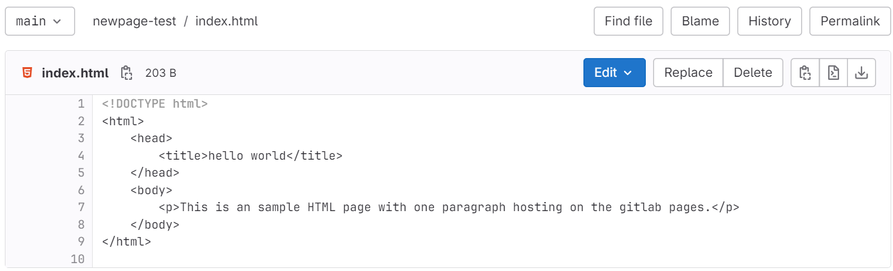
Unlimited Powerful Learning
Step 3: Upload your website content
In repository I have added new file as index.html in that I created a simple page that contains the phrase "Hello, World!" in the body. The page will also have a title - that thing that shows up in the title of the tab in your browser. The <title> element defines the title of the HTML page.

Slide 6
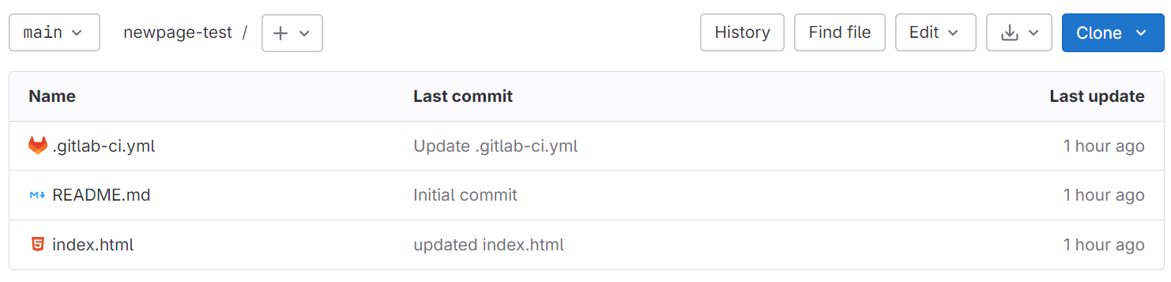
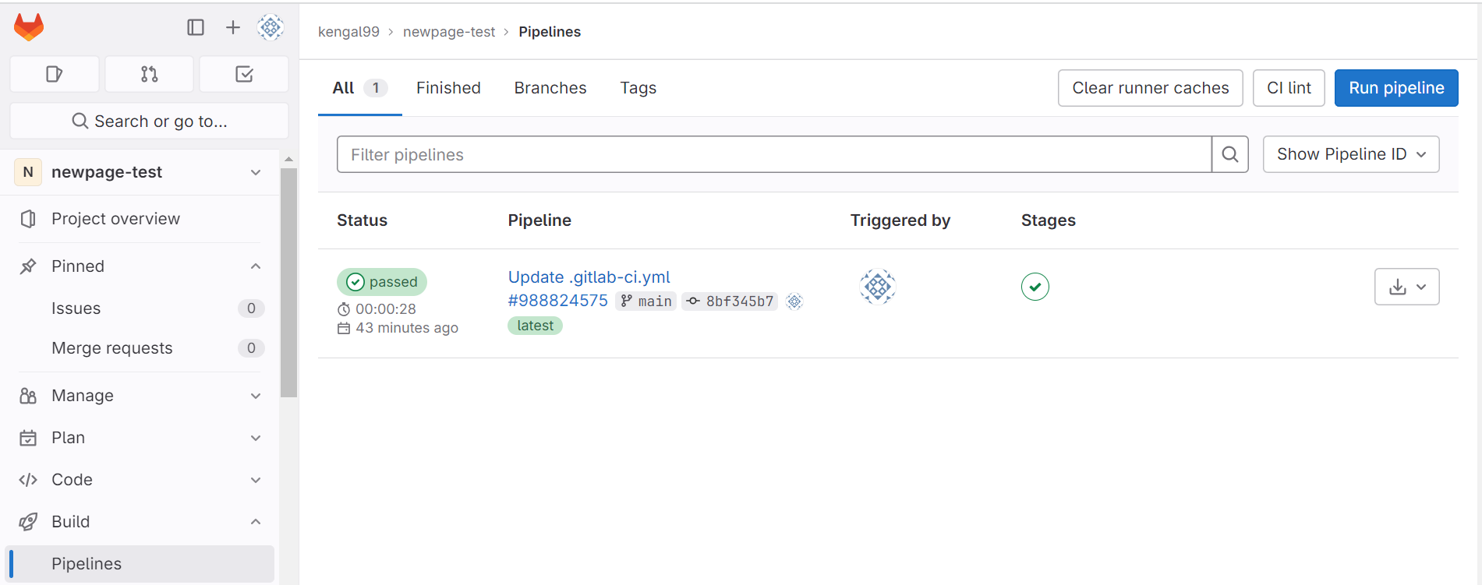
Unlimited Powerful Learning
Added Gitlab CI configuration file and also index.html file.
It’s start building.

Slide 7
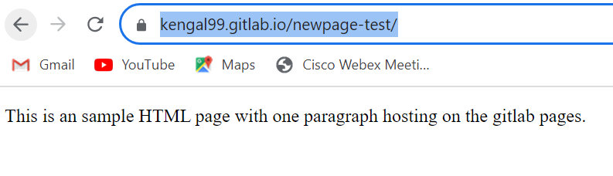
Unlimited Powerful Learning
Access your website by mynamespace.gitlab.io/myproject

