Slide 1
PCES Broker
NAIROBI, MARCH

Slide 2
Flexible and agile system to be able to answer of fast-moving businesses needs and requests
Architecture which can be implemented and connected to different external systems, for example, more than one CBS, or more than one card processor, etc.…
To wrap around all existing legacy systems like CBS, Card processors, telcos, etc.… and to start building new products and functionalities on top of them
Modular applications with independent functionalities which can be installed separate as individual application or together as integrated system
PCES principles and goals for system architecture and design

Slide 3
Scalable and extendable modules and functionalities
Each part of the system to be with clear and unique role in the software and with that providing independent teams working on module without interfering with each other
To have parameterizable and not hardcoded business logic, which can easily implement and follow any business requests
PCES principles and goals for system architecture and design

Slide 4
Broker architecture and design
Several channels and application connecting to each other within the banking ecosystem
Unified integrations within the banking ecosystem
Connect third party applications
Minimize core system alterations
Avoid system and data redundacy
Compatible with multiple banking systems
Reusability of existing connections to digital providers
Reduce time to market for new products
Administration
State Engine
Existing Systems
Broker
Open API
Contracts
Reporting

Slide 5
PCES Broker is built on the concept of Micro service, SOA architecture
Advantages:
SOA is very flexible and agile
Working or Adjusting, different functionality or module without interfering with each other.
Flexible process execution location and delegation of the responsibility per business domain for example CBS service is responsible only for operations with CBSs
architecture and design

Slide 6
Disadvantages:
Autonomous transactional approach is very difficult to implement or almost impossible, to find a way around this disadvantage we are using compensation pattern
Fragmented and sometimes duplicated functionality in more than one service.
Most of the disadvantages in SOA architecture can be addressed by monolith application design as many legacy systems are designed. But monolith system architecture by design is not modular and with that approach, we can’t deliver each module as independent application.
architecture and design

Slide 7
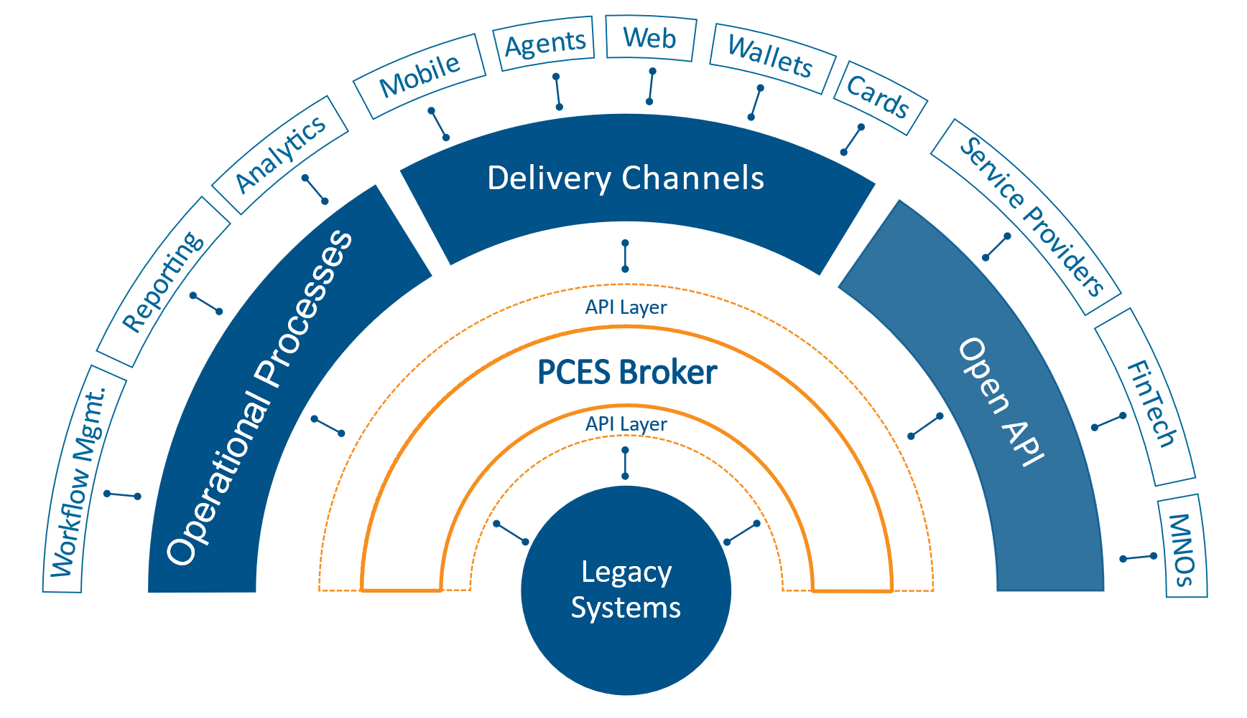
The Solution
Existing
Systems

Slide 8
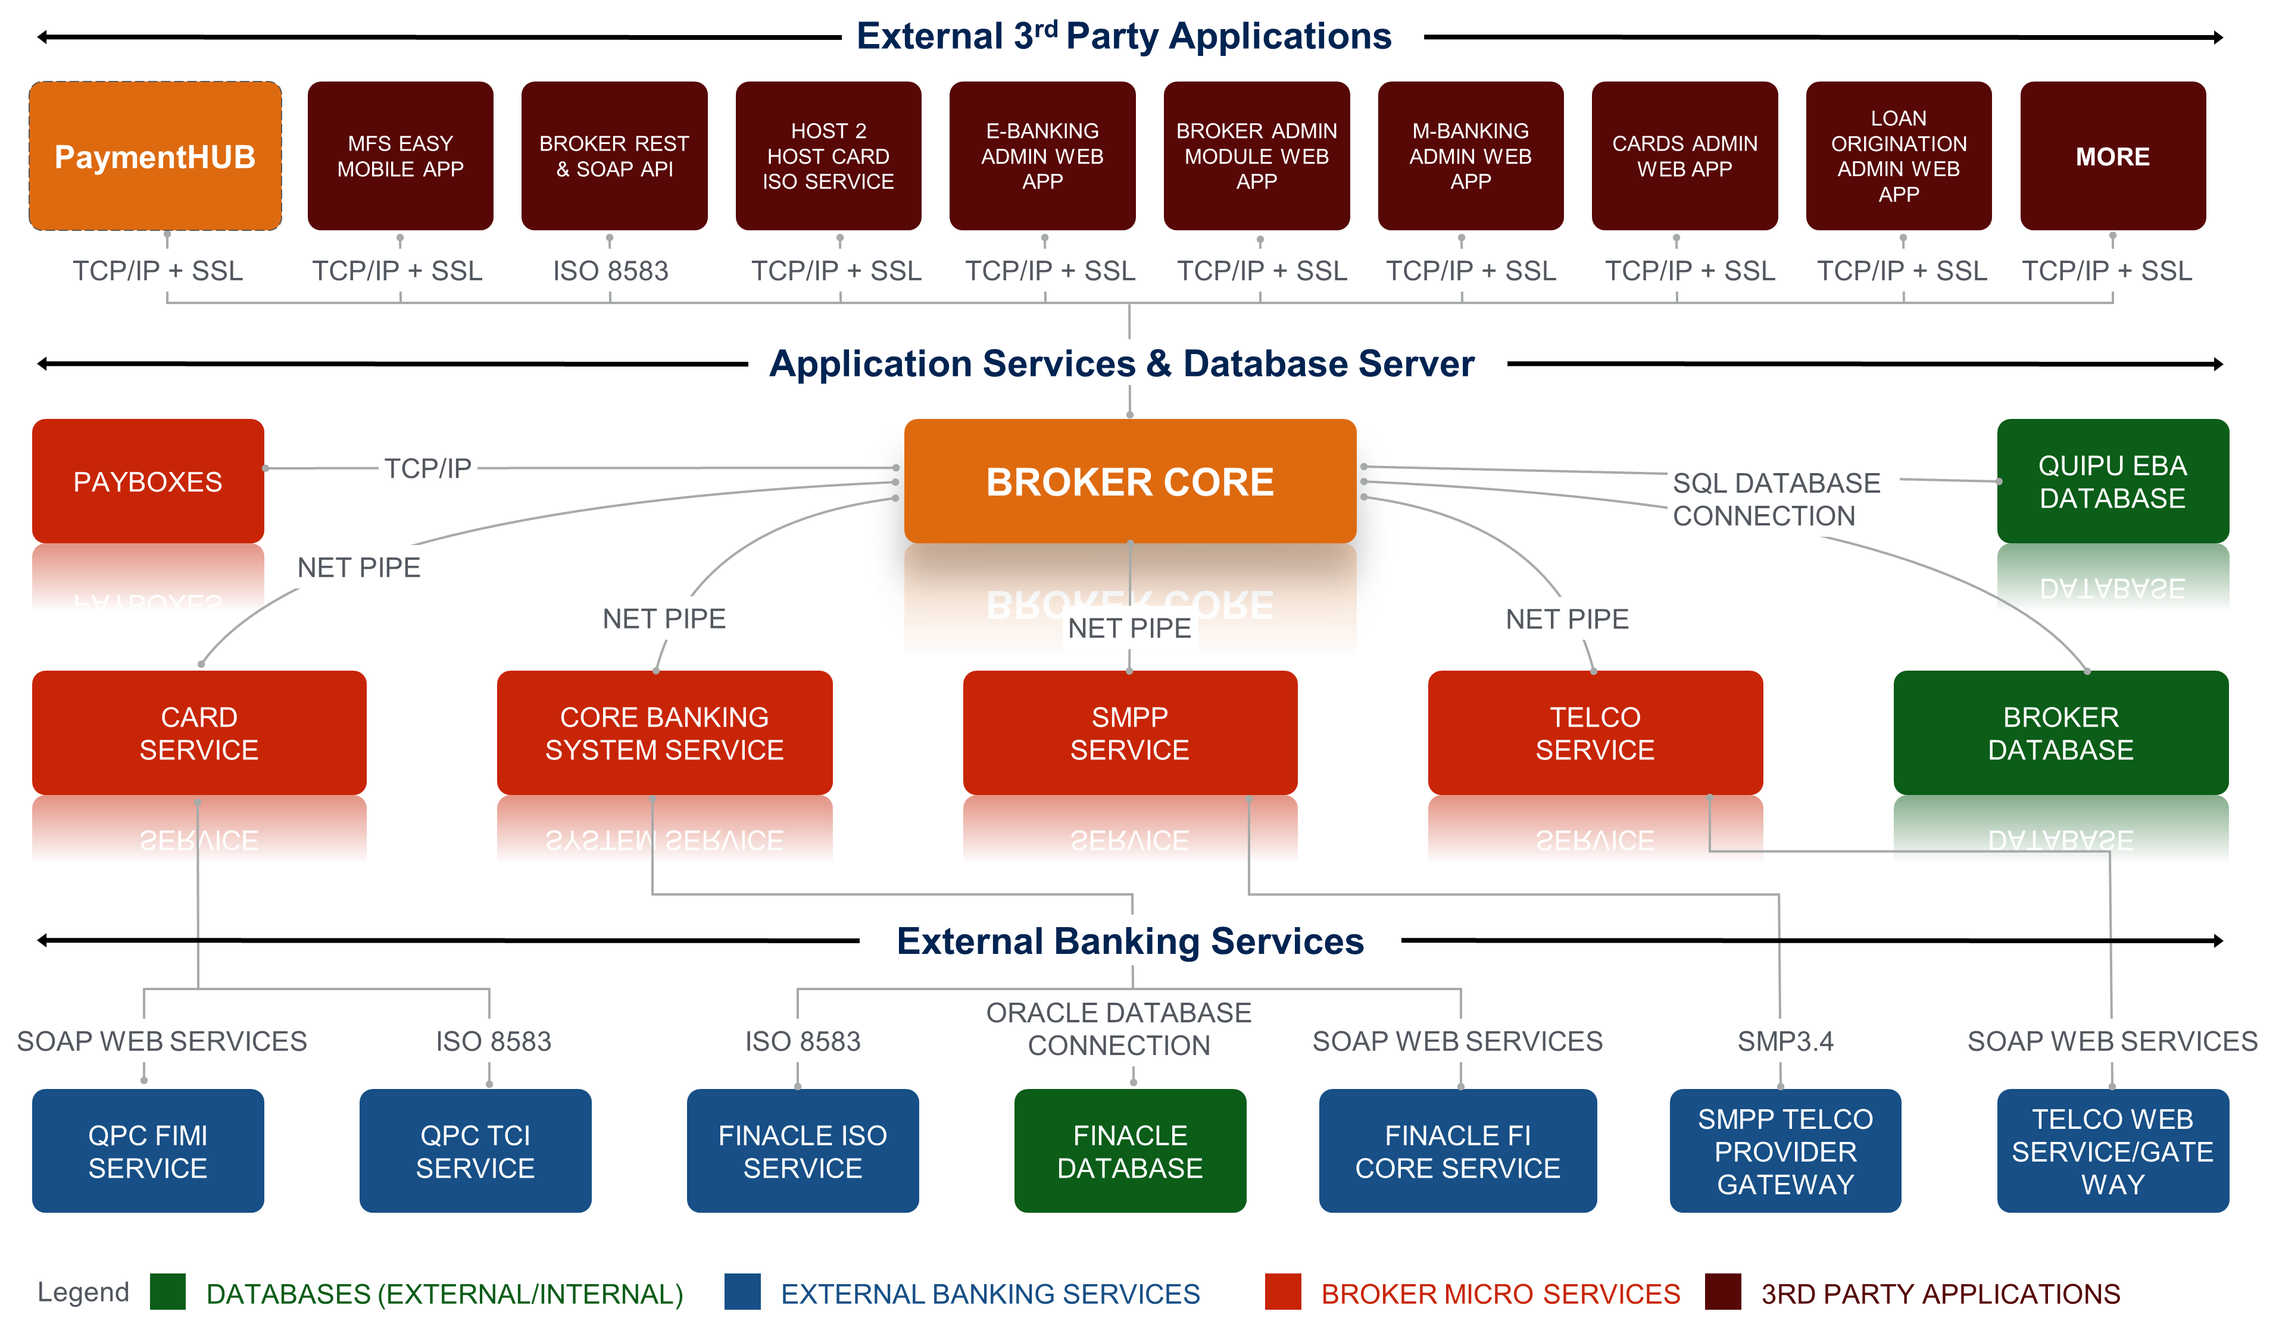
PCES Broker Architecture

Slide 9
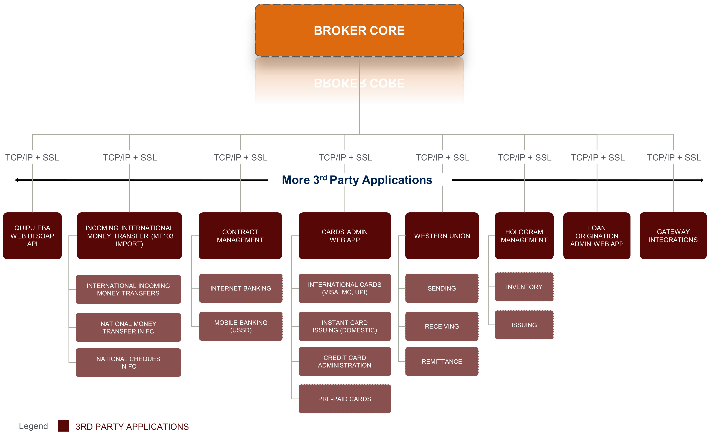
PCES Broker Architecture

Slide 10
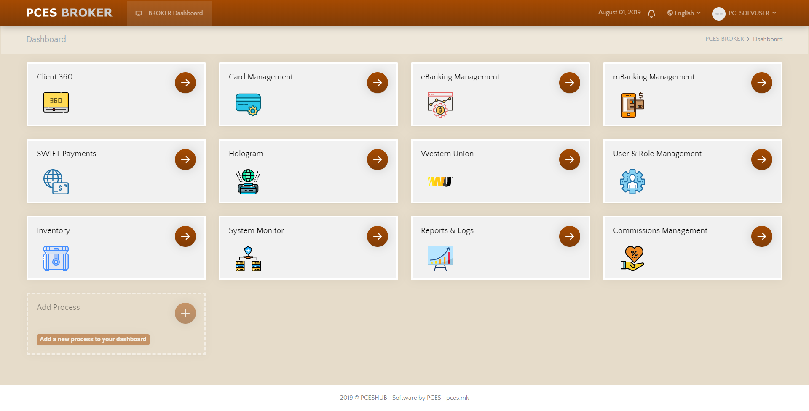
Broker Admin Dashboard

Slide 11
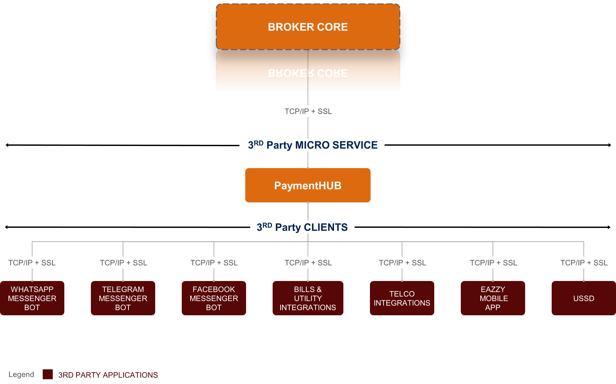
PCES Broker Architecture

Slide 12
Payment Hub
Payment Hub is an extension module of broker to provides multifaceted and secure connection options between the core banking system, third party service providers and partners.
This module exposes core banking integrations to third party integrators as well as bringing useful third party services to the core banking ecosystem.
Because of the flexibility and wide range of connectivity/api consumption options offered in the payment hub, it also provides a single point of entry for service providers to communicate with the core banking system with modern industry standard integration options.

Slide 13
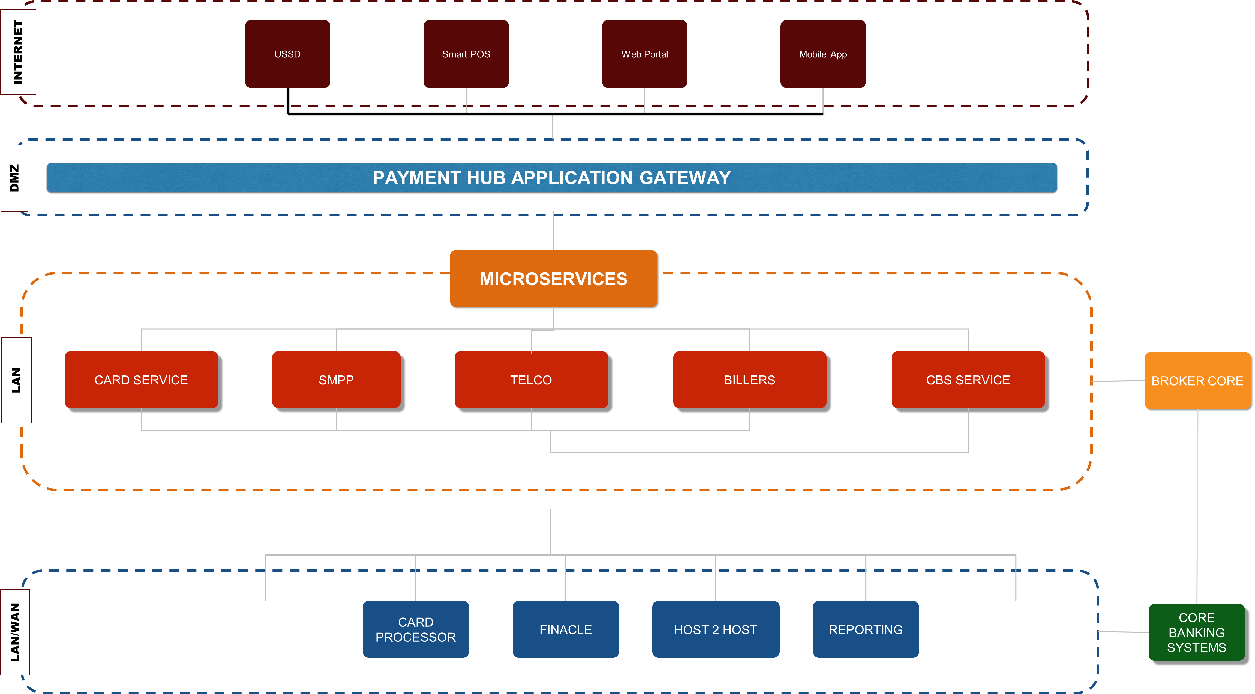
Payment Hub High Level Architecture

Slide 14
Sample Implementations
Withdrawal by Code (Equity, MPESA, Airtel)
Airtime Purchase
USSD Implementation (MPESA, Airtel, Vodacom)
Bill Payment DSTV & Canal Plus
Remittances (Thunes, MasterCard Send, Maxicash)

Slide 15
Conclusion
Questions

