Slide 1

DevOps
Source Code Version Control

Slide 2
Topics
Introduction to Source Code Version Control
Fundamentals of GIT
GIT Concepts

Slide 3
Why are we doing this
Facilitate better development process - Ease of collaboration
Reduce failures resulting from uncoordinated changes
Better Code governance
Compliance with Bank Policies

Slide 4
Introduction
Source Code Version Control is practice of Tracking and Managing changes to software code
Tracking –
Who changed code
What & where it changed
When was it changed
Manage -
Collaborate (Multiple people working same files)
Resolve conflicts
Governance

Slide 5
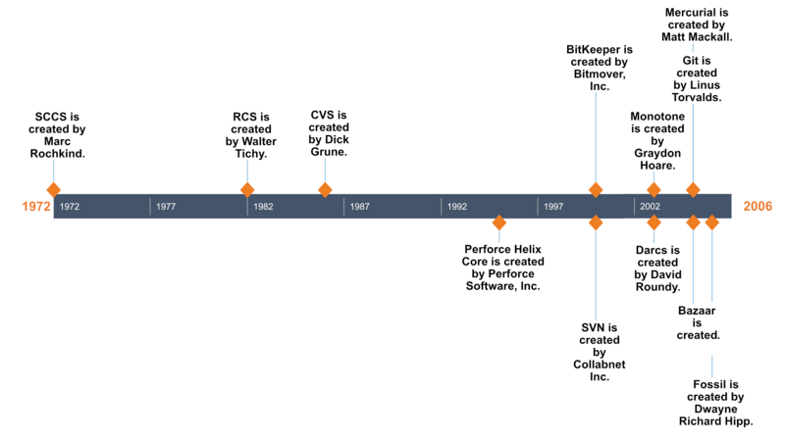
A Brief History

Slide 6
GIT
GIT is a popular distributed version control system used by developers to manage changes to code. It allows developers to track changes made to their codebase, collaborate with team members, and revert to previous versions if needed.
What you need
Install Git software (client + CLI) - https://git-scm.com/download/
Access to a Git remote repository - https://dev.azure.com.mcas.ms/ICT-DevOps

Slide 7
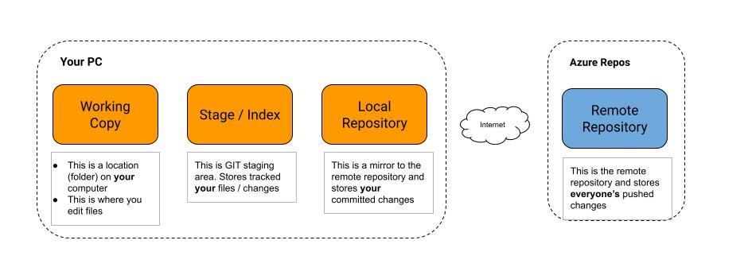
GIT Fundamentals

Slide 8
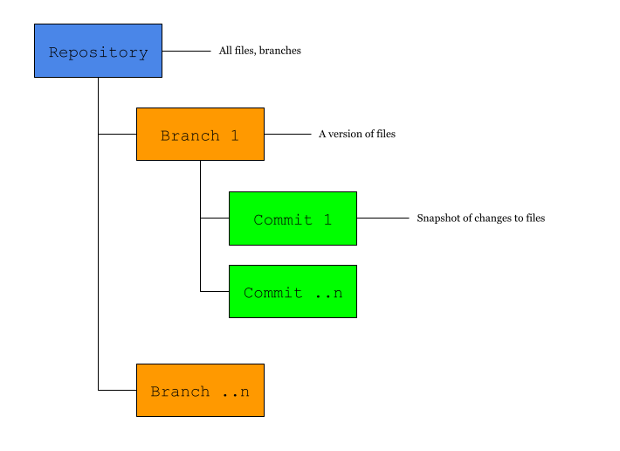
GIT Fundamentals
Repository
Contains one or more branches
Branch
Contains a version of the repository
Commit
Contains a snapshot of changes committed in a particular branch

Slide 9
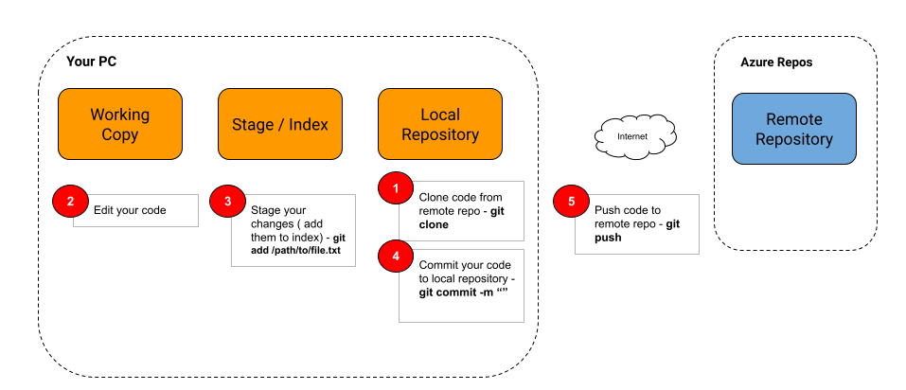
A typical workflow

Slide 10
GIT Concepts

Slide 11
GIT Concepts
Remote Repository
This is a centralized repository shared by everyone. The structure of the remote repository is generally the same as that of the local repository. Usually hosted on server or offered as a SaaS.
Can be accessed via two protocols:
HTTP
Uses the well know HTTP protocol and the repository is represented as a HTTP URL e.g. https://ICT-DevOps@dev.azure.com/ICT-DevOps/DevOps/_git/DevOps
Authentication is via Basic Auth (Username and password). The GIT client will prompt you for username and password when interacting with the repository
SSH
Uses the SSH protocol to access the repository. The URLs will be like: git@ssh.dev.azure.com:v3/ICT-DevOps/DevOps/DevOps
Authentication is via SSH Keys. To use SSH Keys, you must generate the keys on your computer and copy the public key onto the Azure devOps platform. Read more here: Use SSH key authentication - Azure Repos | Microsoft Learn

Slide 12
GIT Concepts
Local Repository
This a local copy of the remote repository that is kept on your computer. It keeps track of the history of changes on your code that you have added to the GIT index (stage).
You can synchronize it with the remote repository through:
Pull / Fetch – fetch changes from remote to local
Push – Push changes from local to remote

Slide 13
GIT Concepts
Git Clone
This is copying the remote repository to the local machine, thus establishing a local repository.
This is achieved using the git clone command e.g. git@ssh.dev.azure.com:v3/ICT-DevOps/test-app
This is usually a one-time exercise for the repository
Git Init
This is the initializing a local repository on your machine to begin tracking your code
This is done on your code's root directory

Slide 14
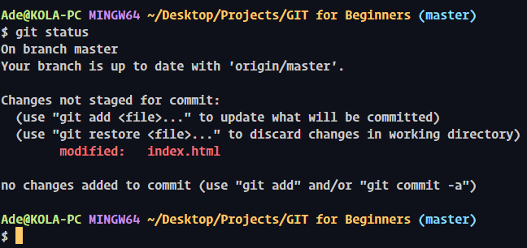
GIT Concepts
GIT Status
This give the state of your local repository
It shows:
The current branch
Files / changes that are untracked – Not staged
Files / changes that are ready for commit
How ahead is the current branch from the remote branch

Slide 15
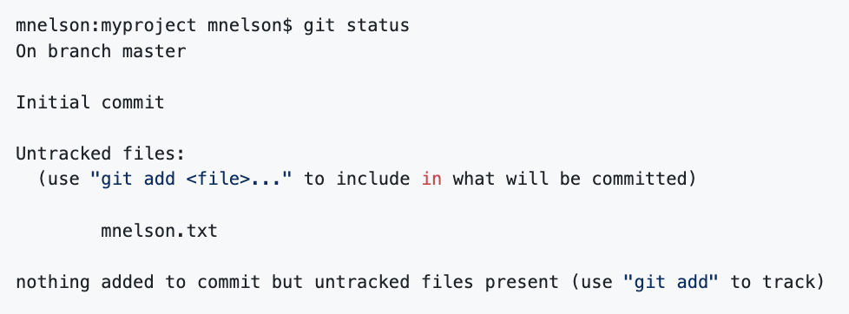
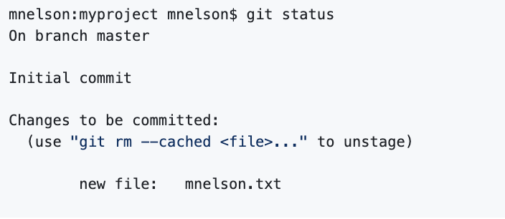

GIT Concepts
Staging
This is the adding of a new or modified file to GIT index
This tells GIT to start tracking the staged file / changes in modified file
Files are staged using the git add command
Once as file is staged, the changes will be ready to be committed
After staging the file

Slide 16
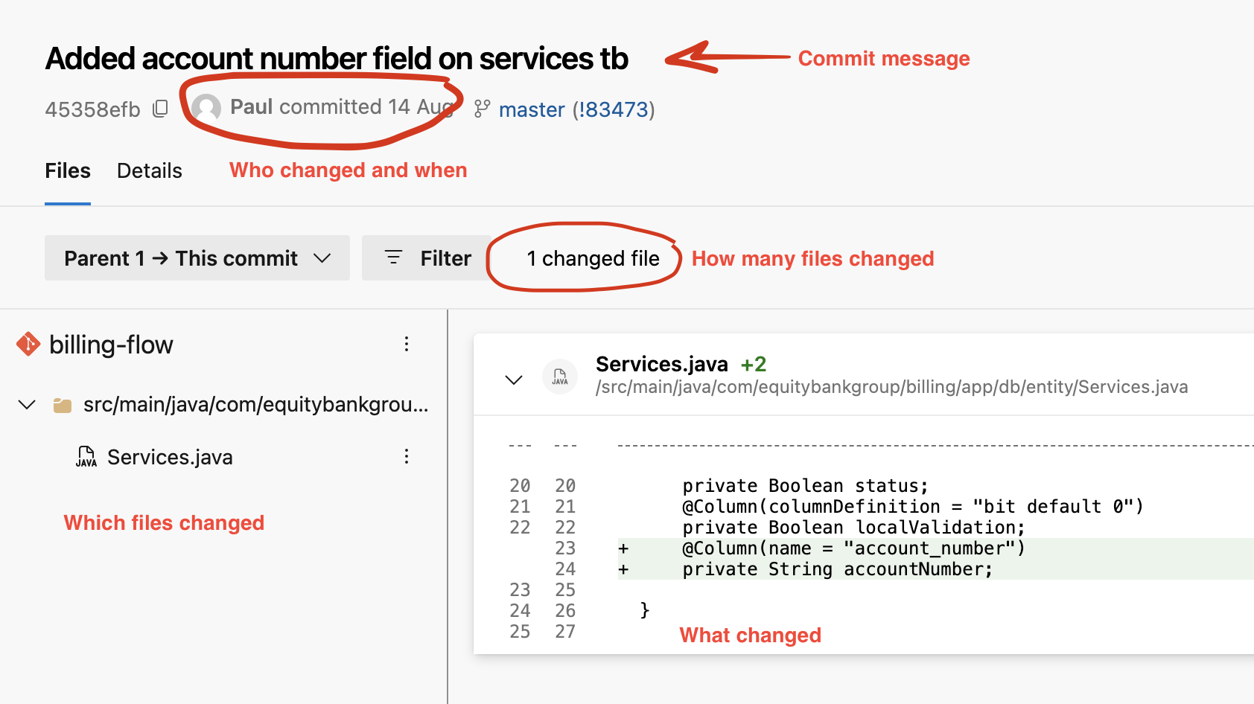
GIT Concepts
Commits
This a snapshot of change that has been committed to a branch in either the local and/or remote repository
A change may involve one or more edits on one or more files
A commit is accomplished via through the git commit command. A commit message is required
For changes to qualify to be committed, they must have been staged using the git add command
Commits on the local repository can be pushed to the remote repository via the git push command
Commits on the remote repository can be pulled to the local repository via git pull, git fetch commands

Slide 17
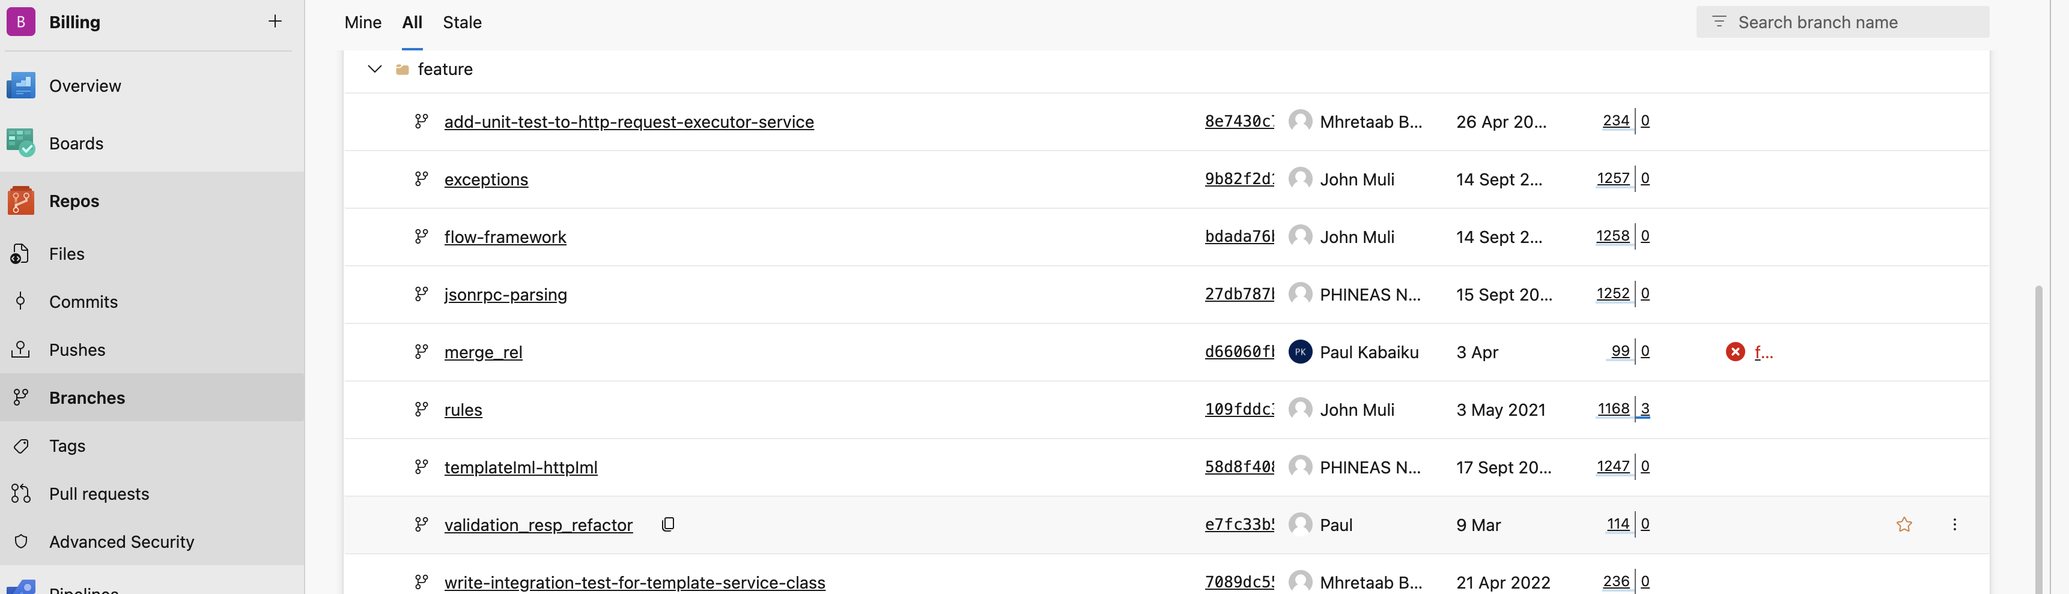
GIT Concepts
Branch
In GIT, a branch is a version or copy of the repository.
commits are contained in a branch.
Typically, you keep your commits for a feature / fix in a branch
The default branch is called main
Branches are created using the git branch <branch name> command
You can switch from one branch to another using the git checkout <branch name> command
Naming convention for branches
Feature branches : feature/<name-of-feature>
Hotfix branches: hotfix/<name-of-hotfix>
Bugfix branches: bugfix/<name-of-bugfix>

Slide 18
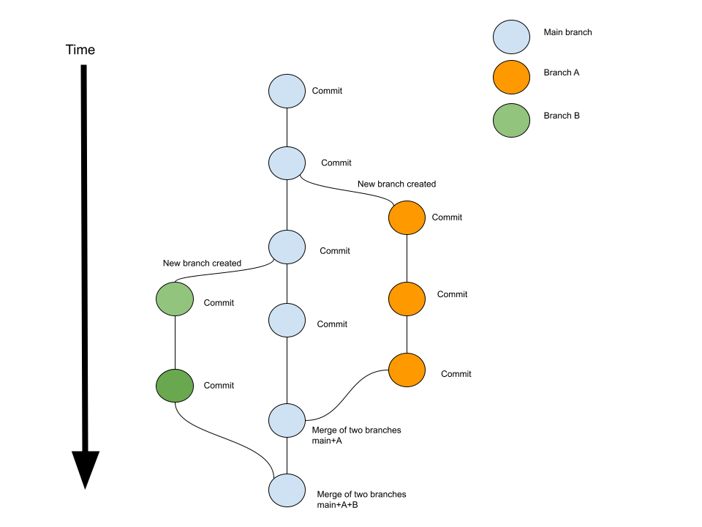
Branches
Commits happen within branches
Branches can be merged, creating a new commit with merged code
Merging of branches can result to conflicts which have to be resolved before proceeding

Slide 19
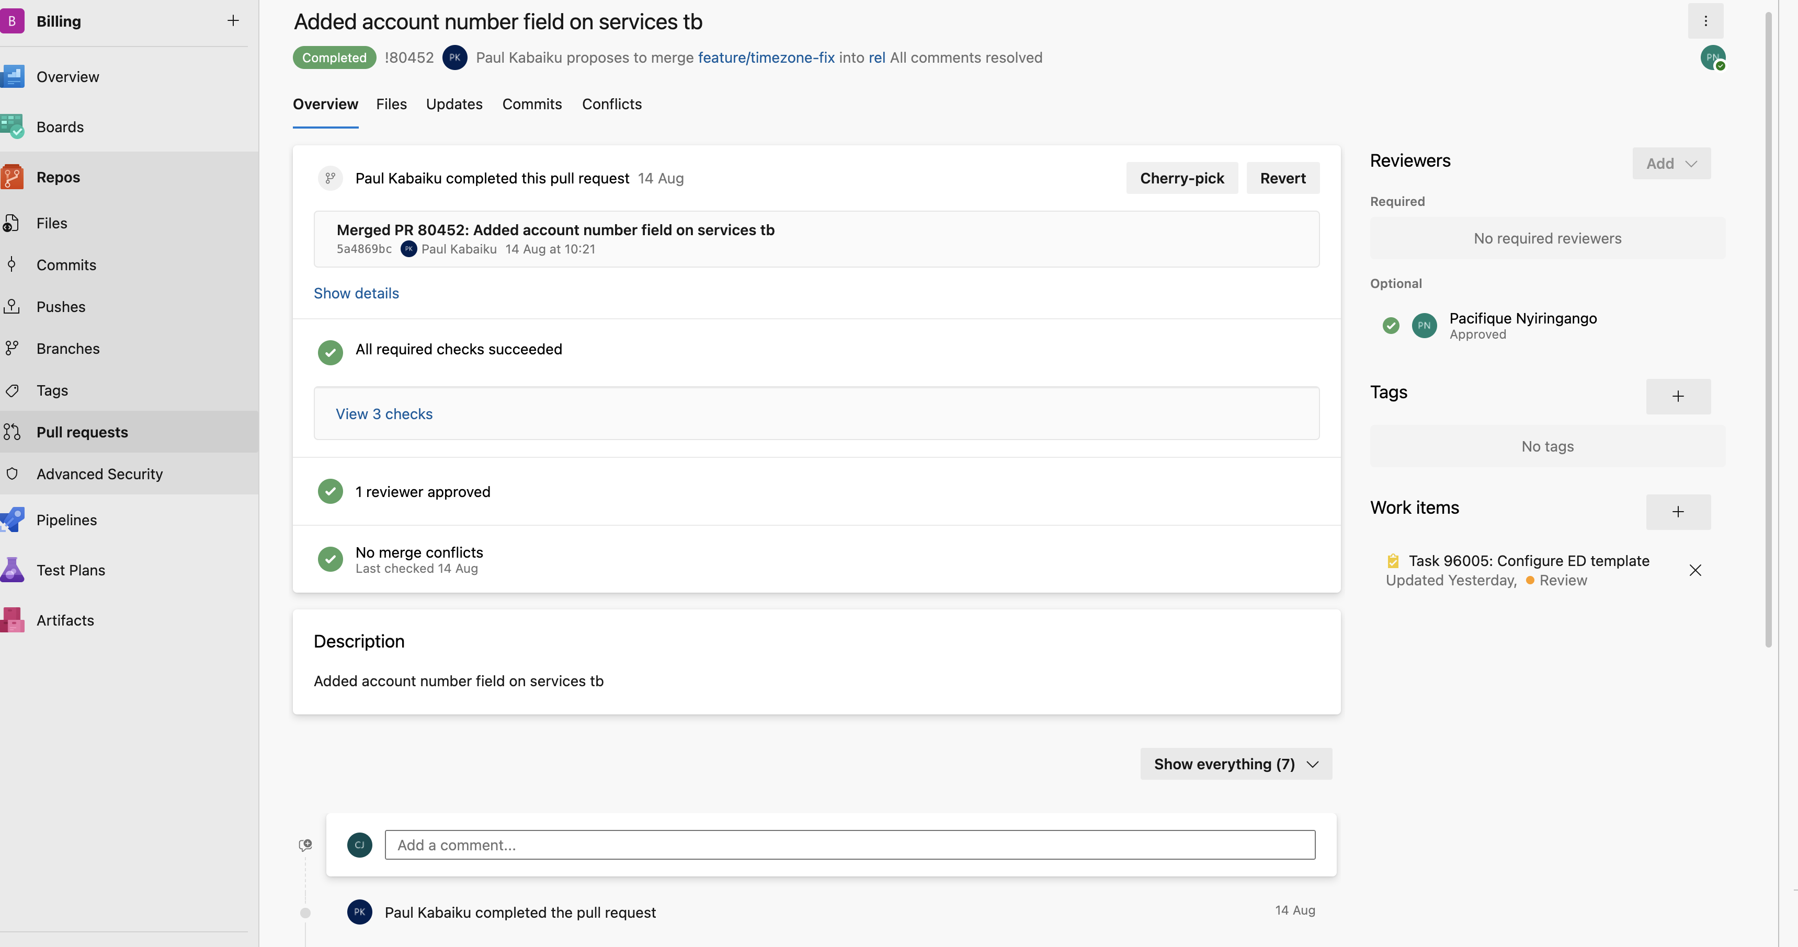
GIT Concepts
Merges / Pull Request
To merge a branch to another, it is best practice to have a code review either by a peer or by the lead dev so that quality of code can be maintained.
To facilitate code review, a developer creates a pull-request and may select the persons to review the code
The reviewer will receive a notification of review and can review the code changes then:
Approve the merge – thus effecting the merge of code to the destination branch
Decline the merge – With notes on what needs to change
Pend the merge with comments

Slide 20
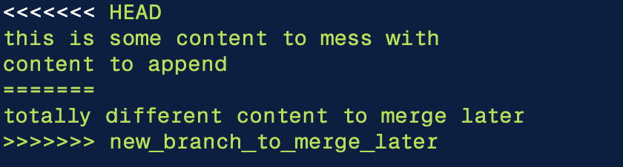
GIT Concepts
Conflicts
In the process of merging branches, you may encounter a conflict
Conflicts generally arise when:
The two branches have code changes on the same lines in the same file
If one branch has deleted a file while another branch has modifications on the same file
Conflicts must to be resolved before a merge proceeds
When a conflict occurs, GIT will add some symbols in your code to mark the location of the conflicts
To resolve a conflict, you can:
Accept incoming change (The other person's change) - Therefore discarding your changes (current)
Accept your changes (current) - Therefore discarding other person's changes (Incoming)
Retain both changes

Slide 21
Best Practices
Make incremental, small changes – Less chances of conflicts
Use Clear and Concise Commit Messages – Easier to debug
Branch Frequently to Isolate Changes – Keep main code clean
Use Pull Requests for Code Reviews – Less chances of bugs
Synchronize your branch with main branches – Less chances of conflict. Keep up with the rest of the team.

Slide 22
Learn More
https://www.freecodecamp.org/news/git-cheat-sheet/
https://www.atlassian.com/git/tutorials/what-is-version-control
https://www.atlassian.com/git/tutorials/setting-up-a-repository
https://git-scm.com/book/en/v2/Git-Basics-Getting-a-Git-Repository
https://www.freecodecamp.org/news/what-is-git-learn-git-version-control/

