Slide 1

The Use of the Internet in the Treatment of Addiction
By Kevin English
University of Hawaii
ICS 614, Fall 2008

Slide 2
What is Alcoholism?
After years of studying alcoholism and addiction there are still a lot misconceptions.
Bad Decisions?
Poor Character?
Lack of Willpower?

Slide 3
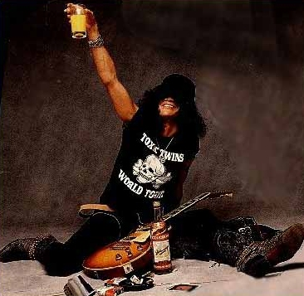
Rock n’ Roll?

Slide 4
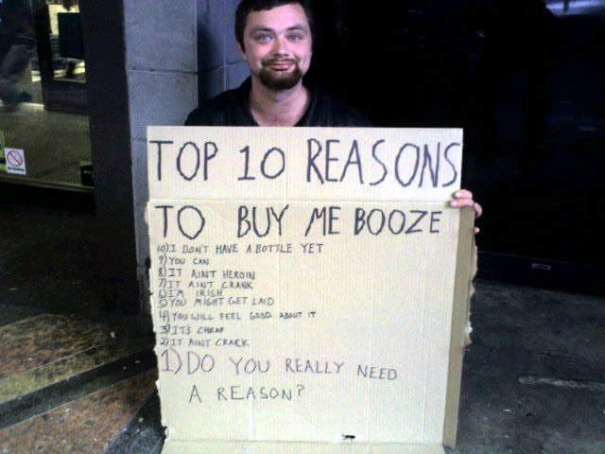
Socio-Economic?

Slide 5
Alcoholism is a Disease
In 1956, the American Medical Association classifies Alcoholism as a disease
Has both biological and psychological characteristics.
If untreated, leads to Cirrhosis, Liver Cancer, Heart Failure.
A 2004 AMA report found that 85,000 deaths were related to Alcohol consumption.

Slide 6
Who is Affected
Approximately 18 million Americans suffer from alcohol dependence or unhealthy abuse.
Alcohol intoxication is the leading risk factor for injury among emergency room visits.
Only 13% of people with either alcohol abuse or alcohol dependence receive treatment to change unhealthy alcohol use.

Slide 7
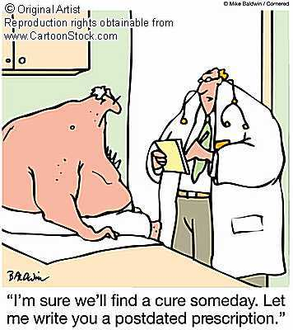
If Alcoholism is a disease, what’s the cure?

Slide 8
Treatment for Alcoholism
There is no universal, one-size fits all treatment.
Cognitive-Behavioral Therapy (CBT) : Teaches problem drinker to “modify their own behavior”. Includes relapse prevention for helping people cope with and anticipate high-risk situations.
Twelve-Step Facilitation (TSF): Get client actively involved in Twelve-Step Program. Client gets AA Sponsor, works AA 12 Steps.

Slide 9
Treatment for Alcoholism
Confrontational Approaches: Boot camp style, structured living. Hawaii-based Habilitat.
Work Therapy: Client is given jobs with daily duties. Hawaii-based Salvation Army ARC (6 month)‏
Motivational Enhancement Therapy (MET): Client is motivated toward evaluating their own situation and develop a plan to abstain from alcohol.

Slide 10
Process of Treatment
Screening and Assessment
Detoxification
Inpatient or Outpatient Counseling
Aftercare, follow-up

Slide 11
Inpatient Treatment
Recommended for severe cases or mandated by courts.
Length varies from
  28-days: what most insurances will pay
  2 years: Example: Sand Island Treatment Center.
Treatment includes daily group session, daily counseling and daily activities.

Slide 12
Outpatient Treatment
Client is attends 2-3 group and counseling sessions per week.
Client is given homework
Client is monitored for relapse.

Slide 13
eGetGoing.com
Provides outpatient treatment ONLINE.
Group session are done using headset and software.
Clients can see the counselor live.
They do not see each other but hear each others voices.
A whiteboard is shared among the clients.

Slide 14
Who is eGetGoing for?
Less severe cases.
People who travel a lot or can not make it to a facility 2-3 times a week.
People who live in areas where there is not adequate treatment available.
Clients who have a serious “fear of people.”
Clients who are very concerned about confidentiality.

Slide 15
More about EgetGoing
3 year outcome: 87% of people who enroll complete the program.
72% of people after 1 year have not relapsed.
The number one rule for e-get-going is that you are abstinent for duration of treatment
Clients may be required to take tox-screen
DUI clients may be required to take tox-screen much more often that voluntary client.

Slide 16
The Critics say....
Surveyed a few counsollors...
Most had negative first response to the idea.
“People need human interaction to re-learn how to be human not just something on the computer...”

Slide 17
The Critics say....
“It doesn’t allow you to get to know your clients personally and you lose the ability to observer client clients directly... body language, etc.”
“Clients don’t build a source of support through online meetings.”

Slide 18
Benefits of eGetGoing
Counselor found that clients actually open up faster because appearances and environment can often be distracting in person.
Some people feel more comfortable and safe on the internet.
“I’ve found that I have become more effective in my private practice. I listen more to what people say.”

Slide 19
Problems with Treatment
High Recidivism Rate.
Court mandated treatment is mixed with regular patients. Good or Bad?
Costs keep going up.
Counselor burn-out due to large case-loads, low pay.
“Many clients continue to recycle through the system.”

Slide 20
Future of Treatment
Online treatment will definitely expand as eGetGoing shows good results
More resources will have to be allocated to treatment if States want better results.
Clients who have the proper motivation to stay sober will succeed the most.
12-step programs will continue to the largest support system for recovering alcoholics and addicts. (Online AA meetings, etc)‏

Slide 21
Possible Work for Medical Informatics
Develop a database to accurately track recidivism rates of specific treatment facilities.
Enhance video conferencing technologies
Drugs to block “desire for a drink”
Educate counsellors on existing technology.

