Slide 1

JPA Continued
Java Persistence API
Leif Olsen
Notes:
09-04-01

Slide 2
Agenda
Introduksjon
Assosiasjoner
Entity Manager
JPQL
Integrasjonstesting vha. Embedded Container
(Patterns)
Notes:
Skal se på problemet og beskrive hvordan ulike mønstre kan håndtere det

Slide 3
Introduksjon
JPA er en del av JSR-220 (EJB3)
En «Standardisering» av Hibernate
POJO persistensmodell
Hvorfor JPA
  Vi jobber med Objekter ikke Tabeller
  Vi må samtidig forholde oss til ER databaser
  JPA løser misforholdet mellom objektassosiasjoner og entity relationship

Slide 4
Fra POJO til Entitet til DDL
@Entity
public class Person
implements Serializable {
@Id
private Integer id;
private String navn;
private Date fodselsdato;
private String epost;
}
public class Person {
private String navn;
private Date fodselsdato;
private String epost;
}
public class Person
implements Serializable {
private String navn;
private Date fodselsdato;
private String epost;
}
create table Person (
id integer generated by default as identity (start with 1),
navn varchar(255),
fodselsdag timestamp,
epost varchar(255),
primary key (id)
);
Notes:
Skal se på problemet og beskrive hvordan ulike mønstre kan håndtere det

Slide 5
Felt- vs. Propertyannotasjon
Annoterer enten felt eller korresponderende get-metode (annotasjon på set-metoder ignoreres)
JPA 1.0: Annotasjonsstrategi kan ikke blandes innenfor samme klasse og heller ikke innenfor samme klassehierarki
JPA 2.0: @Access annotasjon gir mulighet for å blande felt- og property annotasjon

Slide 6
Feltannotasjon
Feltverdier settes via reflection
set- og getmetoder ignoreres
protected, private eller package
public ikke lov ->
(kan gi) kompileringsfeil
«Side effects» er ikke mulig – hvordan regne ut alder?
@Entity
public class Person
implements Serializable {
@Id
private Integer id;
private Date fodselsdato;
@Transient
private int alder;
// Kun getter/setter
// metoder for de feltene
// vi ønsker å eksponere
public Integer getId() {
return id;
}
}

Slide 7
Propertyannotasjon
Følger Java Bean konvensjonen
Get-metoden annoteres
Feltnavn mappes fra get-metode
Annotasjon på set-metode ignoreres
Gir mulighet for «side effects», f.eks beregne verdier for transiente felter
@Entity
public class Person
implements Serializable {
private Integer id;
private Date fodselsdato;
private transient int alder;
@Id
public Integer getId() {
return id;
}
protected void setId(Integer id) {
this.id = id;
}
public Date getFdato () {
alder = idag - dato; // side effect
return fodselsdato;
}
}
public Date getFdato

Slide 8
Arvestrategier
JPA supporterer tre arvestrategier
SINGLE_TABLE – en tabell pr. Hierarki
JOINED – entitet pr. Tabell
TABLE_PER_CLASS – en tabell for hver konkrete klasse

Slide 9

Arvestrategier, eksempel

Slide 10
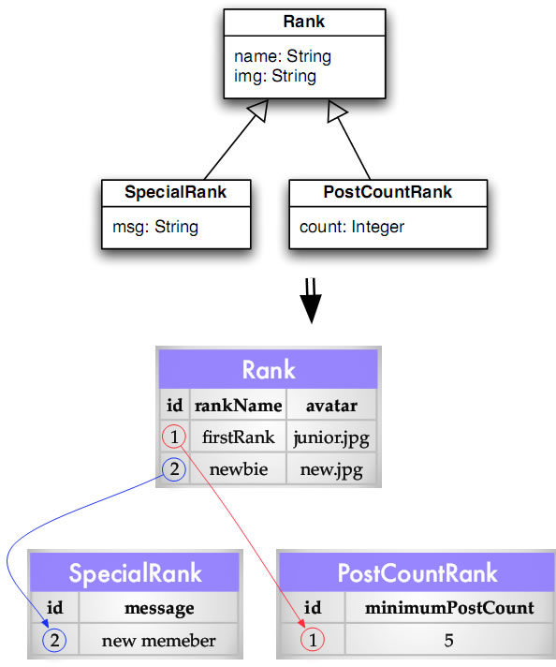
Arvestrategier, SINGLE_TABLE
@Entity
@Inheritance(strategy=SINGLE_TABLE)
@DiscriminatorColumn(name="type",discriminatorType=STRING)
public abstract class Rank {
@Id
@GeneratedValue(strategy=GenerationType.TABLE)
private Long id;
protected String rankName;
protected String avatar;
}
@Entity
@DiscriminatorValue("SPECIAL_RANK")
public class SpecialRank extends Rank {
protected String message;
}
@Entity(name="POST_COUNT")
public class PostCountRank extends Rank {
protected Integer minimumPostCount;
}

Slide 11
Arvestrategier, SINGLE_TABLE
DDL
create table Rank (
type varchar(31) not null,
id bigint not null,
avatar varchar(255),
rankName varchar(255),
message varchar(255),
minimumPostCount integer,
primary key (id)
);
create table hibernate_sequences (
sequence_name varchar(255),
sequence_next_hi_value integer
) ;

Slide 12
Arvestrategier, JOINED
@Entity
@Inheritance(strategy=JOINED)
public abstract class Rank {
@Id
@GeneratedValue(strategy=GenerationType.TABLE)
private Long id;
protected String rankName;
protected String avatar;
}
@Entity
public class SpecialRank extends Rank {
protected String message;
}
@Entity(name="POST_COUNT")
public class PostCountRank extends Rank {
protected Integer minimumPostCount;
}

Slide 13
Arvestrategier, JOINED
DDL
create table Rank (
id bigint not null,
avatar varchar(255),
rankName varchar(255),
primary key (id)
);
create table SpecialRank (
message varchar(255),
id bigint not null,
primary key (id)
);
create table POST_COUNT (
minimumPostCount integer,
id bigint not null,
primary key (id)
);
alter table POST_COUNT
add constraint FKC790549024828CD1
foreign key (id)
references Rank;
alter table SpecialRank
add constraint FK2F68A46524828CD1
foreign key (id)
references Rank;
create table hibernate_sequences (
sequence_name varchar(255),
sequence_next_hi_value integer
) ;

Slide 14
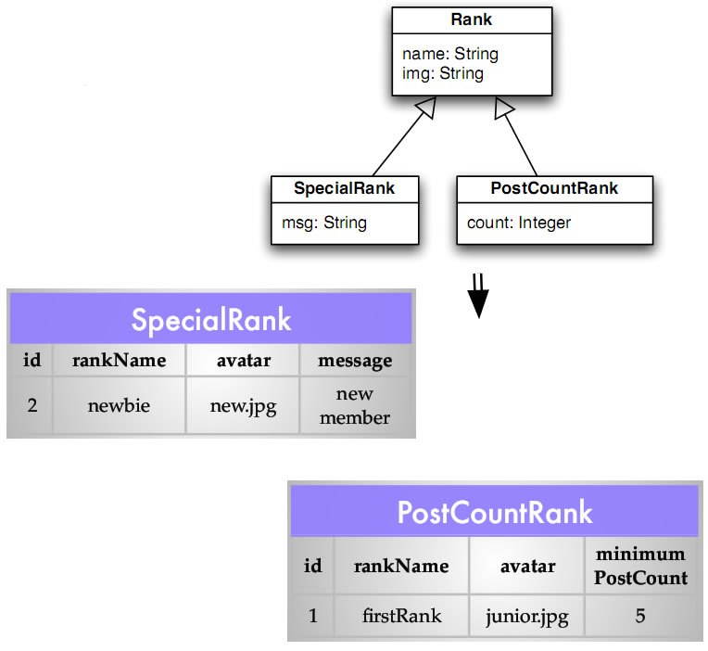
Arvestrategier, TABLE_PER_CLASS
@Entity
@Inheritance(strategy=TABLE_PER_CLASS)
public abstract class Rank {
@Id
@GeneratedValue(strategy=GenerationType.TABLE)
private Long id;
protected String rankName;
protected String avatar;
}
@Entity
public class SpecialRank extends Rank {
protected String message;
}
@Entity
@AttributeOverrides({
@AttributeOverride(
name="avatar", column=@Column(name="image"))
})
public class PostCountRank extends Rank {
protected Integer minimumPostCount;
}

Slide 15
Arvestrategier, TABLE_PER_CLASS
DDL
create table PostCountRank (
id bigint not null,
avatar varchar(255),
rankName varchar(255),
minimumPostCount integer,
primary key (id)
);
create table SpecialRank (
id bigint not null,
avatar varchar(255),
rankName varchar(255),
message varchar(255),
primary key (id)
);
create table hibernate_sequences (
sequence_name varchar(255),
sequence_next_hi_value integer
) ;

Slide 16
Callbacks og Listeners
Callbackmetoder defineres på entitetklassen
Listenermetoder defineres i en klasse utenfor entitetklassen
Callback / Listener metoder annoteres
  @PrePersist/@PostPersist
  @PreUpdate/@PostUpdate – persistence provider dependent
  @PreRemove/@PostRemove
  @PostLoad
Kan overstyres i arvehierarki, superklassens callback kjøres først
@ExcludeSuperclassListeners – endrer rekkefølge

Slide 17
Eksempel på callback
@MappedSuperclass
public abstract class ModelBase {
@PrePersist
public void setDates() {
Date now = new Date();
if (dateCreated == null) {
dateCreated = now;
}
dateUpdated = now;
}
}

Slide 18
Eksempel på Entity Listener
@MappedSuperclass
@EntityListeners({ModelListener.class})
public abstract class ModelBase {
// fields and methods removed for readability
}
public class ModelListener {
@PrePersist
public void setDates(ModelBase modelBase) {
Date now = new Date();
if (modelBase.getDateCreated() == null) {
modelBase.setDateCreated(now);
}
modelBase.setDateUpdated(now);
}
}

Slide 19
Entitet-relasjoner
Navigerbarhet
  Kan være en vei eller begge veier (unidirectional / bidirectional)
Kardinalitet
  one-to-one, one-to-many, many-to-one, many-to-many
Komposisjon / Aggregering
  Eierskap
Ordinalitet
  Må /Kan

Slide 20

Entitet-relasjoner, Navigerbarhet
Unidirectional
Bidirectional

Slide 21

Entitet-relasjoner, Kardinalitet
Kardinalitet (hvor mange)

Slide 22
Entitet-relasjoner, Ordinalitet
Ordinalitet (må / kan relasjon)

Slide 23

Entitet-relasjoner,
Aggregering / Komposisjon
Aggregering / Komposisjon

Slide 24

@OneToOne, bidirectional
@Entity
public class Employee
implements Serializable {
@Id
private Long id;
//....
@OneToOne
@JoinColumn(name="parkingspace_id")
private ParkingSpace parkingSpace;
}
@Entity
public class ParkingSpace
implements Serializable {
@Id
private Long id;
@Version
private Long version;
private Integer lot;
private String location;
@OneToOne(mappedBy="parkingSpace")
private Employee employee;
}
Viktig å huske:
  @OneToOne med @JoinColumn er «owning side»
  «Inverse side» har mappedBy element

Slide 25
@OneToOne, bidirectional, DDL
create table Employee (
id bigint not null,
name varchar(100) not null,
version bigint,
department_id bigint,
parkingspace_id bigint,
primary key (id),
unique (name)
);
create table ParkingSpace (
id bigint not null,
location varchar(255),
lot integer,
version bigint,
primary key (id)
);
alter table Employee
add constraint FK4AFD4ACE285E0064
foreign key (parkingspace_id)
references ParkingSpace;

Slide 26

@ManyToOne, unidirectional
@Entity
public class Employee
implements Serializable {
@Id private Long id;
@Version private Long version;
@Column(unique=true)
@NotNull
@Length(max = 100)
private String name;
@ManyToOne(optional=false)
@JoinColumn(name="department_id")
private Department department;
}
@Entity
public class Department
implements Serializable {
@Id
private Long id;
@Version
private Long version;
@Column(unique=true)
@NotNull
@Length(max = 100)
private String name;
}
@ManyToOne => kardinalitet
(optional=false) => ordinalitet

Slide 27
@ManyToOne, unidirectional, DDL
create table Department (
id bigint not null,
name varchar(100) not null,
version bigint,
primary key (id),
unique (name)
);
create table Employee (
id bigint not null,
name varchar(100) not null,
version bigint,
department_id bigint not null,
primary key (id),
unique (name)
);
alter table Employee
add constraint FK4AFD4ACEC452BC84
foreign key (department_id)
references Department;

Slide 28

@OneToMany, bidirectional
@Entity
public class Employee
implements Serializable {
@Id
private Long id;
//....
@ManyToOne
@JoinColumn(name="department_id")
private Department department;
}
@Entity
public class Department
implements Serializable {
@Id
private Long id;
//...
@OneToMany(mappedBy="department")
private Collection<Employee> employees;
}
Viktig å huske:
  @ManyToOne er «owning side» -> @JoinColumn annotasjon
  @OneToMany er «inverse side» -> mappedBy element

Slide 29
@OneToMany, bidirectional, DDL
create table Department (
id bigint not null,
name varchar(100) not null,
version bigint,
primary key (id),
unique (name)
);
create table Employee (
id bigint not null,
name varchar(100) not null,
version bigint,
department_id bigint,
parkingspace_id bigint,
primary key (id),
unique (name)
);
alter table Employee
add constraint FK4AFD4ACEC452BC84
foreign key (department_id)
references Department;

Slide 30
@ManyToMany, bidirectional
@Entity
public class Employee
implements Serializable {
@Id
private Long id;
//....
@ManyToMany(mappedBy="employees")
private Collection<Project> projects;
}
@Entity
public class Project
implements Serializable {
@Id
private Long id;
//...
@ManyToMany
private Collection<Employee> employees;
}
Viktig å huske:
  «inverse side» har mappedBy element
  Uten mappedBy får vi to enveis assoiasjoner

Slide 31
@ManyToMany, bidirectional, DDL
create table Employee (
id bigint not null,
name varchar(100) not null,
version bigint,
department_id bigint not null,
parkingspace_id bigint,
primary key (id),
unique (name)
);
create table Project (
id bigint not null,
name varchar(100) not null,
version bigint,
primary key (id),
unique (name)
);
create table Employee_Project (
projects_id bigint not null,
employees_id bigint not null
);
alter table Project_Employee
add constraint FKD1E6E1542999C24F
foreign key (projects_id)
references Project;
alter table Project_Employee
add constraint FKD1E6E154EC40DD4D
foreign key (employees_id)
references Employee;

Slide 32

@ManyToMany++
En mange-til-mange assosiasjon har ofte ekstra informasjon knyttet til assosiasjonen

Slide 33
@ManyToMany++
@Entity
@Table(name = "ProjectAssignment")
@org.hibernate.annotations.Table(
appliesTo = "ProjectAssignment", indexes =
@org.hibernate.annotations.Index(
name = "idx_projectassignments",
columnNames = { "project_id", "employee_id" }
) )
public class ProjectAssignment implements Serializable {
@Id private Long id;
@Version private Long version;
@Temporal(TemporalType.DATE)
private Date embarkedDate;
@ManyToOne
@JoinColumn(name="project_id")
private Project project;
@ManyToOne
@JoinColumn(name="employee_id")
private Employee asignee;
}

Slide 34
@ManyToMany++
@Entity
public class Employee implements Serializable {
private static final long serialVersionUID = 1L;
@Id
private Long id;
//...
@OneToMany(mappedBy="asignee")
private Collection<ProjectAssignment> projectAssignments;
}

Slide 35
@ManyToMany++, DDL
create table ProjectAssignment (
id bigint not null,
embarkedDate date,
version bigint,
employee_id bigint,
project_id bigint,
primary key (id)
);
create index idx_projectassignments
on ProjectAssignment
(project_id, employee_id);
alter table ProjectAssignment
add constraint FK6305A2A6EC259750
foreign key (project_id)
references Project;
alter table ProjectAssignment
add constraint FK6305A2A689B32984
foreign key (employee_id)
references Employee;

Slide 36

Komposisjon,
@Embedded / @Embeddable
@Entity
public class Employee
implements Serializable {
@Id
private Long id;
//....
@Embedded
private EmployeeDetail employeeDetail;
}
@Embeddable
public class EmployeeDetail {
private String firstName;
private String lastName;
}
@Embeddable har ingen egen identitet.
Klassen er en del av en annen entitet.

Slide 37
Komposisjon, DDL
create table Employee (
id bigint not null,
firstName varchar(255),
lastName varchar(255),
version bigint,
department_id bigint not null,
parkingspace_id bigint,
primary key (id)
);

Slide 38
Aggregering
Part of eller has-a relasjon
Entiteter i aggregasjonen kan eksistere uavhengig av hverandre eller ikke
Annoteres med
  @ManyToOne
  @OneToMany
  @ManyToMany
  @OneToOne

Slide 39
Aggregering
Styrken på aggregeringen bestemmes av CascadeType.
  ALL
  PERSIST
  MERGE
  REMOVE
  REFRESH
«Actions» når det har skjedd endringer på relaterte objekter.

Slide 40
Aggregering, sterk binding
@Entity
public class Faktura
implements Serializable {
@Id
private Long id;
//....
@OneToMany (mappedBy="faktura",
cascade=CascadeType.ALL)
private Collection<Fakturalinje> fakturalinjer;
}
@Entity
public class Fakturalinje
implements Serializable {
@Id
private Long id;
//....
private String tekst;
@ManyToOne
@JoinColumn (name="faktura_id")
private Faktura faktura;
}
Fakturaline eksisterer kun i kontekst av Faktura
Sletting av Faktura entitet sletter alle Fakturalinje entiteter

Slide 41
Aggregering, svak binding
@Entity
public class Employee
implements Serializable {
@Id
private Long id;
//....
@ManyToMany(mappedBy="employees")
private Collection<Project> projects;
}
@Entity
public class Project
implements Serializable {
@Id
private Long id;
//...
@ManyToMany
(cascade={ CascadeType.PERSIST,
CascadeType.MERGE } )
private Collection<Employee> employees;
}

Slide 42
EntityManager
Gateway mellom entiteter og persistenslag
Håndterer entiteters livssyklus
Typesafe CRUD servicer:
persist, remove, find, merge, etc.
Interface mot Transaction API
Interface mot JPQL
Må ha persistence.xml i classpath
Persistence Context: Entiteter administrert av EntityManager
Dirty checking

Slide 43

EntityManager
Gateway mellom entiteter og persistenslag
Sørger for O/R mappingen

Slide 44
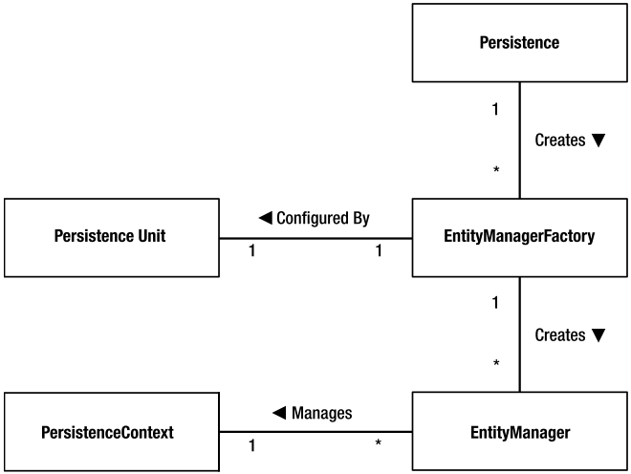
EntityManager
EntityManager hentes via EntityManagerFactory

Slide 45

EntityManager
Håndterer entiteters livssyklus
Sørger for at persistente felter er synkronisert med databasen

Slide 46
EntityManager, persistence.xml
<?xml version="1.0" encoding="UTF-8"?>
<persistence version="1.0" xmlns="http://java.sun.com/xml/ns/persistence"
xmlns:xsi="http://www.w3.org/2001/XMLSchema-instance"
xsi:schemaLocation="http://java.sun.com/xml/ns/persistence
http://java.sun.com/xml/ns/persistence/persistence_1_0.xsd">
<persistence-unit name="movie-unit" transaction-type="JTA">
<provider>org.hibernate.ejb.HibernatePersistence</provider>
<jta-data-source>java:/movie-unitDatasource</jta-data-source>
<properties>
<property name="hibernate.dialect" value="org.hibernate.dialect.HSQLDialect"/>
<property name="hibernate.hbm2ddl.auto" value="create-drop"/>
<property name="hibernate.show_sql" value="false"/>
....
....
<property name="hibernate.transaction.manager_lookup_class"
value="org.apache.openejb.hibernate.TransactionManagerLookup"/>
</properties>
</persistence-unit>
</persistence>
transaction-type="RESOURCE_LOCAL" dersom man håndterer EntityManager selv

Slide 47
EntityManager
Applikasjonskontrollert
EJB Container
EntityManagerFactory
emf = Persistence.
createEntityManagerFactory(“movie-unit”);
EntityManager em = null;
Movie movie = new Movie("The Wall");
try {
em = emf.createEntityManager();
em.getTransaction.begin();
em.persist(movie);
em.getTransaction.commit();
}
catch (Exception ex) {
//........
}
finally {
if (em != null) {
em.close();
}
emf.close();
}
@Stateless
public class MovieService {
@PersistenceContext
private EntityManager em;
public void create(Movie movie) {
em.persist(movie);
}
}

Slide 48
JPQL
Hente ut objekter fra persistenslaget
Forenkler uthentingen. Skriv kun det som er vesentlig. Resten håndterer JPQL:
  JPQL: from Movie
  JPQL: select object(m) from Movie as m
  SQL : select * from movie

Slide 49
JPQL
Projeksjon (hente ut enkeltfelter)
  select m.title from Movie m
ManyToOne
  select distinct m.director from Movie m
Filtering
  select m.director
  from Movie m
  where m.director.name = "Alan Parker"

Slide 50
JPQL
Inner Join
select m
from Director d, Movie m
where d = m.director
Inner Join
select m
from Director d, IN (d.movies) m

Slide 51
JPQL
Inner Join
select m
from Director d JOIN d.movies m
Left Outer Join
select m
from Director d LEFT JOIN d.movies m

Slide 52
JPQL
Fetch Join
select d
from Director d
JOIN FETCH d.movies m
Left Outer Fetch Join
select d
from Director d
LEFT JOIN FETCH d.movies m

Slide 53
JPA Patterns
CRUD Service (DAO / Repository)
public interface CrudService {
public T create(T t);
public T find(Class type,Object id);
public T update(T t);
public void delete(Class type,Object id);
public List findWithNamedQuery(String queryName);
public List findWithNamedQuery(String queryName,int resultLimit);
public List findWithNamedQuery(
String namedQueryName, Map parameters);
public List findWithNamedQuery(
String namedQueryName, Map parameters,int resultLimit);
}
Eksempel på implementasjoner
  Adam Bien, CrudService
  Crank, GenericDAO

Slide 54
Integrasjonstesting vha. OpenEJB
OpenEJB
  «Superrask» EJB-3.x embedded container
  Booter på mindre enn 1 sek
  http://apache.org/openejb
  Eksempelkode:
    http://code.google.com/p/seam-maven-refimpl/
    http://www.adam-bien.com/
    roller/abien/entry/how_to_unit_test_ejb
    http://magnus-k-karlsson.blogspot.com/
    2009/07/effective-unit-testing-ejb-30-with.html

Slide 55
hbm2ddl
<plugin>
<groupId>org.codehaus.mojo</groupId>
<artifactId>hibernate3-maven-plugin</artifactId>
<version>2.2</version>
<executions>
<execution>
<phase>process-classes</phase>
<goals>
<goal>hbm2ddl</goal>
</goals>
</execution>
</executions>
<configuration>
<components>
<component>
<name>hbm2ddl</name>
<implementation>jpaconfiguration</implementation>
</component>
</components>
<componentProperties>
<persistenceunit>movie-unit</persistenceunit>
<outputfilename>schema.ddl</outputfilename>
<drop>true</drop>
<create>true</create>
<export>false</export>
<format>true</format>
</componentProperties>
</configuration>
</plugin>

Slide 56
hbm2ddl
mvn compile
mvn hibernate3:hbm2ddl
=> target/hibernate3/sql/schema.ddl

Slide 57
Eksempelprosjekt
http://code.google.com/p/seam-maven-refimpl/source/browse/trunk/sandbox/loo/jpa-continued/

