Slide 1
Chronological Stratification
in the Epics and Purāṇas
Evidence from Stylometric Seriation
Kengo Harimoto
DICSEP 11 · 4 August 2026
Notes:
Thirty seconds; straight into the picture.

Slide 2
Take a look at the next slide

Slide 3
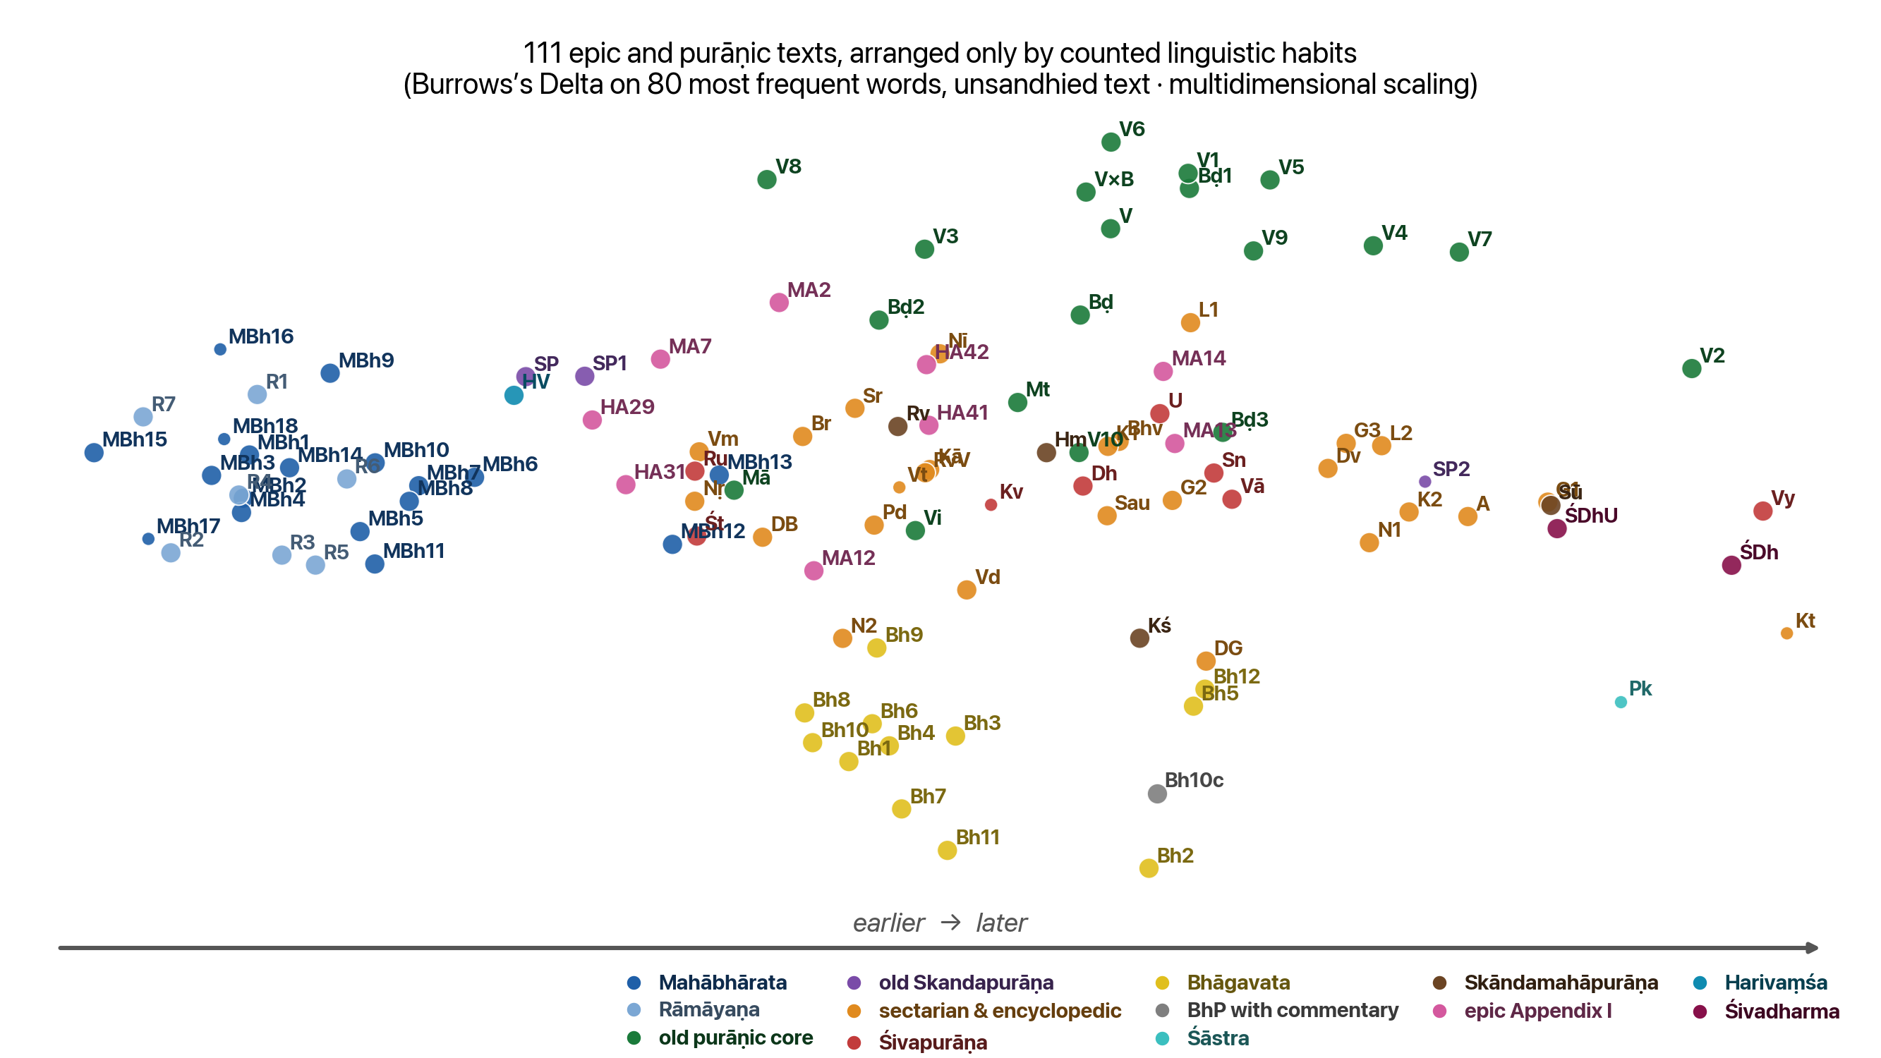
Notes:
Let the audience find their texts. Epics left, old purāṇic core upper middle, sectarian digests right, Bhāgavata below. One color = one stratum of the RECEIVED chronology, not of the computation. MBh 12 and 13 nicely to the right.

Slide 4
THE PICTURE
What was that?
This map was drawn by counting linguistic habits — nothing else
no dates imposed
no chronology considered
no philological judgment made
only the colors were painted on afterwards
Yet the familiar relative chronology reads left to right.
Notes:
The coloring is the only place received scholarship touches the plot; the geometry is blind.

Slide 5
THE PICTURE
Two questions worth thirty minutes
What exactly was counted?
1
Can the left–right axis be trusted —
and what good does it do if it is?
2
Notes:
Roadmap: first how the map is made, then a guided tour, then the robustness case, then honest caveats.

Slide 6
HOW THE MAP WAS MADE
The corpus: 111 texts and sections · ≈ 4.8 million words
111
≈ 4.8 M
× 2
texts and sections
running words
parallel versions:
sandhied · unsandhied
Mahābhārata by parvan (18) · Rāmāyaṇa by kāṇḍa (7)
purāṇas whole, or by khaṇḍa / saṃhitā where transmission demands it
machine-readable editions, cleaned; two parallel versions of every text — with and without sandhi dissolved
Caveat kept in view: sections differ enormously in length; short fragments are marked with smaller dots on every map.
Notes:
One line on e-text provenance; don't linger.

Slide 7
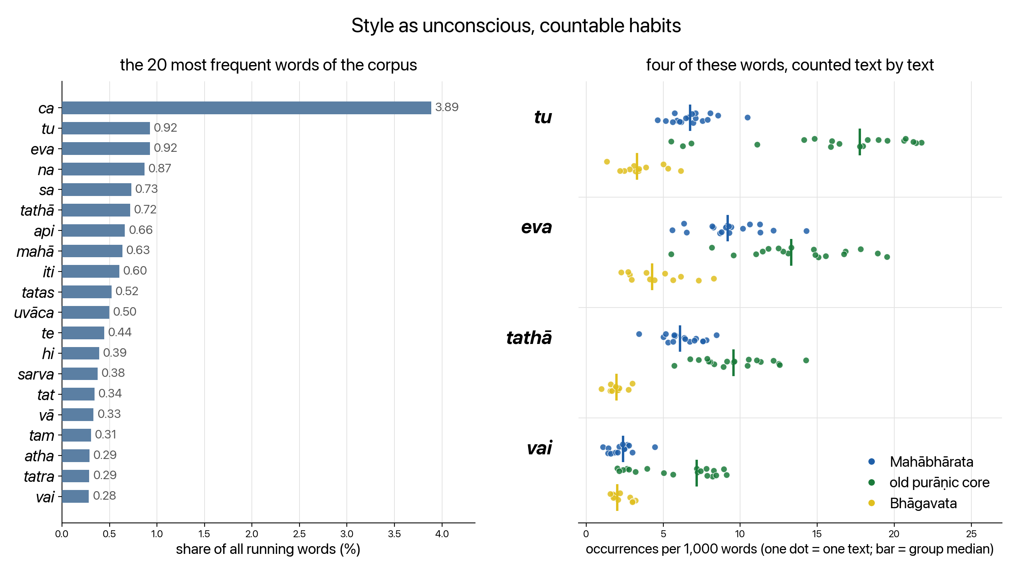
Notes:
Left: the features are ca, tu, eva, na, sa, tathā — grammatical glue, not content. Nobody composes with their rate of 'tu' in mind. Right: the old purāṇic core uses tu/eva/tathā/vai about 1.5–3× as often as the Mahābhārata; the Bhāgavata suppresses all four. These boring words carry the signal.

Slide 8
HOW THE MAP WAS MADE
From counts to distances
For each pair of texts:
how differently do they use their most common words?
similar habits → small number
different habits → large number
Result: a 111 × 111 table of stylistic distances
(Burrows’s Delta — the standard workhorse of stylometry, in use since 2002)
pair | distance
MBh 7 (Droṇa) ↔ MBh 8 (Karṇa) | 0.28
Vāyu ↔ Brahmāṇḍa | 0.28
typical pair in this corpus | 1.04
Rām 2 (Ayodhyā) ↔ Agni | 1.34
Notes:
No formulas: 'an average of disagreements in word habits, in units of what is normal for this corpus.' Table rows preview later tour stops.

Slide 9
HOW THE MAP WAS MADE
The same corpus, measured twice
 | Lens 1 — words | Lens 2 — letter groups
counts | the 80 most frequent words | the 5,000 most frequent 3-letter sequences
input | sandhi dissolved (segmented) | raw sandhied text
sees | particles, pronouns, vocabulary habits | morphology, phonology
Independent failure modes: nothing that could fool one lens can fool the other.
Notes:
Flag now, cash in at Act 4: any segmentation-pipeline artifact could only touch Lens 1; any orthographic/sandhi artifact only Lens 2.

Slide 10
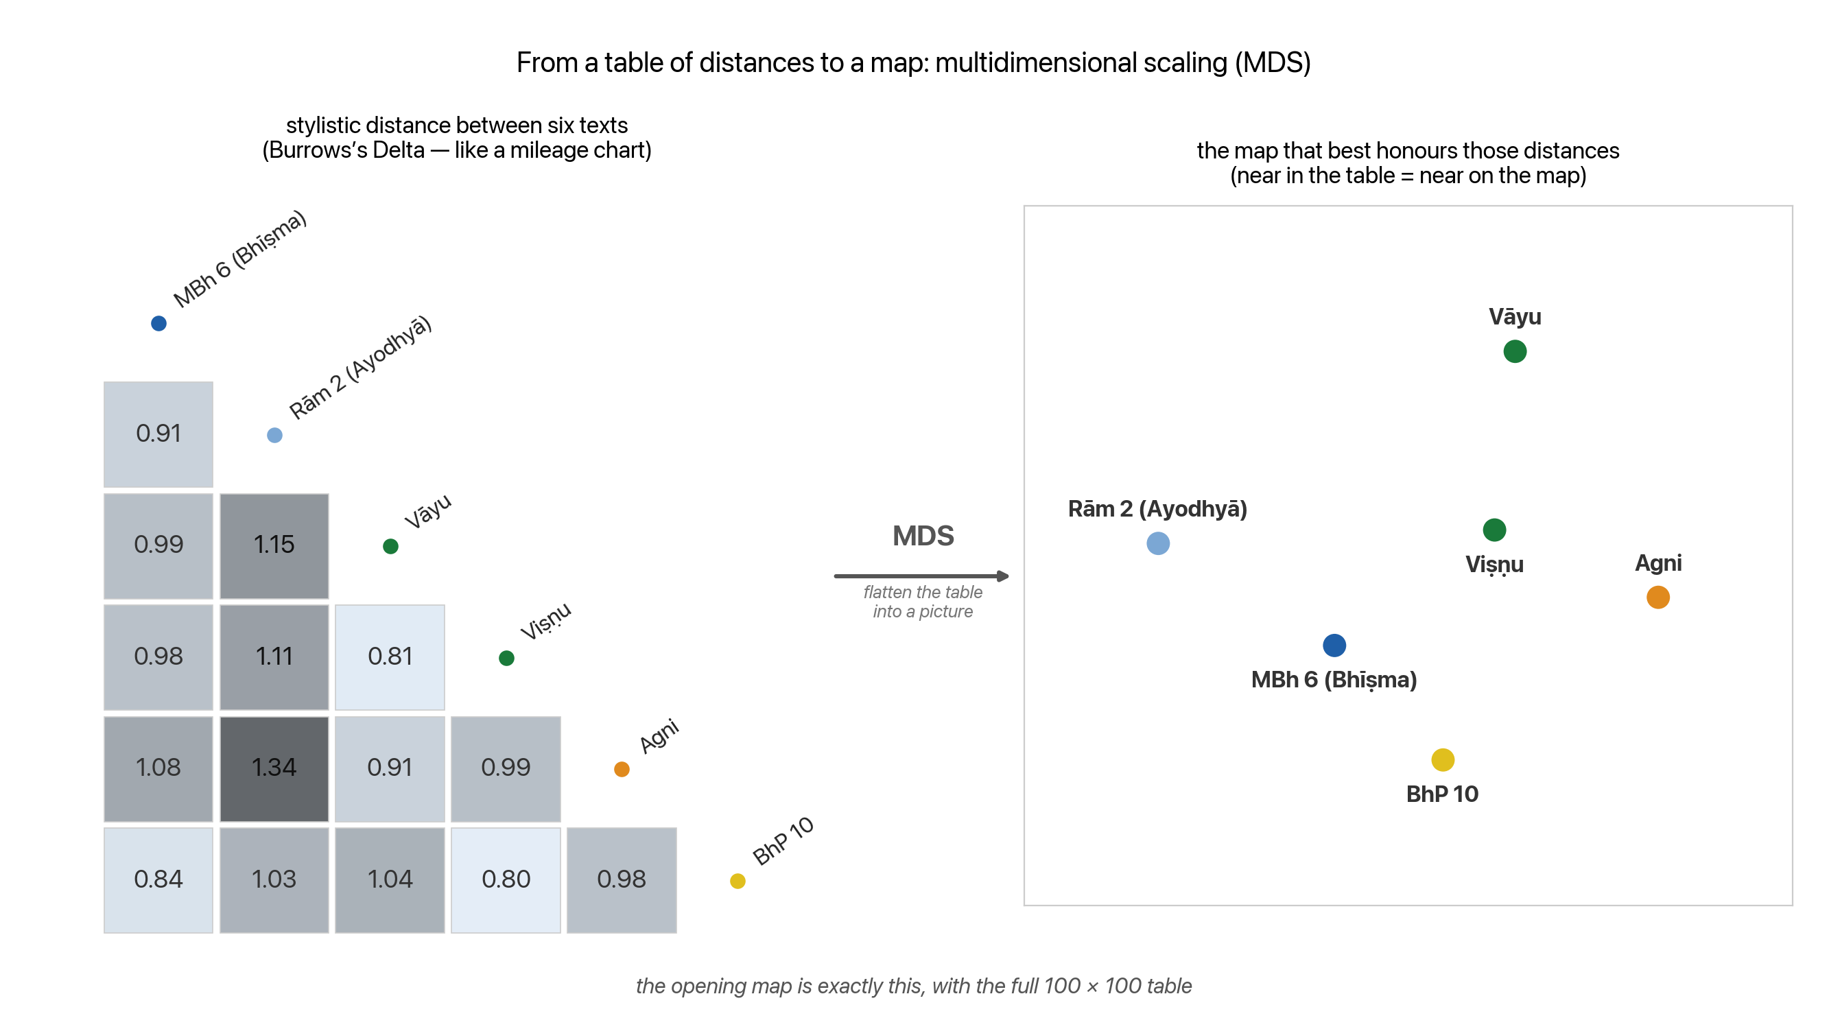
Notes:
Mileage-chart analogy: given only road distances between cities you can redraw the map of India. MDS does exactly that with stylistic distances. The opening map is this with the full 111×111 table. Axes mean nothing by themselves; only nearness does.

Slide 11
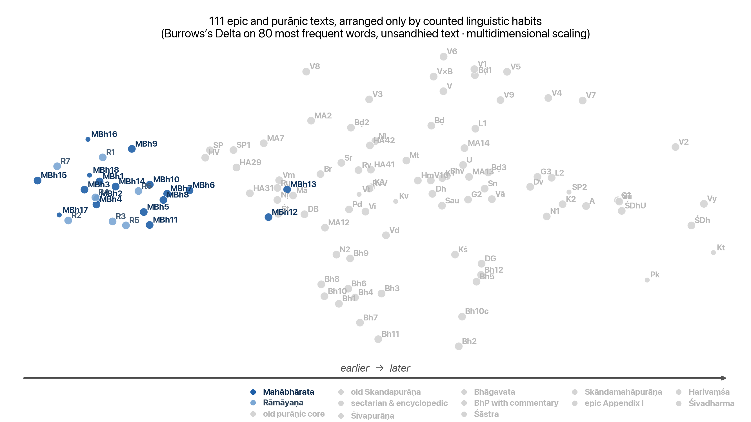
READING THE MAP · 1
The epic zone
battle books MBh 6–9 cluster tightly — Droṇa ↔ Karṇa the tightest pair (0.28 ≈ ¼ of a typical distance)
MBh 12–13 (Śānti, Anuśāsana): mutual nearest neighbours — and drifted toward purāṇa-space...
Rām 2–6 hold together; Bāla(R1)’s nearest neighbour is the Uttara(R7)... — in both lenses
The stratification of higher criticism, recovered blind.
Notes:
The machine has read no Hopkins and no Brockington, yet the battle books cluster, the didactic parvans MBh 12–13 drift toward purāṇa-space, and the two framing khaṇḍas resemble each other. Note (no chronology assumed): coloring is by text — Mahābhārata vs Rāmāyaṇa — not by supposed date; the closing parvans’ extreme position is a finding, not an input. Precision for Q&A: Bāla↔Uttara mutual in the word lens; in the 3-gram lens both are nearest to MBh 3.

Slide 12
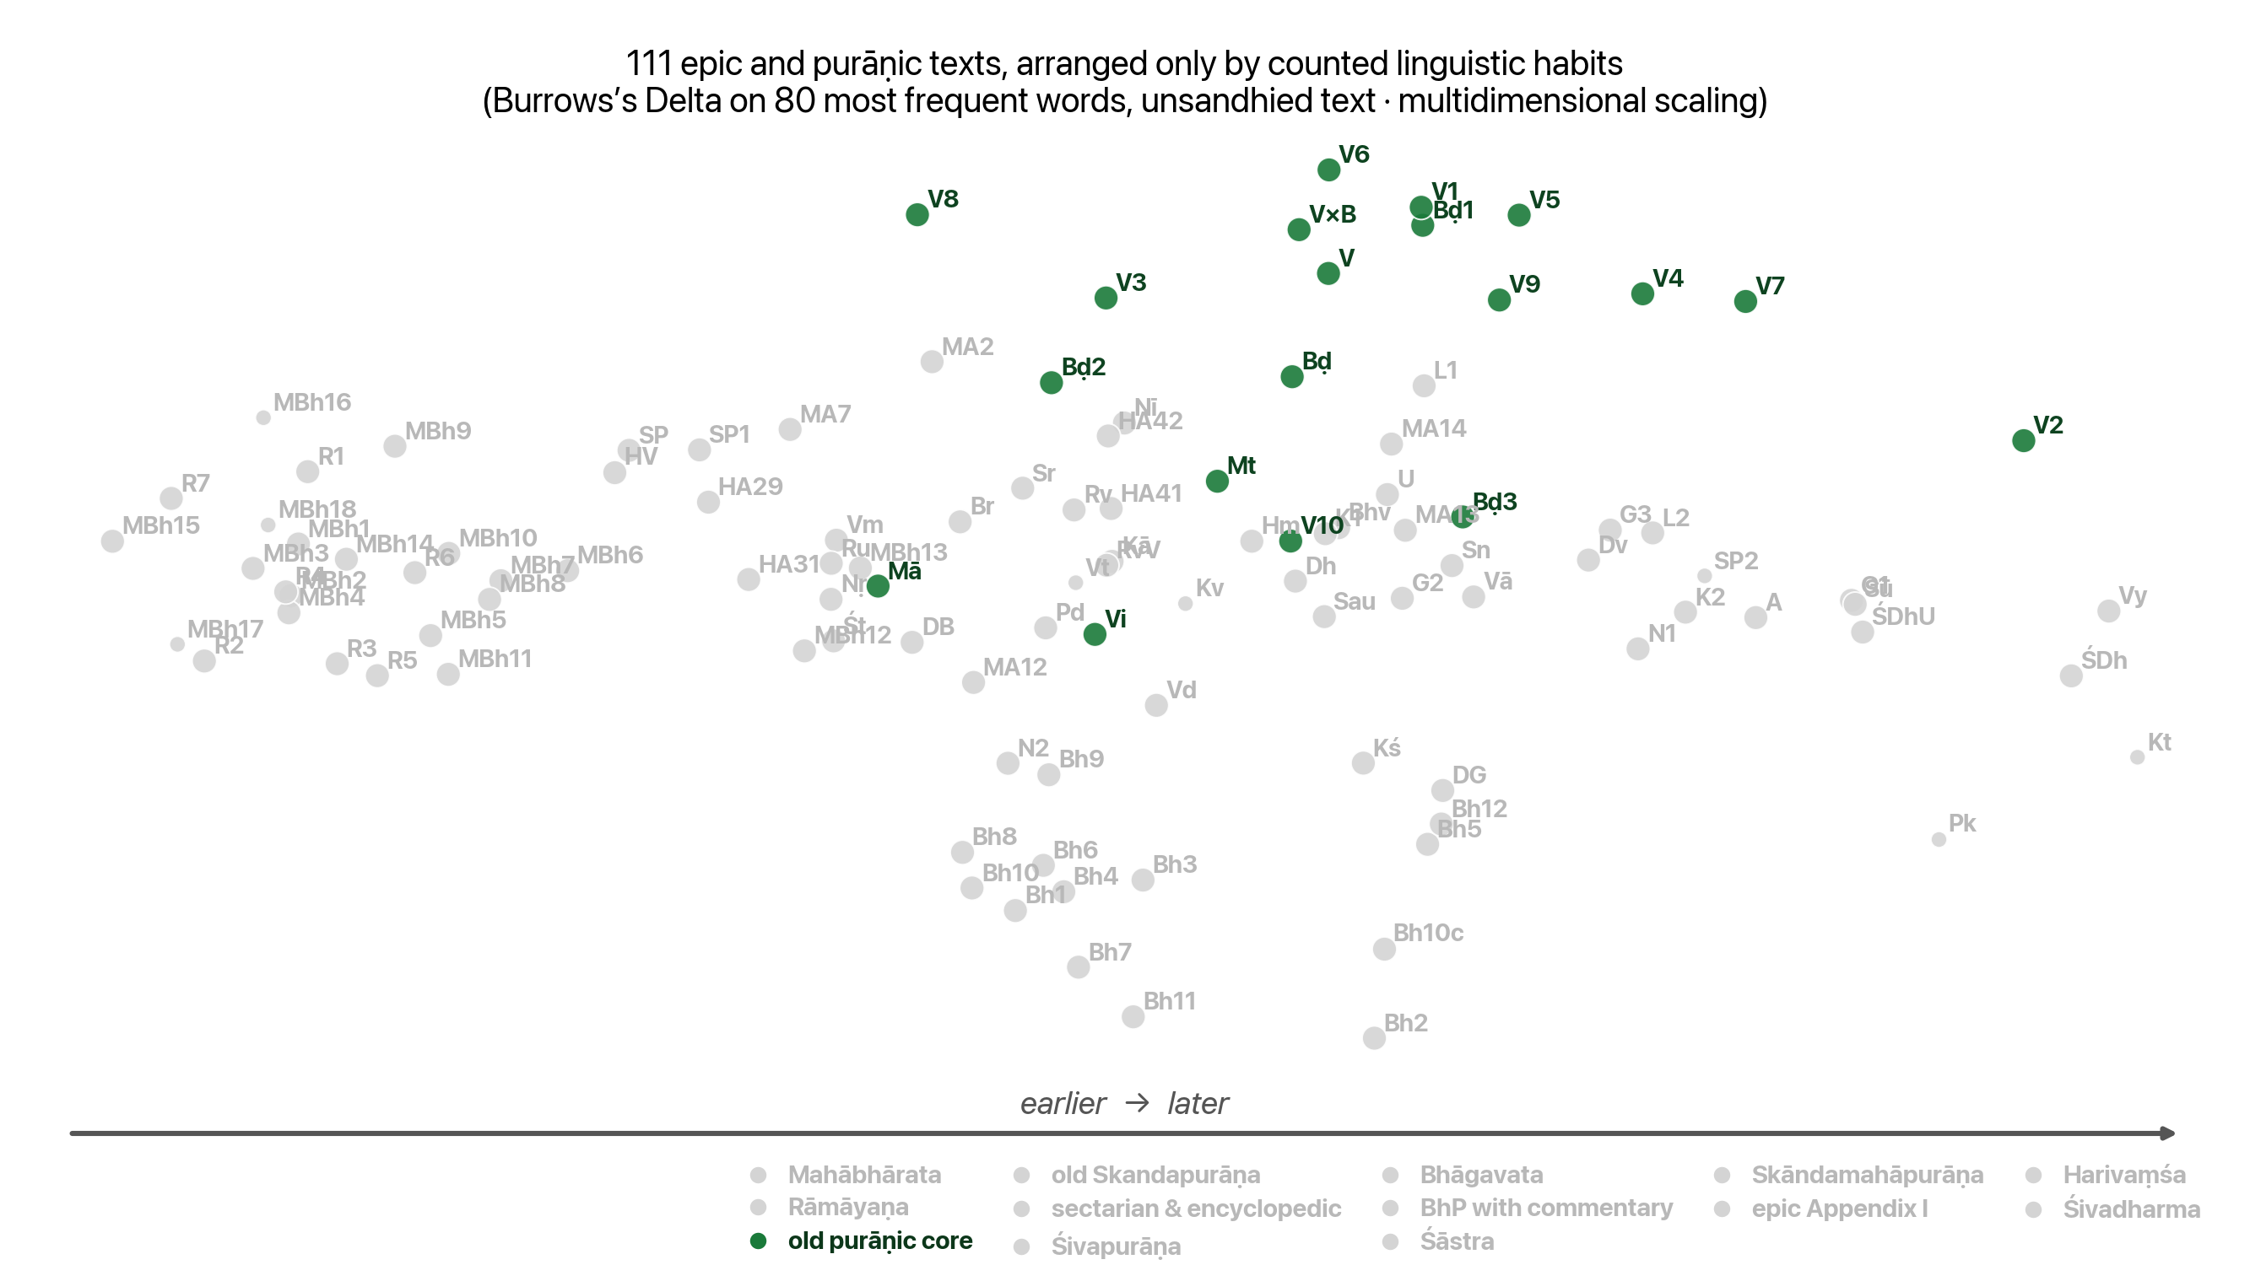
READING THE MAP · 2
The old purāṇic core?
Vāyu ↔ Brahmāṇḍa: 0.28 — a quarter of a typical distance. Kirfel’s single Vāyuproktaṃ Purāṇam, as a number.
Viṣṇu ↔ Mārkaṇḍeya: mutual nearest neighbours, in both lenses
Matsya’s cosmogonic chapters sit with them
Notes:
Kirfel (1927) predicted this cluster a century ago; the counting confirms it without being told. The Vāyu∩Brahmāṇḍa common-material extract (V×B) sits closest of all to both.

Slide 13
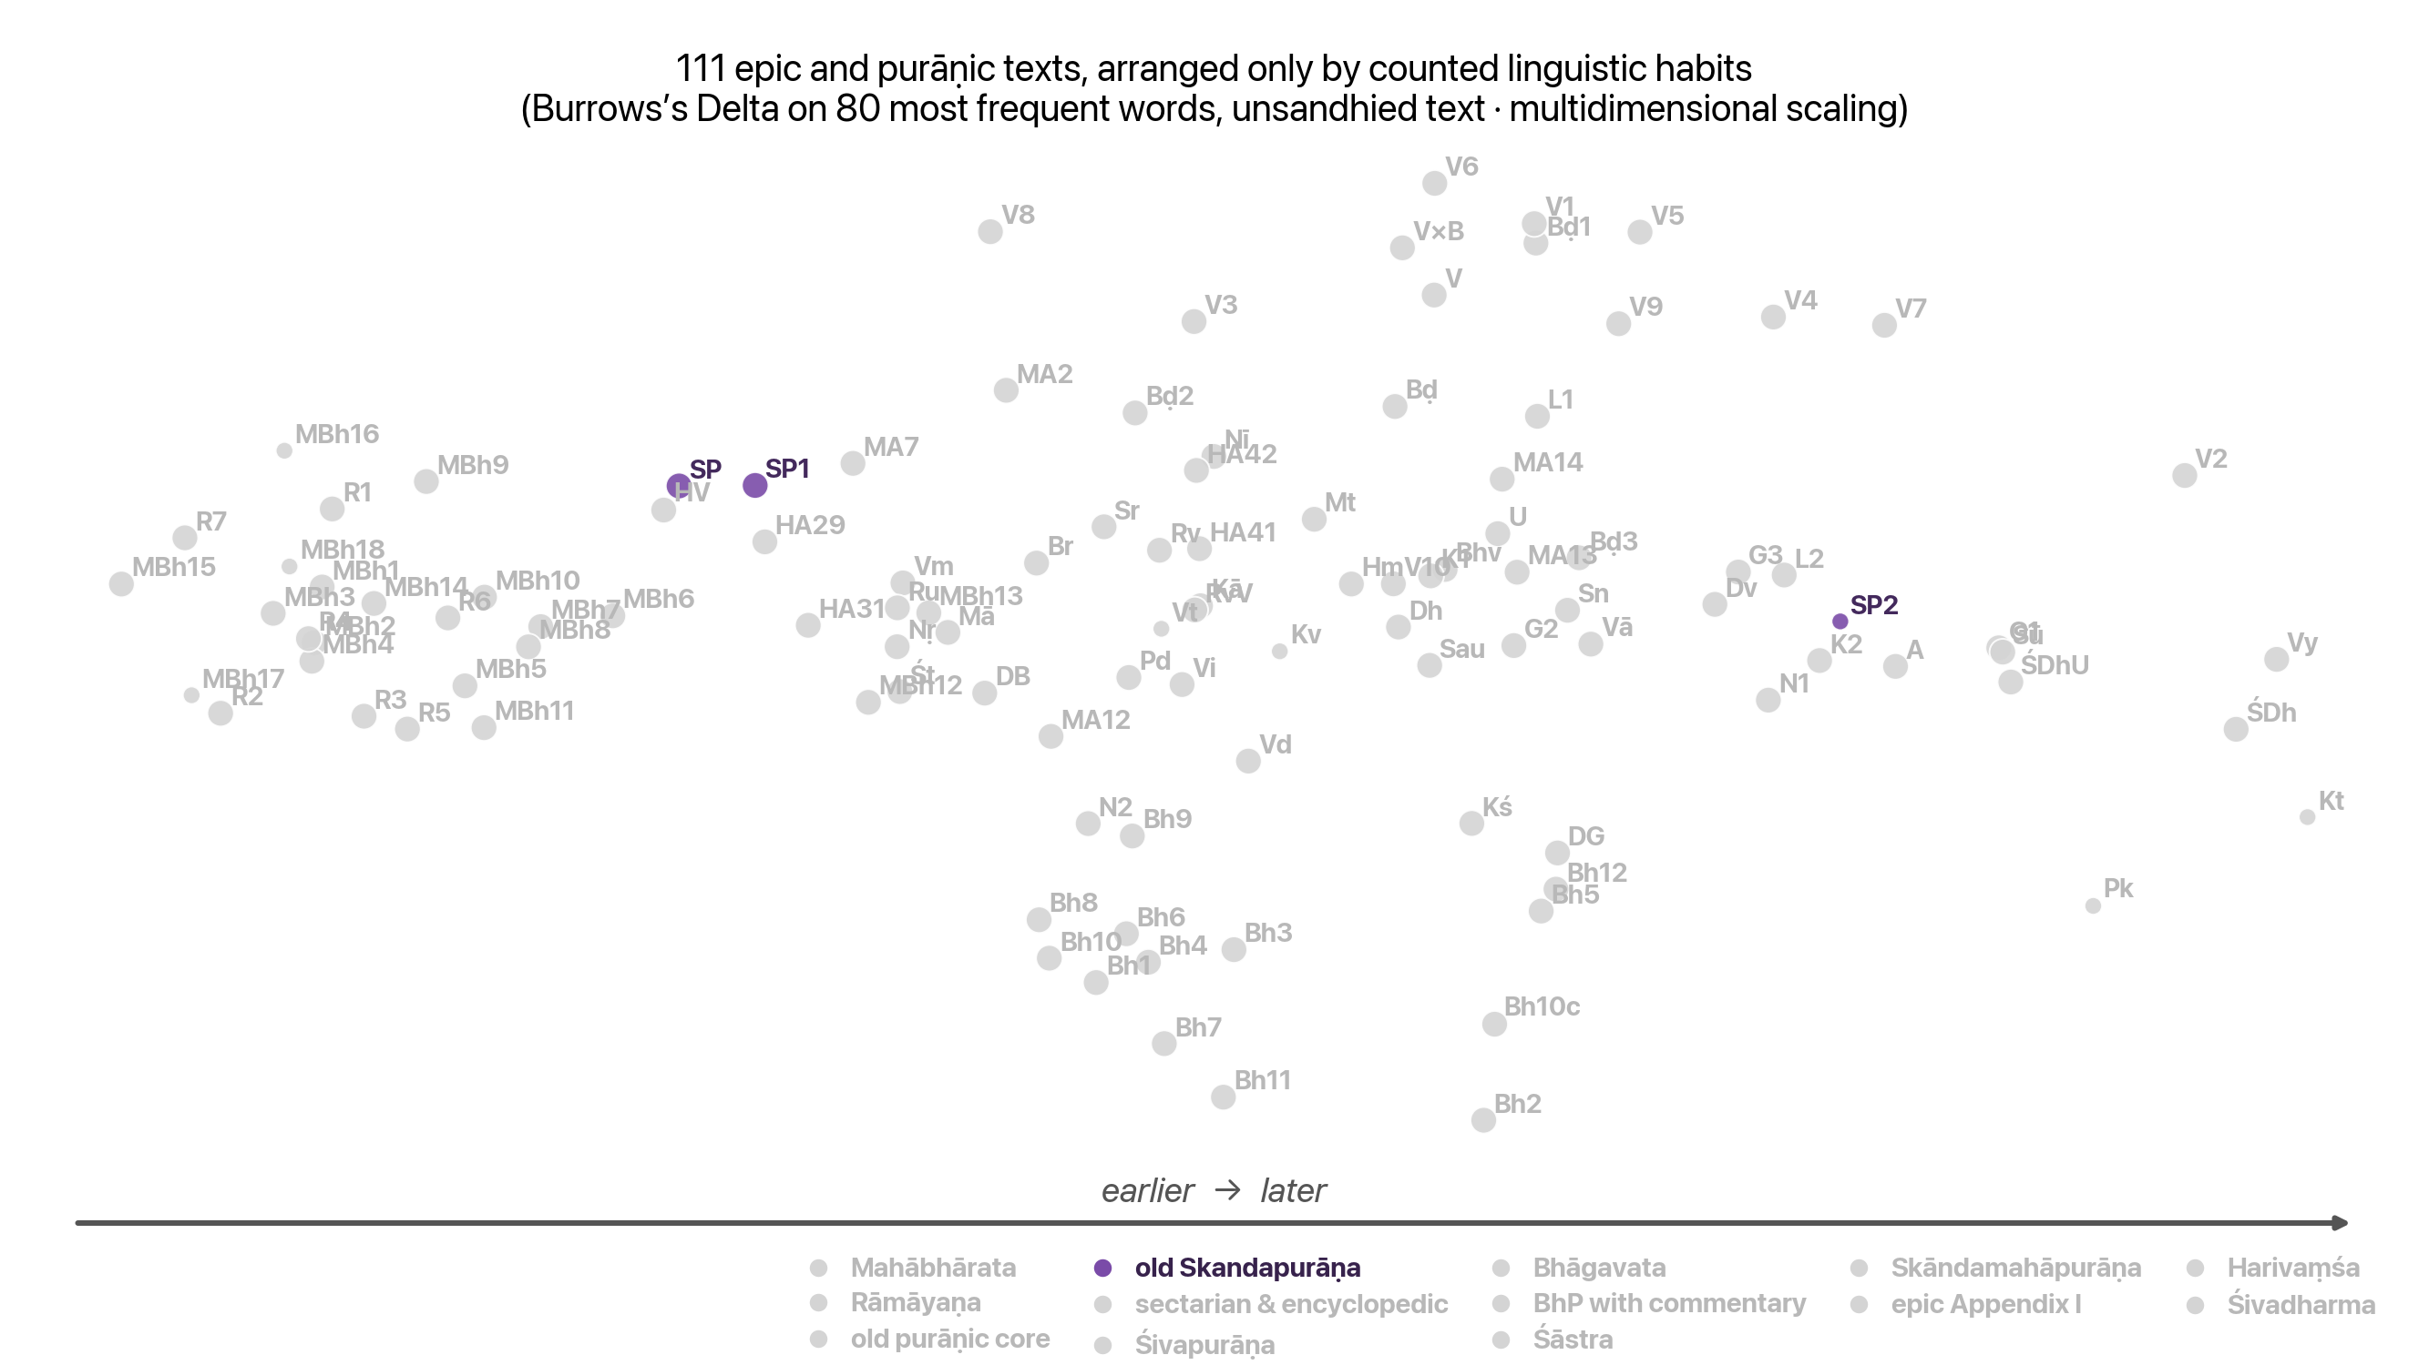
READING THE MAP · 3
The old Skandapurāṇa: mostly old but Pāśupata yoga added later
the old SP (Nepal/Bengal recension, oldest MS 811 CE) sits between the epics and the old purāṇic core
word lens: its nearest neighbours are MBh 1, MBh 10 and Rām 6 — it keeps epic diction
but its Pāśupata section jumps far right, out among the sectarian digests
Notes:
A single work, stratified in front of you: the narrative body reads as a bridge between epic and purāṇa (in the 3-gram lens it shifts toward Matsya/Brahma, the old core), while the Pāśupata doctrinal chapters (SP2) land at the far right with the Śivapurāṇa (Umā, Sanatkumāra) as their word-lens neighbours. The Vāyupurāṇa has its own Pāśupata-yoga section (V2 on the map) that makes the very same jump to the far right — and the two Pāśupata sections share virtually no text (word-trigram overlap ≈ 0.002, no higher than with an unrelated control; longest shared run four words), so their convergence is doctrinal register, not borrowing. Caveat for Q&A: SP2 is a short excerpt, so its exact spot is soft — but the direction of the jump is unmistakable. LIVE: mention the forthcoming edition of the Pāśupata-yoga chapters — the lenses flag exactly what its editors suspected.

Slide 14
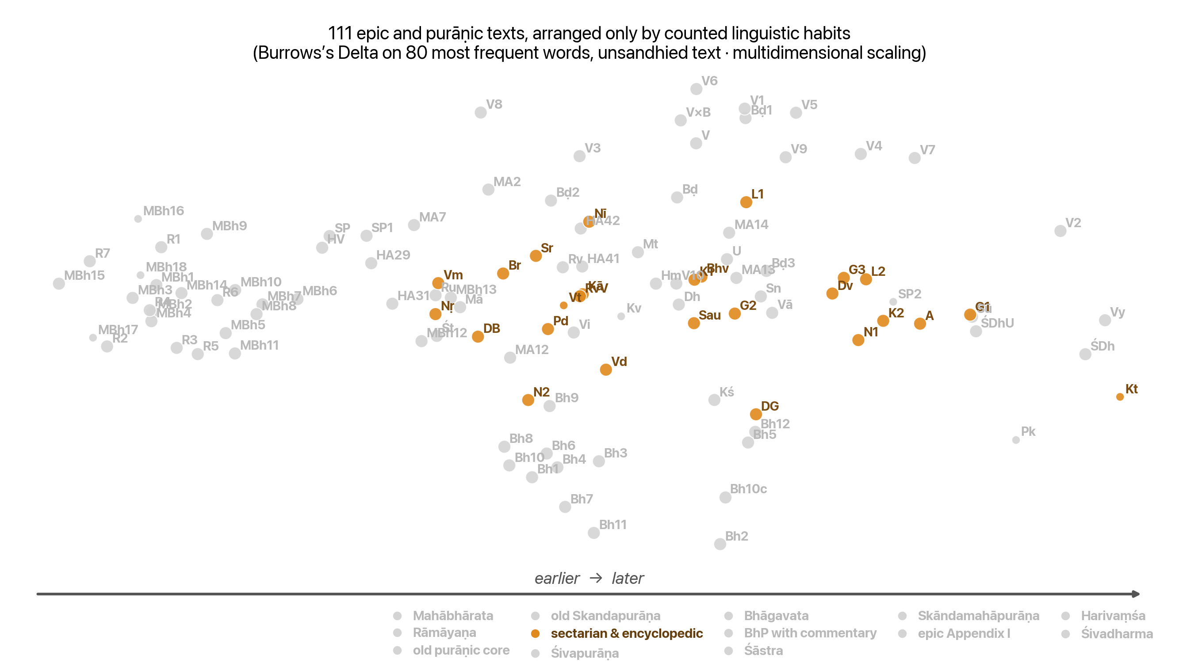
READING THE MAP · 4
The sectarian & encyclopedic mass
one broad, continuous stratum — no clean line between “middle” and “late”
Agni · Garuḍa · Nārada: the encyclopedic digests, crowded on the far right
internally blurry — exactly what compilation literature should look like
Notes:
Folded into one group on purpose: on the map the old boundary between ‘middle purāṇic’ and ‘late sectarian/encyclopedic’ does not survive — the two overlap heavily on axis 1 (medians +0.05 vs +0.21, ranges swamping the gap) and the split rested on external dating and genre, not on the counts. The stratum shades from texts still close to the old core (Kūrma, Liṅga, Viṣṇudharmottara) out to the self-quoting digests at the right, where its style is simply the style of the digest.

Slide 15
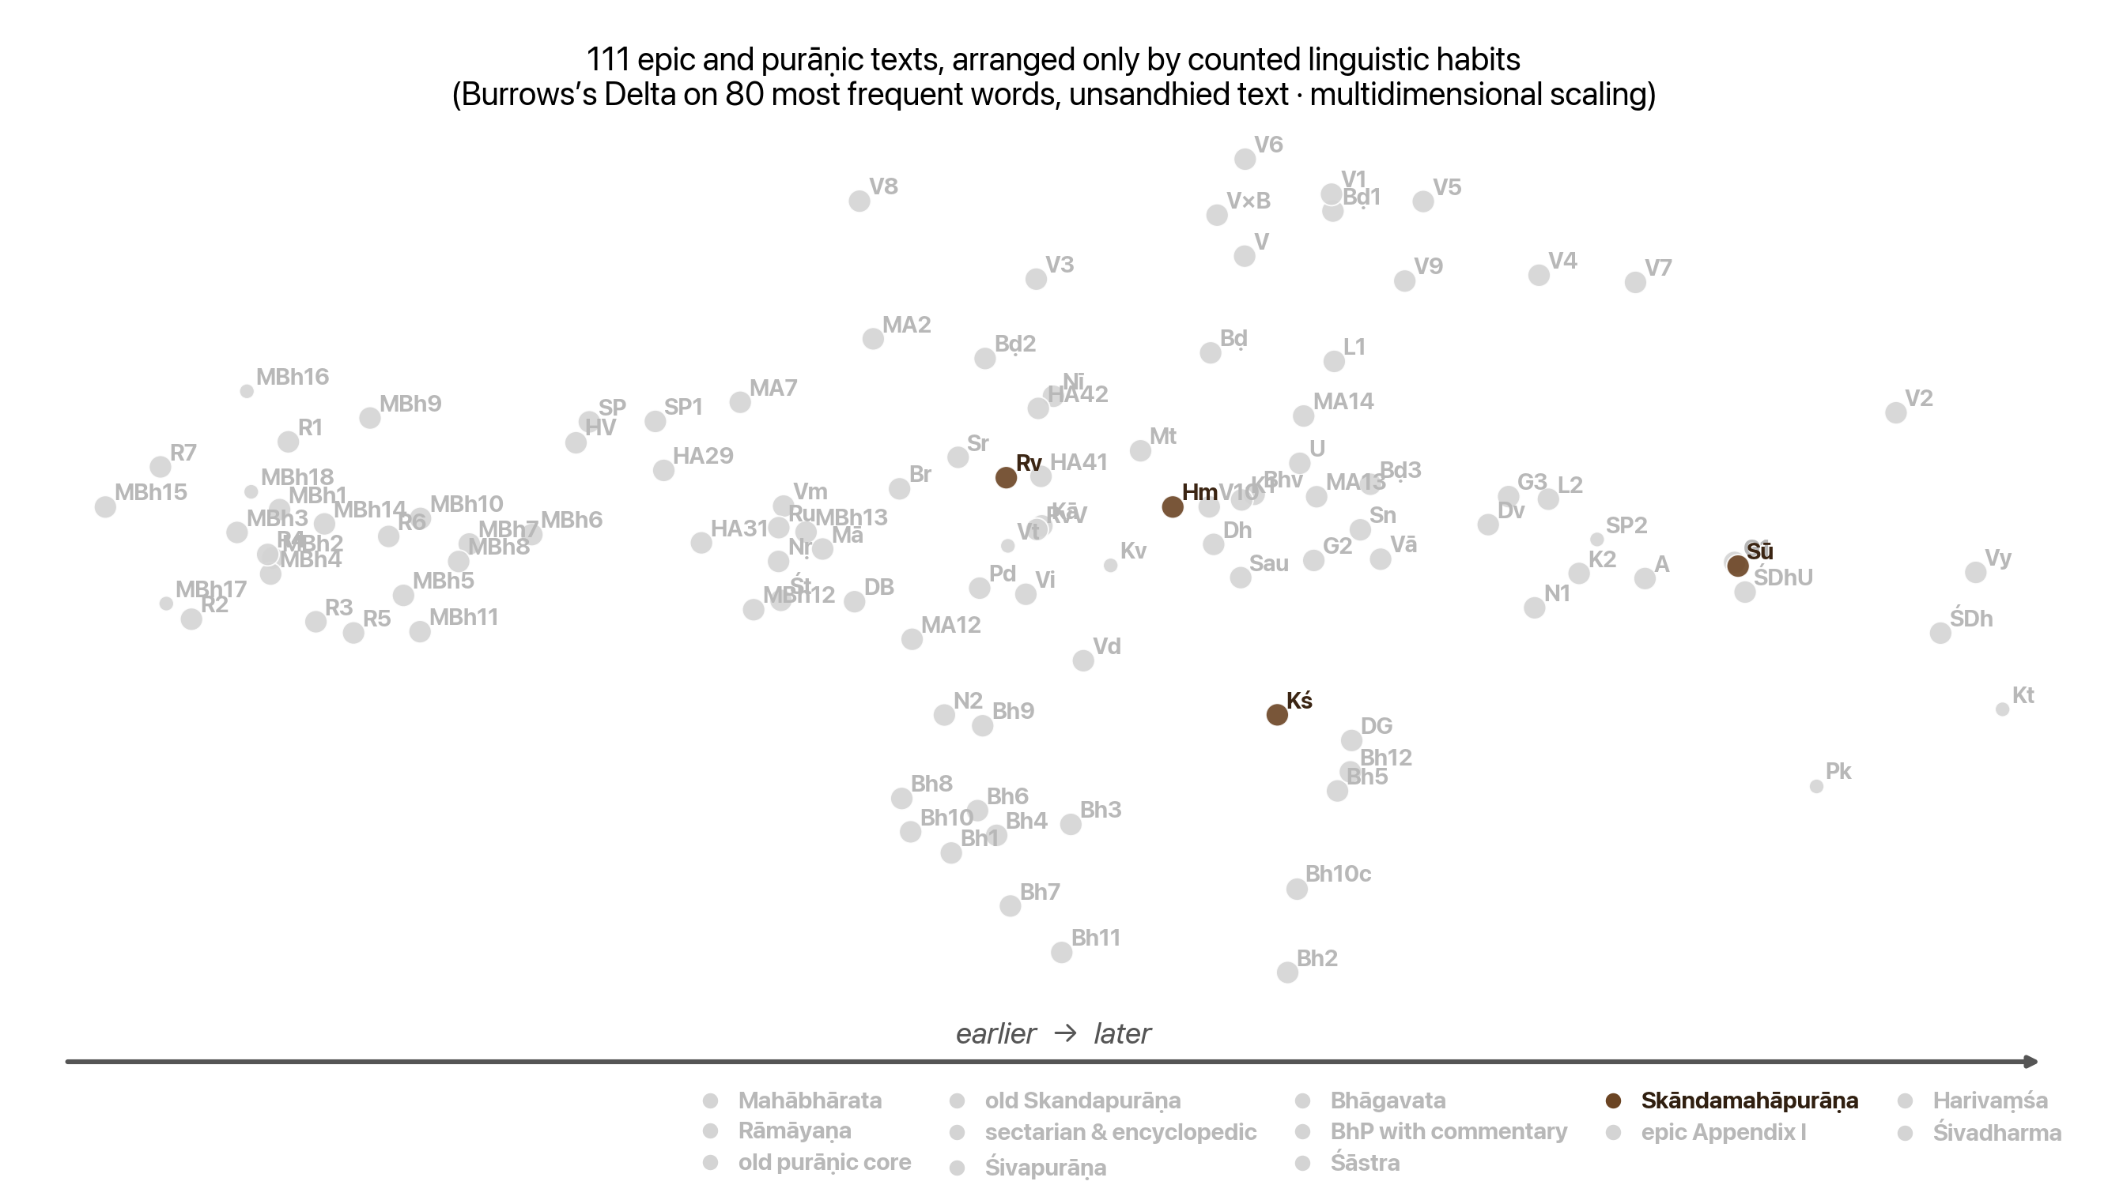
READING THE MAP · 5
A purāṇa that refuses to unify
The Skāndamahāpurāṇa, plotted khaṇḍa by khaṇḍa:
0 of 4 khaṇḍas have their nearest neighbour inside the Skāndamahāpurāṇa — in either lens
the reuse scan finds they share no text with one another
each khaṇḍa is a full-sized text — the length caveat does not apply
What connects them is a phrase in the colophons: (śrī)skānde mahāpurāṇe.
The Śivapurāṇa tells the same story, saṃhitā by saṃhitā (3 of 8 internal in the word lens, 4 of 8 in the 3-gram lens). Compare the Bhāgavata on the next slide — cohesion is measurable.
Notes:
The compilation model, confirmed from word counts alone; contrast with the Bhāgavata set up deliberately. Nothing connects the khaṇḍas but the colophon phrase: Kāśīkhaṇḍa’s word-lens NN is Bhaviṣya, Himavat’s is ŚiP Dharma, Sūtasaṃhitā’s is Garuḍa 1. Best detail if time allows: the Revākhaṇḍa’s NN (both lenses) is the OTHER Revākhaṇḍa, the distinct one transmitted with the Vāyu — the two share ~5% of their lines verbatim while each shares only stock formulae with its own host. A khaṇḍa can be closer to its namesake in another purāṇa than to its own compilation.

Slide 16
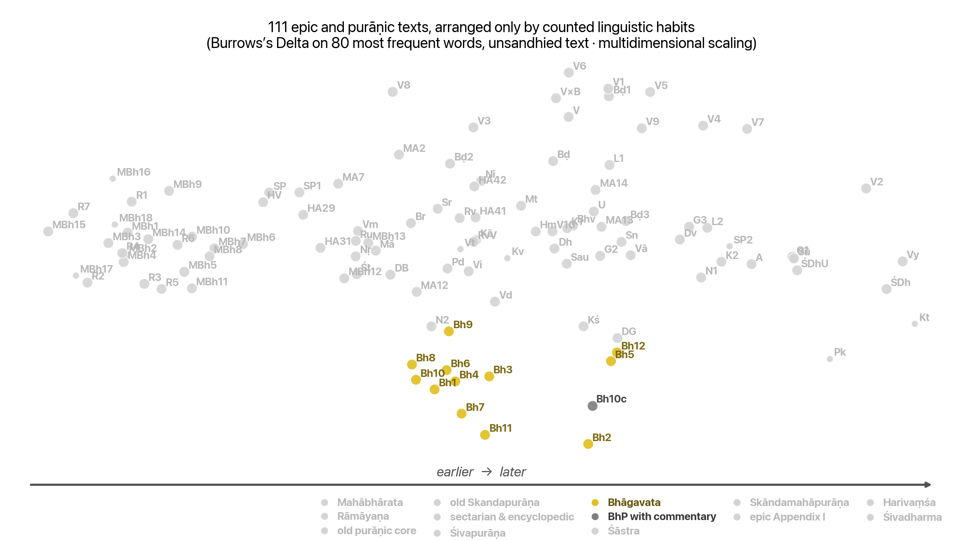
READING THE MAP · 6
The Bhāgavata
The Bhāgavatapurāṇa, plotted skandha by skandha:
all twelve skandhas’ nearest neighbours are internal — in both lenses
archaic features noticed for over a century — its date has already been in dispute
apparently a very unique composition according to our map, virtually no contacts with any of the epic or purāṇas
The numbers do not settle its date; they deepen its puzzle.
Notes:
The date of the purāṇa has always been in dispute. What we have here adds one more data point to the intrigue.

Slide 17
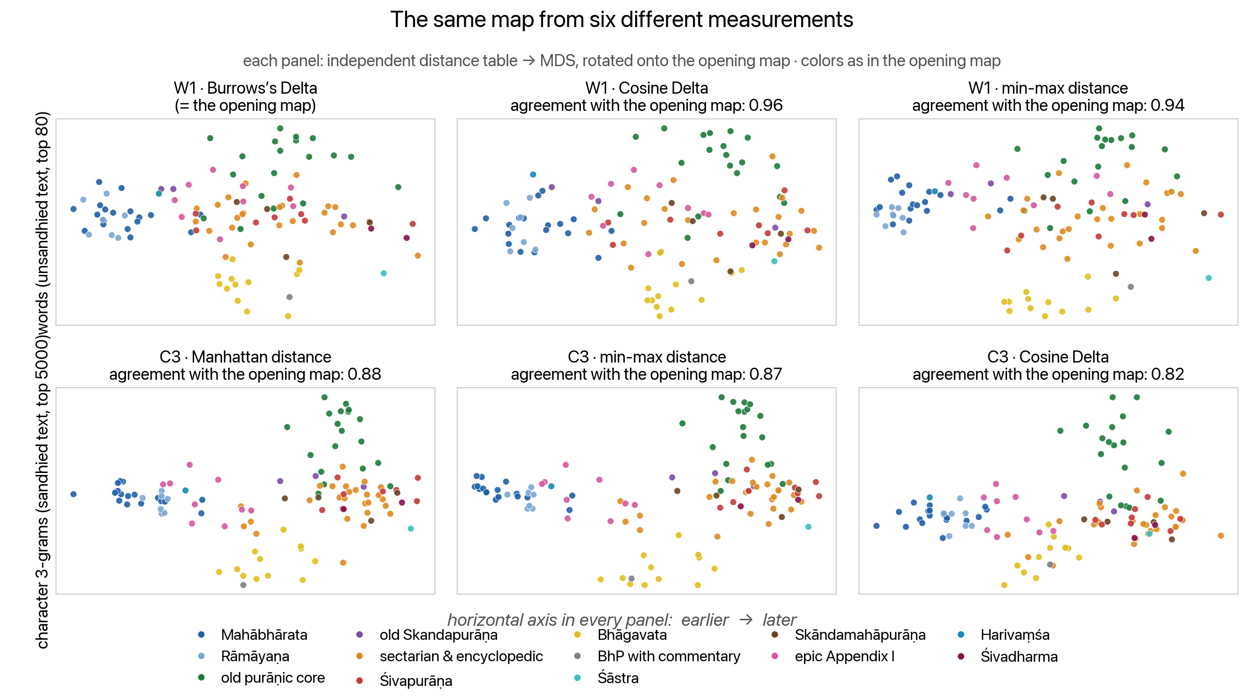
Notes:
Walk the grid: top row words/unsandhied, bottom row 3-grams/sandhied, three distance metrics each — six independent pipelines, one geometry. Layout agreement with the opening map: 0.95–0.96 (words), 0.82–0.89 (3-grams). The epic→purāṇic axis survives every change of lens.

Slide 18
WHY BELIEVE THE AXIS?
Suppose the axis were an artifact…
a flaw in sandhi segmentation
→
could distort the word lens only
an orthographic / sandhi convention
→
could distort the 3-gram lens only
a quirk of one distance formula
→
fails to explain the other five
The lenses share almost no assumptions — yet draw the same axis.
The signal is in the texts.
Notes:
The abstract's core argument; deliver slowly.

Slide 19
WHY BELIEVE THE AXIS?
What the second axis is not
The vertical axis is unstable across configurations.
Depending on features and metric it separates by something like genre, region, or sectarian register — no labeling survives all six panels.
Honest conclusion: one axis is chronology-like and robust;
the second resists a stable name.
Notes:
Promised in the abstract; agnosticism as a feature, not a weakness. The Bhāgavata's vertical displacement is the clearest case.

Slide 20
OLD PROBLEMS, REVIVED
What the axis is made of
“Diachronic linguistic drift” — but confounded:
authorial aptitude
in composing metrical Sanskrit: the use of more fillers as the aptitude goes down. The better author, the less fillers
reuse of preexisting material
the more the materials are shared, the tighter groups the containers form (See slide B8)
genre
when the vocabularies are completely different, there is no telling where they land
Look at where the final parvans of the MBh landed in our map. Those are exactly the parvans whose relative dates are contested; also, look at where the Śivadharmaśāstra and the Śivadharmottara are positioned in the map. The purāṇas that are known to incorporate them are very much to the left.
Notes:
MFWs tend to be fillers; inapt authors tend to rely on metre fillers. The Bhāgavata: when was it composed? An old problem — it shows in our map (B7). The mode or the motivation of composition/compilation: e.g. the Bhaviṣya (B8 and B9).

Slide 21
OLD PROBLEMS, REVIVED
What’s the point of this?
Our lenses confirm some things that we had suspected: The relative age of the epics; the didactic portions of the MBh being late; the affinity of certain purāṇas; relative age of uncontaminated Purāṇas (Skandapurāṇa)
At the same time, they illuminate contentious issues: relative dates of the closing parvans of the Mahābhārata; relative age of the Mahābhārata and the Rāmāyaṇa (well, they show up at about the same place, so, our map also confirms long suspected their being composed about the same time)
It will not date your text; it will tell you whose company it keeps
It also tells us where interesting things are happening; it is about time someone gives serious thought about the uniqueness of the Bhāgavatapurāṇa again; someone should look for unprecedented approaches to settle the questions of the composition, not integration date of the closing parvans of the Mahābhārata; do some fine grained research of the provenance of the Bhaviṣyapurāṇa, etc., etc., ...
Notes:
This is the point of the whole talk: the counts make us look at old problems from a new angle, and the charts hand scholars hints about where to dig. The Bhaviṣya being the fountain of many interesting things — wish there were time to show slide B9.

Slide 22
Counted habits, familiar history and familiar problems.
Notes:
End where we began — now everyone can read the map. Thanks; over to questions.

Slide 23
Backup slides

Slide 24
BACKUP
Burrows’s Delta, one level deeper
for each of the top-80 words: how far is each text from the corpus-average rate, in standard deviations (a z-score)?
Delta(A, B) = the average disagreement of A and B across those words
variants used in the grid: Cosine Delta (angle instead of average), min-max and Manhattan (raw-frequency geometry)

Slide 25
BACKUP
The 111 texts and their strata
Mahābhārata
MBh1 MBh 1
MBh2 MBh 2
MBh3 MBh 3
MBh4 MBh 4
MBh5 MBh 5
MBh6 MBh 6
MBh7 MBh 7
MBh8 MBh 8
MBh9 MBh 9
MBh10 MBh 10
MBh11 MBh 11
MBh12 MBh 12
MBh13 MBh 13
MBh14 MBh 14
MBh15 MBh 15
MBh16 MBh 16
MBh17 MBh 17
MBh18 MBh 18
Rāmāyaṇa
R1 Rām 1
R2 Rām 2
R3 Rām 3
R4 Rām 4
R5 Rām 5
R6 Rām 6
R7 Rām 7
old purāṇic core
Bḍ Brahmāṇḍa
Bḍ1 Brahmāṇḍa 1
Bḍ2 Brahmāṇḍa 2
Bḍ3 Brahmāṇḍa 3
Mā Mārkaṇḍeya 1–93
Mt Matsya
V Vāyu
V×B Vāyu×BḍP
V1 Vāyu §1
V2 Vāyu §2
V3 Vāyu §3
V4 Vāyu §4
V5 Vāyu §5
V6 Vāyu §6
V7 Vāyu §7
V8 Vāyu §8
V9 Vāyu §9
V10 Vāyu §10
Vi Viṣṇu
old Skandapurāṇa
SP SP (old)
SP1 SP (old) 1–31
SP2 SP (old) Pāśupata
sectarian & encyclopedic
A Agni
Bhv Bhaviṣya
Br Brahma
DB DevīBhP
DG Devīgītā (DBhP 7.31–40)
Dv Devī
G1 Garuḍa 1
G2 Garuḍa 2
G3 Garuḍa 3
K1 Kūrma 1
K2 Kūrma 2
Kā Kālikā
Kt Karatoyā
L1 Liṅga 1
L2 Liṅga 2
N1 Nārada 1
N2 Nārada 2
Nī Nīlamata
Nṛ Nṛsiṃha
Pd Padma
RvV Revākh. (Vāyu)
Sau Saura
Sr Saromāhātmya
Vd Viṣṇudharma
Vm Vāmana
Vt ViDhUt (exc.)
Śivapurāṇa
Dh ŚiP Dharma
Kv ŚiP Kārvaṇa māh.
Ru ŚiP Rudra
Sn ŚiP Sanatkumāra
Śt ŚiP Śatarudra
U ŚiP Umā
Vā ŚiP Vāyavīya
Vy ŚiP Vidyeśvara
Bhāgavata
Bh1 BhP 1
Bh2 BhP 2
Bh3 BhP 3
Bh4 BhP 4
Bh5 BhP 5
Bh6 BhP 6
Bh7 BhP 7
Bh8 BhP 8
Bh9 BhP 9
Bh10 BhP 10
Bh11 BhP 11
Bh12 BhP 12
BhP with commentary
Bh10c BhP 10 + comm.
Śāstra
Pk Praṇavakalpa
Skāndamahāpurāṇa
Hm Himavatkh. (SkMP)
Kś Kāśīkh. (SkMP)
Rv Revākh. (SkMP)
Sū Sūtasaṃhitā 4
epic Appendix I
HA29 HV App. 29–30 (Mathurā)
HA31 HV App. 31
HA41 HV App. 41
HA42 HV App. 42 (prādurbh.)
MA2 MBh 2 App. 21 (Śiśupāla)
MA7 MBh 7 App. 8 (Ṣoḍaśarājika)
MA12 MBh 12 App. 29 (Mokṣadh.)
MA13 MBh 13 App. 15 (Umāmah.)
MA14 MBh 14 App. 4 (Vaiṣṇavadh.)
Harivaṃśa
HV Harivaṃśa
Śivadharma
ŚDh Śivadharmaśāstra
ŚDhU Śivadharmottara

Slide 26
BACKUP
The length caveat
sections range from a few thousand to hundreds of thousands of words
short sections have noisy profiles → inflated distances, positions unreliable
marked as small dots on every map; none of the argument rests on them

Slide 27
BACKUP
When the lenses disagree — a diagnostic, not a failure
BhP 10.29–33 transmitted with commentary (Bh10c on the maps):
word lens: nearest neighbour = Kāśīkhaṇḍa — expelled from the Bhāgavata cluster (commentary vocabulary contaminates word counts)
3-gram lens: nearest neighbour = BhP 10 — back inside the family
Disagreement between lenses flags preprocessing problems — it does not hide them.
Notes:
If asked about pipeline trust: same story with the Nīlamata, where a raw-cosine outlier exposed an editorially dissolved source (2026-07-09).

Slide 28
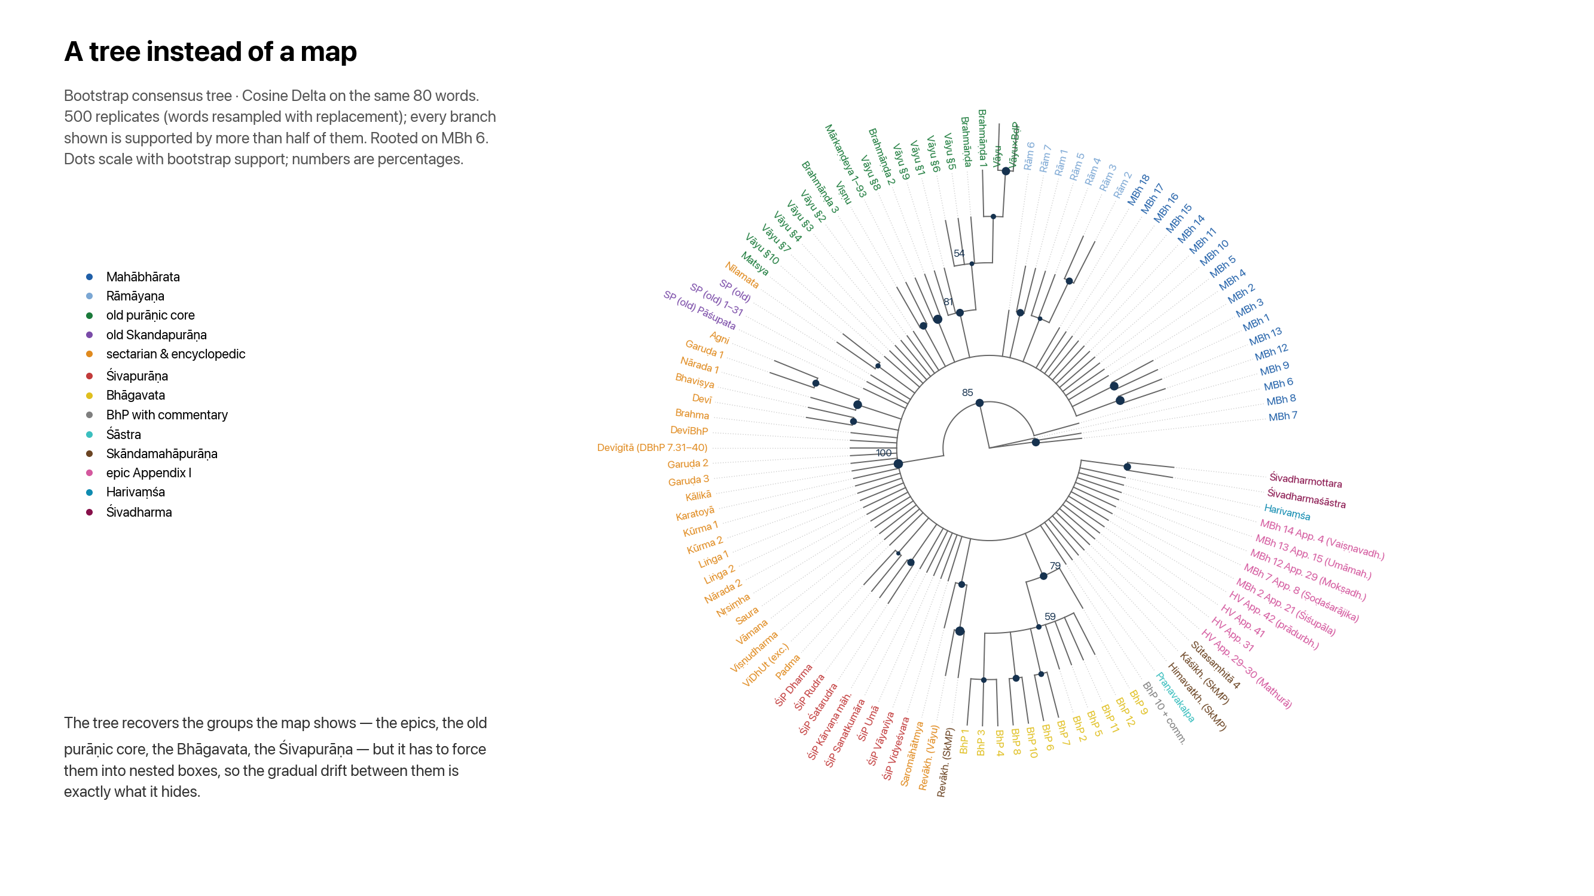
Notes:
If someone asks for a tree: here it is. Cosine Delta on the same 80 words, 500 bootstrap replicates (the words are resampled with replacement), neighbour-joining per replicate, majority-rule consensus — so every branch on the slide is one that survived in more than half of the replicates. Rooted arbitrarily on MBh 6. It finds the same groups the map does: the epics, Vāyu–Brahmāṇḍa and the old purāṇic core, the Bhāgavata, the Śivapurāṇa. But a tree asserts descent and nesting, and our texts drift into one another instead of branching cleanly — which is why the talk is built on the map, not on this.

Slide 29
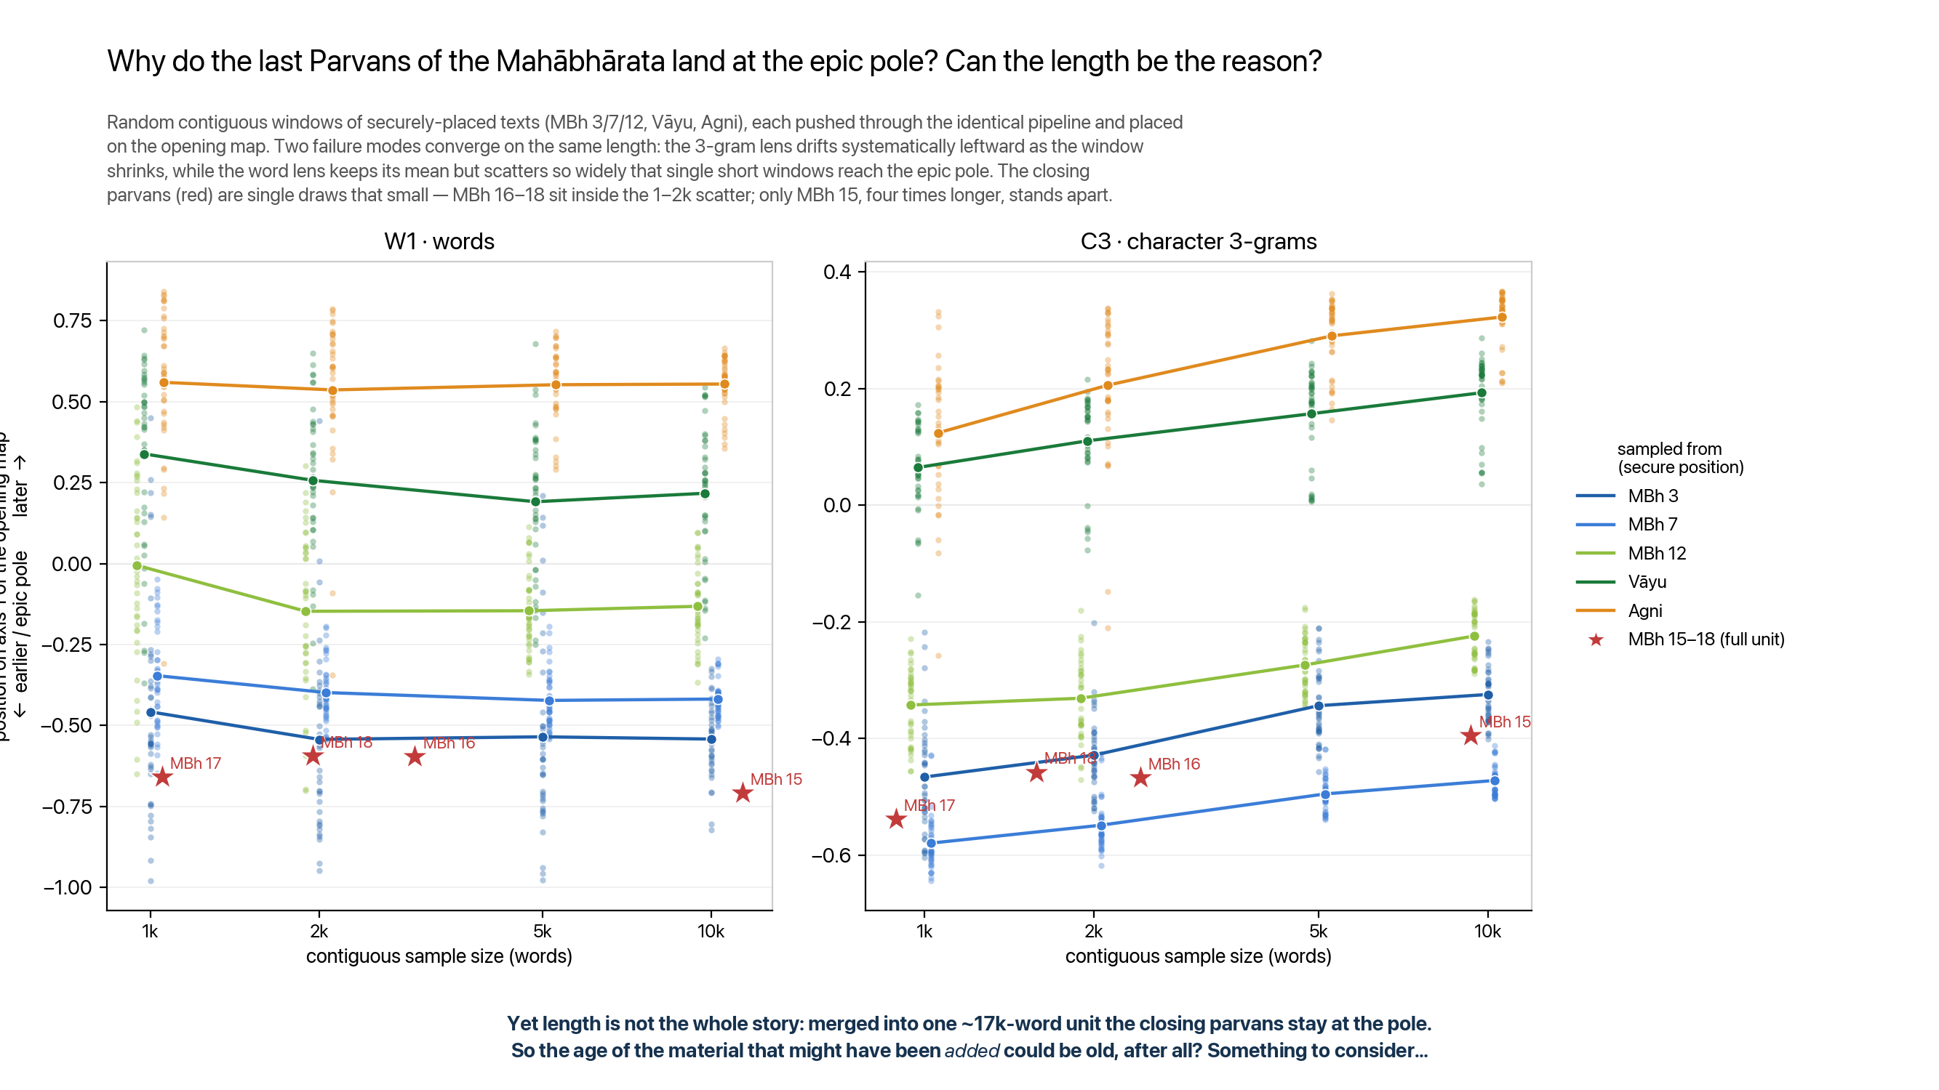
Notes:
The sharp question a specialist will ask: the closing parvans MBh 16–18 sit at the extreme epic pole, ‘earlier’ than the battle books — surely that is just their tiny length? Answer in two moves. (1) It is partly a length effect: drawing random contiguous windows of securely-placed texts (MBh 3/7/12, Vāyu, Agni) and running them through the identical pipeline, at 1–2k words — the size of MBh 16–18 — the 3-gram lens drifts leftward and the word lens scatters so wide that single short windows reach the pole. So the individual positions of MBh 16/17/18 are unreliable; do not build anything on them alone (they carry the small-dot / length flag). (2) But it is not only length: concatenate 15+16+17+18 into one ~17k-word unit and it stays at the pole, not out by MBh 11/14. The group position is real. What it measures is register — narrative-pure text with little of the expository-particle overlay (tu/eva/tathā/vai) that swelled MBh 12–14. Keep two dates apart: when the material was composed, and when it was integrated into the Mahābhārata. The ‘late epilogue’ verdict (e.g. Brockington 1998) — cited here as a position in the literature, not one we endorse — is at most a claim about integration into the corpus; the counts cannot arbitrate the age of the material itself — old material integrated late, and young material left redactionally thin, look the same here. And if the material IS young, move (1) already supplies the explanation for the extreme individual positions: at these sizes, length alone reaches the pole. Full diagnostics: notes/2026-07-15_closing_parvans_length_diagnostics.md.

Slide 30
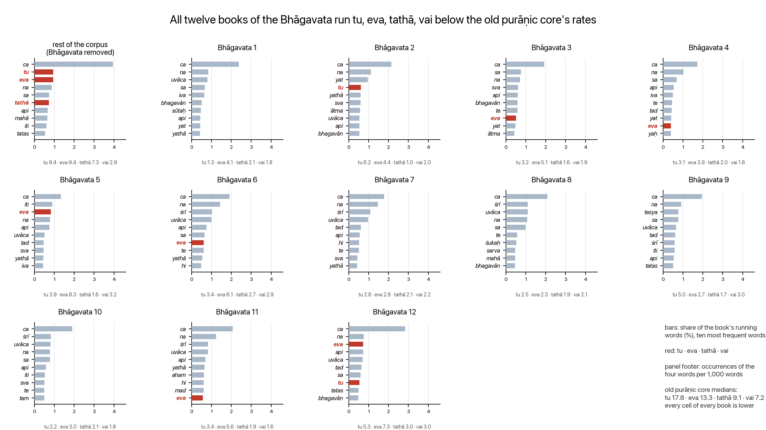
Notes:
For the question ‘is the particle avoidance the work of one book, or of an editor of one layer?’ No: all 48 cells (12 books × 4 particles) sit below the old purāṇic core’s median rates (tu 17.8, eva 13.3, tathā 9.1, vai 7.2 per 1,000). Phrase it group-relative: against the corpus at large, vai is NOT suppressed (BhP ≈ MBh ≈ corpus median; only the old core is vai-heavy), and eva rises to low-normal in books 5 and 12 (8.3/7.3 — even #3 in their own top tens, visible as the red bars). What the BhP runs on instead: ca, na, uvāca, śrī, bhagavān, api — and, at rates unique to it in this corpus, the Vedic particles aṅga, bata, vāva.

Slide 31
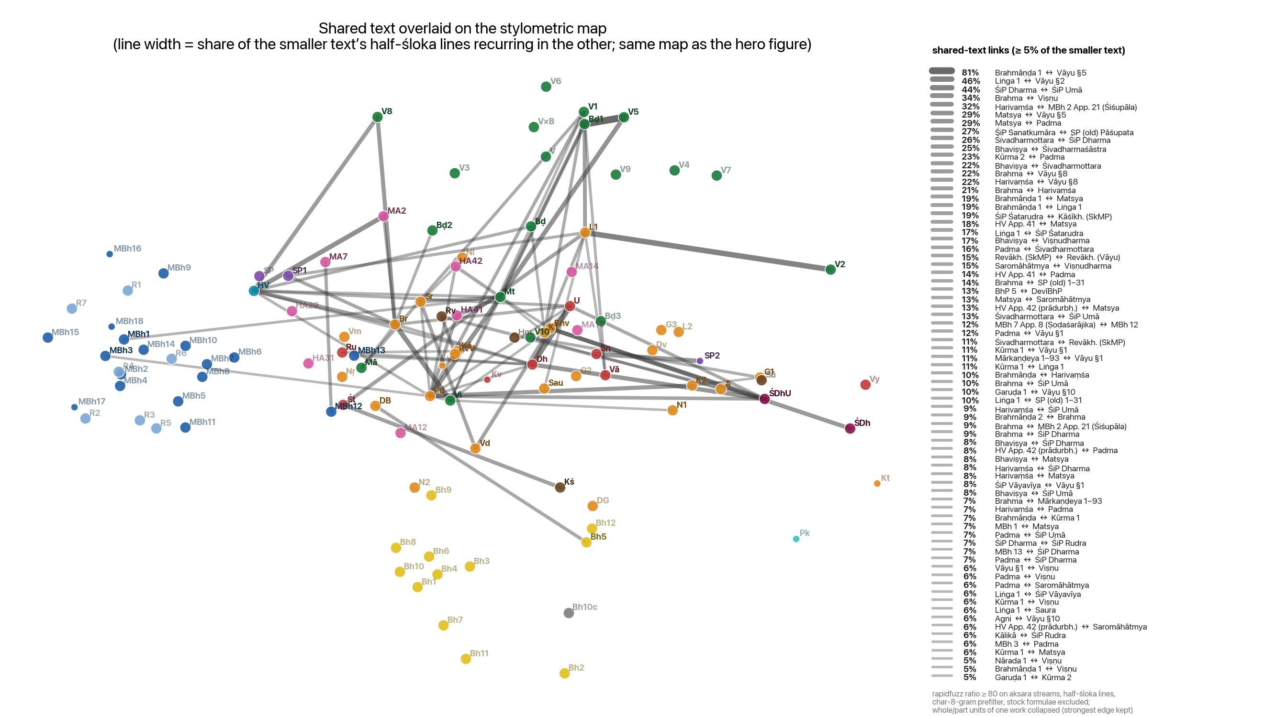
Notes:
The direct answer to the borrowing confound (caveats slide): we MEASURED the copying, independently of style — every pair sharing ≥5% of the smaller text’s half-śloka lines (akṣara-stream matching, stock formulae excluded), drawn on the same map. The two structures do not coincide. Liṅga 1 ↔ Vāyu §2 share 46% of the smaller text’s lines yet stand at Delta 1.02 — essentially the corpus median — and neither is the other’s nearest neighbour; Matsya↔Padma (37%) sit at 0.63, ŚiP Dharma↔Umā (44%) at 0.55 — unremarkable closeness, no mutual NNs among the heavy borrowers. Conversely the tightest clusters — the Bhāgavata (12/12 internal NN), the epics — have almost no edges at all. The one place both webs agree is exactly where philology expects it: Vāyu–Brahmāṇḍa, heavy sharing AND Delta 0.28 — the common-ancestor signature. Delta is not riding on shared ślokas: the map measures habit, the edges measure copying, and they are different facts about the corpus.

Slide 32
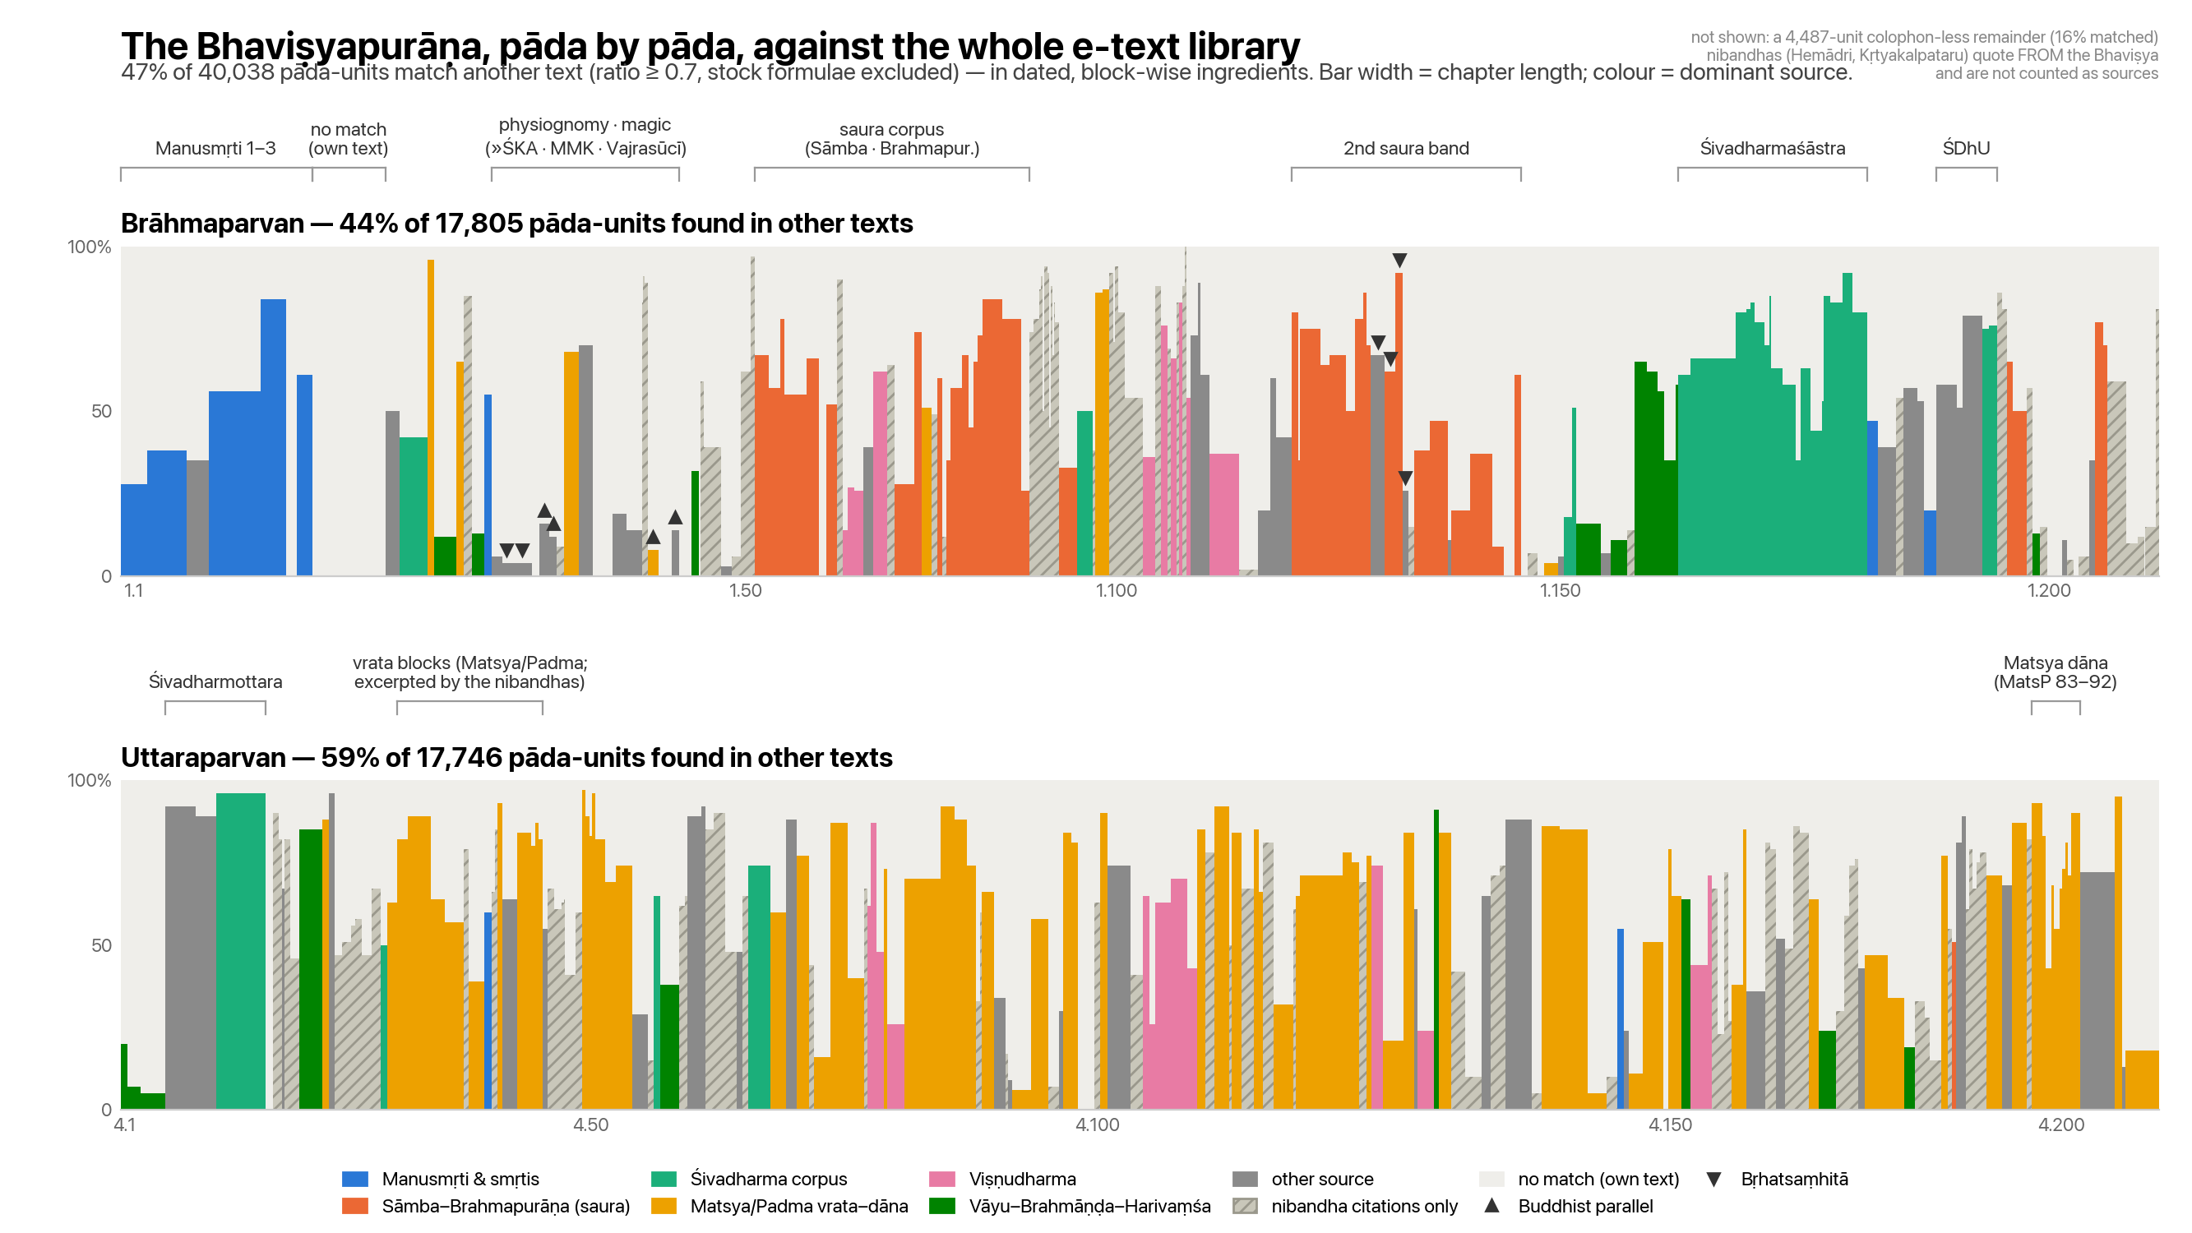
The Bhaviṣyapurāṇa, scanned pāda-by-pāda against the whole e-text library:
47% of its pāda-units occur in other texts (Brāhmaparvan 38%, Uttaraparvan 59%)
the borrowing is block-wise and source-datable: Manusmṛti swallowed whole, the Sāmbapurāṇa’s saura corpus, Śivadharmaśāstra & -ottara, Bṛhatsaṃhitā, Matsya-type vrata blocks — and a physiognomy block shared with the Buddhist Śārdūlakarṇāvadāna
whole stretches match nothing — a genuine own-text residue in between
Not an author’s stratum — a compilation event with datable ingredients.
Notes:
B9 — three beats. (1) THE SCALE: 47% of the entire Bhaviṣya (40k pāda-units; Brāhmaparvan 38%, Uttaraparvan 59%) matches another text at ≥0.7 — the extreme case of compilation literature. Nibandhas (Kṛtyakalpataru, Hemādri) quote FROM it, so they date its terminus, not its sources; the big donors are Padma, Matsya, the Sāmbapurāṇa, and the Śivadharma corpus — the last now on our map as units, donor and mosaic on one plot. (2) BLOCK-WISE AND DATABLE: 1.2–1.7 is Manusmṛti 1–3 nearly contiguously; the saura bands (1.52–1.80, 1.121–1.145) are the Sāmba–Brahmapurāṇa corpus with Vāyu/Brahmāṇḍa astronomy upstream; 1.25–26 Bṛhatsaṃhitā; Uttara 4.4–6 is the Śivadharmottara wholesale; the vrata chapters run at 60–96% reuse. Each ingredient carries its own date — the mosaic is bracketed between its sources and its citers. (3) THE CROSS-CONFESSIONAL ONE: the physiognomy block shares verse text with the Śārdūlakarṇāvadāna (Divyāvadāna 33) — say 'shared divination tradition', not 'borrowed from the Buddhists'. PUNCHLINE: not an author's stratum — a compilation event with datable ingredients. NEVER give the Bhaviṣya a single date (the Pratisargaparvan prophesies Queen Victoria): per-block bracketing is the only dating it admits, and that is precisely what the scan delivers and one dot on the map cannot. If shown after slide 14: the Bhaviṣya is the mosaic that stayed together; the Skāndamahāpurāṇa a 'purāṇa' whose parts never even met.

Slide 33
Notes:
B10 — why do ŚDh and ŚDhU sit at the right edge (axis-1 ranks 109 and 106 of 111) while the purāṇas that absorbed them plot far to their left (ŚiP Dharmasaṃhitā rank 70, Bhaviṣya 76, Padma 48)? (1) Not the expository particles — their tu/eva/tathā/vai are LOW (ŚDhU's vai 0.2/1000, Bhāgavata territory). What pushes them right is the vocabulary of impersonal injunction (yaḥ 'whoever', optative bhavet, sarva, sadā, śiva itself at z +6.6) plus the near-total absence of narrative machinery (tam, tatas, dṛṣṭvā, aham, me, te — the strongest left-pole correlates). Pure frameless prescription: the right pole means discourse type, not date. (2) The hosts are measured mixtures: they absorbed only 15–26% of the pair into narrative-framed bulk 3–30× larger. (3) The dating twist: the pair carries ~6th–7th-c. external anchors with early Nepalese transmission — a text older than much of the sectarian mass plots to the right of it, the cleanest counterexample to reading axis 1 as a timeline; twin of the closing-parvans lesson at the opposite pole. THE POINT: especially when the nature of the texts varies, the same lenses lose their credibility as revealers of a text's age.

