Slide 1
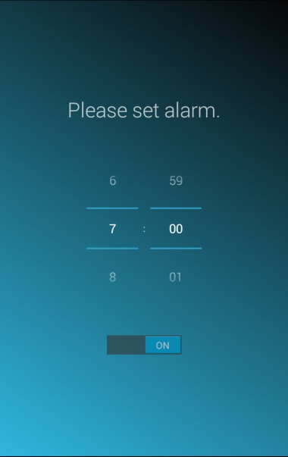
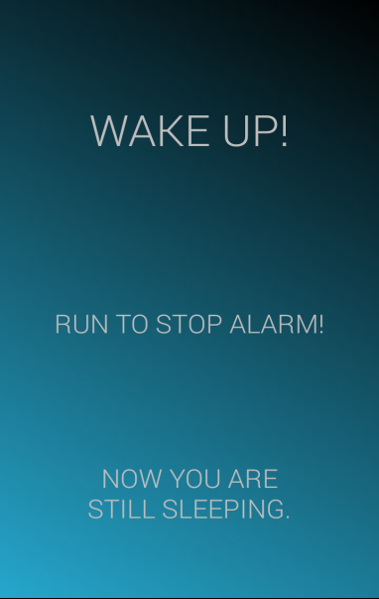




1
Set alarm.
2
Wake you up
with sound/vibration.
3
Run! Run! Run!
4
The alarm stops!

