Slide 1
IT780 : Introduction to Cloud Computing
Course Overview

Slide 2
Course Structure
First half
A lecture to cover each chapter in the text
Hands-on labs (AWS, Azure, GCP)
Second half
Docker
Hands-on lab (Kubernetes)
Well Architected (5 pillars)
API (AWS, Azure, GCP)
In-class deployment presentations

Slide 4
Grading
Labs (30%)
4 hands-on (3-4 hour)
Follow the steps, get full credit
Deployment presentations
Goal (concept) presentation (10%)
Deployment presentation (40%)
Final Exam (20%)

Slide 5
Keys to success
1st half is “easy” – no cloud knowledge assumed
Do the reading prior to the lecture
Do the labs early (No late grades)
Pick a deployment that is interesting to you
2nd half is “peer challenged”
What makes your deployment well-architected?
How does Docker/Kubernetes change things?
API, API, API

Slide 6
Programming Required
Pick the language you like
Cloud has embraced Python
Fundamentally you need to handle
API calls
JSON data manipulation
It shouldn’t be any more complicated than this
Cyber-unh.org DNS lambda deployment

Slide 7
Tools Needed
Browser
Management consoles
Cloud Accounts and related CLIs
AWS
Azure
Google

Slide 8
Brief Cloud History
1962 : DAPRA a computer with 2 simultaneous users
1990’s : Worldwide computer utilities “Grid”
1999 : Salesforce SaaS model
2004 : HPC moves to commodity hardware
2006 : AWS offers SQS
2008 : Google, Azure, IBM create/announce offerings

Slide 9
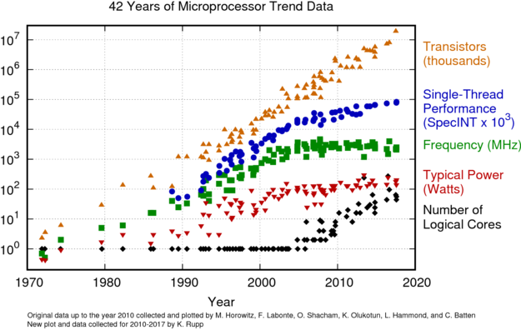

Slide 10
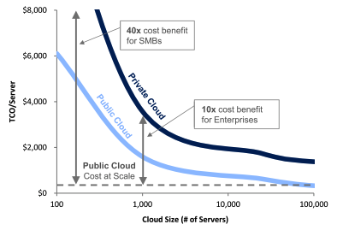

Slide 11
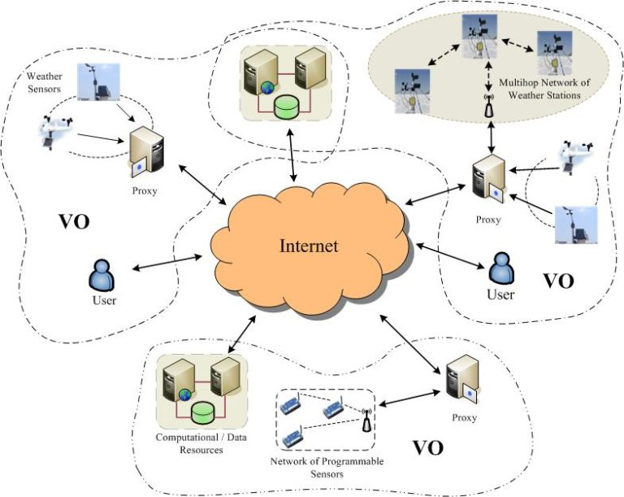
Grid Computing

Slide 12
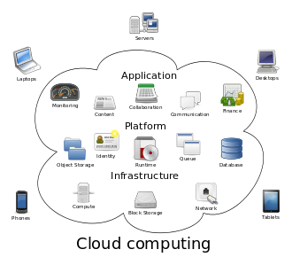

Slide 13
Parameter for Comparison | Cloud Computing | Grid Computing
Application Focus | Business specific applications such as web-based application | Research-based application
Architecture Used | Client-server architecture | Distributed computing architecture
Management | Centralized | Decentralized
Flexibility | High | Low
Accessibility of Services | High because it is real-time | Low because of scheduled services
Service Provided | Offering nearly all services like web hosting, Data Base support, etc | With limited services
Programming Model | Eucalyptus, Open Nebula, Open stack etc, for IaaS but no middleware exists | Different middlewares are available such as Globus gLite, Unicore, etc
Interoperability | Vendor lock-in and integration are some issues | Easily deals with interoperability between providers.

Slide 14
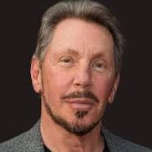
Larry had no interest in Cloud Computing
"Maybe I’m an idiot, but I have no idea what anyone is talking about. What is it? It’s complete gibberish. It’s insane. When is this idiocy going to stop?” – Larry Ellison (Oracle-CEO)
At the time of the quote AWS stock was trading at $40/share a few years later it was over $2,000/share.
Notes:
“I think there is a world market for maybe five computers” - Thomas Watson, IBM, 1943
“There is no reason for any individual to have a computer in his home.” - Ken Olson, DEC, 1977
“The Internet? We are not interested in it” - Bill Gates, Microsoft, 1993
Cloud - Larry Ellison CEO Oracle, 2008

Slide 15
360 degree Google Datacenter tour
https://www.youtube.com/watch?v=zDAYZU4A3w0

Slide 16
Azure Free tier
https://azure.microsoft.com/en-us/free/
$200 for first 30 days
Credit card required to signup
Free tier service for 12 months
Some products are always free
Consumption vs. App Service

Slide 17
AWS Free Tier
https://aws.amazon.com/free
Offer for new customers
Some always free resources
12 months
Needs credit card, will charge for overages
AWS Educate Student (new accounts only)
$100 cap, no credit card required
Service limitations
https://aws.amazon.com/education/awseducate/

Slide 18
Google Cloud Platform (GCP)
Free trial period for new customers
https://cloud.google.com/free/docs/gcp-free-tier
12 months, $300 in credits
You must provide credit card or bank details to set up a billing account and verify your identity, but you won't be charged during the free trial.
There are service limitations
Additional $50 credit for this class. See lab for instructions

Slide 19
What is “Cloud Native”
Automation
Pets vs. Cows
Scale
No human interaction
API-driven design
Everything as software (abstraction)
Serverless (OS agnostic)

Slide 20
Architecture “Pillars”
Reliability
Security
Performance
Cost Optimization
Operational Excellence

