Slide 1
IT780 : Introduction to Cloud Computing
Chapter 1
Introducing Cloud Native Architecture

Slide 2
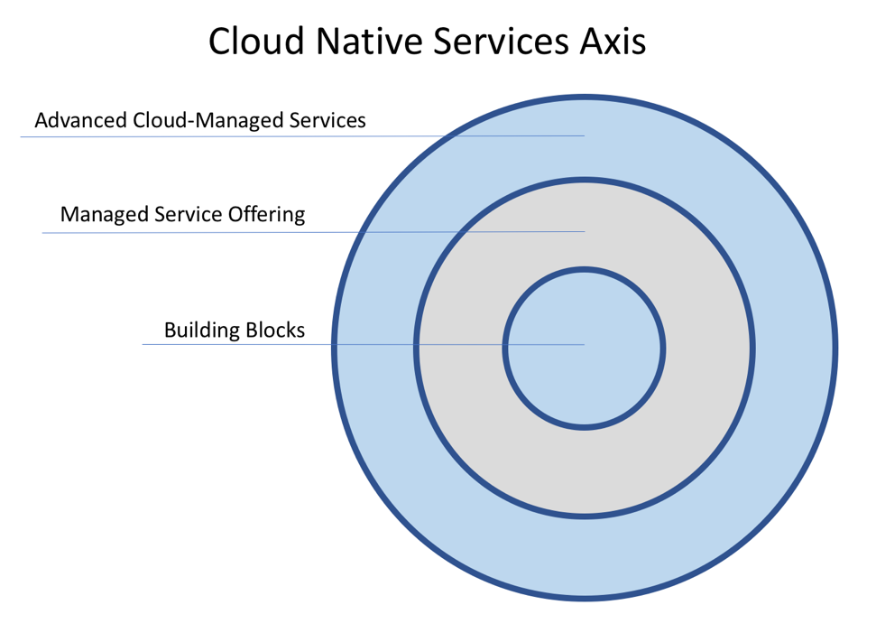

Slide 3
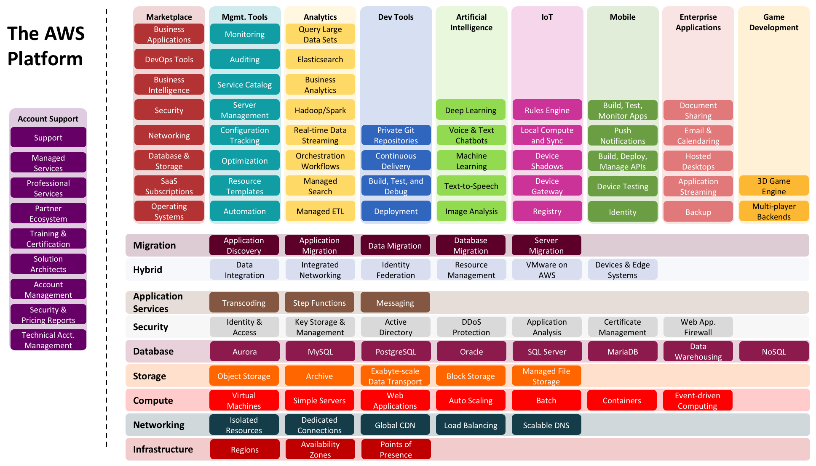

Slide 4
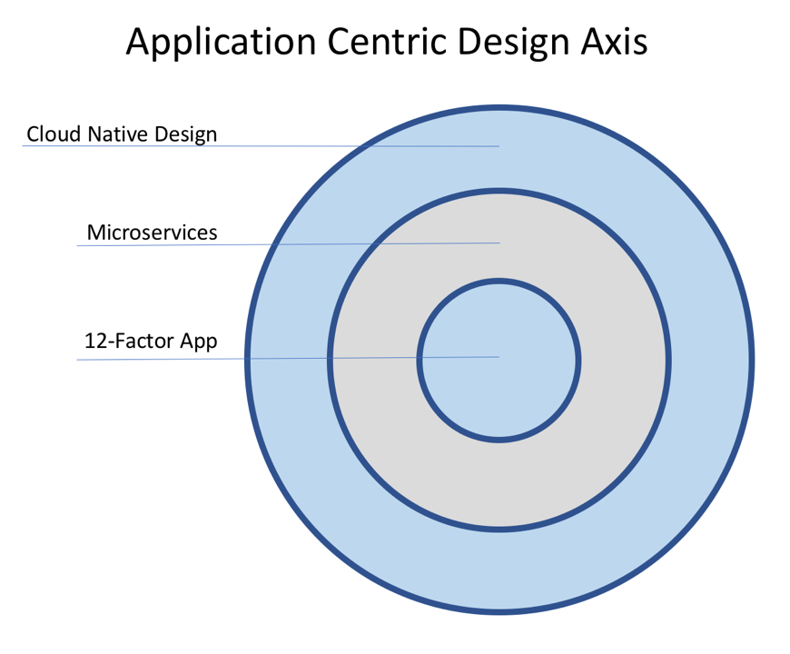

Slide 5
Twelve-factor App (https://12factor.net/)
I. Codebase
One codebase tracked in revision control, many deploys
II. Dependencies
Explicitly declare and isolate dependencies
III. Config
Store config in the environment
IV. Backing services
Treat backing services as attached resources
V. Build, release, run
Strictly separate build and run stages
VI. Processes
Execute the app as one or more stateless processes
VII. Port binding
Export services via port binding
VIII. Concurrency
Scale out via the process model
IX. Disposability
Maximize robustness with fast startup and graceful shutdown
X. Dev/prod parity
Keep development, staging, and production as similar as possible
XI. Logs
Treat logs as event streams
XII. Admin processes
Run admin/management tasks as one-off processes
Demo: https://github.com/docker/labs/tree/master/12factor

Slide 6
Cloud native design considerations
Instrumentation
More than logs
Security
Understand cloud services and blast radius
Parallelization
The secret to Google map reduce
Resiliency
Faults happen all the time at scale
Event-driven
Triggers captured and acted upon by AI
Future-proofed
Easier said than done

Slide 7
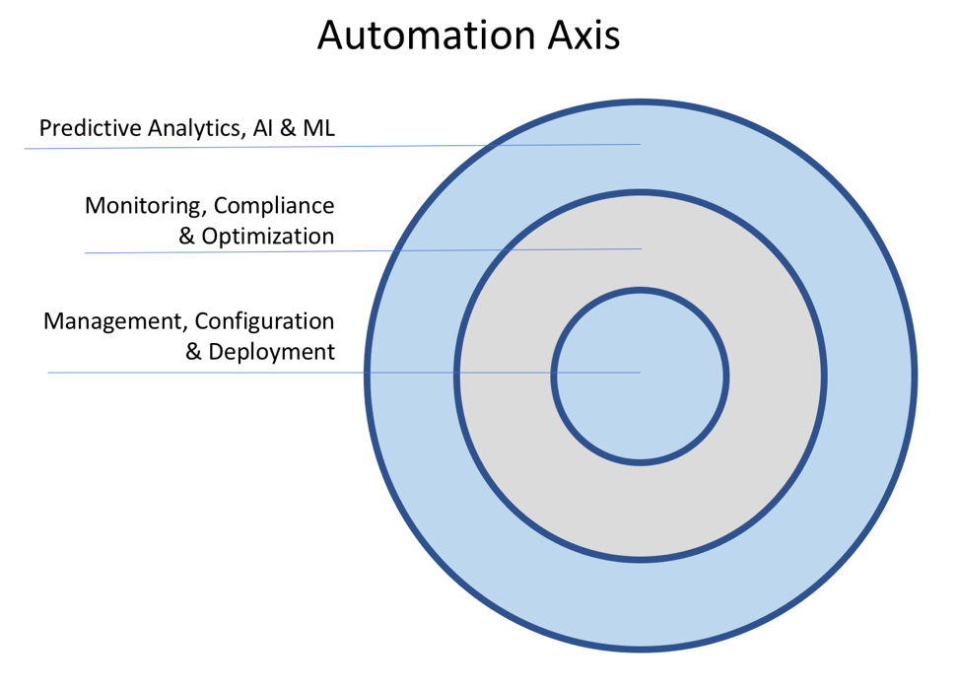

Slide 8
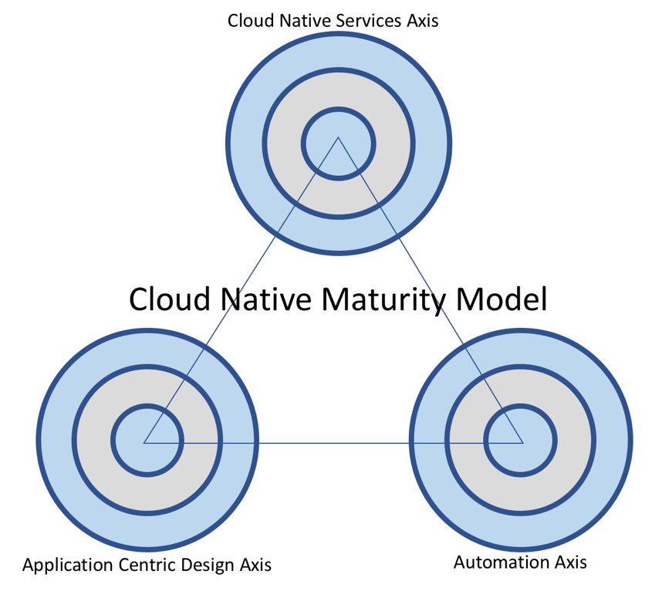
Your Project’s Maturity
Building Blocks
Management,
Configuration, and
Deployment
Some elements of
Twelve-factor App

Slide 9
Cloud-first?
All or All new?
People need new complex skills
Dead cap-ex & op-ex commitments
Customer impact (legacy systems)
Regulations
Data classification and providence
Approval processes

Slide 10
New concepts
Agile and DevOps
Fast and Often deployments
Abstraction
“Unlimited” resources
Events
Parallelization
Microservices and APIs

Slide 11
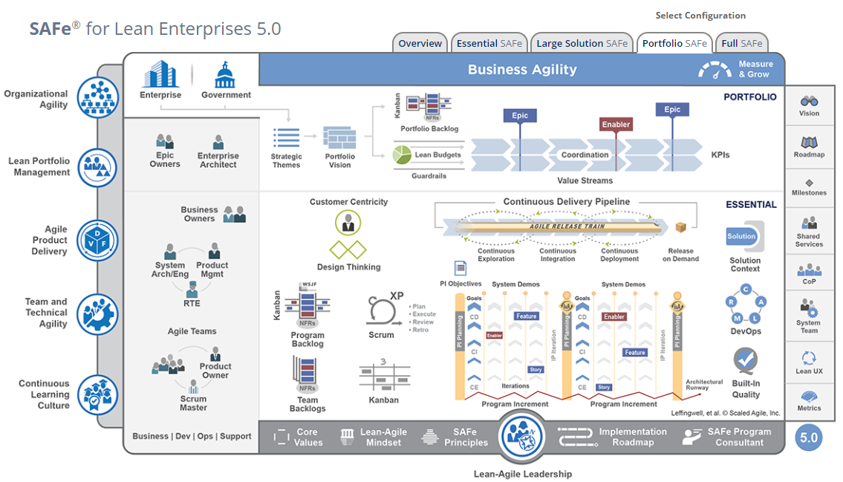
DevOps –SAFe https://www.scaledagileframework.com/

Slide 12
Hybrid
Legacy workloads on-premises and new projects in the cloud
Production workloads on-premises and non-production in the cloud
Disaster recovery environment in the cloud
Storage or archival in the cloud
On-premises workloads bursting into the cloud for additional capacity

Slide 13
Multi-cloud
Book argues don’t bog your down thinking about multi-cloud.
Kubernetes solves only the compute problem

Slide 14
Transition to Cloud (tbd scenarios)
Lift and Shift
Re-engineer
Greenfield

Slide 15
Netflix
Highlight slides
Fragility
Shifting the curve
Standard organizational testing (Simian Army)
https://github.com/Netflix/SimianArmy
Netflix retrospective
https://www.slideshare.net/AmazonWebServices/ent209-netflix-cloud-migration-devops-and-distributed-systems-aws-reinvent-2014

