Slide 1
IT780 : Introduction to Cloud Computing
Chapter 2
The Cloud Application Journey

Slide 2
Agility
What does it take to deploy an app in a datacenter?
Processing needs:
How do you estimate the amount of equipment needed?
What if your estimates are wrong?
Capital needs:
How will you spend for an unknown return?
Fail fast:
“It is not an experiment if you know it’s going to work” – Jeff Bezos

Slide 3
Cost
Free Tier
On-demand
Spot
Reserved

Slide 4
Free Tier
AWS: https://aws.amazon.com/free/
Azure: https://azure.microsoft.com/en-us/free/free-account-faq/
GCP: https://cloud.google.com/free/
Comparison: http://sudhakarplugged.com/azure-vs-aws-vs-gcp-cloud-services-free-tier-comparison/

Slide 5
Security
 | Typical Datacenter | Cloud
Administrative access | Many types of admins (operations, OS, network) with access to most systems | No one allowed unfettered ability to make changes
Patching | Batched: As long running process do not make testing and rollbacks easy | On demand: Small changes locate failure quickly
Known components | A spreadsheet | Deployment manifests
Network monitoring | Firewall | SDN
Physical | Unlimited once in room | Access allowed only by managed request
Deployments | Dev, Test, Prod all have different policies | Dev, test, prod are operationally the same

Slide 6
Soft Factors
Company Expansion
Hiring
Is datacenter management a core competency?
Corporate culture (history)
Technical debt
Current use of CI/CD

Slide 7
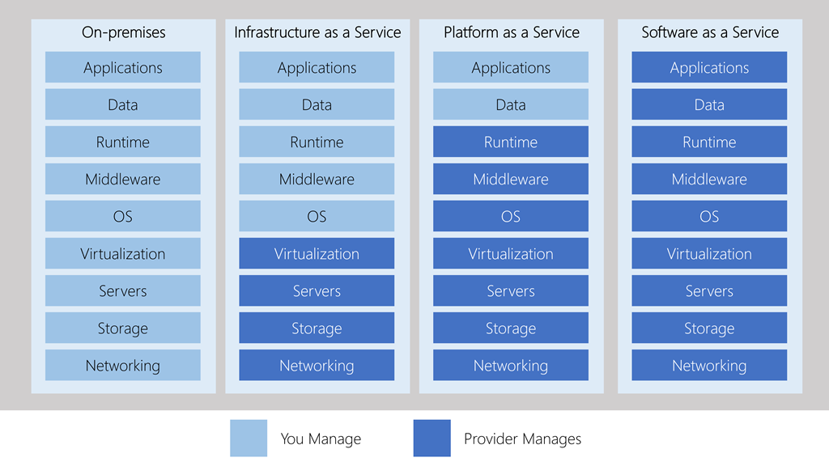
Management responsibilities

Slide 8
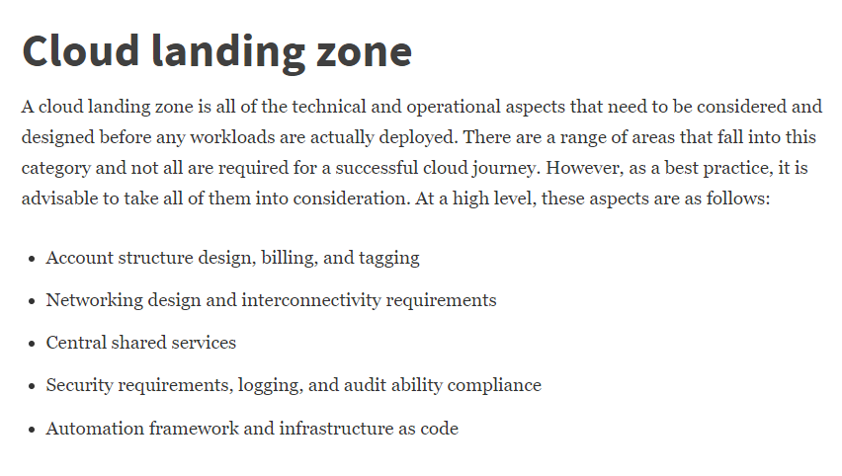

Slide 9
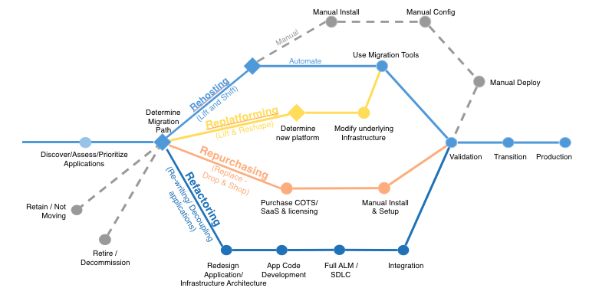

Slide 10
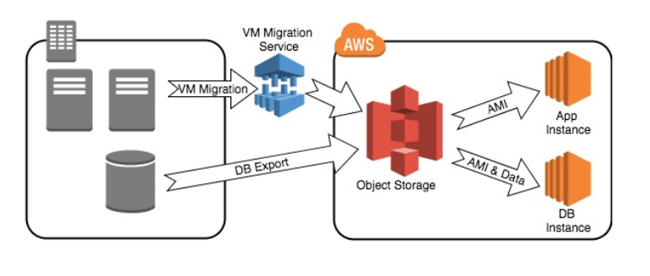
Rehost (Fast, Same quality, Expensive)

Slide 11
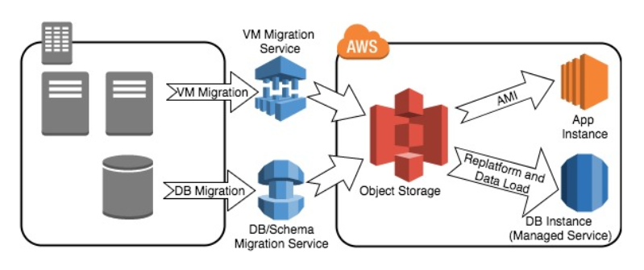
Replatform (Slower, Better quality, Use some new services)

Slide 12
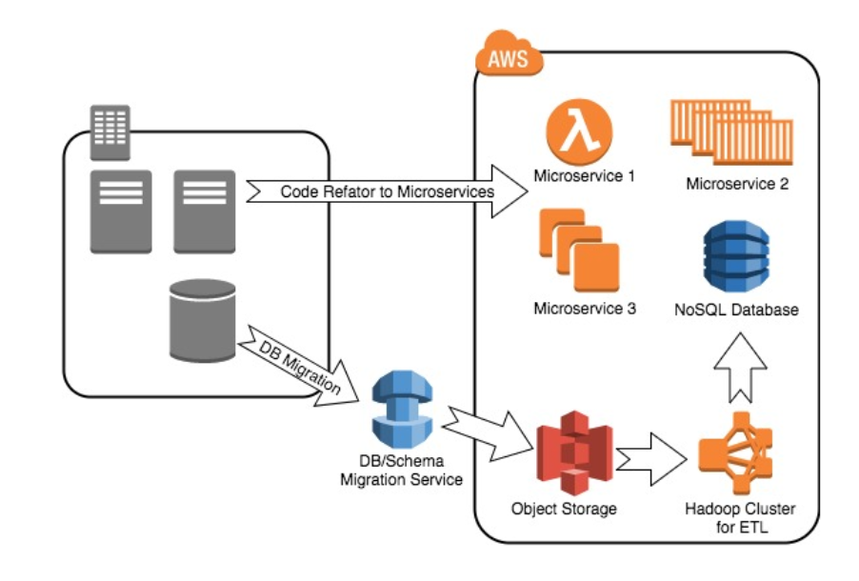
Refactor (Slowest, Best quality, Best cost)

Slide 13
Compliance standards take time to evolve
Cool new tech -> Widespread use -> Change best practice -> Compliance standards updated -> Policy change implemented
Example: PCI-DSS required for systems with cardholder data
Firewalls, anti-virus, physical separation
CIS benchmarks
https://aws.amazon.com/marketplace/pp/Center-for-Internet-Security-CIS-Amazon-Linux-2-Be/B07M68CJS5

Slide 14
SANS Critical Controls
Critical Control | Legacy (Pets) | Cloud (Cattle)
1- Device Inventory | Audit list | API query
2 – Software inventory | Audit list | Pipeline manifests
3 – Secure configurations | System hardening processes | Only latest versions used at launch
4 – Continuous Vulnerability Assessment | Scheduled pen tests. Remediation? | Must pass to be deployed
5 – Control Administrative Privileges | Limit data center access, jump boxes | IAM
6 – Audit Logs | Splunk | CloudTrail, Splunk
7 – Email & Browser protections
8 – Malware defense | Network & Host IDS | Immutable systems
9 – Firewall configuration | Crunchy outside, soft center | API protocols only
10 – Data recovery | Tape | Auto replication of data
11 – Secure network devices | Hardening process | Provided by vendor
12 – Boundary defense | Firewall, WAF, Network | Security groups
13 – Data Protection | Network DLP | Storage service encryption, SSL
14 – Controlled access | Network enclaves, Network DLP | IAM, SSL, Host DLP
15 – Wireless Access
16 – Account Monitoring | Active Directory | SAML, OpenID, IAM
17 – Security Skills Assessment
18 – Application Security | WAF, Penetration tests | ELB/WAF, pipeline testing
19 – Incident Response | Logs | Logs, Vendor’s internet visibility
20 – Pen tests and red team

