Slide 1
IT780 : Introduction to Cloud Computing
Chapter 3
Cloud Native Application Design

Slide 2
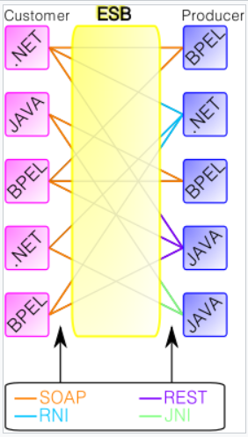
Enterprise Service Bus (ESB)
Route messages between services
Monitor and control routing of message exchange between services
Resolve contention between communicating service components
Control deployment and versioning of services
Marshal use of redundant services
Provide commodity services:
  Event handling
  Data transformation and mapping
  Message and event queuing and sequencing
  Security or exception handling
  Protocol conversion
  Communication SLA

Slide 3
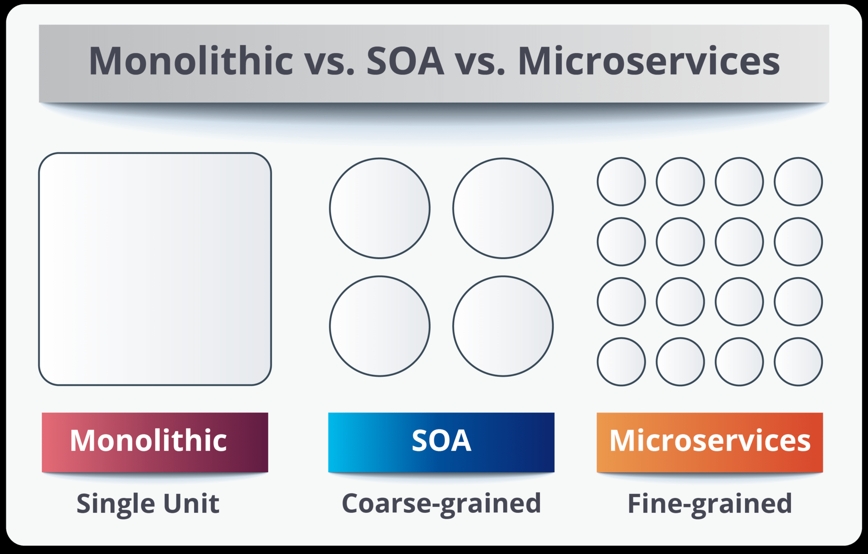
Think agility not size: Concrete vs. Steel vs. Bricks

Slide 4
SOA vs. Microservices
 | SOA | Microservices
Service Granularity | size anywhere from small application services to very large enterprise services | single-purpose services that do one thing really, really, well
Component Sharing | component sharing is one of the core tenets | coupling of a component and its data as a single unit
Messaging | middleware component | API
Remote services | complex: AMQP, MSMQ, and SOAP | simple: REST
Interoperability | multiple heterogeneous protocols | homogeneous
Scaling | multi-threaded | multi-instance

Slide 5
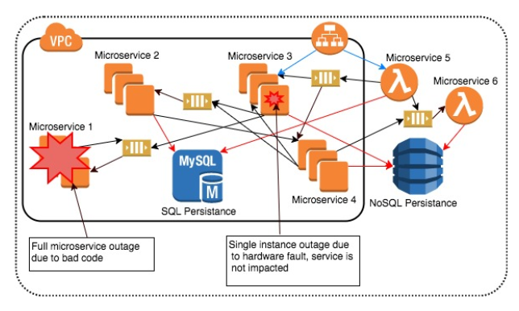
The *abilities (reliability, scalability, supportability)

Slide 6
Evolution to serverless
Microservices
  Gives us small single function blocks of code
Containers
  Allow replicating services without replicating the OS
Kubernetes
  Allows orchestration of containers

Slide 7
Serverless is good for
Compute
API proxy
Storage
Data stores
Messaging
Orchestration
Analytics
Developer tools

Slide 8
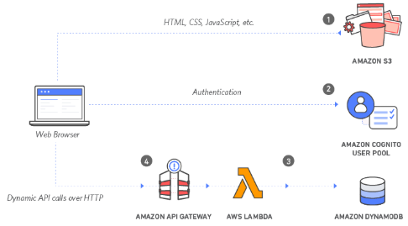
https://aws.amazon.com/getting-started/projects/build-serverless-web-app-lambda-apigateway-s3-dynamodb-cognito/

Slide 9
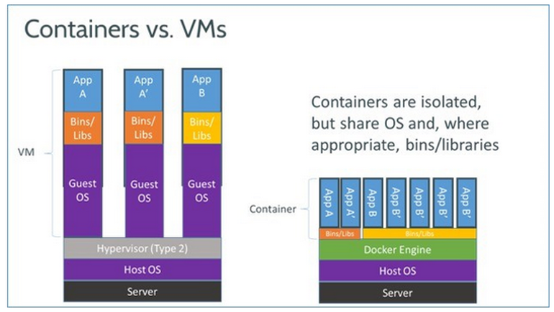

Slide 10
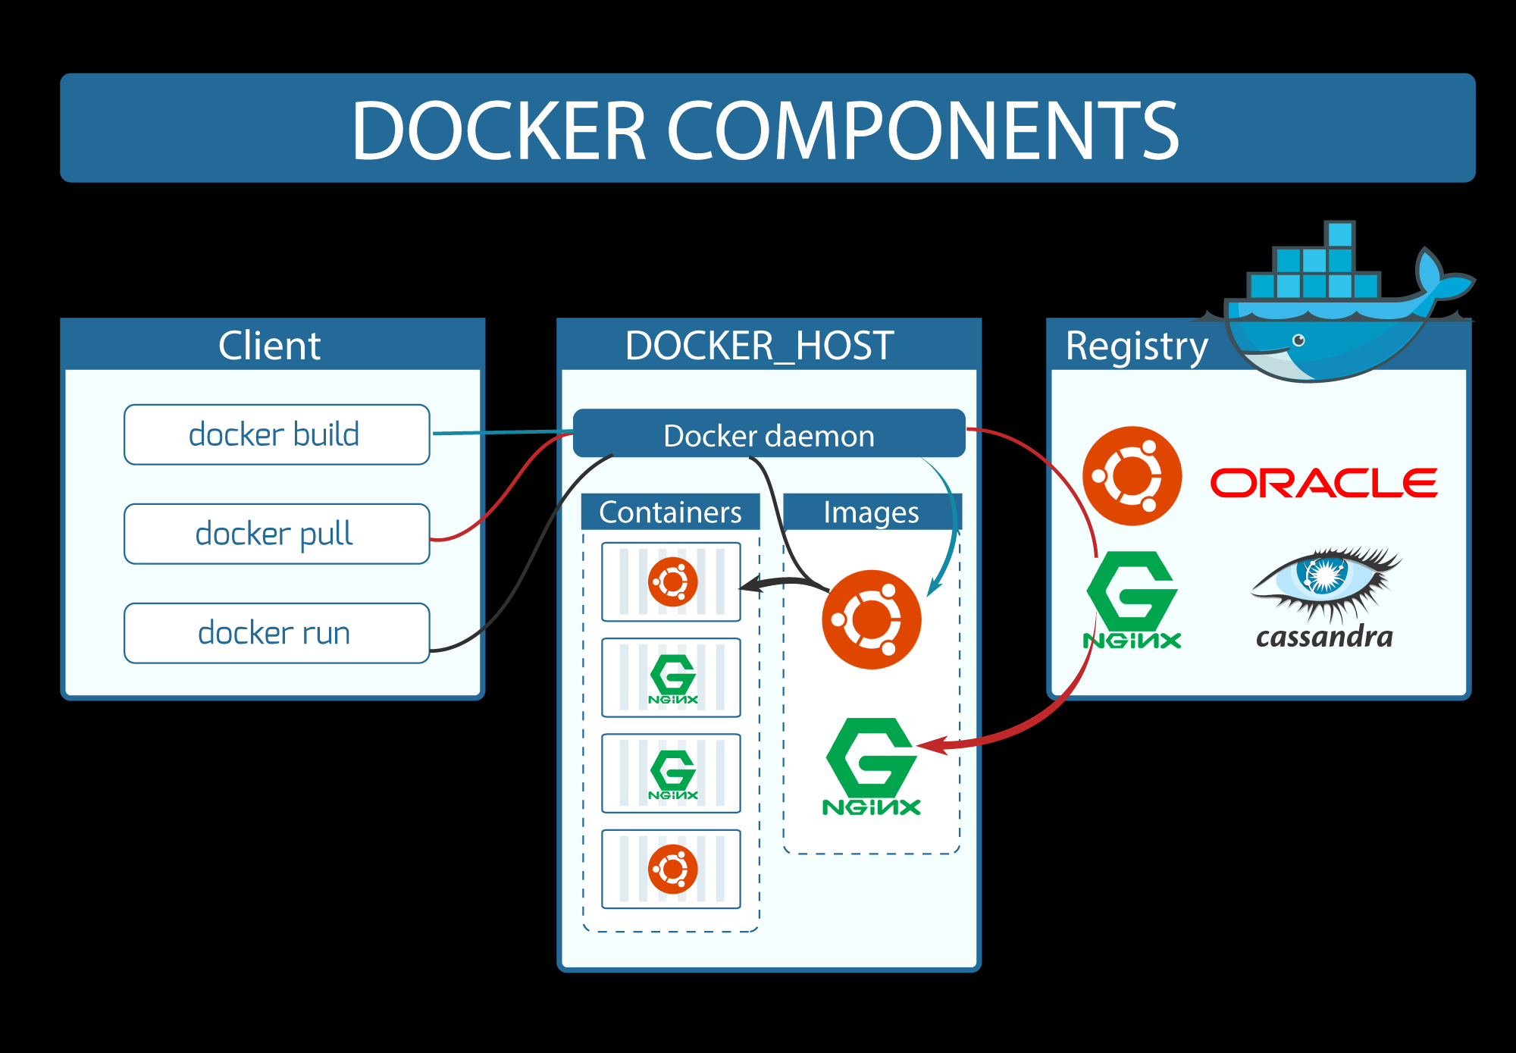

Slide 11
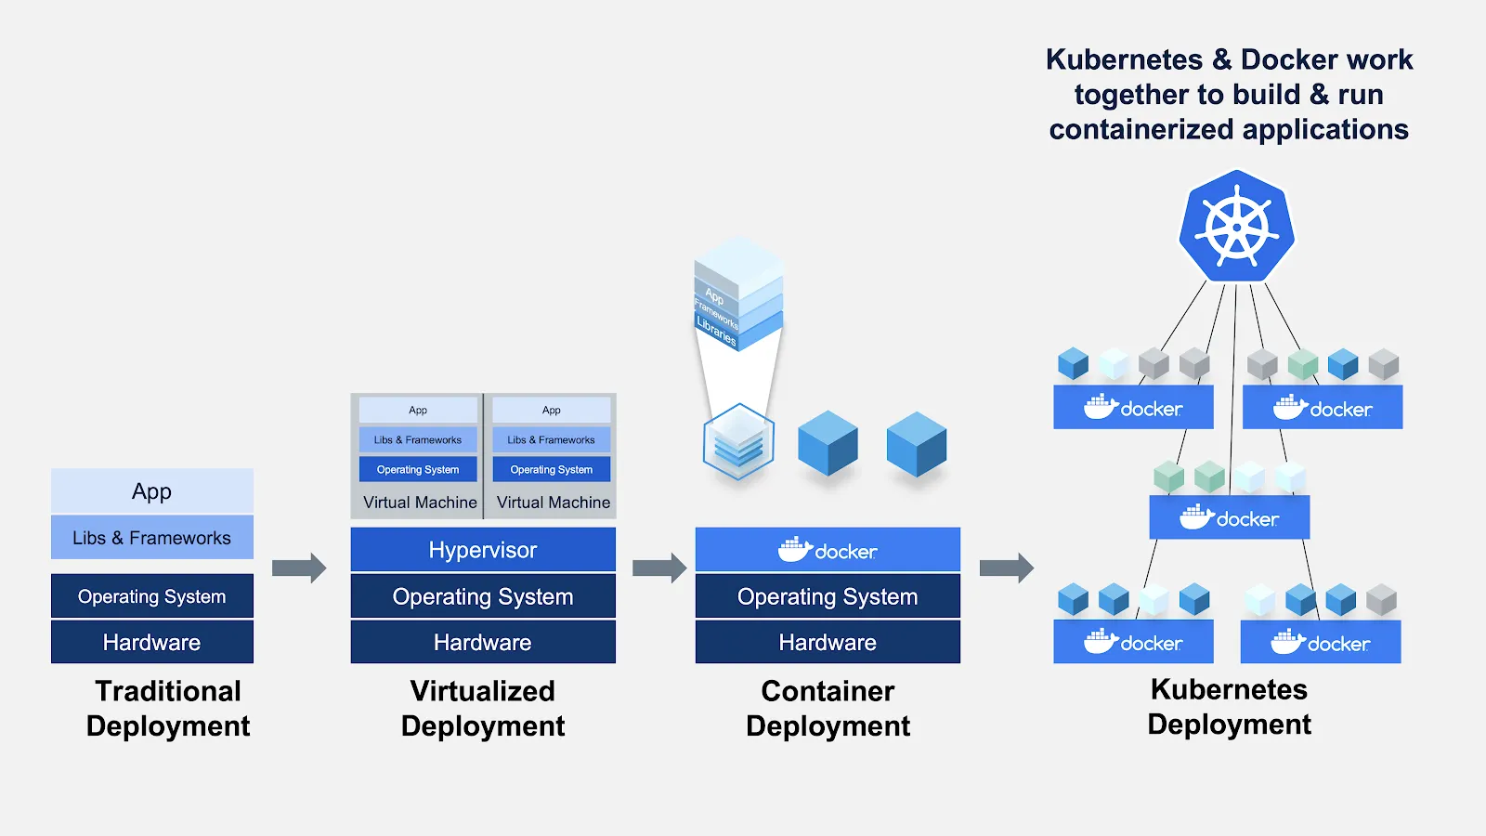
https://www.docker.com/blog/top-questions-docker-kubernetes-competitors-or-together/

