Slide 1
IT780 : Introduction to Cloud Computing
Chapter 4
How to Choose Technology Stacks

Slide 2
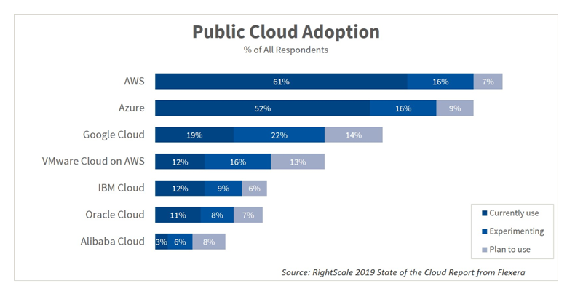

Slide 3
Considerations
Scale
Drives up availability and costs down
Security/compliance
Originally an inhibitor
Now an easier path to compliance
Feature richness
Was computer, messaging, storage
Now machine learning, blockchain, serverless, and AI
Price
Every workload is different
The three major cloud vendors are all cost competitive

Slide 4
Internet Scale Vendors
AWS : https://www.infrastructure.aws/
Azure : https://azure.microsoft.com/en-us/global-infrastructure/
GCP : https://cloud.google.com/about/locations/
IBM : https://www.ibm.com/cloud/data-centers/
Oracle : https://www.oracle.com/cloud/data-regions.html#northamerica

Slide 5
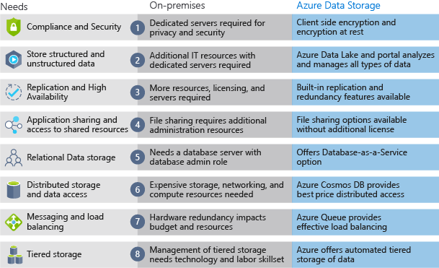

Slide 6
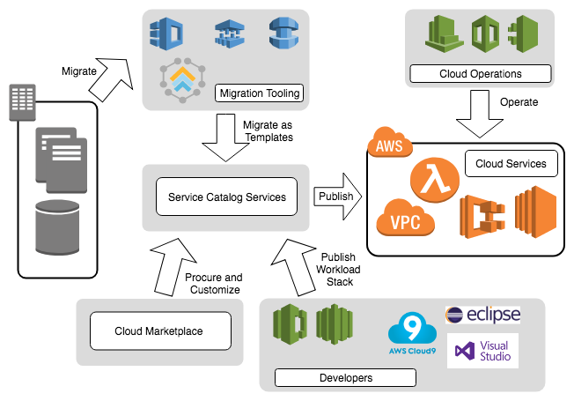
Marketplaces
Pro
Evaluations
Low up-front cost
A ’la carte
Only “off the shelf”
Con
Existing contracts
Long-term deals
No customization

Slide 7
Cloud Pricing Challenges
Unused resources
No centralized cost management
Overprovisioning
Poor design choices

Slide 8
Things to consider
Do operating systems really matter any longer?
Vender lock-in
Self managed cloud services
Your dev environment can drive production vendor choice

