Slide 1
IT780 : Introduction to Cloud Computing
Chapter 5
Scalable and Available

Slide 2
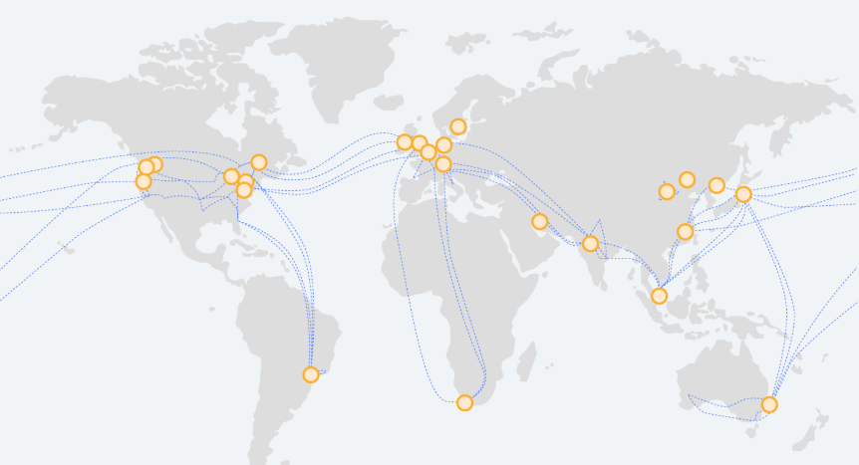
AWS Global Network

Slide 3
Availability Best Practices
Deploy across multiple regions & availability zones
Leverage DNS
Use latency-based routing (LTR) for regional services
Use auto-scaling
Use vendor’s load balancing

Slide 4
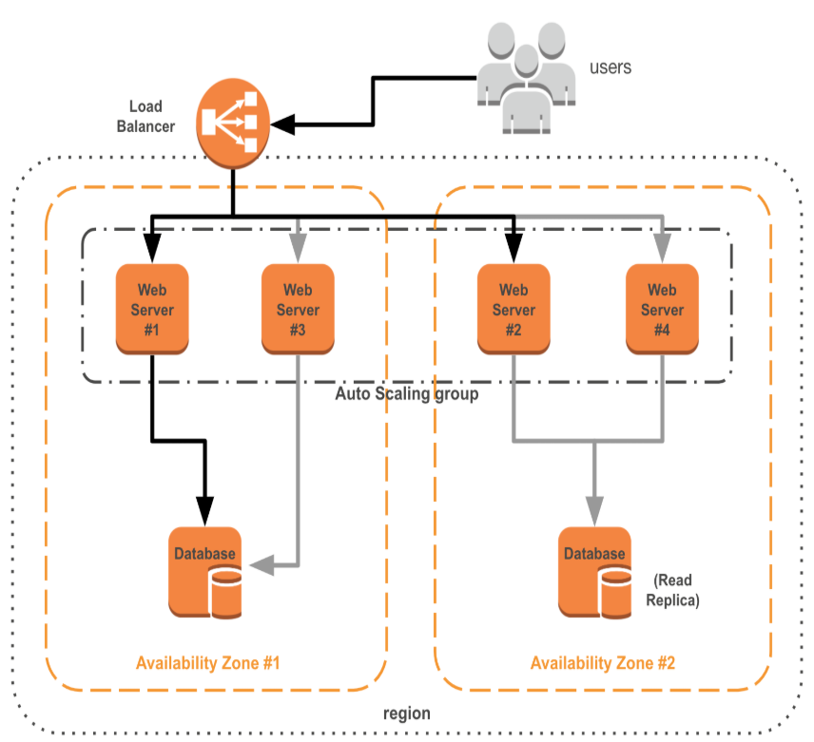

Minimize Blast Radius (Availability Zone = Datacenter)
T-Mobile Datacenter

Slide 5

Best Practice : Small incremental changes

Slide 6
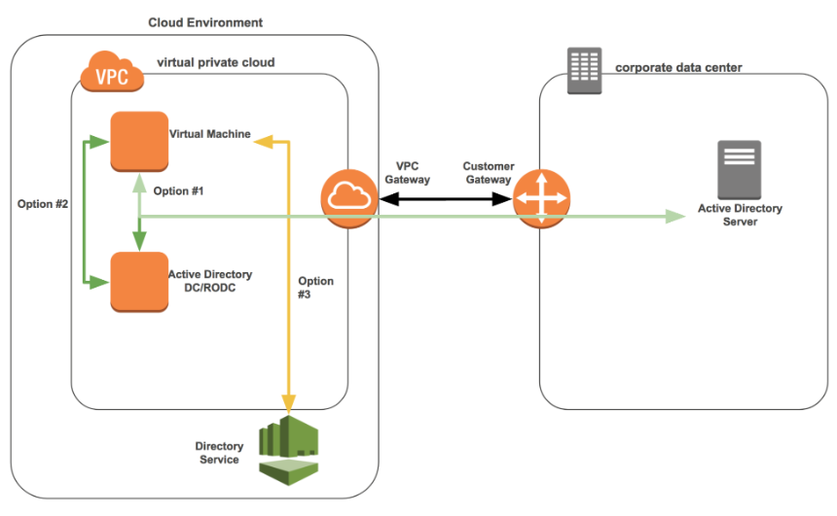
Reliability Best Practices
Network redundancy
Minimum 2 paths, whether ISP or VPN
Separate termination points
Redundant Core Services
Identity stores

Slide 7
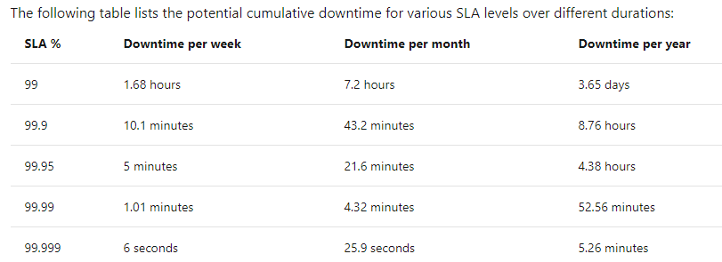
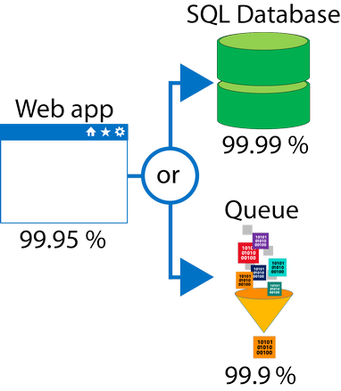
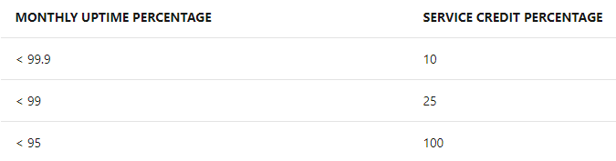

Slide 8
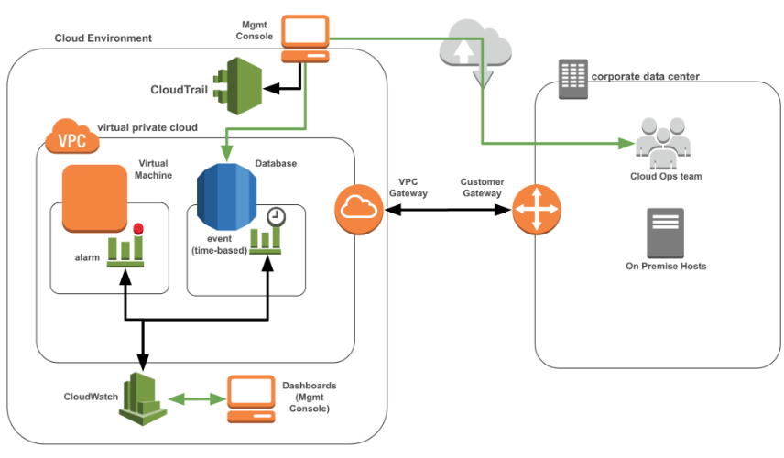
Monitoring (treat logs as event streams)
Infrastructure Monitoring
Application Monitoring
Real Time User Monitoring
Log Monitoring

Slide 9
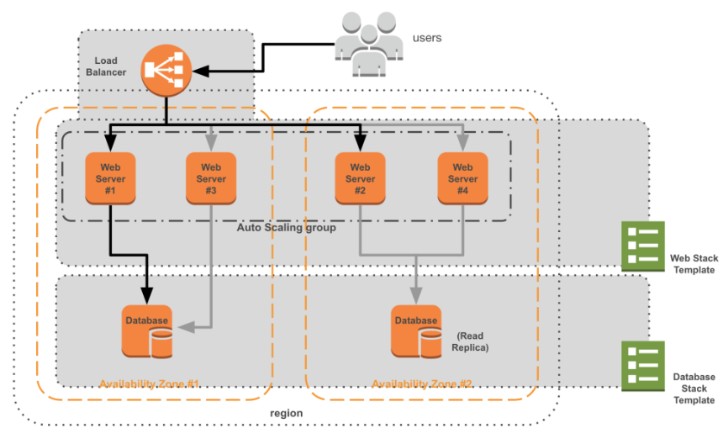
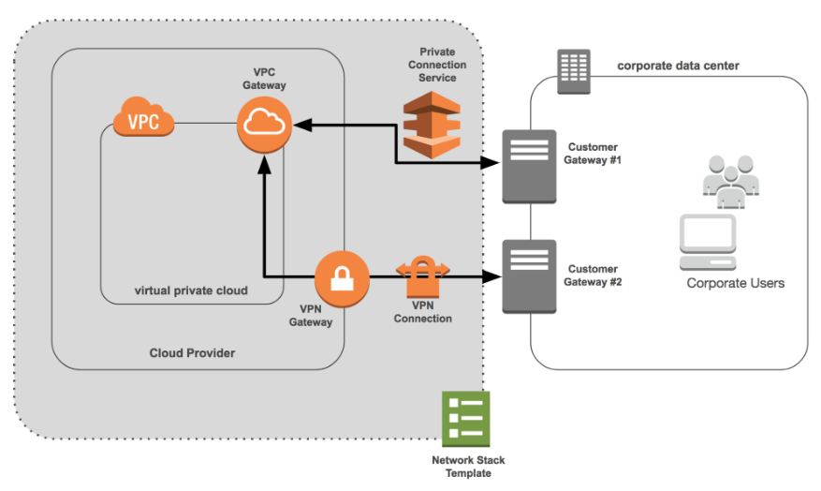
Infrastructure as Code Stacks, Templates, Blueprints, Projects (JSON, YAML)

Slide 10
KEY Concept : Immutable Deployments
NEVER changed after deployment
No patches, no administrative SSH/RDP
Cloud VMs are standardized and easy to replace
Treat your resources like cattle, not pets
Sick resources are culled not cured
Replace not update
Automate everything
Dev, Test, Prod environments build the same way

Slide 11
Self-healing infrastructures
Cloud vendor responsible for hardware self-healing
Live shift compute
Replicated storage
Customer responsible for application self-healing
Auto-scaling groups
DNS (re-route a stack)
Database failover
What about SaaS?

Slide 12
Core Tenets
Compute is distributed and the application is stateless
Storage is non-local and distributed
Create physically redundant network connections
Monitor extensively and exhaustively
Infrastructure as Code
Every deployment is immutable
Design and implement the self-healing infrastructure
Build in configuration checks and rules
Create and maintain an Operational Control Pane
Scalability versus Elasticity—know the difference

Slide 13
Tool discussion
Book lists a dozen, please share your experience
Ansible
Vagrant
OpenStack
Docker
Kubernetes
Linkerd
???

