Slide 1
IT780 : Introduction to Cloud Computing
Chapter 6
Secure and Reliable

Slide 2
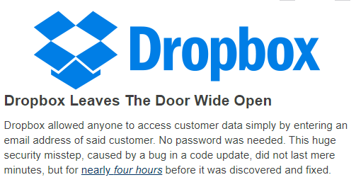
… or is it?
https://techcrunch.com/2011/06/20/dropbox-security-bug-made-passwords-optional-for-four-hours/

Slide 3
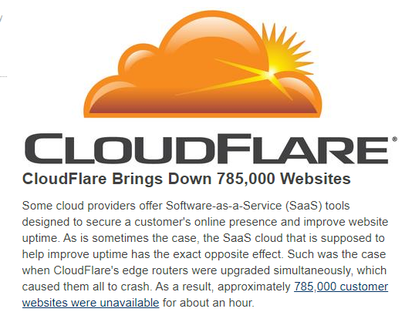
… or is it?
https://techcrunch.com/2013/03/03/cloudflare-is-down-due-to-dns-outage-taking-down-785000-websites-including-4chan-wikileaks-metallica-com/

Slide 4
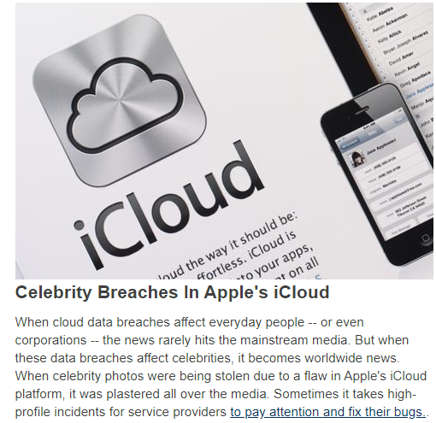
… or is it?
https://gizmodo.com/report-apple-knew-of-security-problems-long-before-icl-1638746390

Slide 5
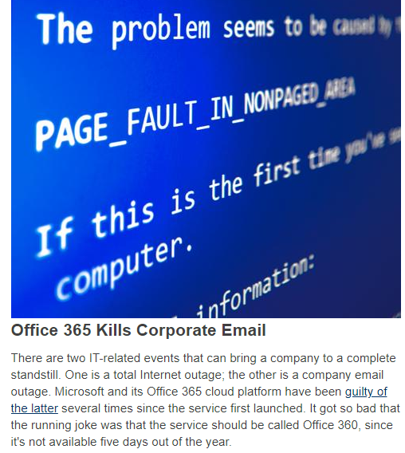
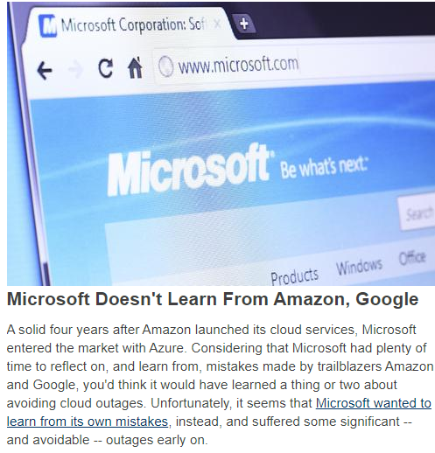
… or is it?
http://www.informationweek.com/cloud/software-as-a-service/microsoft-exchange-online-suffers-service-outage/d/d-id/1278829
https://www.entrepreneur.com/article/240029

Slide 6
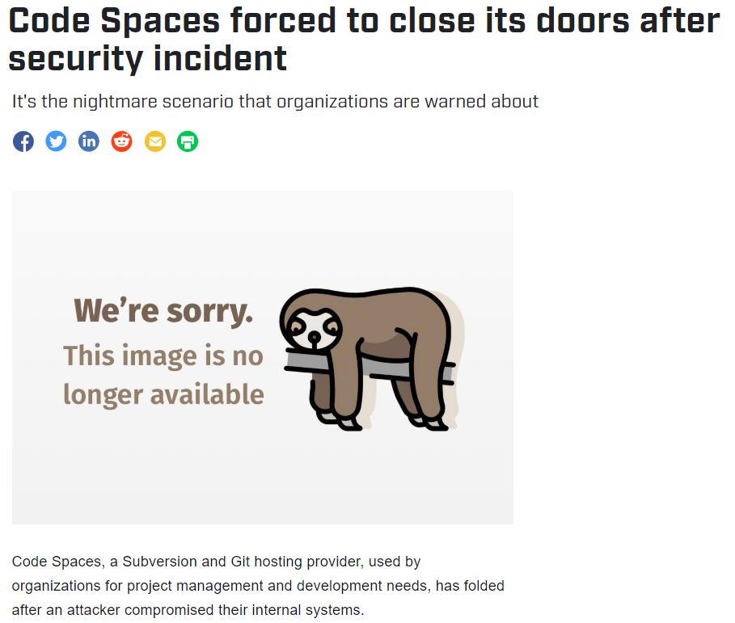
… or is it?
https://www.csoonline.com/article/2365062/code-spaces-forced-to-close-its-doors-after-security-incident.html

Slide 7
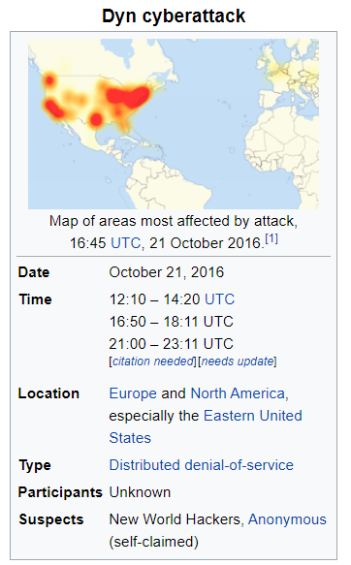
… or is it?
https://en.wikipedia.org/wiki/2016_Dyn_cyberattack

Slide 8
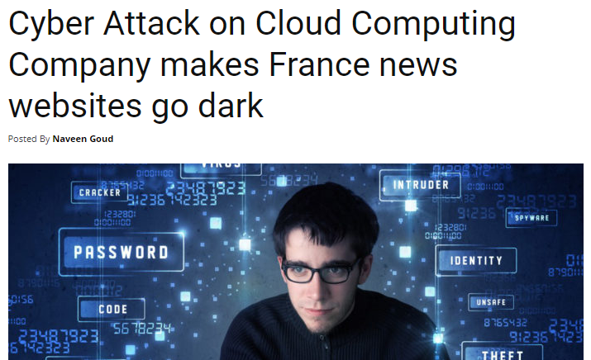
… or is it?
https://www.cybersecurity-insiders.com/cyber-attack-on-cloud-computing-company-makes-france-news-websites-go-dark/

Slide 9
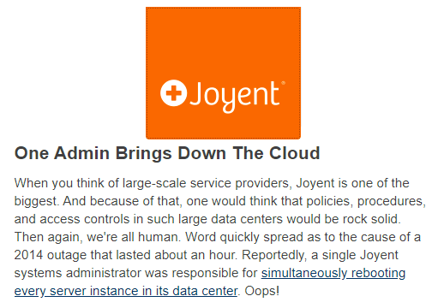
… or is it?
https://www.joyent.com/blog/postmortem-for-outage-of-us-east-1-may-27-2014

Slide 10
Classic factors in datacenter security breaches
Compute resources were dispersed across multiple organizations
Poor tracking and monitoring of physical assets
Inconsistent/heterogenous hardware and software
Weak/poor access control
Deficient overhead management
Insider threat ignored
Security and business teams not aligned
“Control change and review” vs. “fail fast and innovate”

Slide 11
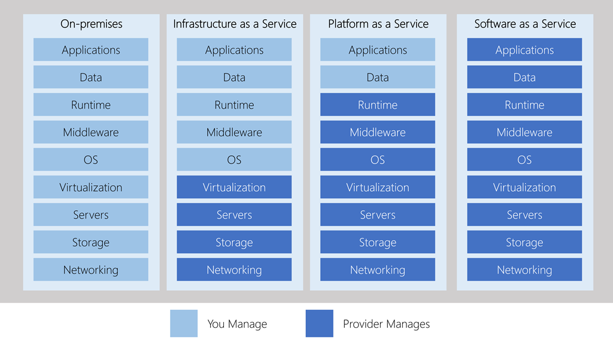
Shared Responsibilities (again)

Slide 12
Cloud is better for security
Infrastructure issues off the table (Physical, Power)
Platform issues (OS, runtimes) homogenized
Security baked into Cloud vendor services
Identity and Access Management (IAM)
Web Application Gateways
Consistent automated updating
Limited administrative access
Vendor has larger scale and deeper experience
Access via API only

Slide 13
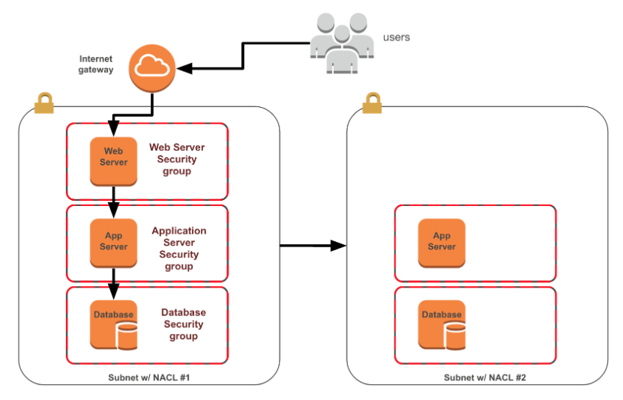
NACLs vs. Security Groups (SG)
SGs | NACLs
Operates at the instance level (first layer of defense) | Operates at the subnet level (second layer of defense)
Supports allow rules only | Supports allow rules and deny rules
Stateful: Return traffic is automatically allowed regardless of any rules | Stateless: Return traffic must be explicitly allowed by rules
We evaluate all rules before deciding whether to allow traffic | We process rules in number order when deciding whether to allow traffic
Applies to instance only if someone specifies the security group when launching the instances, or associates the SG with the instance later | Automatically applies to all instances in the subnets it's associated with (backup layer of defense, so you don't have to rely on someone specifying the correct SG)

Slide 14
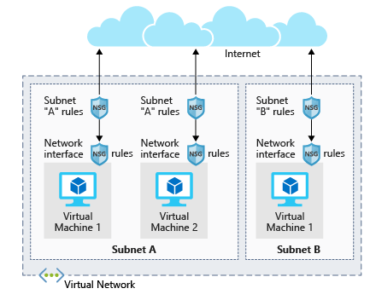
Cloud “firewall” is software

Slide 15
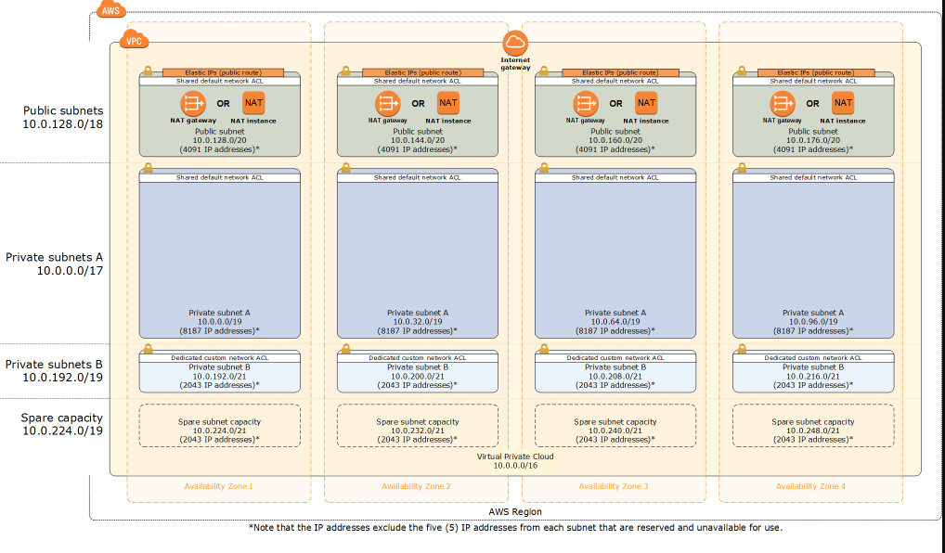
Private vs. Public subnets

Slide 16
No “firewall” to log all traffic
VPC flow logs = Net flow
API gateway
Route all traffic through a proxy

Slide 17
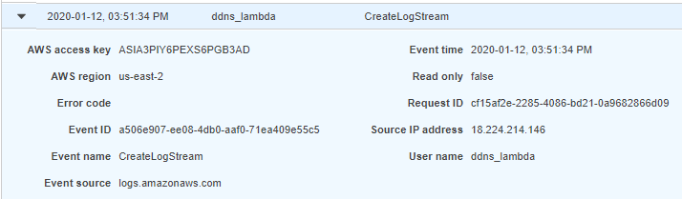
Audit
Capture then Analyze
Every action is an API call
Track admins, users, keys

Slide 18
Monitoring
Detailed monitoring every minute
Set and trigger alarms when monitoring metrics reach certain thresholds
Automate actions based on alarms
Build custom dashboards with graphs and statistics

Slide 19
Configuration Management
Tracking configuration states and changes
Create inventory of all resources

Slide 20
Identity
User
Person or service
Role
Access pattern assumed by a person, machine, or service
Policy
Implicit grant/deny to service, resources, or objects.
Attached to users or roles
Security Credential
Limited privilege grants to a user

Slide 21
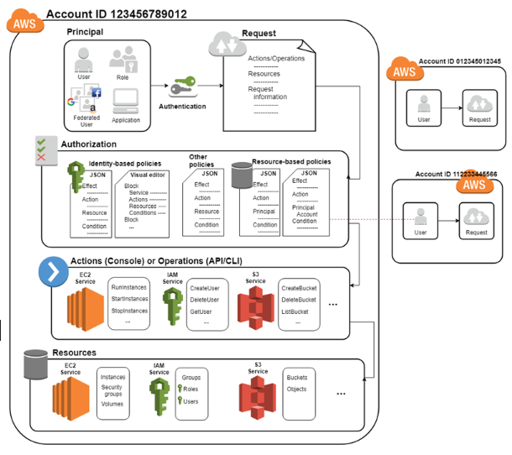

Slide 22
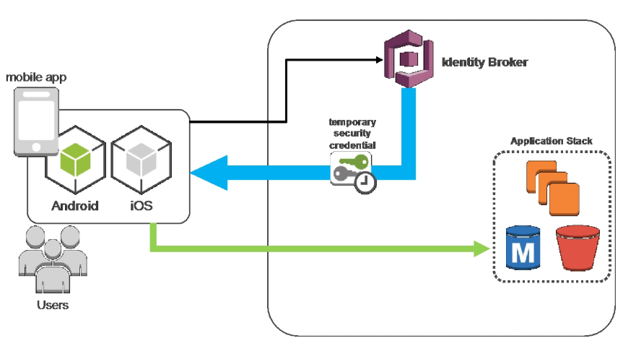
Customer Identity (OAuth 2.0)

Slide 23
Compliance
Cloud service provider tools
AWS's Artifact tool
Microsoft Trust Center
Google's Cloud Compliance
Standards (many, many more)
PCI DSS Payment card
ISO 27001, 27017
SOC {1,2,3}
Cloud Security Alliance (CSA)

Slide 24
DevSecOps : https://www.devsecops.org/
Leaning in | over Always Saying “No”
Data & Security Science | over Fear, Uncertainty and Doubt
Open Contribution & Collaboration | over Security-Only Requirements
Consumable Security Services with APIs | over Mandated Security Controls & Paperwork
Business Driven Security Scores | over Rubber Stamp Security
Red & Blue Team Exploit Testing | over Relying on Scans & Theoretical Vulnerabilities
24x7 Proactive Security Monitoring | over Reacting after being Informed of an Incident
Shared Threat Intelligence | over Keeping Info to Ourselves
Compliance Operations | over Clipboards & Checklists

Slide 25
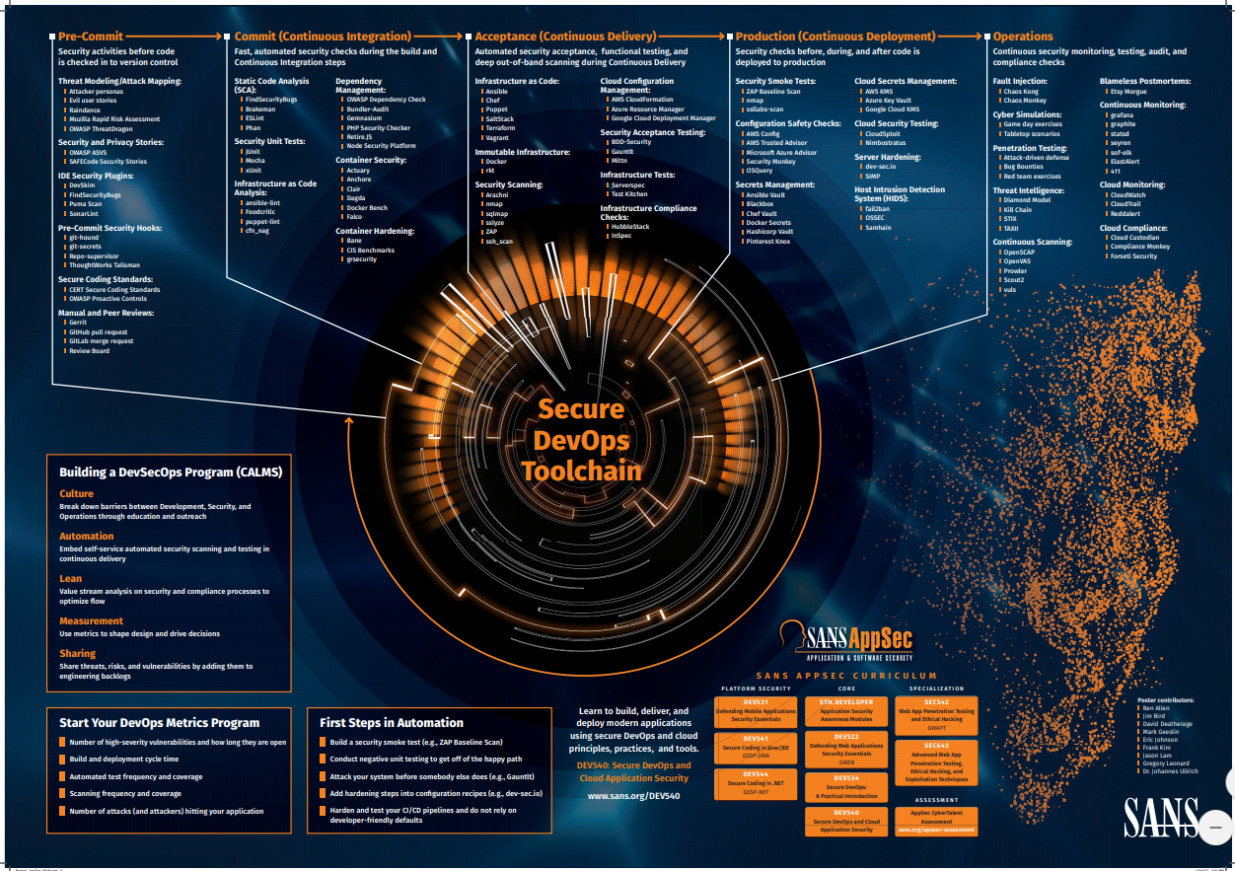
DevOps: https://www.sans.org/security-resources/posters/secure-devops-toolchain-swat-checklist/60/download

