Slide 1
IT780 : Introduction to Cloud Computing
Chapter 7
Optimizing Cost

Slide 2
Datacenter Costs (don’t forget failover)
Physical space
Electric power
Physical Security
Network connectivity
Cooling
Physical hardware
Staff

Slide 3
Cost drivers for Cloud
Reduced complexity
Elastic capacity
Increased speed to the market
Global reach
Increased operational efficiency
Enhanced security

Slide 4
Total Cost of Ownership
Azure:
https://azure.microsoft.com/en-us/pricing/tco/calculator/
AWS:
https://awstcocalculator.com/

Slide 5
Cloud Cost Calculator
Azure
https://azure.microsoft.com/en-us/pricing/calculator/
Google
https://cloud.google.com/products/calculator
AWS
https://calculator.aws/#/estimate

Slide 6
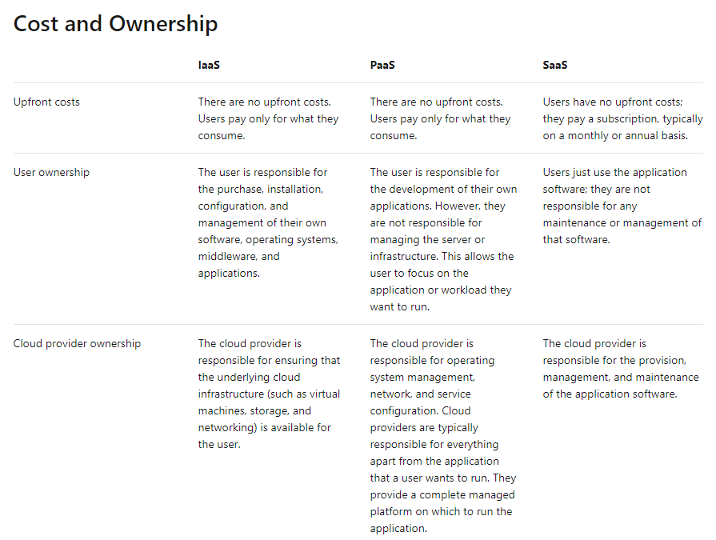

Slide 7
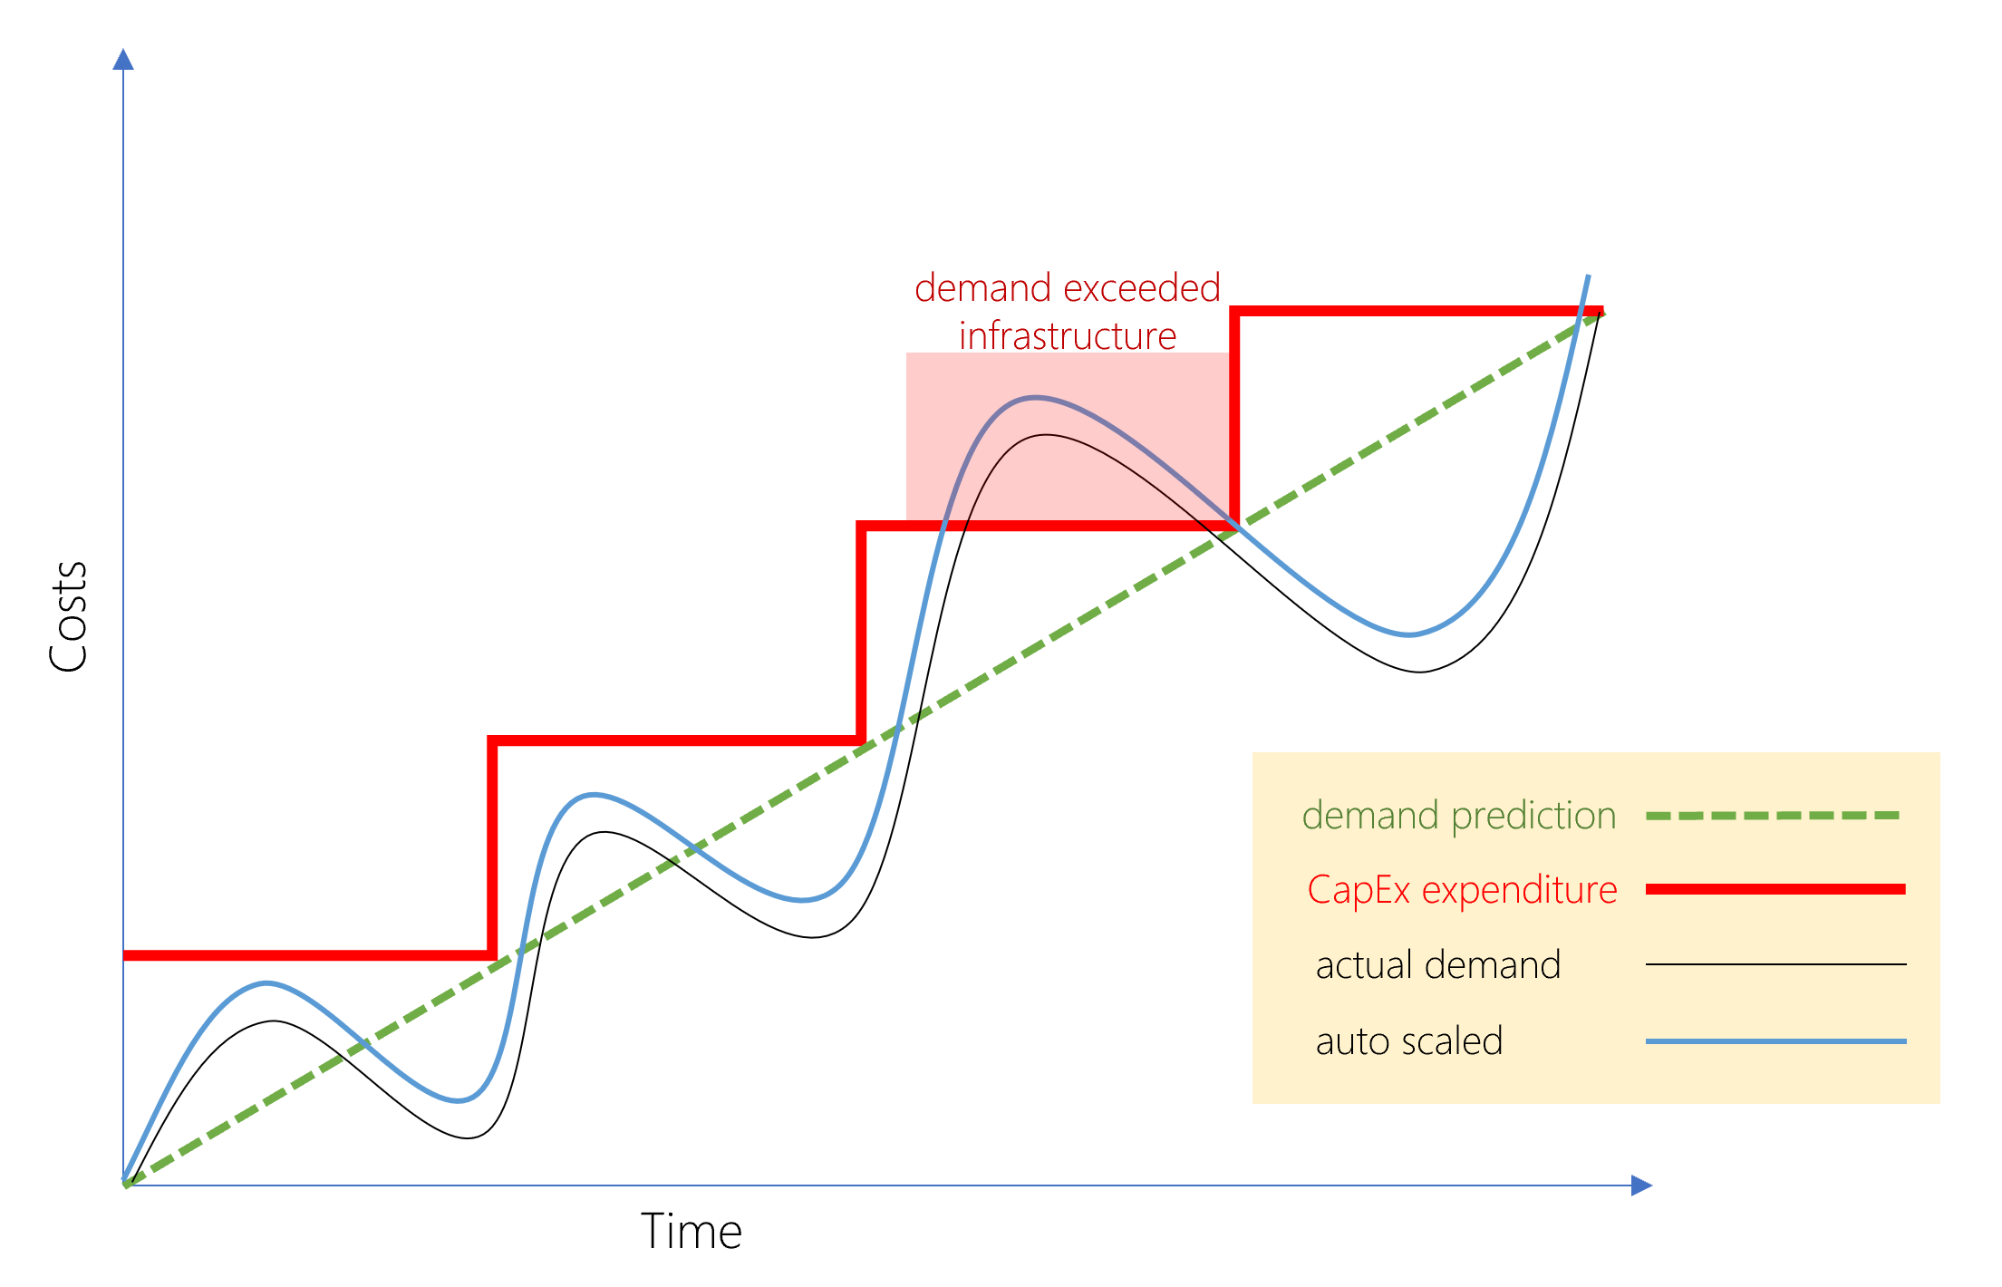
Benefits of OpEx

Slide 8
CapEx vs. OpEx
Recurring costs vs. Upfront investments
Tax benefits
Expense vs. Depreciation
Greater transparency
No chargeback for shared costs
Easier growth
Match business demand
No commitment or lock-in required
Reserve contracts do have a lower in exchange for a commitment

Slide 9
Cost Monitoring
AWS
Account with optional organizational overlays
https://console.aws.amazon.com/billing/home?#/
Azure
Subscriptions within an account
https://docs.microsoft.com/en-us/partner-center/set-an-azure-spending-budget-for-your-customers
Google
Accounts with linked projects
https://cloud.google.com/billing/docs/how-to/budgets

Slide 10
Best Practice: Set Budgets
Normally not a cap but a soft limit that generates an alert
Giving team carte blanche is a bad idea
Automation
Cost estimates during test should generate a good estimate of production costs

Slide 11
Cost Optimization
Right-sizing
Many smaller better than larger instances
Range of CPU types
Storage class : http://coststorage.com/
Hot, warm (on-demand/infrequent), cool (minutes), cold (hours)
Serverless
Invocations * runtime * memory

Slide 12
Tagging
Tags to identify business or billing groups for chargeback
Delete improperly tagged resources
Forces tagging as a critical activity

