Slide 1
IT780 : Introduction to Cloud Computing
Chapter 8
Cloud Native Operations

Slide 2
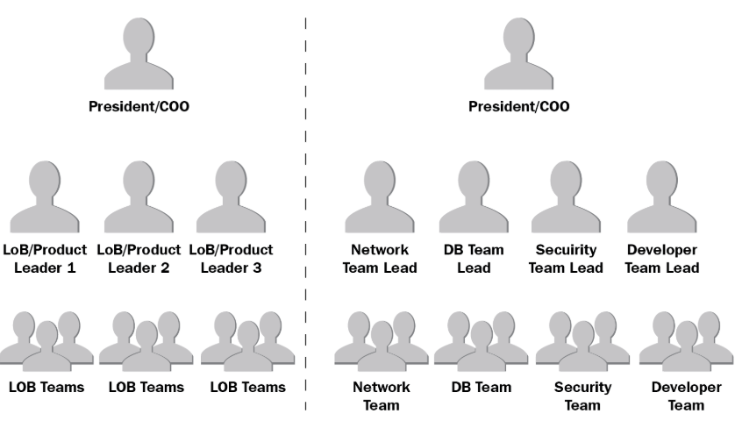
Traditional "Large" Organizations
Notes:
Book’s comments are about really large firms.
Often the security “team”
is a single person
Bain things break at 10 – 100 – 1000
Type of industry IoT 20/80. UNH 90/10
Matrix management

Slide 3
Agile – DevOps - Cloud Native Teams
Small “Two-pizza teams”
Changes the communication dynamic
Independent
Design thru Run phase skills
Responsible for a single (or small set of) microservices
Free to change anything except the API
Hard measures on architecture pillar performance
Notes:
Small your work speaks for itself, chats are about what needs to be done
Large status/review meetings and email approval chains

Slide 4
Inventory
On-premise
Change Management Database
Spreadsheets
Never 100% accurate
Cloud
On demand queries
Dashboards
Automated alerts drive governance and reporting
Notes:
LM 1500 systems scanned only 900 had a known business owner
UNH expected 80 internet facing systems, actually almost 500

Slide 5
Cloud Native Tenets
Complete ownership of their service
Streamline decision-making within their group
Rotate operations responsibility
Publish and maintain APIs forever
APIs are the only way to interface with other services
The right tools are the ones that get the job done
The team determines which language, framework, platform, engine, etc
Automation is more important than new features
Release of more features more quickly in the long run

Slide 6
URI – URL – URN – GUID
Every HTTP URL conforms to the syntax of a generic URI. The URI generic syntax consists of a hierarchical sequence of five components:^{[14]}
URI = scheme:[//authority]path[?query][#fragment] where the authority component divides into three subcomponents:
authority = [userinfo@]host[:port]
arn:aws:iam::788715698479:user/Ken
GUID/UUID: 33046AB3-A3F0-42B8-BB24-5ECDA1FB9760

Slide 7
Representational state transfer (REST)
HTTP Verb | CRUD | Entire Collection (e.g. /customers) | Specific Item (e.g. /customers/{id})
POST | Create | 201 (Created), 'Location' header with link to /customers/{id} containing new ID. | 404 (Not Found), 409 (Conflict) if resource already exists..
GET | Read | 200 (OK), list of customers. Use pagination, sorting and filtering to navigate big lists. | 200 (OK), single customer. 404 (Not Found), if ID not found or invalid.
PUT | Update Replace | 405 (Method Not Allowed), unless you want to update/replace every resource in the entire collection. | 200 (OK) or 204 (No Content). 404 (Not Found), if ID not found or invalid.
PATCH | Update Modify | 405 (Method Not Allowed), unless you want to modify the collection itself. | 200 (OK) or 204 (No Content). 404 (Not Found), if ID not found or invalid.
DELETE | Delete | 405 (Method Not Allowed), unless you want to delete the whole collection—not often desirable. | 200 (OK). 404 (Not Found), if ID not found or invalid.

Slide 8
Discussion
UNH has out-sourced email to a SaaS service.
Does that make the UNH email team “Cloud Native”?
What APIs must be supported?
Would it be cheaper to use PaaS or IaaS instead?
Is this a stepping stone in UNH’s journey to the cloud?
What does "pager duty" look like?
Who approves changes?
New features
New contract/subscription

Slide 9
Versioning
What to version?
The client has a version
The message format has a version
The API implementation (server) has a version
The documentation (API description) has a version
Resources don’t have a version
Relations between resources don’t have a version
The API itself doesn’t have a version
What are the extension rules?
You must not take anything away
You must not change processing rules
You must not make optional things required
Anything you add must be optional

Slide 10
Discussion : Netflix
Ownership:
How many ways might a Netflix service rely upon other services?
Streamline decision:
What/if any boundaries exist for a service?
Rotate operations responsibility
Are you rotated within a team or moved to a new team?
Publish and maintain APIs forever
True? Obtainable?
APIs are the only way to interface with other services
Corporate standards?
The right tools are the ones that get the job done
Can one team pick python and another PHP?
Automation is more important than new features
What does the path to publishing look like?

Slide 11
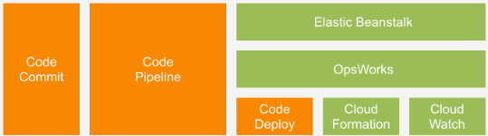
Infrastructure as Code
Notes:
Same process as code development, the code is “just” creating cloud infrastructure

