Slide 1
IT780 : Introduction to Cloud Computing
Chapter 9
Amazon Web Services (AWS)

Slide 2
AWS Background
Simple Queue Service (SQS) goes public 2004
AWS starts with SQS, EC2, S3 in 2006
Amazon sites migrated to AWS in 2010
2018 Revenue $25.6B, Income $7.2B
Customer survey 2017
https://www.2ndwatch.com/wp-content/uploads/2017/05/Cloud-Native-Services.pdf

Slide 3
Areas of expansion
SaaS
Amazon Chime
A managed service for video calls and chat
Amazon WorkDocs
Enterprise storage and sharing service
Amazon Connect
Managed contact center service
IoT
Polly (text to voice), Kinesis (streaming), Rekognition (images)

Slide 4
News
Tradeshow re:Invent: https://reinvent.awsevents.com/
Blog: https://aws.amazon.com/blogs/aws
Web: https://aws.amazon.com/new

Slide 5
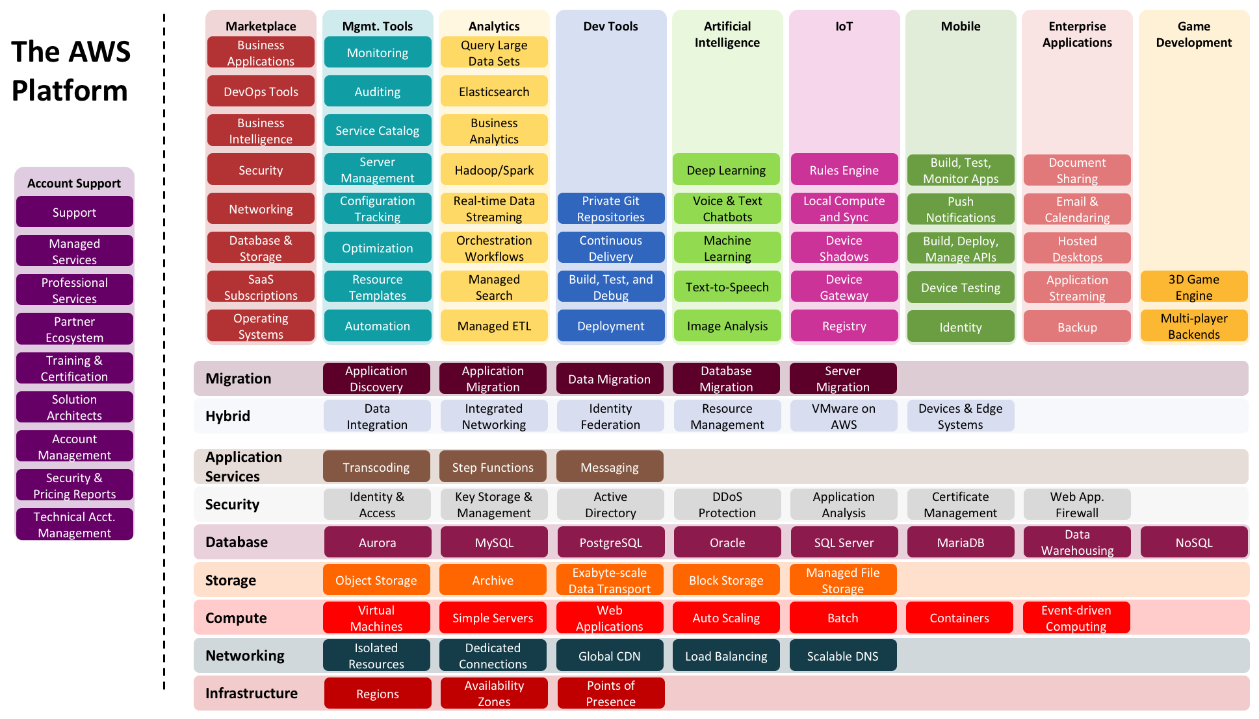

Slide 6
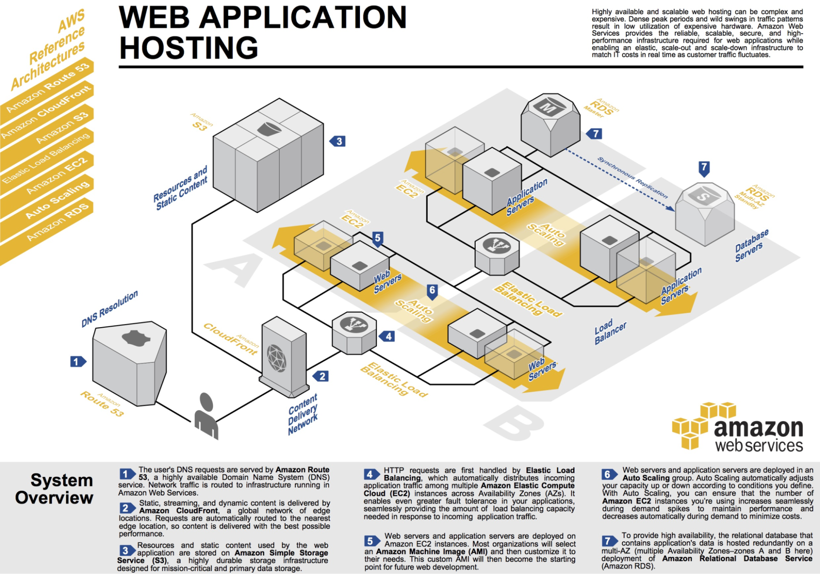
Notes:
http://media.amazonwebservices.com/architecturecenter/AWS_ac_ra_web_01.pdf

Slide 7
Cloud Adoption Framework (CAF)
Business
People
Governance
Platform
Security
Operations
https://aws.amazon.com/professional-services/CAF/

Slide 8
Key Security Services
Identity and access management (IAM)
Key Management Service (KMS)
CloudTrail
Inspector
Shield (DDoS protection)
WAF (API Gateway more popular)
GuardDuty: https://aws.amazon.com/guardduty/
Macie: https://aws.amazon.com/macie/

Slide 9
Demos from Book
Serverless via the console
SAM and YAML
Swagger

Slide 10
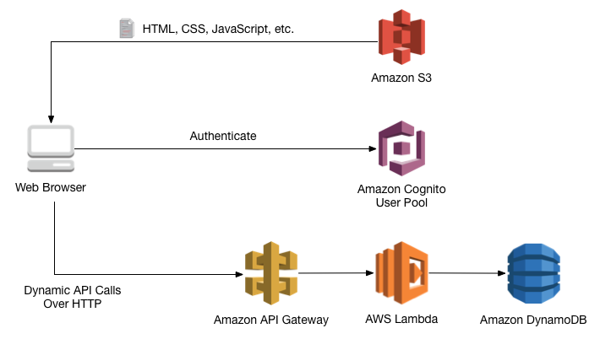

Slide 11
Build a Serverless Web Application (5 steps)
WildRydes
https://aws.amazon.com/getting-started/projects/build-serverless-web-app-lambda-apigateway-s3-dynamodb-cognito/

