Slide 1
IT780 : Introduction to Cloud Computing
Chapter 10
Microsoft Azure

Slide 2
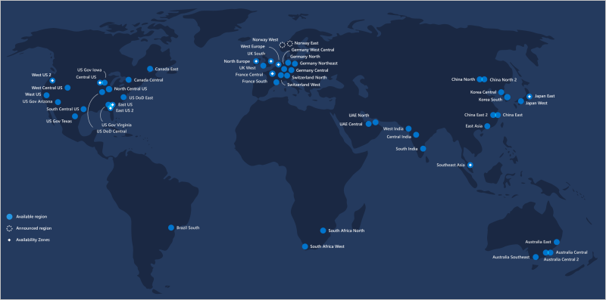
Azure Regions

Slide 3
Azure Background
“Windows” Azure goes public 2010
Team Foundation Server 2012
“Microsoft” Azure 2014
Majority of compute is Linux not Windows based
2019 revenue: $30B includes Office365 and more
Future contracts: $10B JEDI, $2B AT&T
Availability Zone = Region
Visual Studio team services

Slide 4
News
Tradeshow Ignite: https://www.microsoft.com/en-us/ignite
Blog: https://azure.microsoft.com/en-us/blog/
Web: https://azure.microsoft.com/en-us/updates/

Slide 5
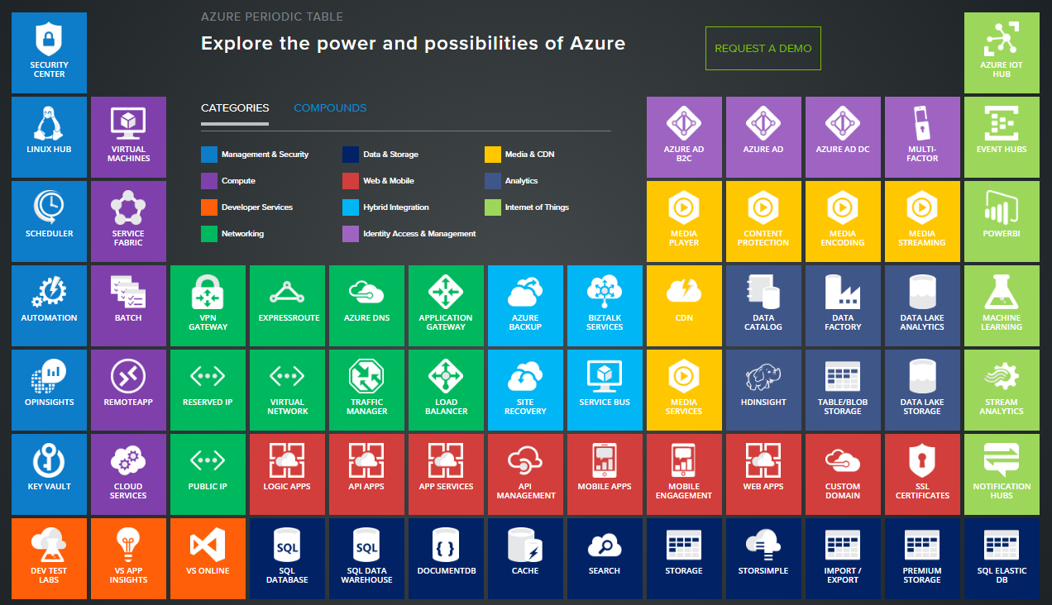
Notes:
https://azure.microsoft.com/en-us/services/

Slide 6
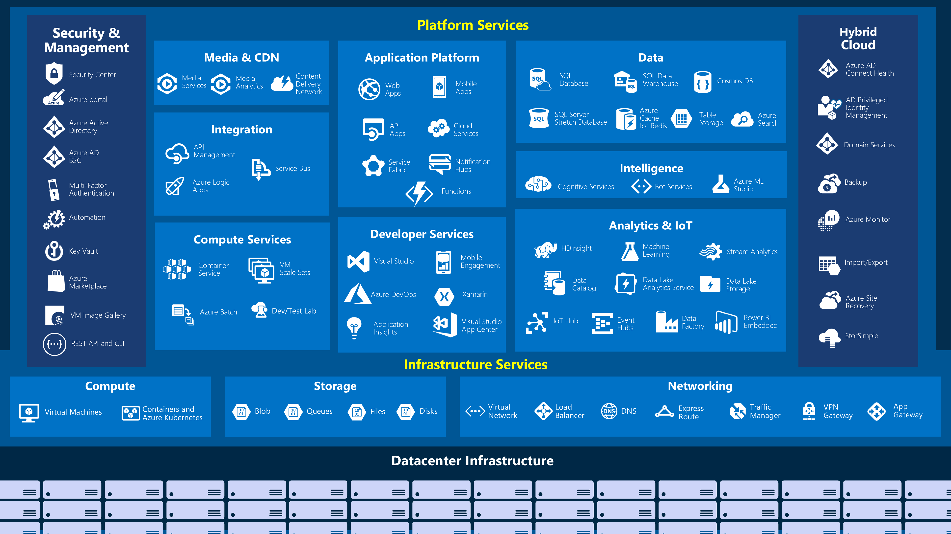
“Old Console”

Slide 7
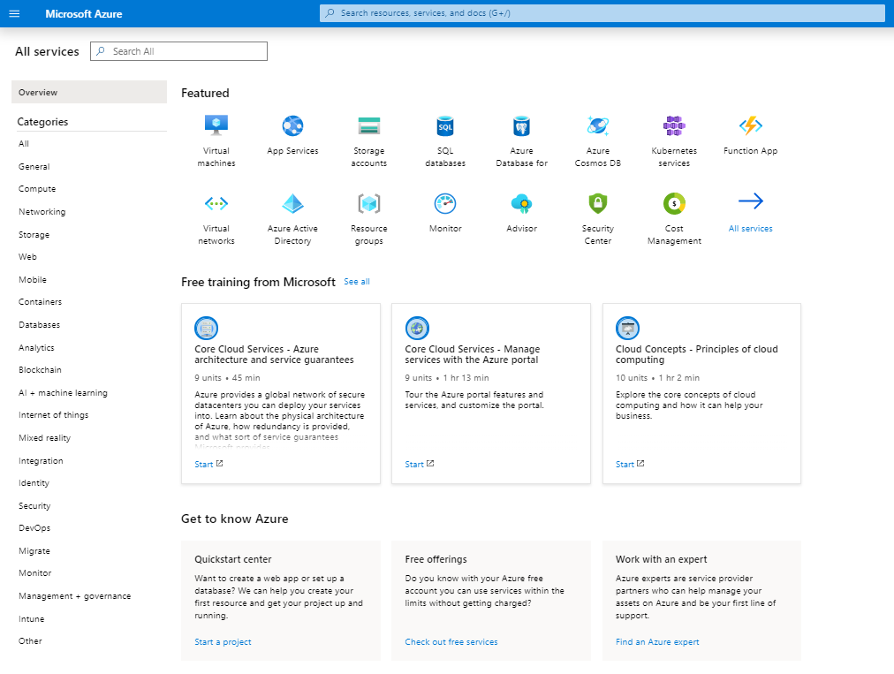
“New console” https://portal.azure.com/#allservices

Slide 8
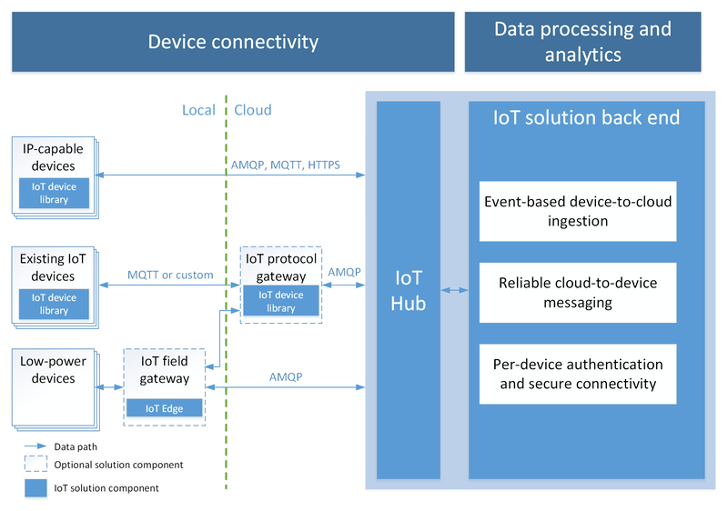

Slide 9
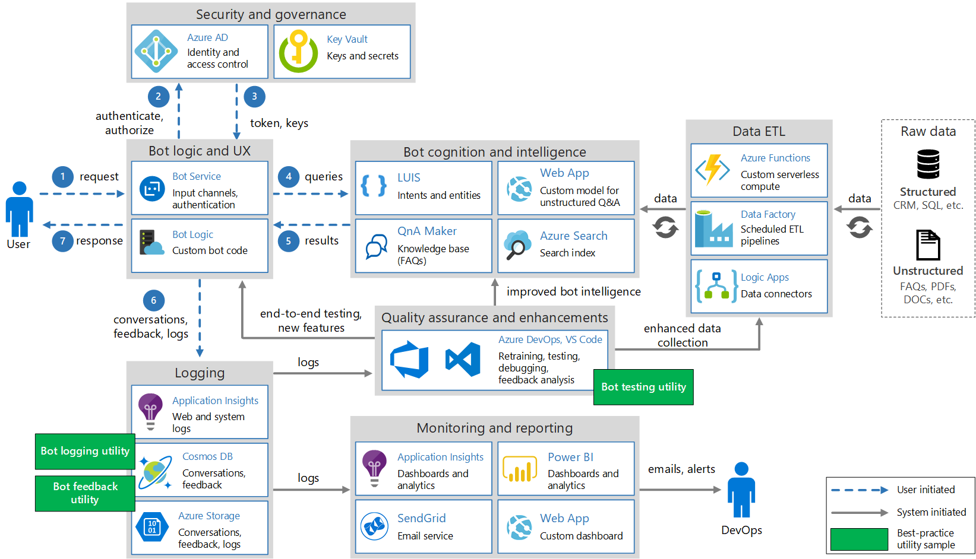
Notes:
https://medium.com/@marioamendieta/ai-100-designing-and-implementing-an-azure-ai-solution-study-guide-f0065db01c83

Slide 10
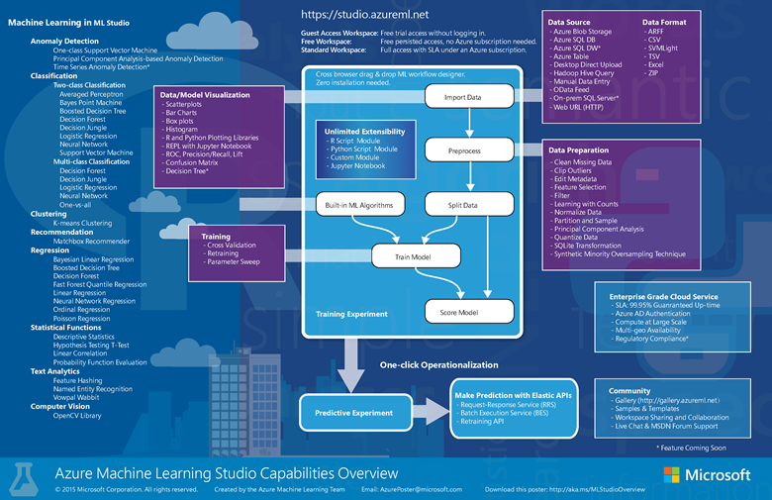

Slide 11
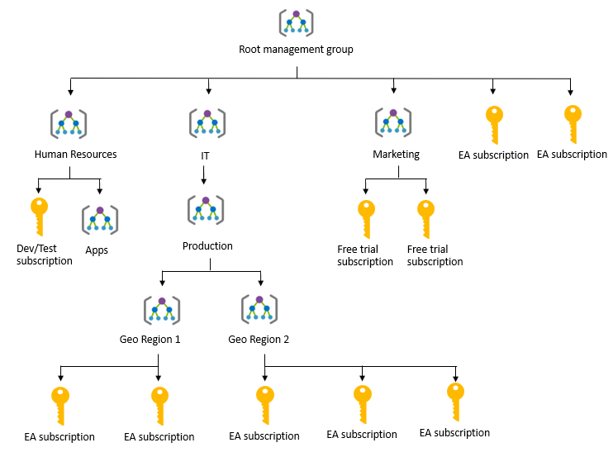

Slide 12
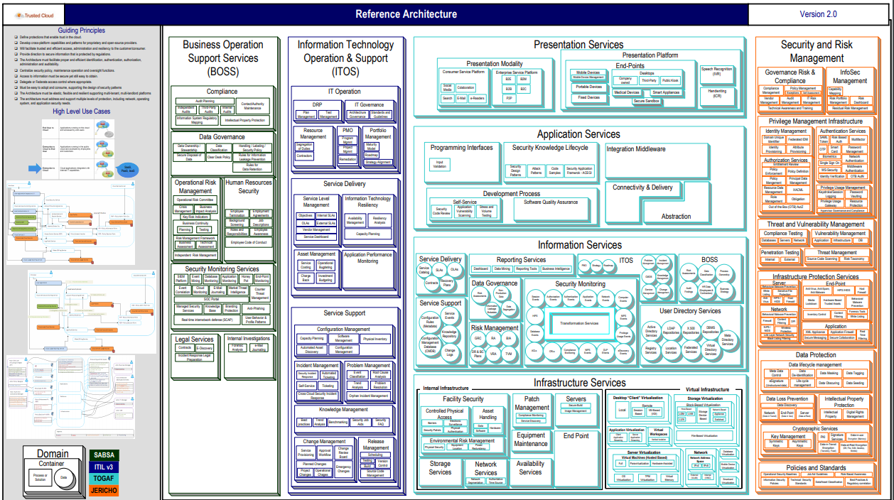
https://cloudsecurityalliance.org/artifacts/tci-reference-architecture-v2-0/

Slide 13
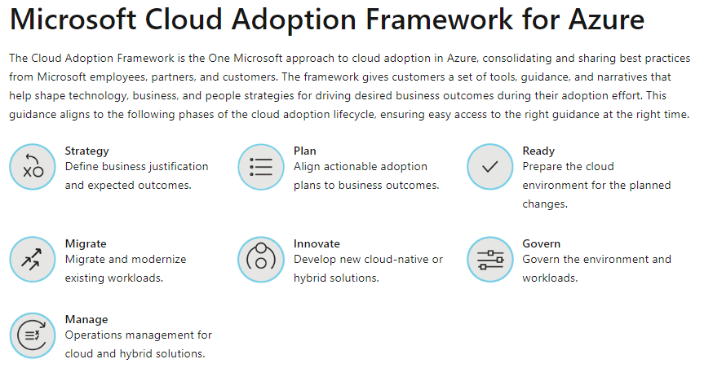
https://docs.microsoft.com/en-us/azure/cloud-adoption-framework/

Slide 14
Cloud Adoption Framework roadmap (Stack-centric)
Businesses are motivated to migrate to the cloud to:
Optimize operations
Simplify technology
Increase business agility
Reduce costs
Prepare for new technical capabilities
Scaling to market demands or new geographical regions
Businesses are motivated to innovate using the cloud to:
Improve customer experiences
Increase customer engagements
Transform products
Prepare for and build new technical capabilities
Scale to market demands or new geographical regions
https://docs.microsoft.com/en-us/azure/cloud-adoption-framework/getting-started/migrate

Slide 15
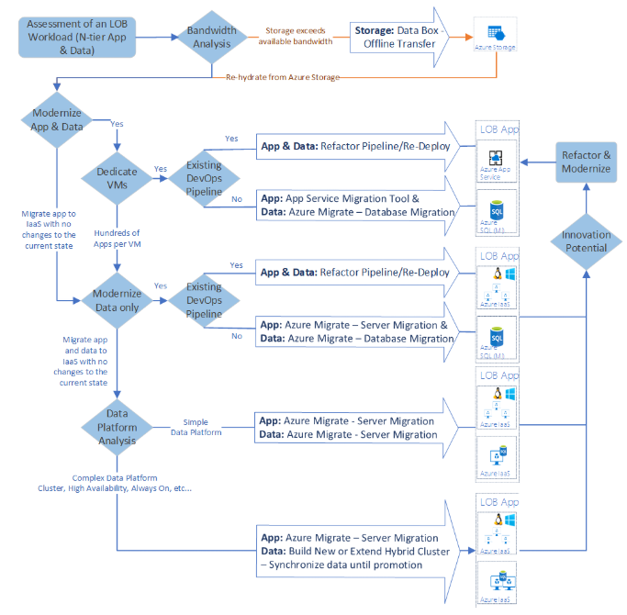
https://docs.microsoft.com/en-us/azure/cloud-adoption-framework/decision-guides/migrate-decision-guide/

