Slide 1
IT780 : Introduction to Cloud Computing
Chapter 11
Google Cloud Platform (GCP)

Slide 2
Azure Background
App Engine (Preview) 2008
Google Cloud Storage 2010
Google Cloud Engine 2013
Kubernetes Engine (GKE) 2014, open sourced 2015
Google Cloud
Maps, Firebase, Apigee, and G Suite
2019 revenue $8B
Availability Zone = Datacenter

Slide 3
Areas of excellence
Containers (Kubernetes)
Serverless Apps
Maps
Cloud AI
Image and Video Analysis
Speech and text-related AI services
Chatbots
Custom Machine Learning

Slide 4
News
Tradeshow Next: https://cloud.withgoogle.com/next/sf/
Blog: https://cloud.google.com/blog/

Slide 5
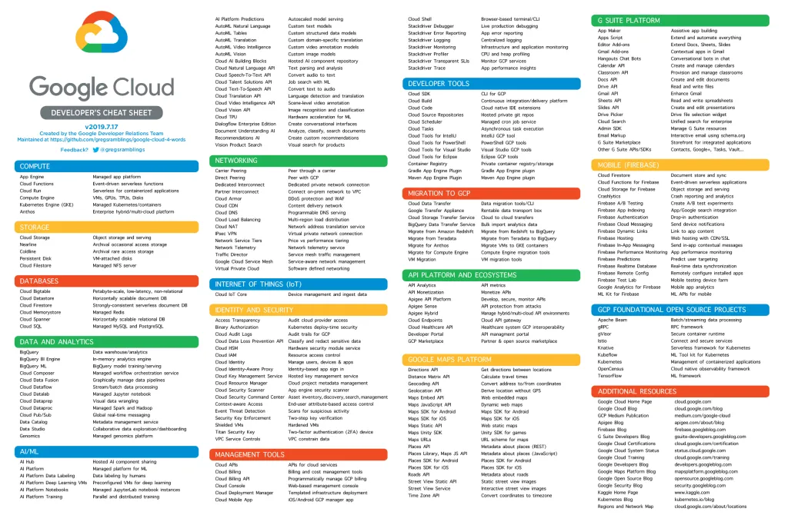
Notes:
https://www.intelligencepartner.com/en/definitive-cheat-sheet-for-google-cloud-products/

Slide 6
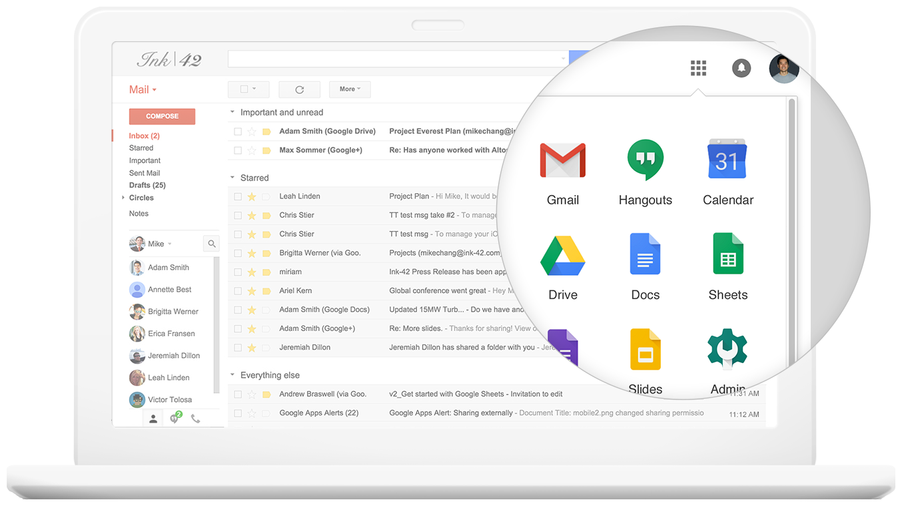
Notes:
https://gsuite.google.com/features/

