Slide 1
IT780 : Introduction to Cloud Computing
Chapter 12
What’s Next? Future/Trends

Slide 2
Future trend #1 - Open source frameworks and platforms
Lots of open source in Cloud
Kubernetes
Cloud Native Computing Foundation (CNCF)
https://www.cncf.io/

Slide 3
Future trend #2 – Increased Abstraction
Focus on business logic
Does it really matter which database you use?
CPU?
Network technology?

Slide 4
Future trend #3 – AI/ML drives NoOps
Cloud services and systems will be smarter
Typical requirements around infrastructure and application operations will diminish
“old ways” will not be requirements
Resulting in newer principles of NoOps
Automated reasoning for security
https://aws.amazon.com/blogs/security/protect-sensitive-data-in-the-cloud-with-automated-reasoning-zelkova/

Slide 5
Future trend #4 – Development in the Cloud
Why still use Desktop IDEs? (Visual Studio, Eclipse, etc)
Loss of code control
Not always connected
Comfort
Giving away to browser based tools
Allow global interaction
Consistent testing
Fastest deployments

Slide 6
Future trend #5 – AR/VR
Natural Language Processing (NLP)
Voice-to-text
Text-to-voice
Image recognition
Optical Content Recognition (OCR)

Slide 7
Future trend #6 – IoT
20 billion devices worldwide
Edge Computing
Supports limited function not always connected devices

Slide 8
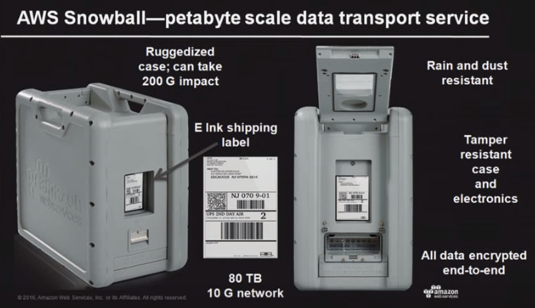
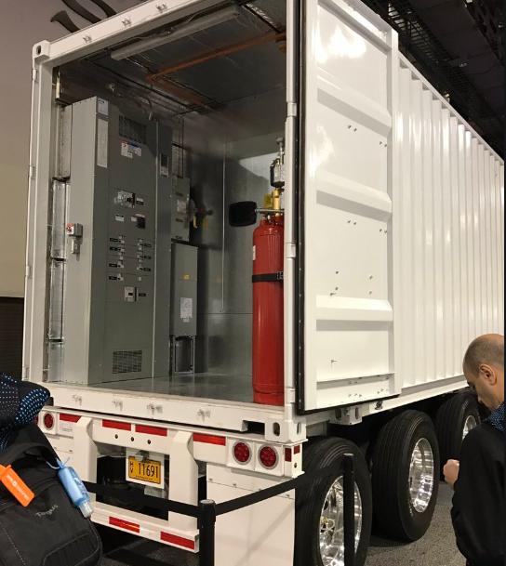
Future trend #7 – Data is the new “oil”
Example: Your phone beaconing its GPS location
Example: Google storing browser requests
Example: CIA tracking objects in satellite photos

Slide 9
Cloud enterprise case studies
AWS:
https://aws.amazon.com/solutions/case-studies/enterprise/
Azure:
https://azure.microsoft.com/en-us/case-studies/
Google Cloud:
https://cloud.google.com/customers/

