Slide 1
IT780 : Introduction to Cloud Computing
Docker

Slide 2
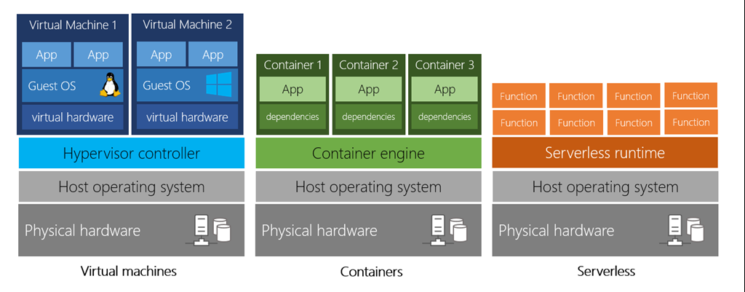

Slide 3
Docker hands-on practice
https://training.play-with-docker.com/
https://github.com/docker/labs

