Slide 1
IT780 : Introduction to Cloud Computing
Kubernetes

Slide 2
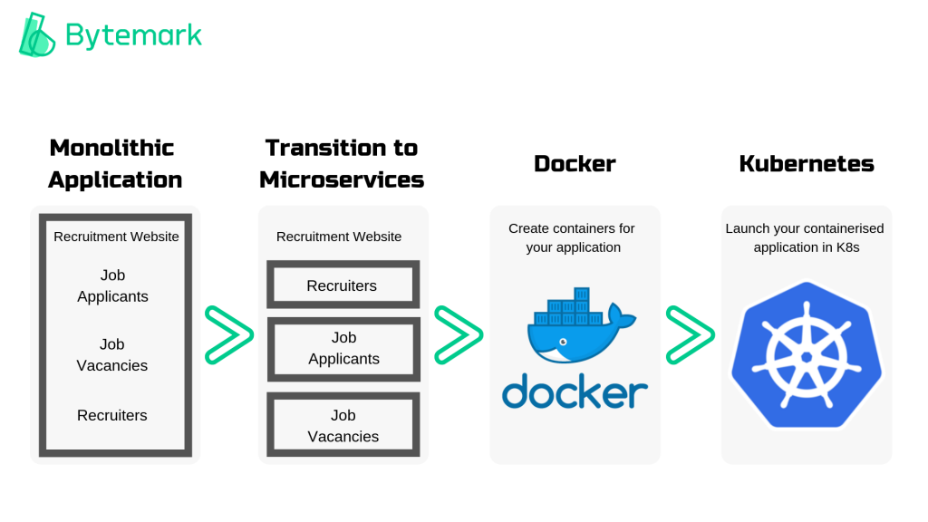

Slide 3
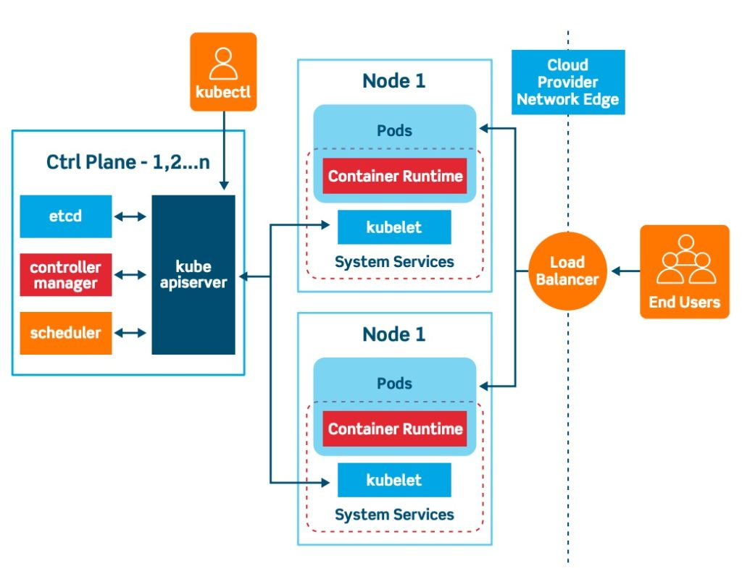
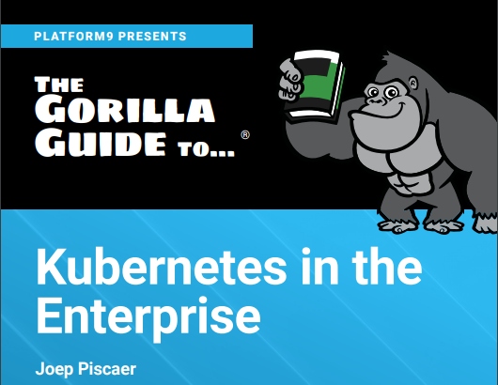
Copy of the guide in the classroom’s MyCourses files

Slide 4
First cluster: Link at end of comic
https://cloud.google.com/kubernetes-engine/kubernetes-comic/
First cluster walkthrough: https://console.cloud.google.com/cloudshell/open?git_repo=https://github.com/GoogleCloudPlatform/kubernetes-engine-samples&page=editor&working_dir=try-gke&open_in_markdown_viewer=README.md

Slide 5
Class lab: Guestbook example
https://cloud.google.com/kubernetes-engine/docs/tutorials/guestbook
Cloud Shell Editor: https://ssh.cloud.google.com/cloudshell/editor?page=editor
Get current examples: “git clone https://github.com/kubernetes/examples.git”
To deploy and run the guestbook application on GKE:
Set up a Redis master
Set up Redis workers
Set up the guestbook web frontend
Visit the guestbook website
Scale up the guestbook web frontend

