Slide 1
IT780 : Introduction to Cloud Computing
Looking Forward
What your employer will want you to know
Course Text: Cloud Native Architectures, ISBN-13: 978-1787280540, Authors: Tom Laszewski; Erik Farr; Kamal Arora; Piyum Zonooz

Slide 2
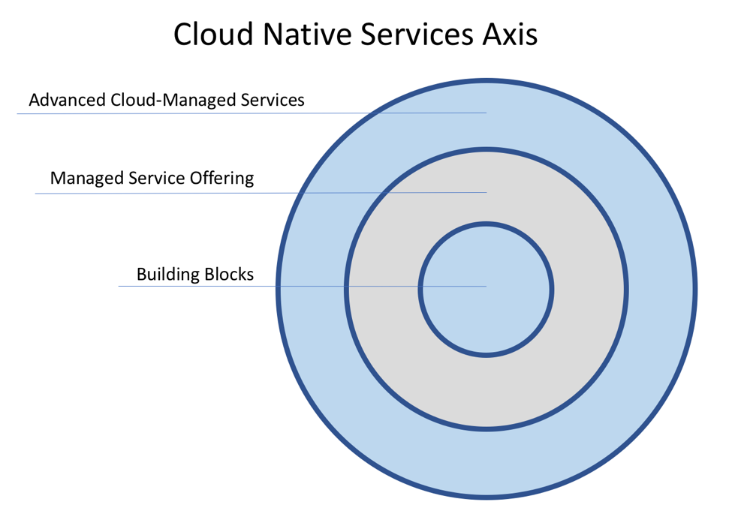
Course Text: Cloud Native Architectures, ISBN-13: 978-1787280540, Authors: Tom Laszewski; Erik Farr; Kamal Arora; Piyum Zonooz

Slide 3
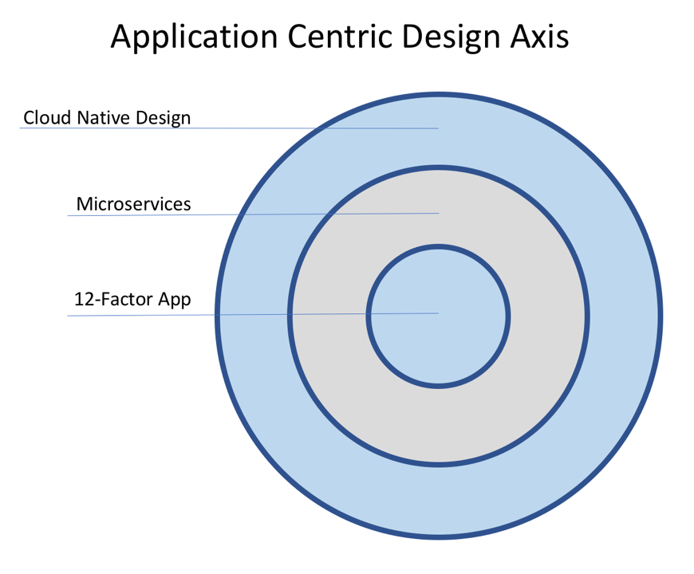

Slide 4
Twelve-factor App (https://12factor.net/)
I. Codebase
One codebase tracked in revision control, many deploys
II. Dependencies
Explicitly declare and isolate dependencies
III. Config
Store config in the environment
IV. Backing services
Treat backing services as attached resources
V. Build, release, run
Strictly separate build and run stages
VI. Processes
Execute the app as one or more stateless processes
VII. Port binding
Export services via port binding
VIII. Concurrency
Scale out via the process model
IX. Disposability
Maximize robustness with fast startup and graceful shutdown
X. Dev/prod parity
Keep development, staging, and production as similar as possible
XI. Logs
Treat logs as event streams
XII. Admin processes
Run admin/management tasks as one-off processes
Demo: https://github.com/docker/labs/tree/master/12factor

Slide 5
Cloud native design considerations
Instrumentation
More than logs
Security
Understand cloud services and blast radius
Parallelization
The secret to Google map reduce
Resiliency
Faults happen all the time at scale
Event-driven
Triggers captured and acted upon by AI
Future-proofed
Easier said than done

Slide 6
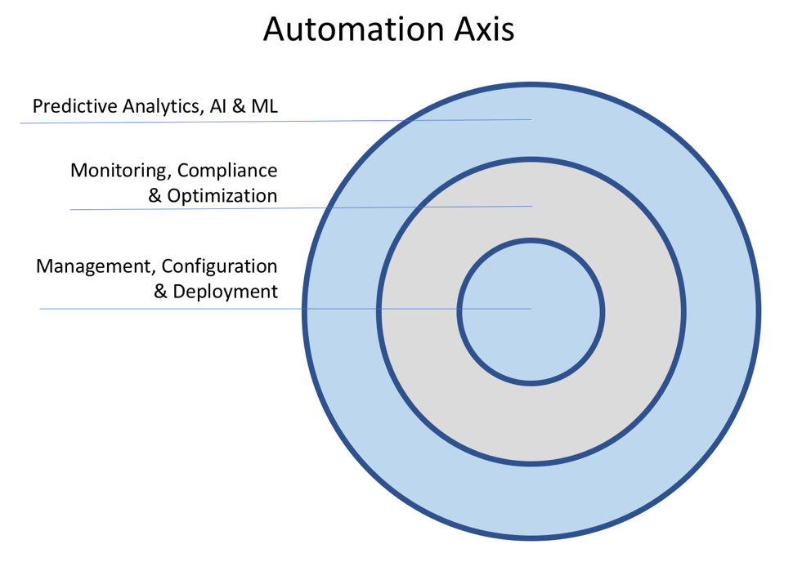

Slide 7
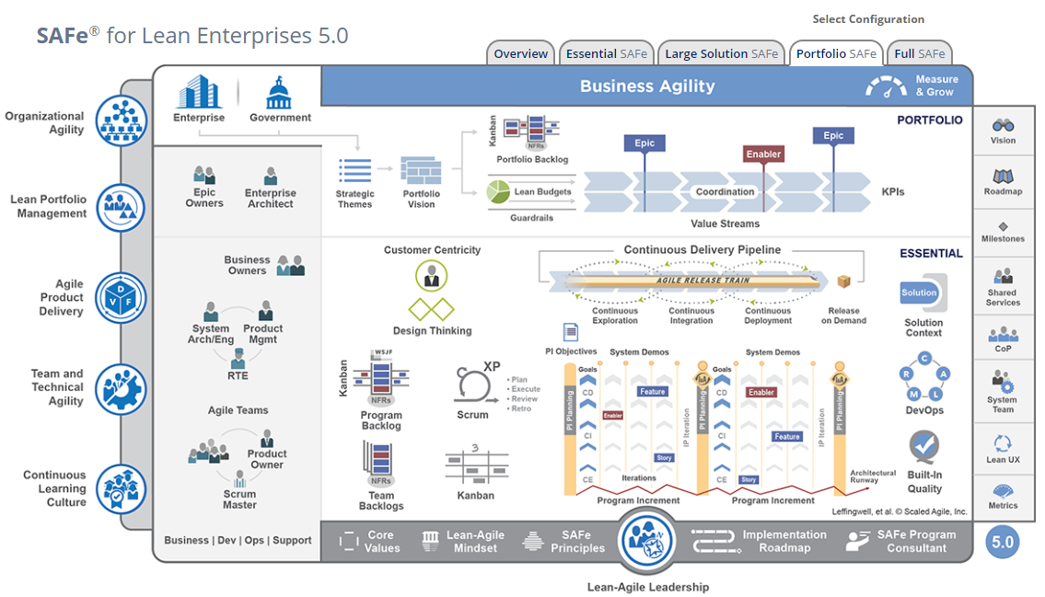
DevOps –SAFe https://www.scaledagileframework.com/

Slide 8
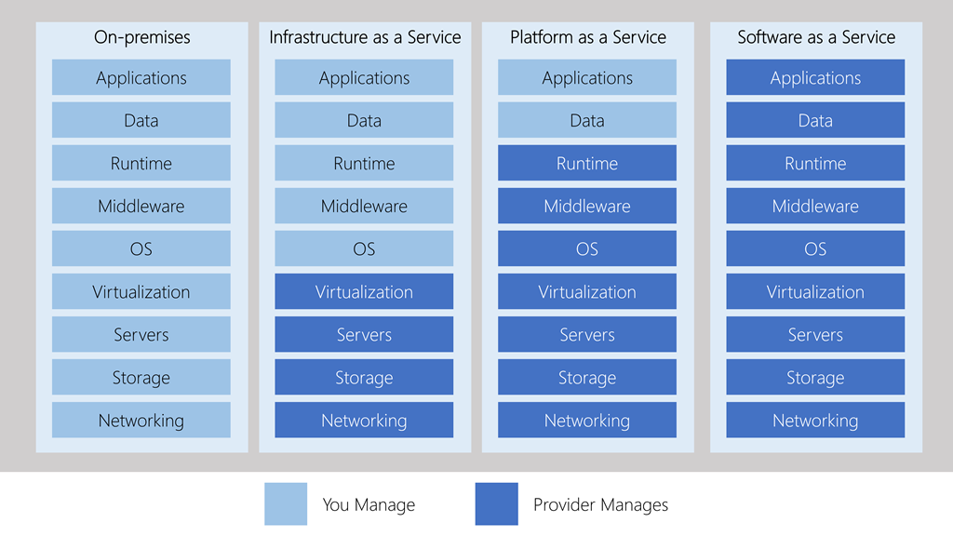
Management responsibilities

Slide 9
Hybrid
Legacy workloads on-premises and new projects in the cloud
Production workloads on-premises and non-production in the cloud
Disaster recovery environment in the cloud
Storage or archival in the cloud
On-premises workloads bursting into the cloud for additional capacity

Slide 10
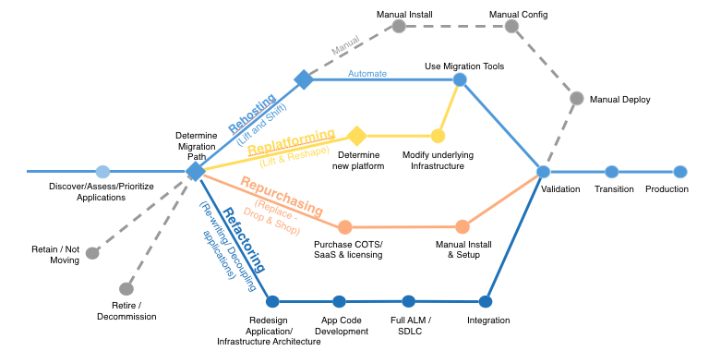

Slide 11
SANS Critical Controls
Critical Control | Legacy (Pets) | Cloud (Cattle)
1- Device Inventory | Audit list | API query
2 – Software inventory | Audit list | Pipeline manifests
3 – Secure configurations | System hardening processes | Only latest versions used at launch
4 – Continuous Vulnerability Assessment | Scheduled pen tests. Remediation? | Must pass to be deployed
5 – Control Administrative Privileges | Limit data center access, jump boxes | IAM
6 – Audit Logs | Splunk | CloudTrail, Splunk
7 – Email & Browser protections
8 – Malware defense | Network & Host IDS | Immutable systems
9 – Firewall configuration | Crunchy outside, soft center | API protocols only
10 – Data recovery | Tape | Auto replication of data
11 – Secure network devices | Hardening process | Provided by vendor
12 – Boundary defense | Firewall, WAF, Network | Security groups
13 – Data Protection | Network DLP | Storage service encryption, SSL
14 – Controlled access | Network enclaves, Network DLP | IAM, SSL, Host DLP
15 – Wireless Access
16 – Account Monitoring | Active Directory | SAML, OpenID, IAM
17 – Security Skills Assessment
18 – Application Security | WAF, Penetration tests | ELB/WAF, pipeline testing
19 – Incident Response | Logs | Logs, Vendor’s internet visibility
20 – Pen tests and red team

Slide 12
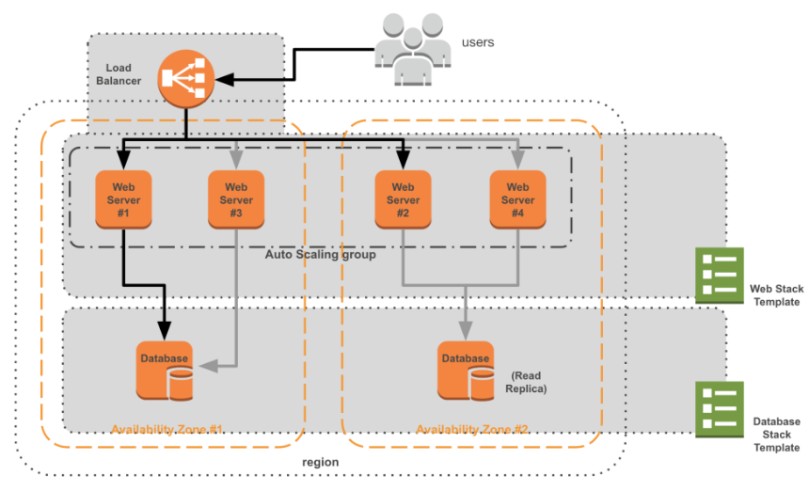
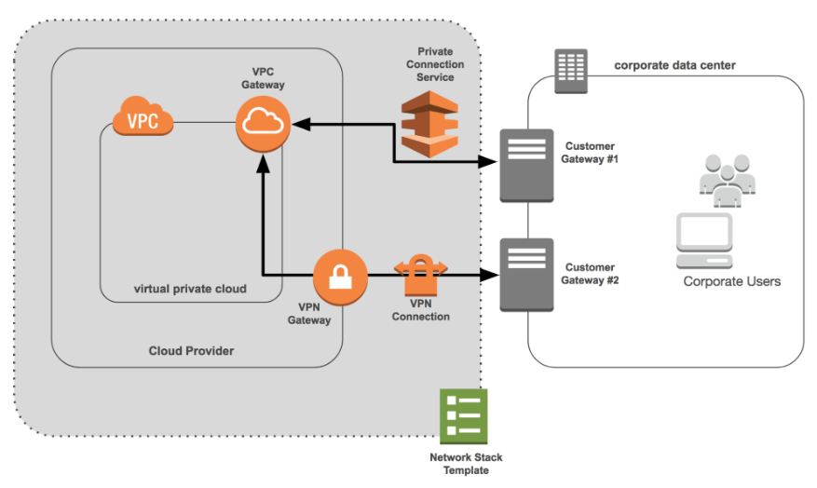
Infrastructure as Code Stacks, Templates, Blueprints, Projects (JSON, YAML)

Slide 13
Identity
User
Person or service
Role
Access pattern assumed by a person, machine, or service
Policy
Implicit grant/deny to service, resources, or objects.
Attached to users or roles
Security Credential
Limited privilege grants to a user

Slide 14
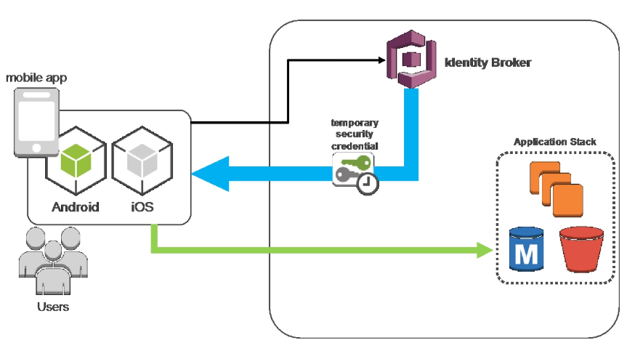
Customer Identity (OAuth 2.0)

Slide 15
Cloud Native Tenets
Complete ownership of their service
Streamline decision-making within their group
Rotate operations responsibility
Publish and maintain APIs forever
APIs are the only way to interface with other services
The right tools are the ones that get the job done
The team determines which language, framework, platform, engine, etc
Automation is more important than new features
Release of more features more quickly in the long run

Slide 16
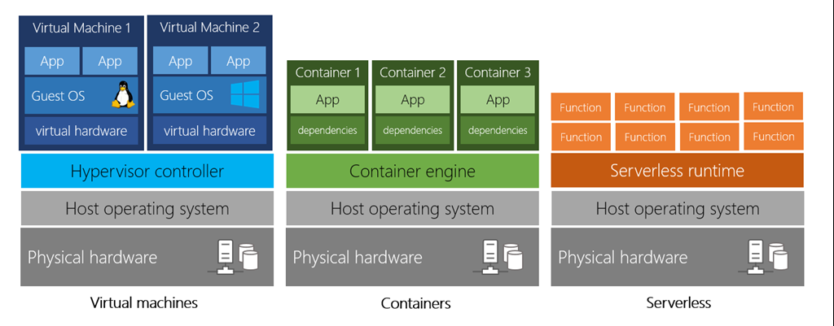

Slide 17
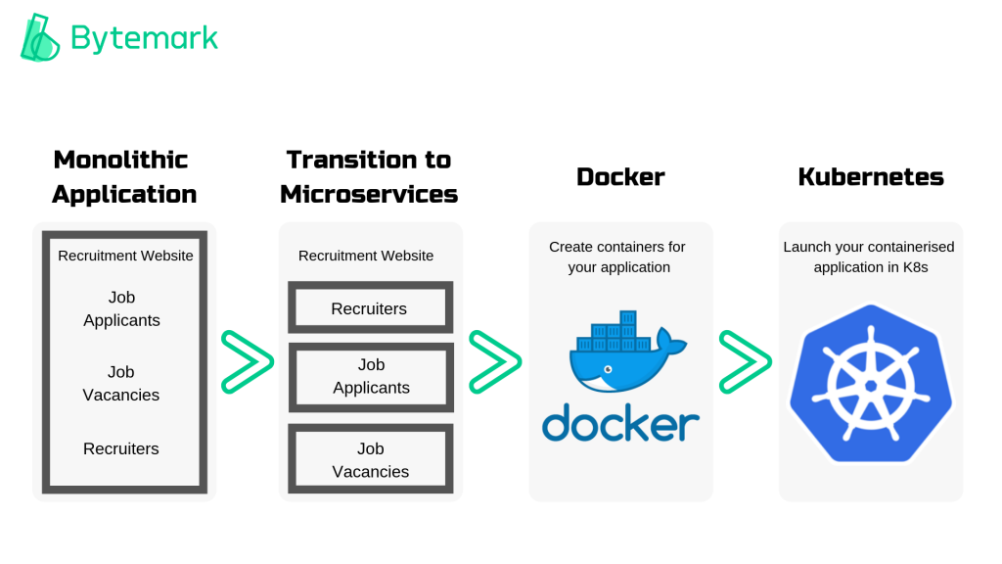

Slide 18
Application Automation – AWS Amplify
https://github.com/aws-samples/create-react-app-auth-amplify

