Slide 1
IT780 : Introduction to Cloud Computing
AWS Well-Architected Tool

Slide 2
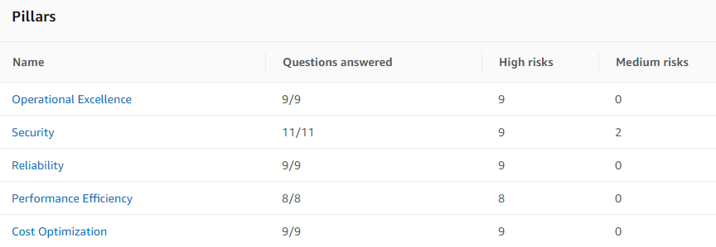
AWS Well-Architected Tool

