Slide 1
Course Overview
Modules
Labs

Slide 2
Course Structure
CompTIA Security+
12 Weekly Modules
  Book provides terminology and questions
  Classes and labs are practical
    Mondays: How-to hands-on sessions
    Wednesdays: Reading related lectures and a quiz
    Labs are designed to be completed in 2-3 hours
Course announcements on myCourses
Text
    CompTIA Security+ All-in-One Exam Guide, Fifth Edition (Exam SY0-501)
    Author: Andrew Conklin
    eBook ISBN: 978-1-26-001929-2 is available on Safari
    Hardcover ISBN: 978-1-26-001932-2

Slide 3
Grading
Modules
  Weekly lab assignment : 40% of course grade
    Due before class, no credit for late work
  Weekly quizzes : 30% of course grade
    Will drop lowest quiz grade
    In class on Wednesday, bring laptop
Security event paper & class presentation
  30% of course grade
Security+ practice exam
  Final exam time. Pass/Fail. Raise 1 letter grade

Slide 4
Every generation has made mistakes
“I think there is a world market for maybe five computers”
“There is no reason for any individual to have a computer in his home.”
“The Internet? We are not interested in it”
“What is it [Cloud]? It's complete gibberish. It's insane. When is this idiocy going to stop?”
Notes:
“I think there is a world market for maybe five computers” - Thomas Watson, IBM, 1943
“There is no reason for any individual to have a computer in his home.” - Ken Olson, DEC, 1977
“The Internet? We are not interested in it” - Bill Gates, Microsoft, 1993
Cloud - Larry Ellison CEO Oracle, 2008

Slide 5
… who is right about the Internet?
‘If you change the way you make wealth, you inevitably change the way you make war’ – Alvin Toffler
‘Going to good, old-fashioned paper, in this modern age, is the best way to do it.’ – Donald Trump

Slide 6
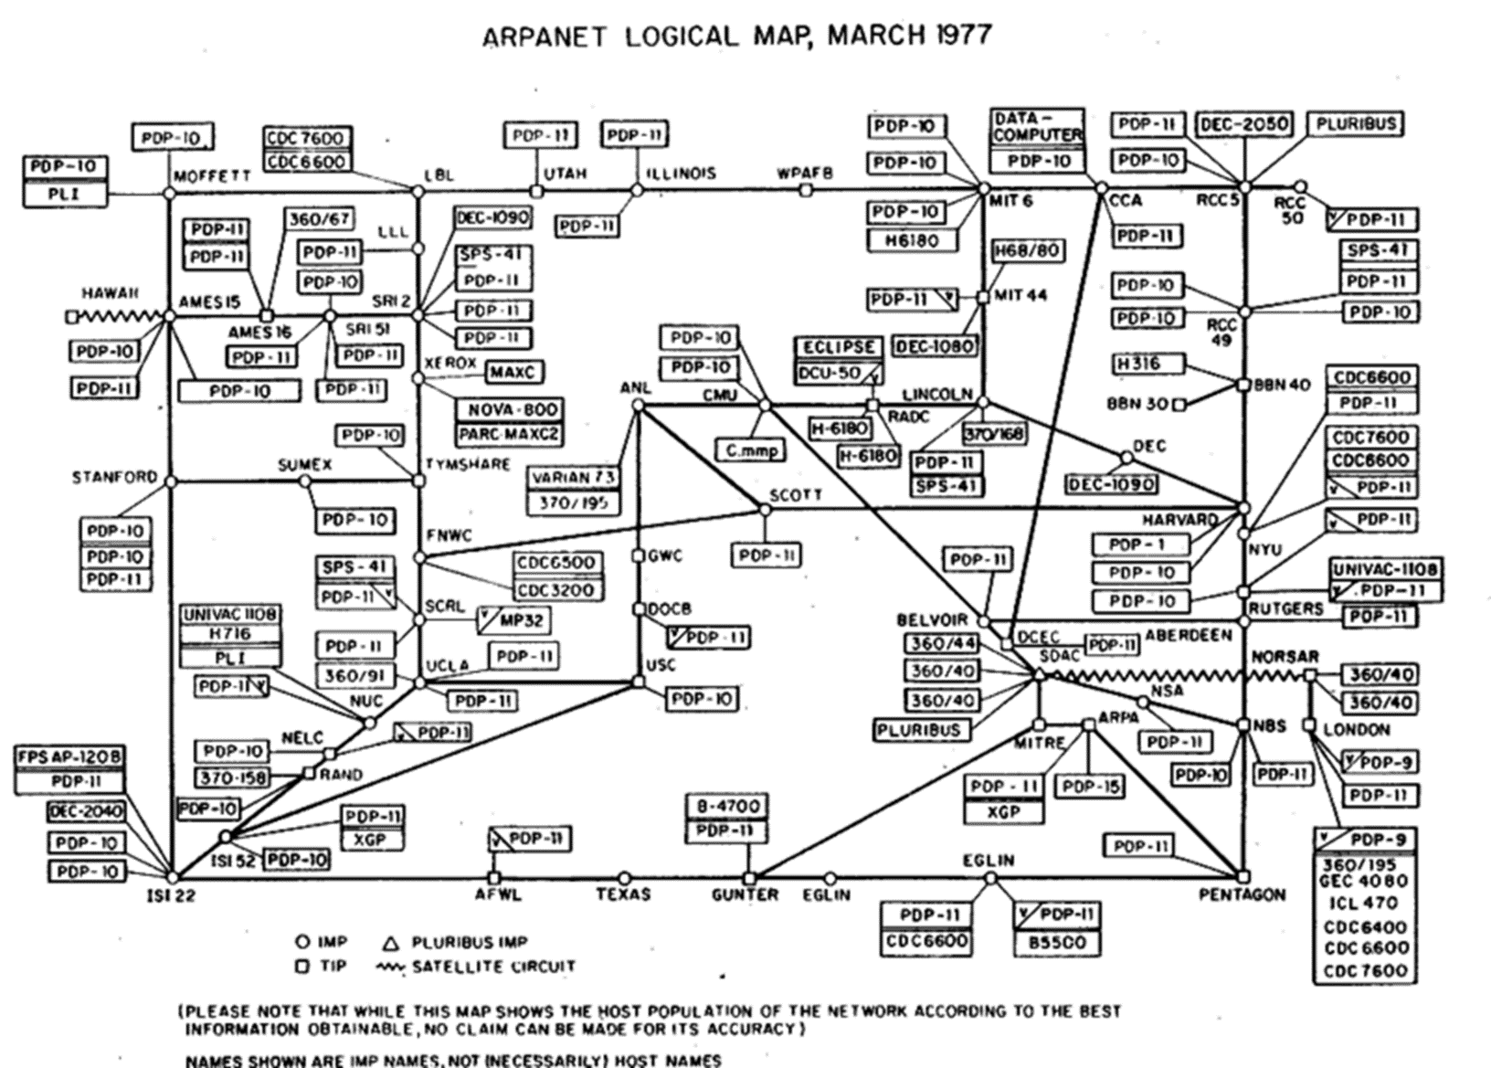

Slide 7
What does the UNH AUP (dis)allow you to do?
Can you hack AGATE while taking this class?
How do firewalls make your computer secure?
When is jail breaking an iPhone legal?
What does CIA stand for?
What type of cipher is a Caesar cipher?
RSA uses what type of keys?
Linux file permission of 007 allows what?
How many bits makes a key uncrackable?
What is the goal of a DoS attack?
What does XSS stand for?
Does TLS use the RSA or AES cipher?

Slide 8
Top 100 Gawker passwords (+24K)
123456
password
12345678
qwerty
abc123
12345
monkey
111111
consumer
letmein
1234
dragon
trustno1
baseball
gizmodo
whatever
superman
1234567
sunshine
iloveyou
fuckyou
starwars
shadow
princess
cheese
123123
computer
gawker
football
blahblah
nintendo
000000
soccer
654321
asdfasdf
master
michael
passw0rd
hello
kotaku
pepper
jennifer
666666
welcome
buster
Password
batman
1q2w3e4r
maggie
michelle
pokemon
killer
andrew
internet
biteme
orange
jordan
ginger
123
aaaaaa
tigger
charlie
chicken
nothing
fuckoff
deadspin
valleywa
qwerty12
george
swordfis
summer
asdf
matthew
asdfgh
mustang
yankees
hannah
asdfghjk
1qaz2wsx
cookie
midnight
123qwe
scooter
purple
banana
matrix
jezebel
daniel
hunter
freedom
secret
redsox
spiderma
phoenix
joshua
jessica
asshole
asdf1234
william
qwertyui
Notes:
Gizmodo, gawker, kotaku, deadspin, valleywag, jezebel all gawker run blog sites
Truncation to 8 chars
Leeted variations of password
Almost 500K password analyzed, 180K unique
SONY: http://www.troyhunt.com/2011/06/brief-sony-password-analysis.html

Slide 9
Lab tools used
Kali (VirtualBox)
  OpenSSL
  OpenVPN
  Wireshark/Cloudshark
  OWASP ZAP
  Burpsuite
AWS (AWS Educate account)
Browser

Slide 10
Keys to success
Do the labs on-time
Understand the practice questions in the book
If you don’t have much/any Linux knowledge: ./missing-semester
Get an instance of Kali running
  Past students have preferred VirtualBox appliance
  Dedicated, Live USB, Cloud, are options
Enroll in AWS Educate
  Requires confirmation process
  No credit card
  Expenses capped

