Slide 1
Cryptography

Slide 2
Cryptographic Types
Symmetric
  Typically transposition and/or substitution
  C = encrypt (M, k) and M = decrypt( C, k )
Asymmetric
  Discrete mathematics or formulas
  C = encrypt (M, k1) and M = decrypt( C, k2)
Secure Hash
  One way functions
  C = hash (M) there is no M = unhash(C)

Slide 3
Symmetric Algorithms
Substitution
  Typically an “S-BOX” message bytes used as index to table of new value
  New values in given order
Transposition
  Rotations and shifts of bytes
  New order with given values
Diffusion operations
  Vector multiplication, XOR
AES Animation
  http://www.formaestudio.com/rijndaelinspector/archivos/Rijndael_Animation_v4_eng.swf
Notes:
Most algorithms designed to very efficient in hardware
Need to balance speed and strength

Slide 4
Symmetric Encryption
Alice
Bob
Message
E
Cipher text
D
Message
K
K
Alice shares a key K with Bob.
K is used to both encrypt and decrypt

Slide 5
Symmetric Encryption
ZLOGFDWV
ABCDEFGHIJKLMNOPQRSTUVWXYZ
WILDCATS

Slide 6
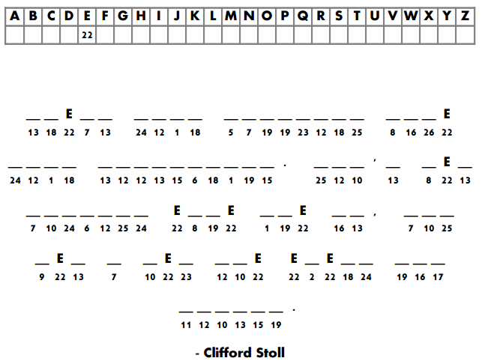
Notes:
Solution
“Treat your password like your toothbrush. Don't let anybody else use it. And get a new one every six months.” - Clifford Stoll

Slide 7
Asymmetric Algorithms
Based on the presumed hardness of a mathematical problem, for example:
  Factoring the product of two large primes (RSA)
  Computing discrete logarithms (ECC)
Keys are generated together (paired)
  One key is kept secret (Private key)
  One key is “given” to everyone (Public Key)
Certificates associate a specific user with a specific public key.
Notes:
Most algorithms designed to very efficient in hardware
Need to balance speed and strength

Slide 8
Asymmetric Encryption
Alice
Bob
Message
E
Cipher text
D
Message
Bob_{public}
Bob_{private}
Alice encrypts with Bob’s public key.
Bob uses his private key to decrypt.
The keys are mathematically related.

Slide 9
Digital Signatures
Alice
Bob
Message
E
Cipher text
D
Message
Alice_{private}
Alice_{public}
Alice encrypts with her private key.
Bob uses Alice’s public key to decrypt.
The keys are mathematically related.

Slide 10
RSA
Key Generation Algorithm
  Generate two large random primes, p and q, of approximately equal size such that their product n = pq is of the required bit length, e.g. 1024 bits.
  Compute (φ) phi = (p-1)(q-1).
  Choose an integer e, 1 < e < phi, such that gcd(e, phi) = 1
  Compute the secret exponent d, 1 < d < phi, such that ed ≡ 1 (mod phi)
The convention is the public key is (n, e) and the private key is (n, d) because “e” is normally assigned rather computed.
Keep all the values d, p, q and phi secret (discard).
n is known as the modulus it determines the number of bits (size).
e is known as the public exponent or encryption exponent or just the exponent. (Convention: e=65537 or 2^16 + 1)
d is known as the secret exponent or decryption exponent.
Encrypt, c = m^{e} mod n
Decrypt, m = c^{d} mod n
Notes:
Example
Select 2 primes (p,q) p=211 q=233
Compute n = p*q = 49163
Compute phi = (p-1)(q-1) = (211-1)(233-1) = 48720
Select e such that gcd(e,phi) = 1. e=17
Compute d such that (e * d ) mod phi = 1; d=25793

Slide 11
Crack a simple RSA private key
Public key:
N =33 (computed) E =3 (assigned)
Private key:
N =33 D =?
Such that
X = Y^{D} mod 33
Y = X³ mod 33
Notes:
Sample encrypt/decrypt:
14⁷ mod 33 = 20
20³ mod 33 = 14
Choose p = 3 and q = 11
Compute n = p * q = 3 * 11 = 33
Compute φ(n) = (p - 1) * (q - 1) = 2 * 10 = 20
Choose e such that 1 < e < φ(n) and e and n are coprime. Let e = 3
Compute a value for d such that (d * e) % φ(n) = 1. One solution is d = 7 [(7 * 3) % 20 = 1]
Public key is (e, n) => (3, 33)
Private key is (d, n) => (7, 33)

Slide 12
Hashing
C = hash( M )
  There is no “unhash”
Birthday attacks – MD5 broken in Dec ’08
  Hash algorithms are the weak link (SHA1 ~70 bits)
Strength need is different for signature vs. nonce
“SHA-3” selection
  KECCAK http://keccak.noekeon.org/
  BLAKE http://www.131002.net/blake/
  Grostl http://www.groestl.info/
  JH http://www3.ntu.edu.sg/home/wuhj/research/jh/
  Skien http://www.skein-hash.info/
Notes:
NIST has selected five SHA-3 finalists - BLAKE, Grøstl, JH, Keccak, andSkein to advance to the third (and final) round of the SHA-3competition. The email announcement was sent to the hash-forum listserv on December 9, 2010.[PDF]
NIST hosted a one-year public comment period in 2012
The SHA-3 standard (KECCAK) was released by NIST on August 5, 2015.
SHA-3, the state consists of a 5 × 5 array of 64-bit words, 1600 bits total.

Slide 13
XOR
11 11 00 00 <- original text
00 11 11 00 <- “key”
11 00 11 00 <- result
If the “key” is unknown you can not infer the original text from the cipher text

Slide 14
Message Authentication
Conventional Encryption
Alice
Bob
Message
Message
H
Compare
D
K
H
K
E

Slide 15
Message Protection: Alice Sends...
Session Key
(symmetric)
Bob’s
Public Key
From Somewhere
Data
Encryption
Encrypted
Session Key
Key
J(fS_=2j!jsd@nm%Deh
Cleartext
Ciphertext
H4*m£h0D(h$hjoNm3_hf9)H’Jley6LLv+gf^~`9Cl3d
Encryption
To Bob
Notes:
In this next example we are going to use Alice & Bob who are trying to communicate with one another over an insecure channel.
They want to achieve message protection:
“sealed” so that only they can read it
“hashed” so that Bob knows it wasn’t modified enroute.
Alice therefore uses a session key and encrypts using Bob’s public key.

Slide 16
Message Protection: Bob Receives
Bob’s
Private Key
Encrypted
Session Key
Decryption
Session Key
J(fS_=2j!jsd@nm%Deh
H4*m£h0D(h$hjoNm3_hf9)H’Jley6LLv+gf^~`9Cl3d
Ciphertext
Decryption
Cleartext
From Alice
Notes:
When Bob receives Alice’s message he applies his private key to decrypt the message.

Slide 17
Digital Signatures: Alice Signs
Alice’s
Private Key
Message
Digest
Hash
M(&g$Xs?7
Sign
Signature
Cleartext
The quick brown fox jumped over the...
&G0:8j4C+p
To Bob
Encrypt if required
Notes:
Now lets modify the process to introduce digital signature. Alice will create a message AND a hashing function. She will sign both the message and the hash with her private key.
If one can decrypt something with Alice’s public key, then in means only Alice’s private key could have encrypted it.
Assuming Alice has done a good job of protecting her private key (such that no one else could have used it, the message must be from Alice.

Slide 18
Digital Signatures: Bob Verifies
Message
Digest
Alice’s
Public Key
Decrypt
M(&g#$Xs?7
From Alice
Compare
The quick brown fox jumped over the
&G0:8j4C+p
Signature
Hash
M(&g$Xs?7
Message
Digest
Notes:
If one can decrypt something with Alice’s public key, then in means only Alice’s private key could have encrypted it.
Assuming Alice has done a good job of protecting her private key (such that no one else could have used it, the message must be from Alice.

Slide 19
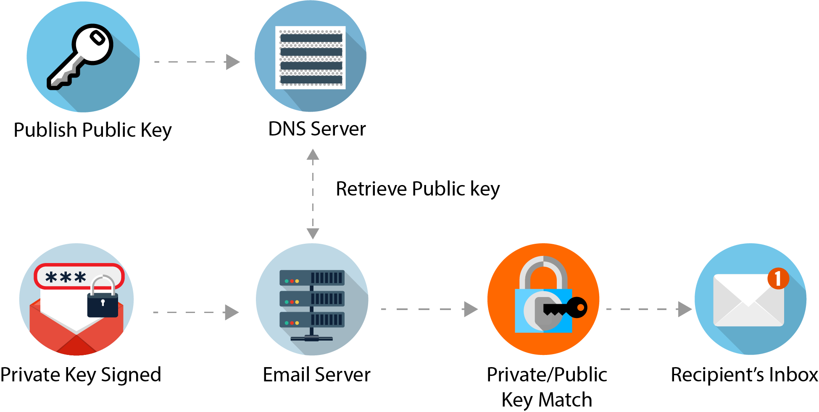
Email – DKIM
DMARC domain checker: https://dmarcian.com/domain-checker/
Notes:
https://dmarcian.com/what-is-dkim/
DKIM is a free technology that is used to link a piece of email back to a domain. When an email is sent, it is signed using a private domain key and then validated on the receiving mail server (or ISP) using a public key that is located within the DNS. This action authenticates that the content of the email was not modified during its transfer. It prevents someone from intercepting your email, altering it, then sending it along with altered information.
DKIM signatures can survive forwarding, which makes it superior to SPF and a great way to secure your email.

Slide 20
Algorithm Comparison
Type | Common | Keys | Input | CPU | Output
Symmetric | AES 3DES | 1 secret | Block Stream | Fast | Input + padding
Asymmetric | RSA ECC | 1 pair public & private | Small <keysize | Slow | keysize
Hash | SHA MD5 | 0 | Any | One Way | MD5 = 128 bits SHA1 = 160 SHA2 = 256/512 SHA3 = 1600

