Slide 1
Email, Phishing, & Privacy

Slide 2
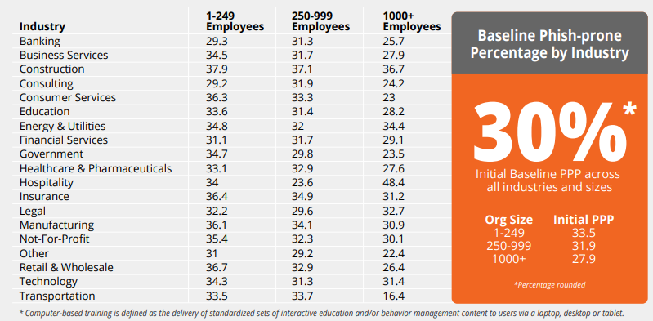
Phishing rate prior to training

Slide 3
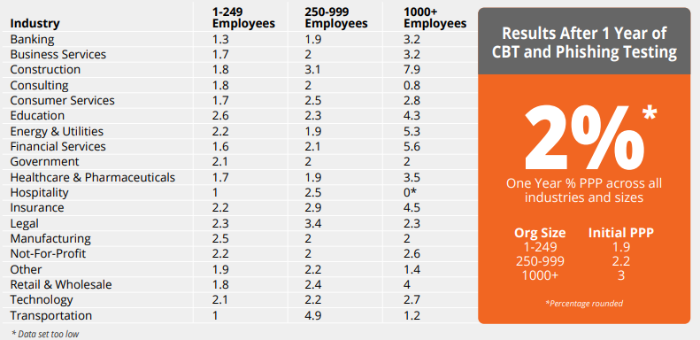
..after training

Slide 4
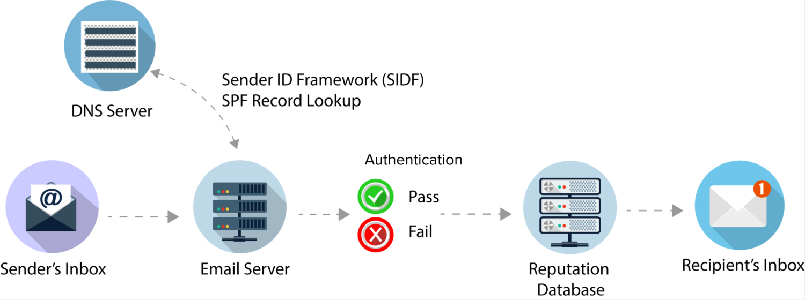
Email - SPF
Notes:
https://dmarcian.com/what-is-spf/
SPF is a way for Internet Service Providers to verify that a mail server (IP address) is authorized to send email for a specific domain.
To use SPF, the administrator of an email domain publishes a list of servers or IP addresses that are allowed to send email on behalf of the domain. When a sender tries to hand-off email to an email “receiving” sever for delivery, the email server checks to see if the sender is on domain’s list of allowed senders. If so, then a link has been established between the piece of email and the email domain.

Slide 5
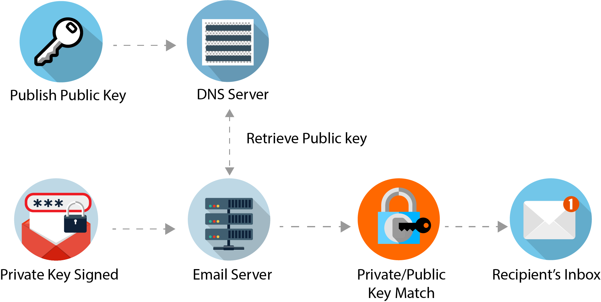
Email – DKIM
DMARC domain checker: https://dmarcian.com/domain-checker/
Notes:
https://dmarcian.com/what-is-dkim/
DKIM is a free technology that is used to link a piece of email back to a domain. When an email is sent, it is signed using a private domain key and then validated on the receiving mail server (or ISP) using a public key that is located within the DNS. This action authenticates that the content of the email was not modified during its transfer. It prevents someone from intercepting your email, altering it, then sending it along with altered information.
DKIM signatures can survive forwarding, which makes it superior to SPF and a great way to secure your email.

Slide 6
Privacy

Slide 7
Do you have a right to privacy?
Part of the constitution in 150 countries
  Not specifically mentioned in the USA; but the Supreme Court has ruled for implied rights
Does the right to privacy need to be forfeited as part of the social contract in order to bolster national defence?
A legal mind field we will not cover in class

Slide 8
History: US laws started as crypto = munitions
US export laws
  Flawed based on US as “the” source of crypto
Chinese law prevents import
Fundamentally governments want to spy on others
Snowden effect: trend is toward regulation that keeps information about citizens within the country or at least outside of the USA.

Slide 9
Physical vs. Virtual is unresolved
Governments
  Rely on tariffs
  Enact laws to protect those tariffs
  Make agreements to enforce tariffs
You buy Red Sox tickets online in your dorm:
  Do you pay Mass taxes?
You sell ___ to someone in New York City
  Do you need to collect NY state and NY city sales tax?
You provide online advice to EU residents:
  Does GDPR apply?

Slide 10
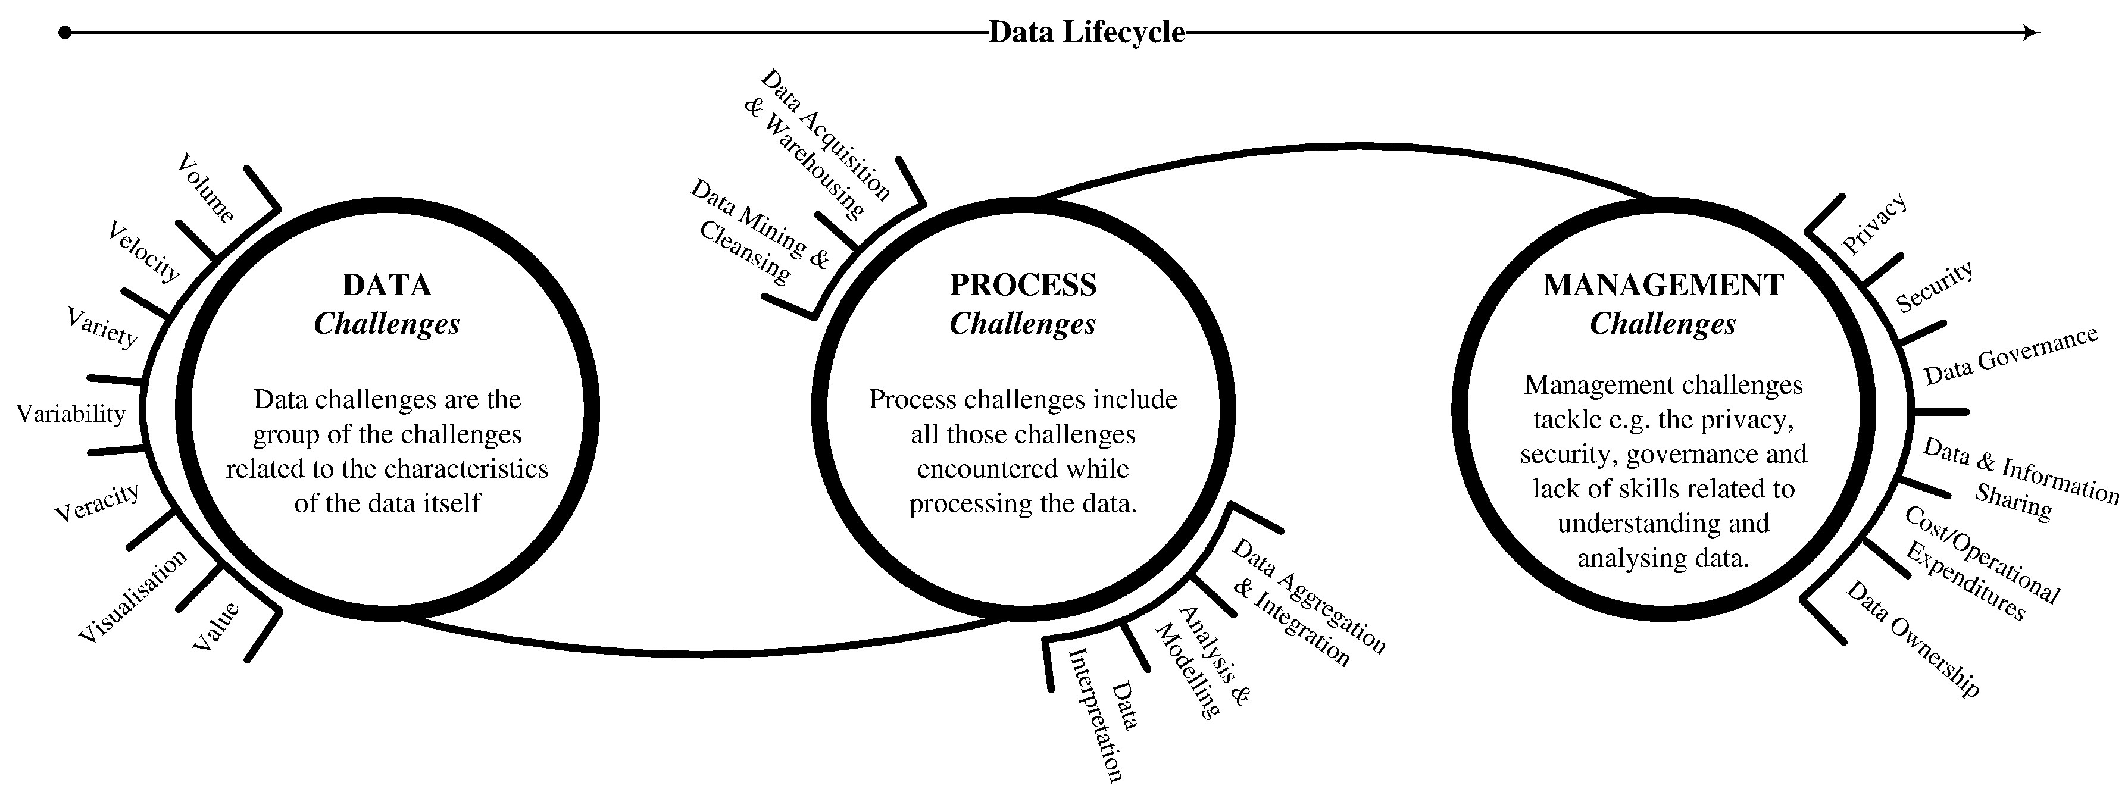
Disconnection of data collection and privacy
https://www.sciencedirect.com/science/article/pii/S014829631630488X#f0005

Slide 11
Privacy vs. Anonymity vs. Confidentiality
Privacy
  The ability to keep some things to yourself
Anonymity
  You want your action to count, but not tied to you directly
Confidentiality
  Sharing of private information

Slide 12
Personally Identifiable Information (examples)
Name, address or phone number
Employment history
Job title
Work email address
Birth date
Passport
National ID
Photographs
Performance review
IP address

Slide 13
A.K.A.
PII : Personally Identifiable Information
PHI : Personal Health Information
NPPI : Non-Public Personal Information

Slide 14
Internet laws are evolving
HIPAA
FERPA
Sarbanes-Oxley
PCI-DSS
Gramm-Leach-Bliley
GDPR
California data
NATO Cyberspace

Slide 15
HIPAA–Health Info. Privacy & Accountability Act
Dept. of Health & Human Services (2002)
Protect patient data
Health care providers must comply
Prison terms for non-compliance
Controls are mostly legal not technical
Patients normally sign away consent
Privacy and data management

Slide 16
FERPA- Family Educational Rights and Privacy Act
1974
FERPA gives parents access to their child's education records, an have the records amended, and some control over the disclosure.
Schools must have a student's consent prior to the disclosure of education records after that student is 18 years old.
The law applies only to educational agencies and institutions that receive funding under a program administered by the U.S. Department of Education.
Privacy and data management

Slide 17
Sarbanes-Oxley
Enacted July 30, 2002; also known as the "Public Company Accounting Reform and Investor Protection Act“
SEC enforcement
Cover responsibilities of a public corporation's board of directors
Adds criminal penalties for misconduct
Data integrity and audit trails

Slide 18
Gramm-Leach-Bliley
Also known as the Financial Services Modernization Act of 1999
Financial institutions must provide clients:
  A privacy notice that explains what information the company gathers about the client
  Where this information is shared
  How the company safeguards that information.

Slide 19
PCI-DSS:Payment Card Industry Data Security Standard
VISA, Mastercard, AMEX, Discover, JCB: 2004
Must pass an audit
External assessment by a qualified assessor
Requirements:
  Build and Maintain a Secure Network and Systems
  Protect Cardholder Data
  Maintain a Vulnerability Management Program
  Implement Strong Access Control Measures
  Regularly Monitor and Test Networks
  Maintain an Information Security Policy

Slide 20
General Data Protection Regulation (GDPR)
EU legislation drafted to regulate the data privacy protections of EU residents
Went into effect in May 2018
Compliance for anyone doing business in EU
  Customers must be notified within 72 hours
  Fines of up to 20 million euro or 4% of the company’s revenue

Slide 21
GDPR concerns
Applies if you retain PII about EU citizens
  States laws in US have a similar reach
Understand what PII you have
Must notify in 72 hours
  This requires having a breach notification plan
Affects the entire organization
Give customers control of their data
Train/Hire a data protection officer
Fines are significant

Slide 22
EU - General Data Privacy Reg (GDPR)
What constitutes personal data?
Any information related to a natural person or ‘Data Subject’, that can be used to directly or indirectly identify the person. It can be anything from a name, a photo, an email address, bank details, posts on social networking websites, medical information, or a computer IP address.
https://www.eugdpr.org/eugdpr.org.html

Slide 23
California Consumer Protection Act (CCPA)
Who or What Is Regulated by the CCPA?
  Must “do[ ] business” in California for profit or for the financial benefit of shareholders, and must meet or surpass one of the following three minimum thresholds:
  $25 million in annual gross revenue
  Buy, receive for commercial purposes, sell, or share for commercial purposes, the personal information of 50,000 or more consumers
  Derive 50 percent or more of annual revenue from selling consumers’ personal information

Slide 24
NATO Cyberspace
Cyber defense is part of NATO’s core task of collective defense.
NATO has affirmed that international law applies in cyberspace.
NATO's main focus in cyber defense is to protect its own networks.
In July 2016, recognized cyberspace as a domain of operations in which NATO must defend itself
Cyber Defense Pledge in July 2016 to enhance their cyber defenses, as a matter of priority.
NATO Cyber Rapid Reaction teams are on standby to assist Allies, 24 hours a day
At the Brussels Summit in 2018, Allies agreed to set up a new Cyberspace Operations Centre
NATO and the European Union (EU) are cooperating through a Technical Arrangement on cyber defense.
NATO is intensifying its cooperation with industry through the NATO Industry Cyber Partnership.

Slide 25
Collecting and Processing Sensitive Data
You must be particularly careful when collecting and processing a specific category of personal data called sensitive data.
Sensitive data is personal information that reveals a person's:
  medical information
  sexual preference
  racial or ethnic origin
  political opinions
  religious or philosophical beliefs
  criminal record
  trade union membership

Slide 26
Collecting and Processing Personal Data
Under the EU Data Protection laws, collecting and processing personal data about EU residents is illegal unless certain conditions apply.
  Data subjects have freely and clearly consented to the data collection
  And understand how the data will be used.
  Even with consent, you may not be allowed to process sensitive data.
You may collect and process personal data if it is required for:
  the performance of a contract,
  a legal obligation, such as tax reporting on an employee's salary
  protecting the vital interests of the data subject, such as in a medical emergency
  In some limited cases, data can be processed for legitimate business interests if those interests are not outweighed by the data subject's right to privacy.

Slide 27
Foundational Privacy Tenets
Respect each individual’s right to the privacy
Collect only the personal information needed
Provide notice of privacy practices
Maintain accurate records
Provide individuals reasonable access to their personal information
Safeguard personal information
Do not sell personal information to marketers
Retain PII only for as long as needed
Securely dispose of the information
Notes:
Policyholders, customers, claimants and employees entrust us with their personal information and we strive to protect the confidentiality of that information. The following principles are the :
1. Recognizes and respects each individual’s right to the privacy of their personal information. Information which can be associated with, or used to identify, an individual, particularly information about their finances, health or affiliations, is personally identifiable information. Personally identifiable information is vital to the operation of our businesses, but it is also private. While we must utilize personally identifiable information to provide our products and services, we respect and maintain the confidentiality of the information.
2. Collect only the personal information needed to provide our products and services and manage our businesses. We expect our employees and representatives to respect and observe the reasonable privacy expectations of each consumer, customer or claimant who inquires about, or receives, any of our products or services, as well as the reasonable privacy expectations of our personnel.
3. We provide notice of our privacy practices. Generally, our privacy notices provide information about the type of personal information we collect and how we may use the information. If applicable, the notice may also provide the individual the opportunity to limit sharing of their personal information or identify how to contact the business with inquiries regarding the collection and use of their personal information.
4. Maintain accurate records and when required provide individuals reasonable access to their personal information. We make all reasonable efforts to keep customer files and information complete, current and accurate. If applicable, individuals are notified of their rights, and the procedures to follow, with respect to accessing and correcting their personal information.
5. Safeguard personal information that we collect. ensure personal information is protected from unauthorized access, use and disclosure. Our policies and procedures include mandatory training for personnel authorized to access personal information.
6. Do not sell personal information to marketers. share personally identifiable information with business partners for purposes of providing our products and services or with other third parties as otherwise required or permitted by law.
7. Retain personal information for as long as needed and then securely dispose of the information. maintain records in accordance with applicable retention policies and procedures. These records retention policies and procedures are designed to comply with applicable law. Records which are no longer required to be maintained are securely disposed.

Slide 28
The Rights of EU Residents
The EU Data Protection Directive and local EU data protection laws give EU residents extensive rights concerning their personal data and how it is processed, including the right to:
be informed when personal information is collected,
know the identity of the data controller,
review any available information about the sources of the data,
know when and why data is being processed,
access personal data about themselves in an intelligible form
have inaccurate personal data amended and third parties notified of the change.
Data controllers are expected to respond to an individual's request for access to his or her personal information in a "reasonable" amount of time. In some member states, the data controller may charge a "reasonable" fee for providing access: in others, this service must be free or charge.

Slide 29
CCPA Rights
Right to Know What Information Is Collected About You
Right to Request Deletion
Right to Request Disclosures About Personal Information That Is Sold
Right to Opt Out of the Sale of Personal Information
Right to Be Free From Discrimination

Slide 30
PII Principals
Notice— data subjects should be given notice when their data is being collected;
Purpose— data should only be used for the purpose stated and not for any other purposes;
Consent— data should not be disclosed without the data subject’s consent;
Security— collected data should be kept secure from any potential abuses;
Disclosure— data subjects should be informed as to who is collecting their data;
Access— data subjects should be allowed to access their data and make corrections to any inaccurate data; and
Accountability— data subjects should have a method available to them to hold data collectors accountable for following the above principles

Slide 31
Equifax: Does the promised service uphold privacy?
Notice— No, a freeze does not stop data collection
Purpose— No, if unfrozen who gets data?
Consent— Yes, but customer action required
Security— No, commitment to best practices, peer reviews, or publishing audits of operations
Disclosure— No, still unknown requestors
Access— No, statement about fixing inaccurate data
Accountability— No, commitment should be (SMART) Specific, Measurable, Assignable, Relevant, Timely
http://webreprints.djreprints.com/4197300009442.html

Slide 32
Categorize PII
Unique or a set people
  SSN vs. hometown
Number of PII records
  Risk increase as numbers increase
Data field sensitivity
  Bank number vs. phone number
Context
  Email subscriber list vs. system admin list
Legal Obligations
  PCI, HIPAA
Notes:
There are no hard fast rules
 Identifiability. Organizations should evaluate how easily PII can be used to identify specific individuals. For example, a SSN uniquely and directly identifies an individual, whereas a telephone area code identifies a set of people.
 Quantity of PII. Organizations should consider how many individuals can be identified from the PII. Breaches of 25 records and 25 million records may have different impacts. The PII confidentiality impact level should only be raised and not lowered based on this factor.
 Data Field Sensitivity. Organizations should evaluate the sensitivity of each individual PII data field. For example, an individual‘s SSN or financial account number is generally more sensitive than an individual¡¥s phone number or ZIP code. Organizations should also evaluate the sensitivity of the PII data fields when combined.
Context of Use. Organizations should evaluate the context of use¡Xthe purpose for which the PII is collected, stored, used, processed, disclosed, or disseminated. The context of use may cause the same PII data elements to be assigned different PII confidentiality impact levels based on their use. For example, suppose that an organization has two lists that contain the same PII data fields (e.g., name, address, phone number). The first list is people who subscribe to a general-interest newsletter produced by the organization, and the second list is people who work undercover in law enforcement. If the confidentiality of the lists is breached, the potential impacts to the affected individuals and to the organization are significantly different for each list.
Obligations to Protect Confidentiality. An organization that is subject to any obligations to protect PII should consider such obligations when determining the PII confidentiality impact level. Obligations to protect generally include laws, regulations, or other mandates (e.g., Privacy Act, OMB guidance). For example, some Federal agencies, such as the Census Bureau and the Internal Revenue Service (IRS), are subject to specific legal obligations to protect certain types of PII.

Slide 33
Windows 10 Privacy
Shares your personal information with Microsoft by default
  You can turn off, but 13 privacy screens to do it
Borrows bandwidth from your home Internet connection
  Windows Update Delivery Optimization
Shares your wireless password with other PCs
  WiFi Sense (password shared with friends, and not by default)
Will continue to send information to Microsoft after you disable data-sharing settings
  Behavior data not the queries
Scans for counterfeit games
  License agreement does allow Microsoft to disable the game
Notes:
Microsoft just can't seem to shake the image that Windows 10 is spying on you. And Microsoft's lack of transparency about Windows 10's privacy isn't doing much to dispel the notion.
In the nearly three weeks following Windows 10's release, there have been numerous reports about how much personal information Microsoft collects, and the hurdles to stopping it.
Now take a deep breath. There's actually a reasonable explanation for all of this -- it enables some of Windows 10's best and most convenient features.
Here are the main privacy gripes about Windows 10:
1) Shares your personal information with Microsoft by default
By default, Windows 10 shares a lot of information about you with Microsoft. According to the company's privacy policy, Windows sends Microsoft everything you say to Cortana, Windows 10's Siri-like virtual assistant. It also collects your name and nickname, your recent calendar events, the names of the people in your appointments, and information about your contacts -- including their names and nicknames.
The good news: If you don't want to share that information, you can disable it.
The bad news: Microsoft has an incredible 13 separate privacy screens that you'll have to navigate through to shut off all information sharing.
2) Borrows bandwidth from your home Internet connection
Windows 10 will use your Internet connection to help other people download apps or update their PCs.
If someone (let's call her Rebecca) is having trouble connecting to Microsoft's servers, Rebecca might instead download that update or app from you, a complete stranger.
It all happens in the background, without either of you ever knowing it.
It's a feature called Windows Update Delivery Optimization, and it's actually a potentially brilliant way to help Windows 10 users update their PCs faster by connecting to millions of different people instead of just Microsoft.
But Microsoft isn't upfront with customers about it. To turn it off, you'll have to navigate to a submenu ("Choose how updates are delivered") of a submenu ("Advanced options") within the settings app.
Microsoft should be more forthright that it's using your PC as an update server, and it should make turning the feature off easier.
3) Can share your wireless password with your friends' PCs
Windows 10 includes a new feature called Wi-Fi Sense, which allows you to automatically log your friends onto your Wi-Fi network without ever giving them your password.
That freaked some people out, because Microsoft (MSFT, Tech30) is storing and delivering your Wi-Fi password, which can be a key to all your private photos.
In truth, there's really not much to worry about. Though Microsoft enables Wi-Fi Sense by default on Windows 10, it doesn't share your networks by default -- you have to choose to do that. When your friends connect via Wi-Fi Sense, they won't then, in turn, be able to share your network with their friends. Wi-Fi Sense encrypts your password, and it won't work on corporate networks with special security protocols. And you can opt out.
Still, Microsoft's all-or-nothing policy is potentially troubling. Choosing to share access to your Wi-Fi network with all your Facebook (FB, Tech30), Skype and Outlook.com contacts means your best friend will get access, but your stalker will too.
4) Will continue to send information to Microsoft after you disable data-sharing settings
If you went to all 13 privacy pages and shut off all data sharing, you'll still share information with Microsoft.
As Ars Technica first reported, even if you disable Cortana and Bing queries in the search box, opening the Start Menu and typing -- anything -- will still send some data to Microsoft.
Microsoft said there's nothing nefarious going on there. It's not reading your search queries, just learning some basic habits about how you (and many others) are using search. It's not clear exactly what Microsoft means by that, but the company hinted that it's looking at broad behaviors. For example, it may be recording the simple fact that you searched for an item on your PC and how you initiated the search (a click vs. a keystroke).
"As part of delivering Windows 10 as a service, updates may be delivered to provide ongoing new features to Bing search, such as new visual layouts, styles and search code," a Microsoft spokeswoman said in a statement. "No query or search usage data is sent to Microsoft, in accordance with the customer's chosen privacy settings."
But, come on, Microsoft. Shouldn't there be a way to just opt out of all data being sent to you?
5) Can scan for counterfeit games
Tech blog Alpha noted late last week that the Windows 10 license agreement everyone agrees to (without reading) includes language that seems to allow the company to scan your computer for pirated games and disable them at will.
"We may automatically check your version of the software and download software updates or configuration changes, including those that prevent you from accessing the Services, playing counterfeit games, or using unauthorized hardware peripheral devices."
This applies to Windows 10 services, such as Xbox Live, not Windows 10 itself. So Microsoft isn't scanning your PC for illegal copies of Halo. But it's written like it could -- and Microsoft should make that clearer in its privacy statement.

Slide 34
Windows 10 good or bad?
Privacy advocates unhappy with Windows 10.
But Microsoft isn't doing itself any favors
  Overly broad privacy statements
  Difficult-to-navigate privacy settings
  General lack of transparency

Slide 35
Controls
Policy
  HIPAA enforcements are typically paper not technology
  Training
  Threat of termination
Audits
  PCI-DSS relies upon approved 3rd parties to perform annual audits
Logs
  Forensics and investigations after the fact

Slide 36
How to Minimize PII Usage and Replication
Services to perform PII related actions
  Federated logins
  Payment systems
Asking the right question
  Birthdate vs. (Over 13 / Legal drinking age)
Attribute vs. Full record retrieval
Backups and offline access

Slide 37
Legal Domains
Does UNH need to follow …
  Massachusetts 201 CMR 17?
  U.S. HIPAA?
  GDPR?
Notes:
EEC is a recommendation and is nonbinding superseded by GDPR
Mass law applies to all mass residents,
Hipaa now covers business associates

Slide 38
Federal Laws
Do not track
  Provides an option for consumers to opt out of online tracking that advertisers use to target ads
Red flags rules
  Requires organizations to have a written identity theft prevention program designed to detect the warning signs (red flags) of identity theft in their day-to-day operations.
Regulations
  HIPAA, SOX
Notes:
Is do not track a browser issue?
Redirect via the browser or a direct server-to-server call?

Slide 39
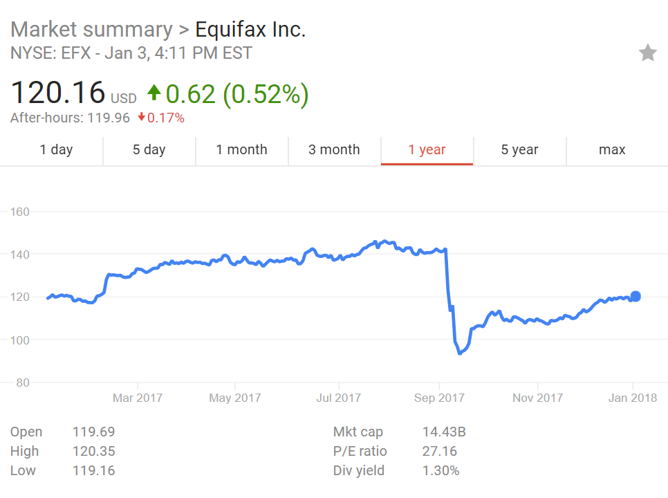
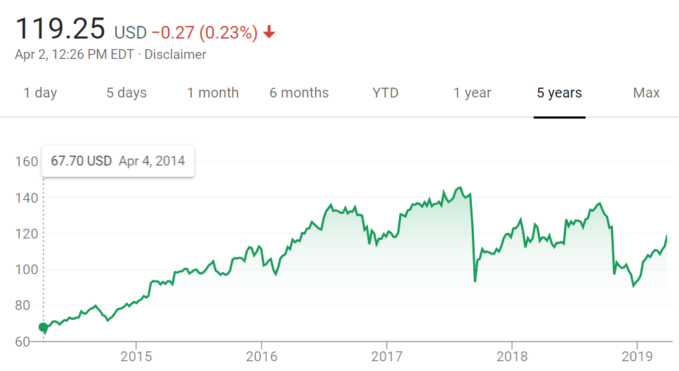

Slide 40
Governance, Risk & Compliance (GRC)
Auditing Mechanisms
Standards
Case Study: UNH UAP

Slide 41
Regulatory Complexity
Potentially thousands of requirements
Need to reduce overlaps
Manage changes to requirements
Manage adoption of new technology

Slide 42
Privacy and IP Protection
Data is highly dynamic
Different local, state, and country policies
Cloud and data mining
3rd Party access
Most espionage focused in this area

Slide 43
Cybersecurity Risks
Loss of direct control over data
  Cloud, BYOD, social networks
Attacks via social engineering can be difficult to detect
Complex global network of partners and suppliers
Silos within an organization can prevent collaboration

Slide 44
Secure Training

Slide 45
Capitalize on Interest by Senior Executives
An appropriate tone at the top is critical
Build a concise business case for awareness spending.
Identify and understand employee behaviors

Slide 46
Segment and Target Employee Population
Companies that use a uniform set of security awareness tactics for all employees receive limited results and/or encounter employee disengagement.
In particular, the psychological reasons for secure behavior can differ and campaigns should target those underlying psychological drivers.
There are differences in how securely employees behave across countries.

Slide 47
Types of Training
Traditional
  Books, Seminars, Classes
  Posters
Competitions
  Capture The Flag (CTF)
  Games/Puzzles
Simulations
Behavior gamification

Slide 48
Why companies want security trained employees
Your are the first line of defense
Comply with regulatory requirements
Build customer trust and loyalty
You understand personal and enterprise risk
Teach and advice others
You can work with security technology
Mindset aligned to corporate objectives

Slide 49
Why companies embrace training
Most data breaches are caused by human error
Hackers target users via Social Engineering
“Spear” phishing is hard to spot
Younger employees are less sensitive to security issues
  They choose efficiency over security
Small reductions have a big impact

Slide 50
Make Greater Use of Incentives
While incentives are powerful tactics to increase employee awareness and possibly change behavior, they are typically underutilized by awareness campaigns
Globally less than 10% of employees are praised by their manager for exhibiting secure behavior.

Slide 51
Usability
Auditing Mechanisms
Standards
Case Study: UNH AUP

Slide 52
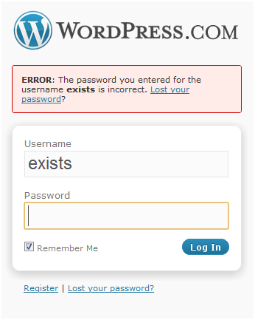
What is wrong?
Notes:
https://wordpress.com/wp-login.php 27-MAR-2011

Slide 53
Northwestern University’s Password Requirements
It must:
  be six to eight characters in length.
  contain a nonalphabetical character such as 1 2 3 ! $ & * , ? + =
  contain one or more nonalphabetical characters between alphabetical characters (example: “A3b,” “j3;M”).
It cannot:
  be a password used in the previous 18 months.
  be similar to your previous password.
  be a palindrome (example: “abc.cba,” “cb,,bc”).
  include the characters # @ ‘ “ ` \
  include character strings from any part of your name (examples for “James Smith”:, “ames,”).
  include part of your name with uppercase characters (example: “AmeS”).
  include part of your name with numbers substituted for letters (example: “j4m3s”).
  include reserved strings (example: “wild,” “cats”).
  include part of reserved strings with uppercase characters (example: “WilD,” “cAtS”).
  include part of reserved strings with numbers substituted for letters (example: “wi1d,” “E3e3”).
  include repeated letters or numbers (example: “AaAa,” “3E3e,” “aaaa”).
  include runs of adjacent keys (example: “hjkl”)

Slide 54
Are Policies Based on Evidence?
A breach + lax policy = getting fired
Policies cannot be changed easily
Only when policies are too lax does a site get any evidence of brute-forcing
Best practices prevent gathering of data because “sharing security data is bad”
Sites cannot necessarily distinguish brute-force from other attacks

Slide 55
NIST Password Guidance
Favour the user
  To begin with, make your password policies user friendly and put the burden on the verifier when possible.
  In other words, we need to stop asking users to do things that aren’t actually improving security.
  Much research has gone into the efficacy of many of our so-called “best practices” and it turns out they don’t help enough to be worth the pain they cause.
https://pages.nist.gov/800-63-3

Slide 56
NIST Password Guidance (continued)
A minimum of 8 characters. (
  That’s not a maximum minimum – you can increase the minimum password length for more sensitive accounts
A maximum length of at least 64
  So no more “Sorry, your password can’t be longer than 16 characters.”
  Considering that passwords must be salted and hashed when stored which means a fixed-length representation in storage
Applications must allow all printable ASCII characters
  Including spaces, and should accept all UNICODE characters, too, including emoji!
We often advise people to use passphrases
  So they should be allowed to use all common punctuation characters
  Any language to improve usability and increase variety.

Slide 57
NIST Password Guidance (continued)
Check new passwords against a dictionary of known-bad choices. You don’t want to let people use ChangeMe, thisisapassword, patriots, and so on.
More research needs to be done into how to choose and use your “banned list,” 100,000 entries is a good starting point.

Slide 58
NIST Password Guidance (continued)
No composition rules
  No rules that force you to use particular characters or combinations
  Encourage longer phrases instead of hard-to-remember passwords or illusory complexity such as pA55w+rd
No password hints
  People set password hints like rhymes with assword when you allow hints
Knowledge-based authentication (KBA) is out
  Why guess the password when you can guess the KBA?
No more expiration without reason
  If we want users to comply and choose long, hard-to-guess passwords, we shouldn’t make them change those passwords unnecessarily
  Requires that the user is informed when their account is used from a new device
  The only time passwords should be reset is when they are forgotten, if they have been phished, or if you think (or know) that your password database has been stolen and could therefore be subjected to an offline brute-force attack.

Slide 59
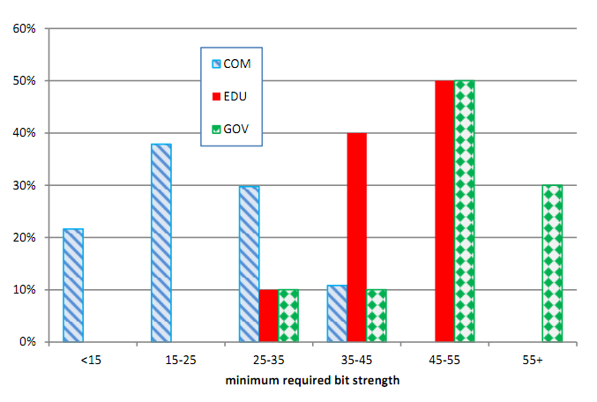
Min. Required Password Entropy
http://www.cs.unh.edu/~it666/reading_list/Usability/where_do_security_policies_come_from.pdf

Slide 60
Browsers Borrow Usability Features
HTTPS lock icon
New SmartScreen Filter “Collects”:
  URLs
  Referrer URL
  Program downloads
    Hashes
    Antivirus results
    Digital Certificates
Suggested Sites “Collect”
  Information about keystrokes, video and images

Slide 61
Security as an Enabler
Apple’s FaceID – no password compromise
TPM – secrets in hardware
Cloud storage file backups – address data loss
“Docker” style containers - manifests
SDN – mix-n-match network functions
DevSecOps – automation drives compliance
OAuth – reduce authentication attempts

