Slide 1
Identity
Authentication
Tokens

Slide 2
Authentication
Something you know
Something you have
Something you are
Inferential
Password strength

Slide 3
Authentication “who are you?”
Something you know
  Passwords, SSN, birthdate, recent transactions
Something you have (Tokens)
  Card (ATM, credit), Keys, Laptop, iPhone
Something you are (Biometrics)
  Fingerprint, face, voice, ears
Inferential (context)
  Location (GPS, Network address)
  Browser fingerprint

Slide 4
Something you know - Issues
Some of what you know is public/shared
  Mother, address, public records
Some things can be guessed
  Pins based on birthday
  Passwords based on favorite things/places/people
People forget
  Accounts you use once year

Slide 5
Something you are - Issues
False Positives
  Someone else’s biometric shows as me
False Negatives
  My biometric does not work
“Gummi Bear” attacks
Changes to biometrics
  Aging and medical alteration
Revocation
  Can’t revoke fingerprints
Missing & “Stolen” biometrics
Notes:
Gummi bear attack uses gelatin and photo-sensitive printed-circuit board
Fools 70-80 % of commercial readers
Biometric devices violate privacy? The argument can be made that the no one has the right to the information that our bodies reveal about us

Slide 6
Something you have - Issues
Possession is 9/10ths of the law
  Lost/stolen credit cards
Physical damage
  Degauss of mag stripe
  Loss of token’s battery power
  Reader/termination malfunction
Logical damage
  Laptop/iPhone hacked
Inconvenience caused by re-provisioning
  May need alternate mode during shipping

Slide 7
Inferential - Issues
Rarely a primary authenticator
Often a device rather than person
Anonymizers and proxies
  Easy to remotely drive a device
Out-of-band verification adds complexity
  iPhone GPS matched to stationary device based on Bluetooth connection

Slide 8
Biometrics
Measuring your face, voice, and ears
Privacy concerns
Facebook tagging (case study)

Slide 9
Classes
Physical
  Identifiers
    Iris, Retina, Ears, Hand, Face, DNA, Fingerprints, Scent, Palm, Footprint, Veins, Dental, MRI, Skin reflection, Lips, Thermo grams, Sweat pores, Fingernail, Brain-wave
  Attributes
    Weight, Sex, Height, Blood Type, Hair Color
Behavioral
  Walk(gait), Typing rhythm, Voice, Signature, Lip motion

Slide 10
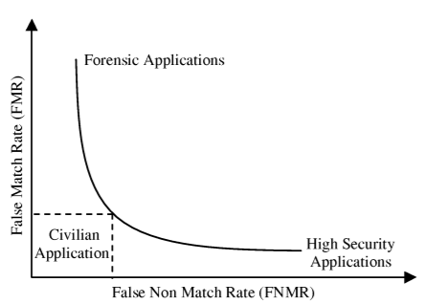
All biometrics have errors
http://www.cse.msu.edu/~rossarun/BiometricsTextBook/Papers/Introduction/JainRossPrabhakar_BiometricIntro_CSVT04.pdf

Slide 11
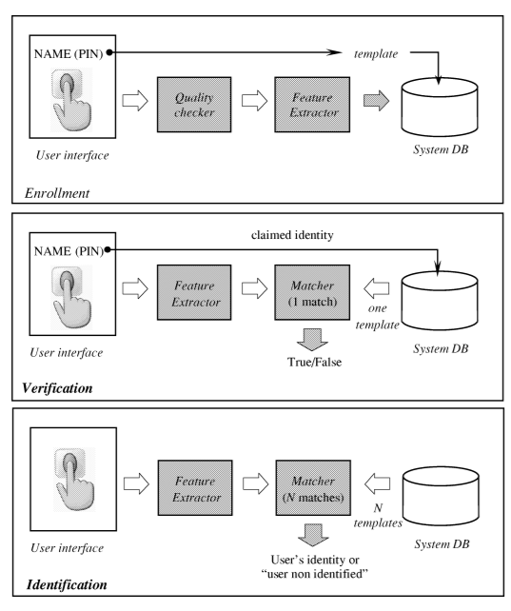
Biometric modes

Slide 12
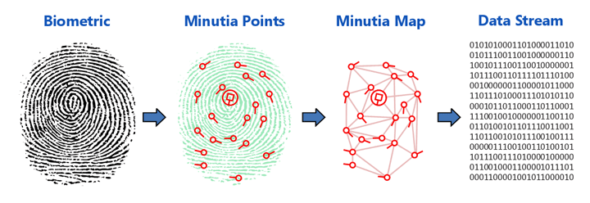
Templates
Numeric representation of the image
Normally proprietary to the vendor
Can “stored on system” or “stored on card”
Templates are not reversable
Smaller & quicker to match than the full image

Slide 13
Biometric Characteristics
Universality: each person should have the characteristic.
Distinctiveness: any two persons should be sufficiently different.
Permanence: the characteristic should be sufficiently invariant over a period of time.
Collectability: the characteristic can be measured quantitatively

Slide 14
Biometric system issues
Performance: Recognition accuracy and speed, as well as the operational and environmental factors that affect the accuracy and speed
Acceptability: The extent to which people are willing to accept the use of a particular biometric in their daily lives
Circumvention: How difficult to use fraudulent methods.

Slide 15
Biometric Identifier | Universality | Distinctiveness | Permanence | Collectability | Performance | Acceptability | Circumvention
DNA | H | H | H | L | H | L | H
Ear | M | M | H | M | M | H | M
Face | H | M | M | H | L | H | M
Thermogram | H | H | L | H | M | H | H
Fingerprint | M | H | H | M | H | M | M
Hand | M | M | M | H | M | M | M
Vein | M | M | M | M | M | M | H
Iris | H | H | H | M | H | L | H
Odor | H | H | H | L | L | M | H
Palmprint | M | H | H | L | L | M | H
Retina | H | H | M | L | H | L | H
Gait | M | L | L | H | L | H | M
Keystroke | L | L | L | M | L | M | M
Signature | L | L | L | H | L | H | L
Voice | M | L | L | M | L | H | L

Slide 16
Biometric Selection
Select a biometric for entering a dining hall
 | DNA | Fingerprint | Face
Universality | 3 | 2 | 3
Distinctiveness | 3 | 3 | 2
Permanence | 3 | 3 | 2
Collectability | 3 | 2 | 3
Performance | 1 | 3 | 2
Acceptability | 1 | 2 | 3
Circumvention | 3 | 3 | 2
Should the characteristics be equally weighted?
What might be a scenario where DNA is preferred?

Slide 17
Token Security
Token Characteristics
SAML
JWT
EMV

Slide 18
Token Attributes
Format
  Assertion (a.k.a. self contained)
    Full record
    Directly validated
  Handle
    Reference (pointer)
Access
  Bearer
    Can be used by anyone (think bearer bonds)
  Proof
    Specific to domain/client/server

Slide 19
Assertions (self-contained tokens)
Typically has
  A duration
  An audience, and is digitally signed containing information about the user and the client.
Examples formats
  SAML assertions
  Kerberos tickets
Typically can be independently validated.
  This results in better performance and scalability in deployment where issuing and consuming entity reside on different systems.
Implementing token revocation is more difficult with assertions than with handles.

Slide 20
Handles
A reference to some internally maintained data structure
May contain some attributes (user id, scope, ...)
Enables simple revocation
Does not require cryptographic mechanisms
Require communication between issuing and consuming entity
  In order to validate the token and obtain token-bound data
  This communication might have an negative impact on performance and scalability
A 'handle' token is 'opaque’
  as data is never exposed

Slide 21
Bearer token
Mere possession is enough to use the token
Communication between end-points be secured to ensure that data is not disclosed
Convenient to client apps as it does not require the app to do anything to use them.
  Such as a add proof of identity
Bearer tokens have similar characteristics to web single-sign-on (SSO) cookies used in browsers.

Slide 22
Proof token
A token that can only be used by a specific end-point (client or server)
Each use of the token, requires some action that proves that it is the authentic
Examples
  Digitally signed MAC tokens
  OAuth tokens
Notes:
1) Previous (client received from server)
MAC key identifier: h480djs93hd8
MAC key: 489dks293j39
MAC algorithm: hmac-sha-1
Issue time: Thu, 02 Dec 2010 21:39:45 GMT
2) Client calcs time(age) and generates random and nonce
Age: 264095
Random string: dj83hs9s
Nonce: 264095:dj83hs9s
3) Client calc MAC for specific resource
GET /resource/1?b=1&a=2 HTTP/1.1
Host: example.com
Authorization: MAC id="h480djs93hd8",
nonce="264095:dj83hs9s",
mac="SLDJd4mg43cjQfElUs3Qub4L6xE="

Slide 23
Token Protections
Sign and/or Encrypt
Expiration time
Limit type of usages
Limit number of usages (One time)
Bind token to a particular server (Audience)
Bind token to client id
RNG
Use standard formats (SAML)

Slide 24
Oath : Google Authenticator
Send the client a QR code
  https://chart.googleapis.com/chart?chs=200x200&chld=M|0&cht=qr&chl=otpauth://customerkey?secret=secret;
Both server and client know secret and current time
Server maintains customerkey
Example code
  https://github.com/kengraf/TOTP

Slide 25
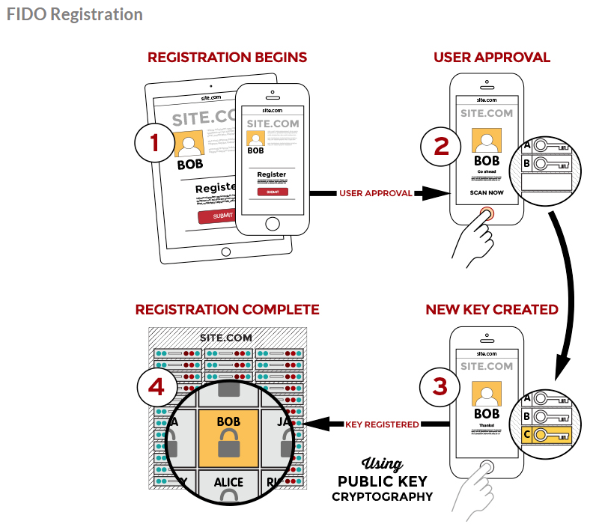
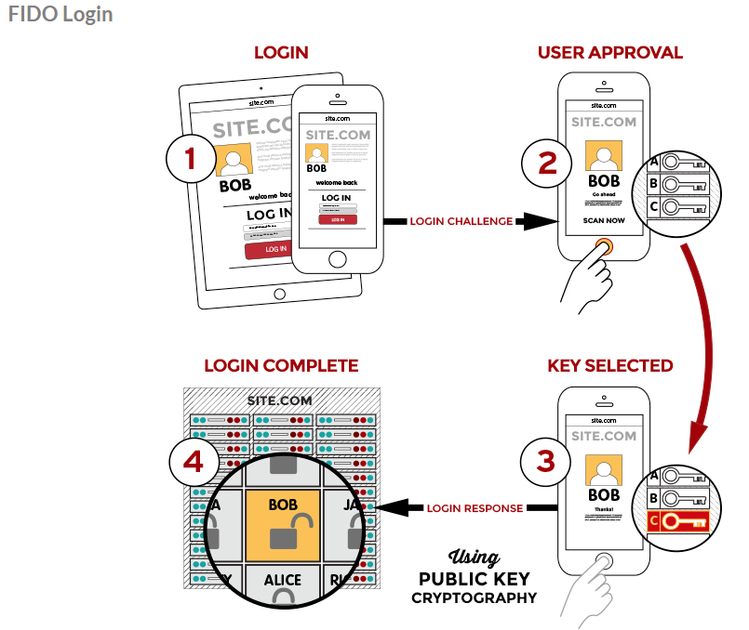
FIDO (Fast IDentity Online) Alliance
Chrome, Windows 10, Apple iTouch, et.al. https://fidoalliance.org/specifications/overview/

Slide 26
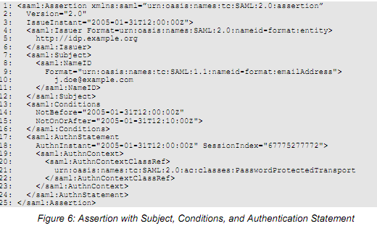
A very “simple” SAML assertion

Slide 27
Canonicalization (C14N)
Means Standardization or Normalization
Very character matters to a hash
Schemas make this a very technical process
Do these XML strings have the same hash?
  <n1 name=‘blank’>Data</n1> <n2> </n2>
  <n1>Data</n1><n2/>
  <n1>Data</n1><n2 type=“xs:string”/>
Notes:
A full summary of canonicalization changes is listed below:
The document is encoded in UTF-8
Line breaks normalized to #xA on input, before parsing
Attribute values are normalized, as if by a validating processor
Character and parsed entity references are replaced
CDATA sections are replaced with their character content
The XML declaration and document type declaration are removed
Empty elements are converted to start-end tag pairs
Whitespace outside of the document element and within start and end tags is normalized
All whitespace in character content is retained (excluding characters removed during line feed normalization)
Attribute value delimiters are set to quotation marks (double quotes)
Special characters in attribute values and character content are replaced by character references
Superfluous namespace declarations are removed from each element
Default attributes are added to each element
Fixup of xml:base attributes is performed
Lexicographic order is imposed on the namespace declarations and attributes of each element

Slide 28
JSON Web Tokens (JWT)
Registered Claim Names
  "iss" (Issuer) Claim
  "sub" (Subject) Claim
  "aud" (Audience) Claim
  "exp" (Expiration Time) Claim
  "nbf" (Not Before) Claim
  "iat" (Issued At) Claim
  "jti" (JWT ID) Claim
  Public Claim Names
    IANA registered
  Private Claim Names
    A producer and consumer of a JWT MAY agree to use Claim Names that are Private Names

Slide 29
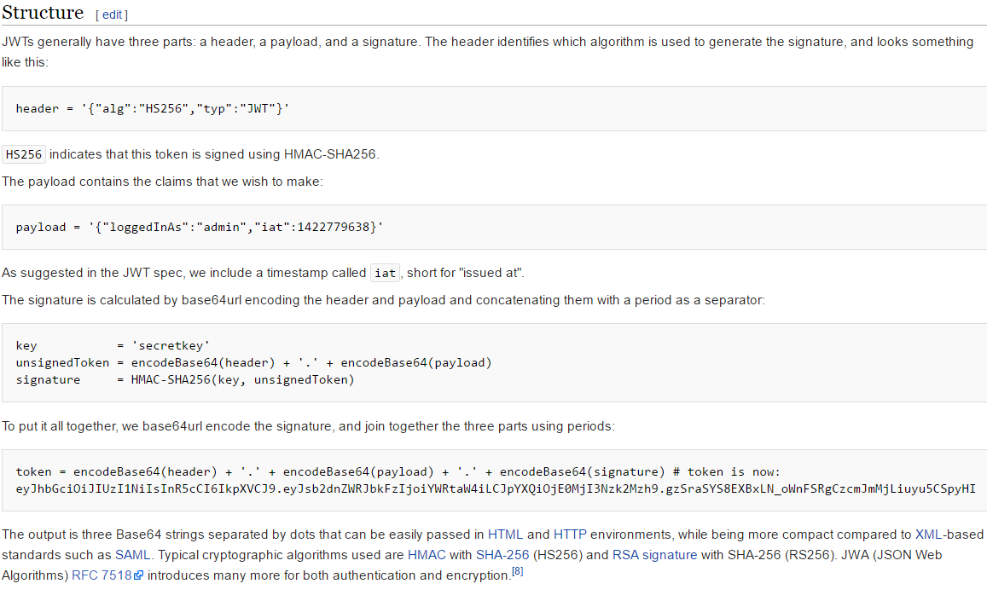
JWT example from Wikipedia

Slide 30
Plain, Signed, Encrypted
JWT
  The starting point, or payload for JWS, JWE
JWS
  A proof that the payload hasn't changed
JWE
  Make the payload secret

Slide 31

The technical enabler for cloud based identity is OAuth
Actively deployed by Google, Facebook, Twitter and others since 2006
OAuth 2.0 focuses on client developer simplicity while providing specific authorization flows for web applications, desktop applications, mobile phones, and living room devices.
It specifies a process for resource owners to authorize third-party access to their server resources without sharing their credentials.
IETF Standard
RFC 6749

Slide 32
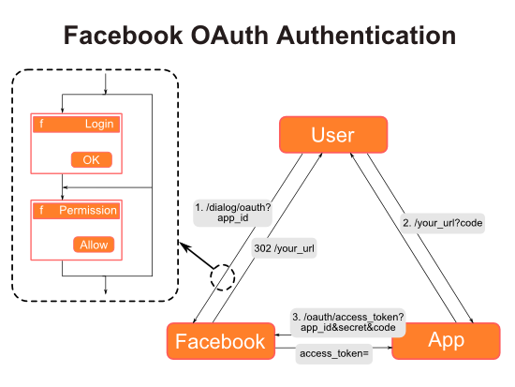
OAuth 2 - http://oauthbible.com/

Slide 33

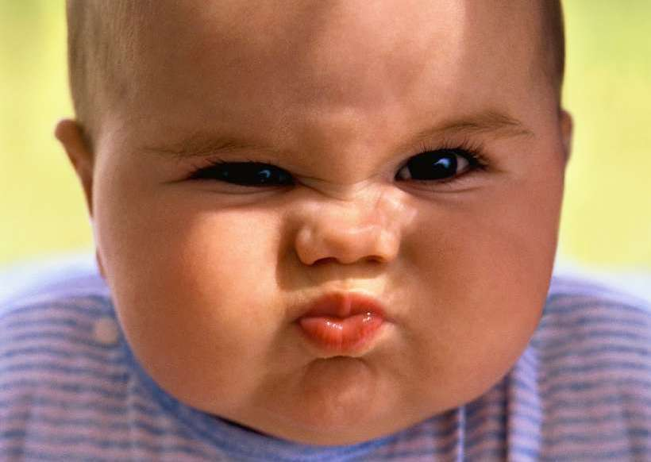
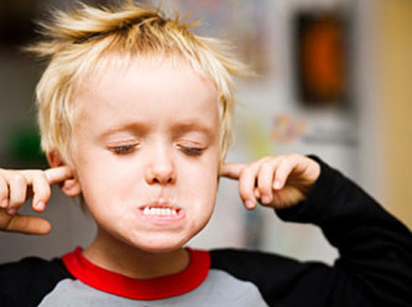
Developers : “But I hate OAuth !”
More complex message flows compared to passwords
Must manage additional registration, grant and revocation processes
Confusion due to multiple token & credential patterns
Crypto and metadata registration required
Need to expose a unique URL for every resource

Slide 34
So why suffer the pain?
Empower the customer
  Let the customer, partner or employee determine the type access allowed to their data
  Embrace the notion of devices “clients” initiating actions for customers “resource owners”
  Alerts and notifications may happen when a customer is not present or willing to authenticate
Access tokens
  Cryptographically stronger than passwords
  Stateless; no session management or artifact resolution
  No PKI (beyond TLS)
No prescribed authentication process
  No centralized authorities, services or gateways required
Numerous lightweight implementations to choose from
  Java, .Net, Python, Ruby, PHP
  Designed for browser, mobile, cloud and micro-service deployments

Slide 35
Authentication
Trust models (Kerberos, Shibboleth, OpenID)

Slide 36
Who is trusted?
Kerberos
  Everything trusts the KDC
SAML/Shibboleth
  Servers trust identity providers (IdP) not users
OAuth/OpenId Connect
  Users trust resource servers
  Resource servers trust the user’s delegation to a client

Slide 37
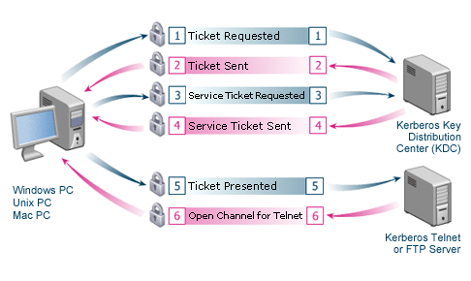
Kerberos

Slide 38
Kerberos Limitations
Central server is a single point of failure
Compromise of the KDC will allow an attacker to impersonate any user.
Each service requires its own set of Kerberos keys.
KThe administration protocol is not standardized
erberos requires all accounts, clients and services to be in the same domain, or that the domains have a trust relationship
Kerberos cannot be used in scenarios where users want to connect to services from unknown/untrusted clients as in a typical Internet or cloud computer scenario
The required client trust makes creating staged environments (dev, test, prod) difficult

Slide 39
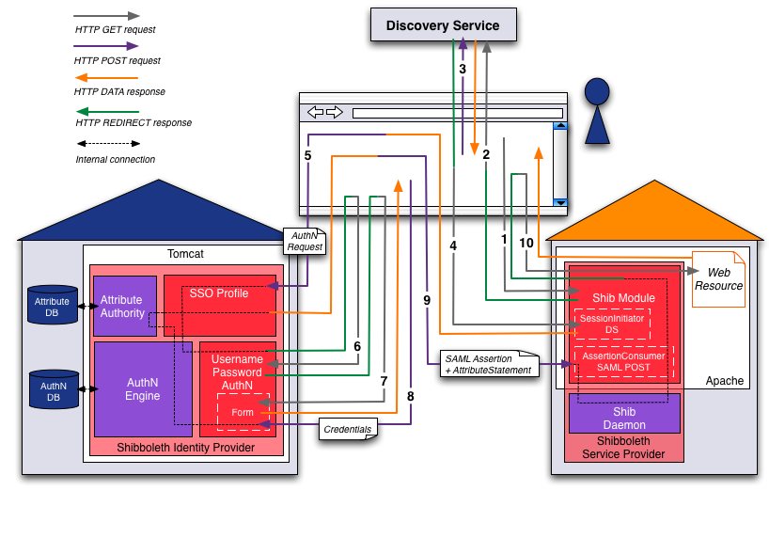
SAML (Shibboleth) request flow
Notes:
Step 1 (User ⇔ Browser ⇔ Service Provider):The user opens a web browser and accesses the Service Provider
Step 2: (Browser ⇔ Discovery Service) SP redirects the web browser to send a new request to the Discovery Service
Step 3: (User ⇔ Browser ⇔ Discovery Service) the user makes Identity Provider selection
Step 4 (Browser ⇔ Service Provider): Directory service redirects back to SP, to initiate session
Step 5 (Browser ⇔ Identity Provider):The browser posts AuthN request
Step 6 (Browser ⇔ Identity Provider):The web browser is redirected to the username/password login handler
Step 7 (Browser ⇔ Identity Provider):The browser redirected to login page
Step 8 (User ⇔ Browser ⇔ Identity Provider):The user types his username and password credentials and submits them to the IP
Step 9 (Browser ⇔ Service Provider):Assertion redirect to SP
Step 10 (Browser ⇔ Service Provider): Repeat step 1, request to SP this time resource is returned

Slide 40
SAML Limitations
XML can be greater than 10K bytes
  Too large for URL or HTTP headers in most browsers
Runtimes required for parsing and canonicalization (not mobile friendly)
Certificate chain validation often requires a service call

Slide 41
OpenID : Your identity is the resource being requested

Slide 42
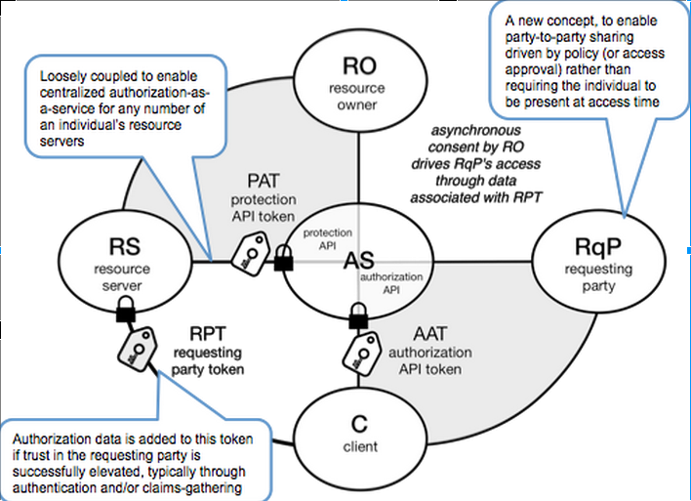
User Managed Access (UMA)
https://en.wikipedia.org/wiki/User-Managed_Access

Slide 43
Trust models - Summary
Implementation | Authentication | Authorization | Deployment
Kerberos/RADIUS | Integrated |  | Workgroups/Domains
SAML/Shibboleth | External | Internal | Federations
OAuth/OpenID | External | Delegated | Web apps
UMA | Delegated | Delegated | API

Slide 44
Authorization
Access Control
Lists, Trees, Graphs

Slide 45
Key principles of access control
Least privilege
  The principle by which members of the organization can access the minimum amount of information for the minimum amount of time necessary to perform their required duties
Need to Know
  Limits a user’s access to the specific information required to perform the currently assigned task, and not merely to the category of data required for a general work function
Separation of Duties
  A control requiring that significant tasks be split up in such a way that more than one individual is responsible for their completion

Slide 46
Mandatory Access Control (MAC)
Structured and coordinated within a data classification scheme that rates each collection of information as well as each user
These ratings are often referred to as sensitivity levels
When MACs are implemented, users and data owners have limited control over access to information resources

Slide 47
Discretionary Access Control (DAC)
Discretionary Access Controls (DACs)
  Implemented at the option of the data user
  Users can allow general, unrestricted access, or they can allow specific individuals or sets of individuals to access the resources
  Most personal computer operating systems are designed based on the DAC model
  One discretionary model is rule-based access controls where access is granted based on a set of rules specified by the central authority
Notes:
Are Linux files permissions MAC or DAC?
What is Cloud?

Slide 48
MAC requires Multilevel Security
Goals
  Process information with incompatible classifications
  Permit different security clearance and need-to-know
One system to prevent subversion and separate domains
Second system to enforce DAC
Example:
  SIPRNet *.sgov.gov and *.smil.mil
  NIPRNet *.gov and *.mil

Slide 49
Identity Stores
SQL and LDAP are popular options
Access Control for user “Records”
Applications use user’s credentials
  SQL SELECT * FROM users WHERE …
  Bind to user’s DN
Approach is well known
Implementations often take shortcuts

Slide 50
Role Base Access Control (RBAC)
The requester’s role or function will determine whether access will be granted or denied.
RBAC allows for the grouping of individuals into categories of people
Used to control large number of users and/or resources.
Allows for separation of Duties
Over provisioning of access over time is an issue
Can enforce either MAC or DAC frameworks

Slide 51
Categories of Access Control
Deter – incident warning
Preventative – avoid an incident
Detective – identify incident
Corrective – mitigate damage done
Recovery – restore operation
Compensating – cover up shortcomings

Slide 52
Access Control Lists (ACL)
Are the oldest and most basic form of access control.
Created to limit access to files and data on shared systems
Each resource on a system has its own associated list of mappings
  Resource: The object to be protected
  Entity: The user or service requesting access
  Action: Create, Read, Update, Delete (CRUD), Execute
Can be applied to groups (resources and/or entities)
ACLs maybe be resources with their own mappings
Must set on every resource and be checked on every access

Slide 53
Problems with ACLs
Doesn’t handle inheritance
Difficult to do remote access enforcement
Difficult to get consistent logging of actions

Slide 54
Trees (Groups)
Manage groups of resources and users
Allow for groups of groups
Manage ACL at the group level
Historically implemented via LDAP
Problems
  Doesn’t handle temporal changes well
  Changes centralized to management of the tree
  Assumes group over individual resource ownership

Slide 55
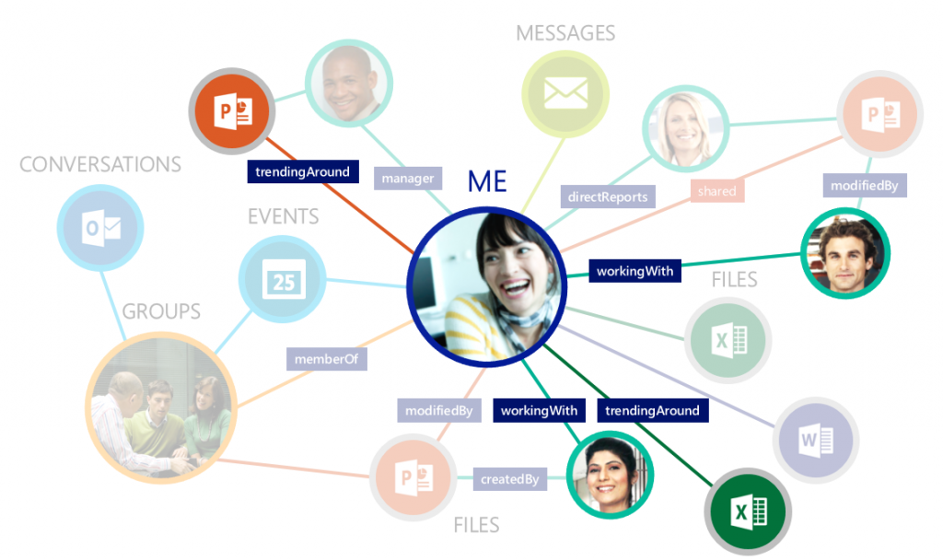
Graphs vs. Trees : relationships are complex not hierarchical

Slide 56
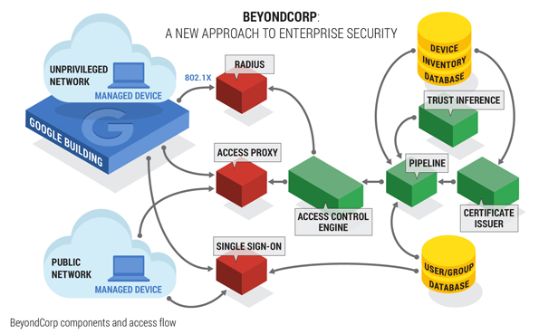
BeyondCorp (Google) https://www.beyondcorp.com/
Notes:
Guiding Principles:
Perimeter less Design
Connecting from a particular network must not determine which services you can access.
Context-Aware
Access to services is granted based on what we know about you and your device.
Dynamic Access Controls
All access to services must be authenticated, authorized and encrypted.

Slide 57
Sources for analytics (BeyondCorp)
Behavior analytics
  Check whether behavior is outside the norm (transaction/activity history).
Device recognition
  Determine whether the device is recognized and associated with a known user
  Can include web browser configuration, language, installed fonts, browser plug-ins
  Device fingerprint/certificate
  Device IP/MAC address
Directory lookup
  Check repository for group membership and user attributes
Geographical location / Geofencing
  Determine whether a request is coming from a known good location.
  Determine whether access requests come from within or outside a geographic barrier set by the customer.
  Velocity checks
Identity governance
  Take an access rights score from IAM and utilize that score in determining the riskiness of access requests.
IP reputation
  Compare the IP address of an authentication request with known white and black lists.
Jailbreak detection
  Detect whether mobile phone is rooted or "jailbroken.“
User input analysis
  Gather keystroke dynamics and cursor movements with a particular user on a particular device.
Known fraud checking
  Consider known fraudulent elements from security intelligence providers

